Slide 1
SOCIAL WORLD
This unit of work is related to people and the difference that exist between countries.
One career link is a humanitarian aid worker, could this type of work be for you? Click and find out what it includes.

Slide 2
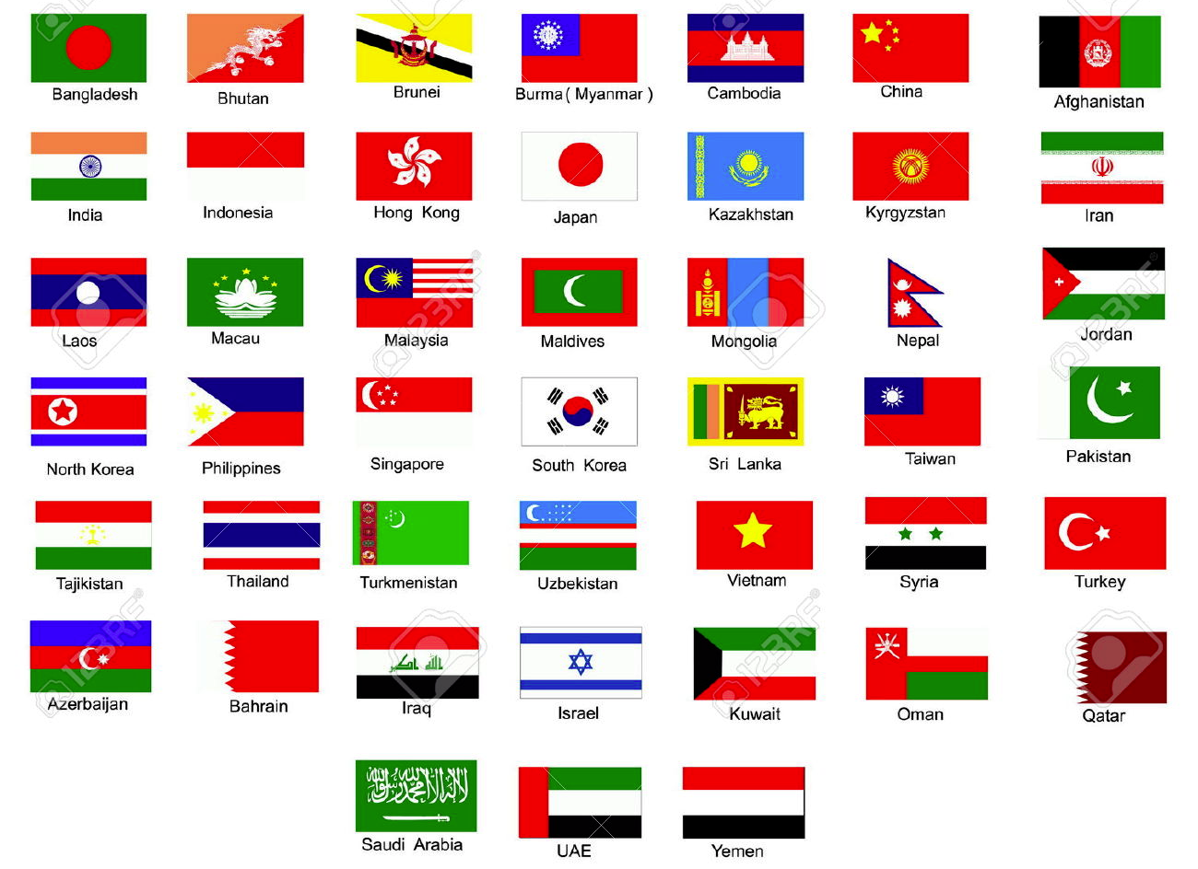
Where is Asia?
AF3 – describe the development of countries in Asia.

Slide 3
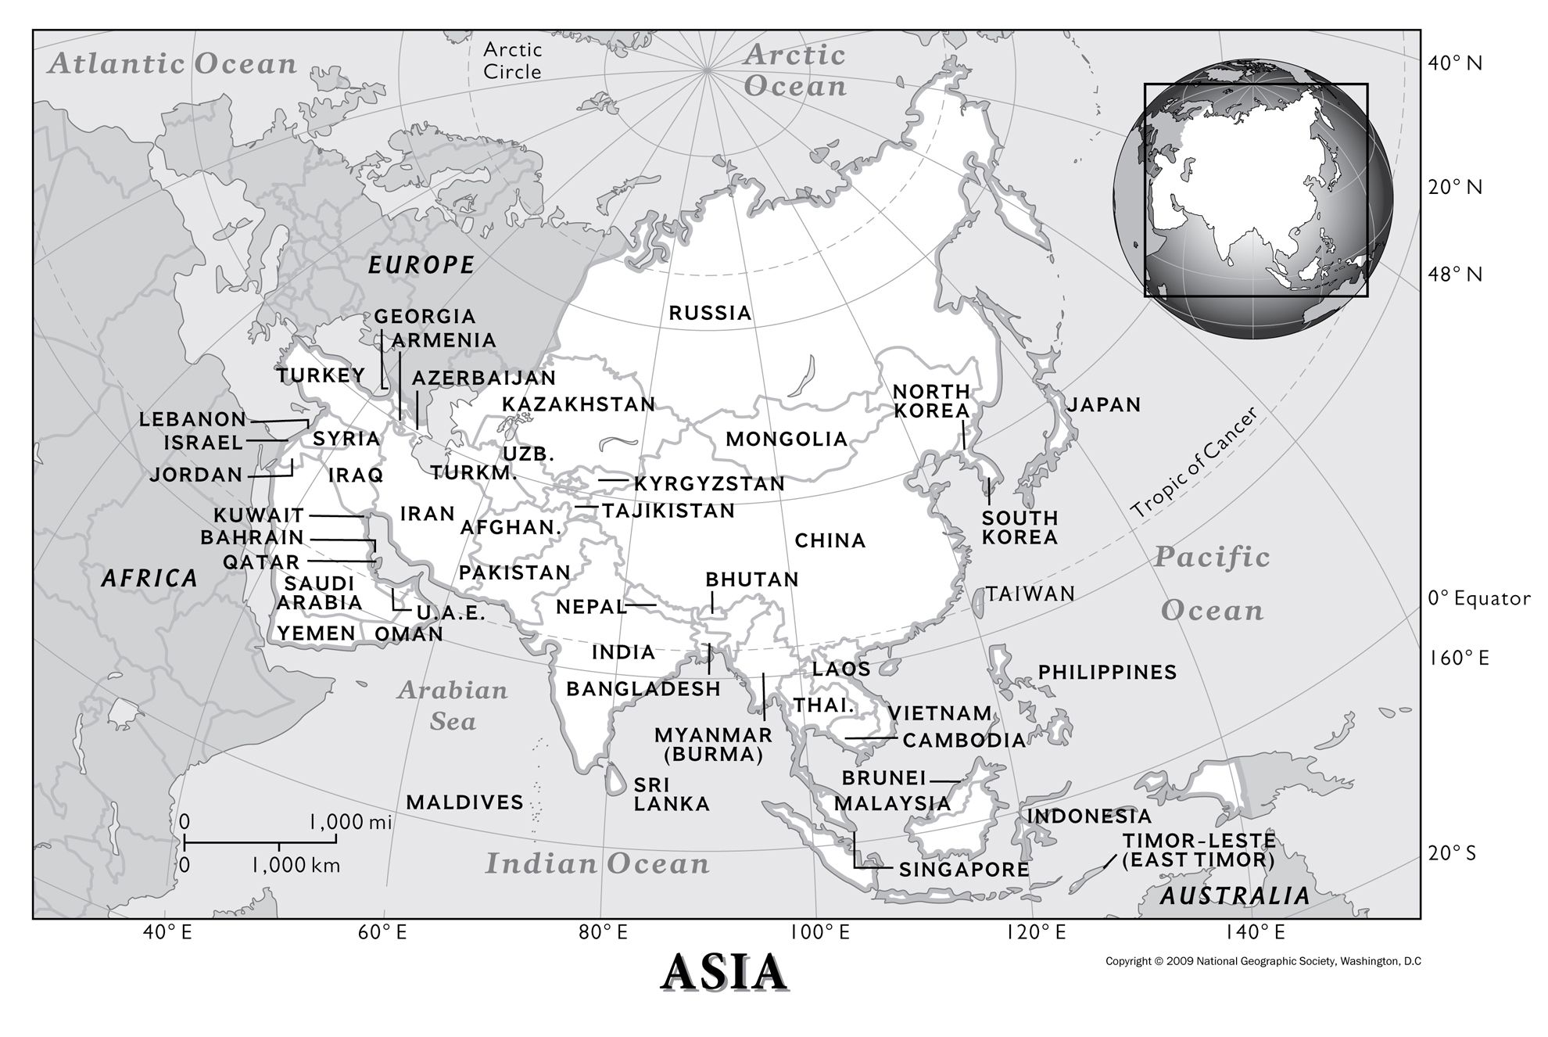

Slide 4
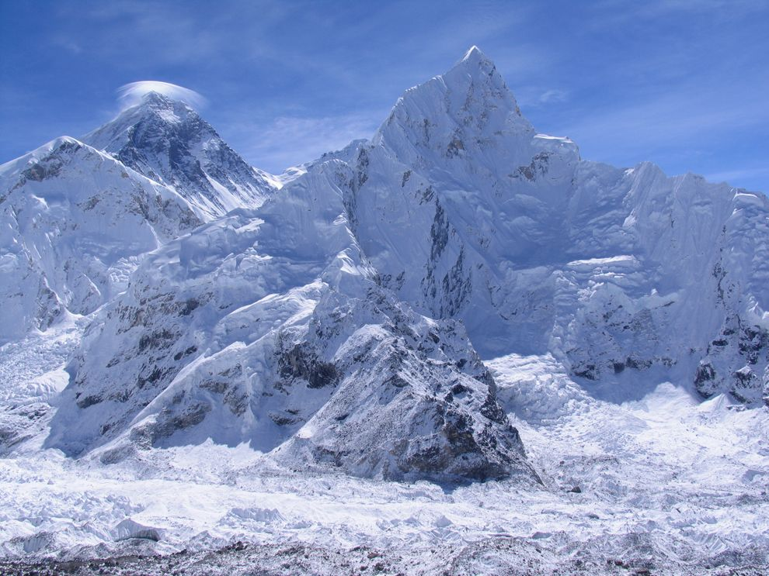
Mount Everest, Nepal, is the highest landform on Earth. Mount Everest is part of the Himalaya range that runs through central Asia. This view of Mount Everest was taken from Kala Pattar, another Himalayan mountain.
Guess the country! Where in Asia is it?

Slide 5
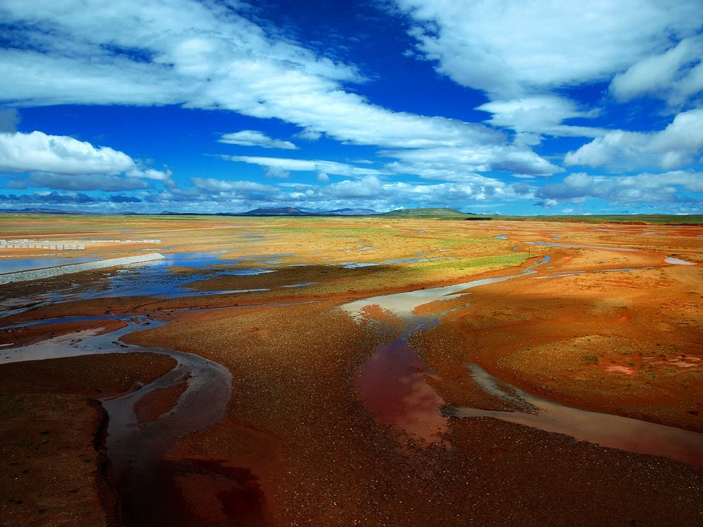
This flat, sandy wetland on the Tibetan Plateau of China is the headwaters of three major rivers: the Yangtze, the Yellow, and the Lancang. The streams on the Tibetan Plateau are fed by glaciers from the Himalayas.

Slide 6
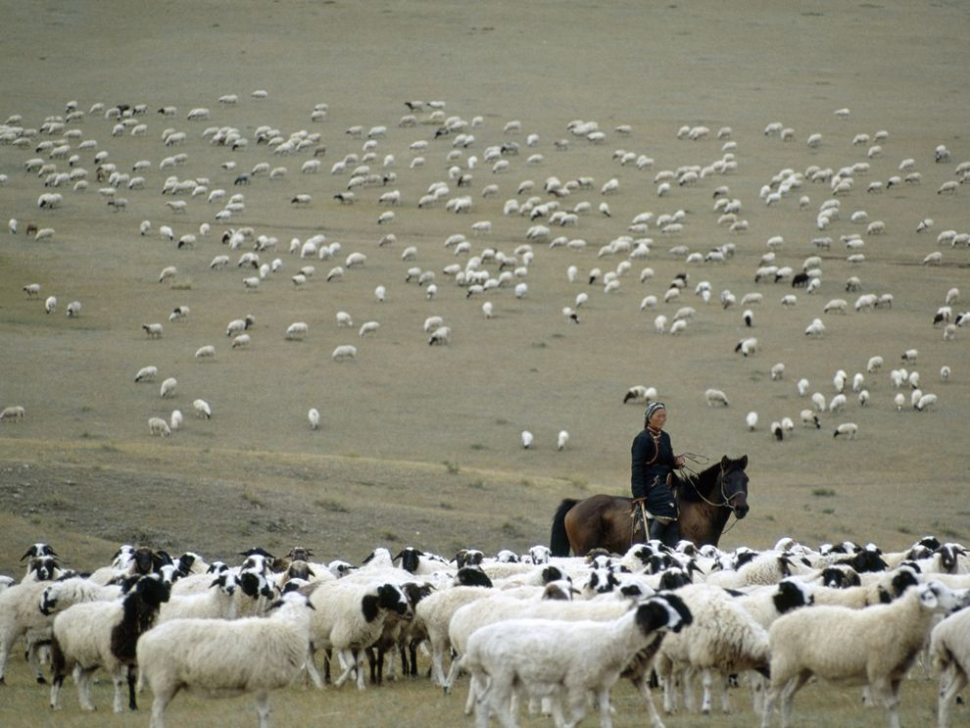
Herding is the practice of caring for roaming groups of livestock over a large area. Sheep were one of the first animals to be domesticated by ancient herders. Here, a woman herds a large group of piebald sheep near Arbay Heere, Mongolia.

Slide 7
Using your map of Asia, answer the following questions.
Name the Ocean to the east of Asia.
Name the three Asian countries on 140°E line of longitude.
3. How many Asian countries does the Tropic of Cancer run through?
4. Name the country 8°N 82°E.
5. Name the country 38°N 30°E.
6. Using the ‘C’ of China as a starting point. Which countries are within a 1,000km radius?
7. In km, how far is the ‘K’ of Pakistan from Brunei?
8. How far is Beijing from Lebanon?
9. Which countries border Iran?
10. What direction are the Maldives from North Korea?
11. What direction is Kazakhstan from Qatar?

Slide 8
ANSWERS
Pacific Ocean
Russia, Japan and Indonesia
8 – Saudi Arabia, UAE, Oman, India, Bangladesh, Myanmar, China, Taiwan
Sri Lanka
Turkey
Mongolia, India and Myanmar
9.4cm/1.7cm = 5.53 × 1000 = 5530km
10.7cm/1.7cm = 6.29 × 1000 = 6290km
Yemen, Saudi Arabia, UAE
South west
North east

Slide 9
Development
COPY: Development is a way of measuring the standard of living of a country.
Looking at how and why people and places change over time and the effects of these changes – it is about progression and improvement.
Some countries are rich with a higher standard of living and a good quality of life.
Others are poor, have a lower standard of living and have a poor quality of life.

Slide 10
Development Key Terms
COPY
MEDC – a more economically developed country (a rich country)
LEDC - a less economically developed country (a poor country)

Slide 11
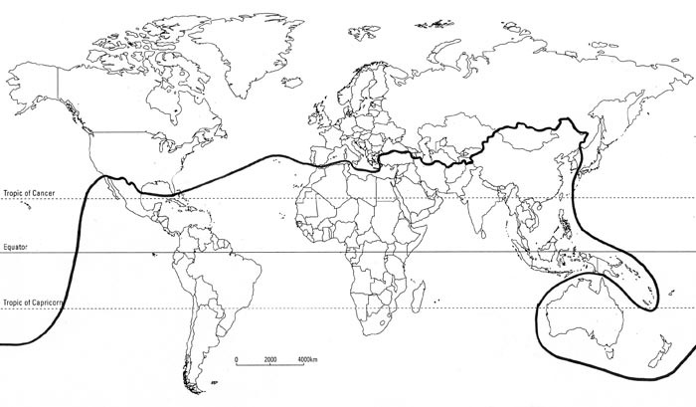
The Brandt Line
In the 1980s, former Chancellor Willy Brandt created this line to show the north-south divide.
He was awarded the Nobel Peace Prize in 1971 for his work reconciling with the countries of eastern Europe.
MEDC – North of the Brandt Line
LEDC – South of the Brandt Line

Slide 12
Indicators
Economic: give information about the general wealth of a country.
Social: Give information about people and how they live, what they do and their quality of life
Environmental: Give information on the effect of the country on the environment, e.g. air pollution

Slide 13
Development Indicators
Create a table to classify these development indicators.
Social | Economic | Environmental
Infant Mortality Rate
Child Mortality Rate
Number of Doctors
Give/Receive Aid
% Employed in Primary Jobs
% Employed in Tertiary Jobs
GNP
Fertility Rate
Energy Use
Trade
Industrial Output
Education
Healthcare
Housing
Birth Rate
Death Rate
Number of Internet Users
Calorie Consumption
CO₂ Emissions
Access to safe drinking water
Adult Literacy Rate

Slide 14
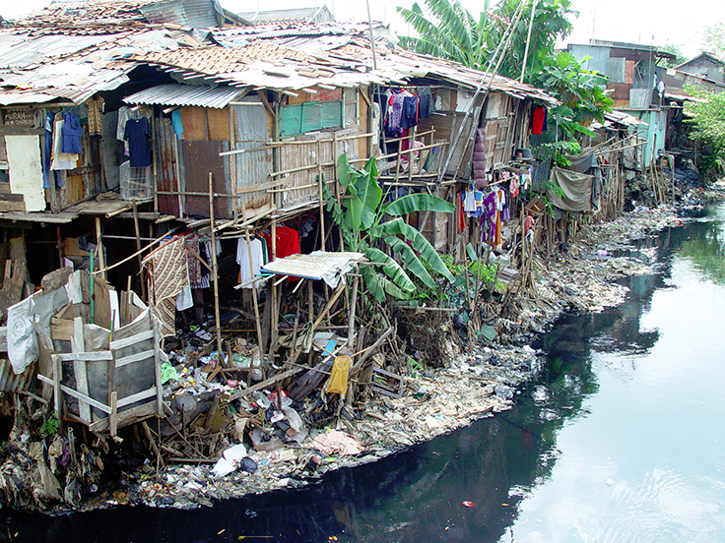
Substandard housing in a slum near Jakarta, Indonesia
Guess the countries and
what features show whether they are developed or not.

Slide 15
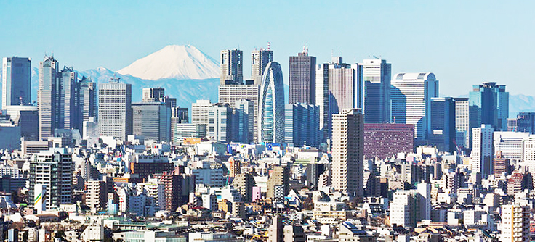
The Land of the Rising Sun has more than 126 million people. Japan has the third-largest economy in the world based on nominal GDP, fourth based on purchasing power, fourth biggest exporter and fourth biggest importer.

Slide 16
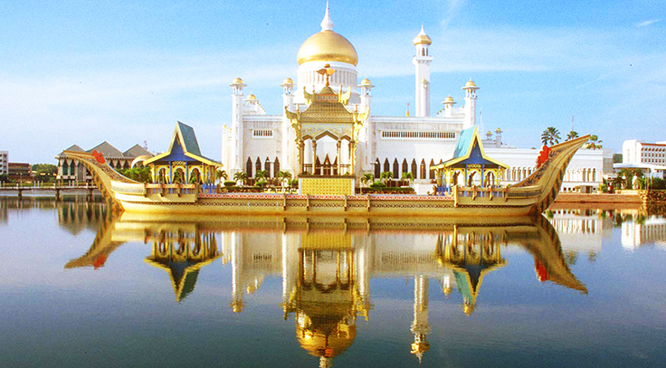
Brunei is ranked fifth in GDP per capita at purchasing power parity in the globe. It has a 0% public debt. Brunei is the fifth-richest country among 182 on petroleum and natural gas fields.

Slide 17
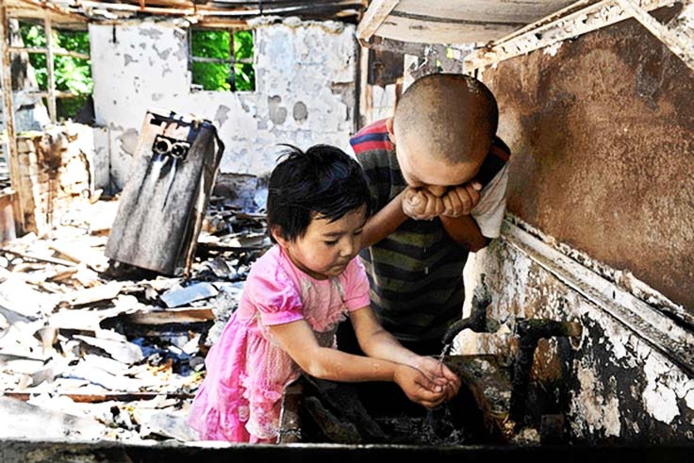
Poverty and hunger are major issues in this former Soviet Republic. Almost half the population of this country lives below the poverty line. Often the hunger crisis in Kyrgyzstan is exacerbated by natural disasters.

Slide 18
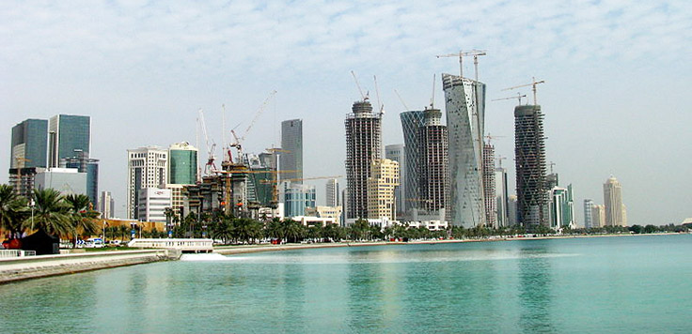
The economic growth of Qatar is mainly based on its petroleum and natural gas. 14% of its households are millionaires, while 94% of its workforce are migrant workers.

Slide 19
Homework
Find a picture of a country in Asia. Annotate it with descriptions of its development. Consider Social, Economic and Environmental development.
Explain why you think it is an LEDC or an MEDC.

Slide 20
KEY
Brandt Line
My Brandt Line today
On your map of Asia draw 2 lines.
Draw on the real Brandt Line and where you think his line of development would be placed today.

Slide 21
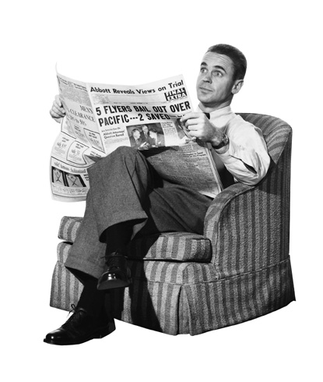
PLENARY
Extra! Extra!
Write a newspaper headline about today’s lesson…

