Slide 1
Where is the Caribbean?
AF3 - Read and plot locations using co-ordinates.
AF4 · describe the distribution of earthquakes

Slide 2
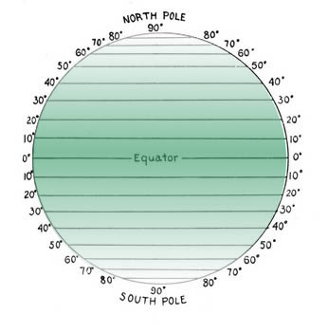
LINES OF LATITUDE
COPY the sentence
Lines of latitude go across, marked north and south.

Slide 3
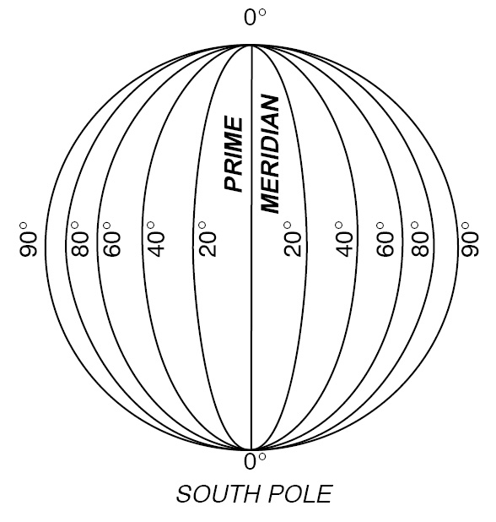
LINES OF LONGITUDE
COPY the sentence
Lines of longitude go down, marked west and east.

Slide 4
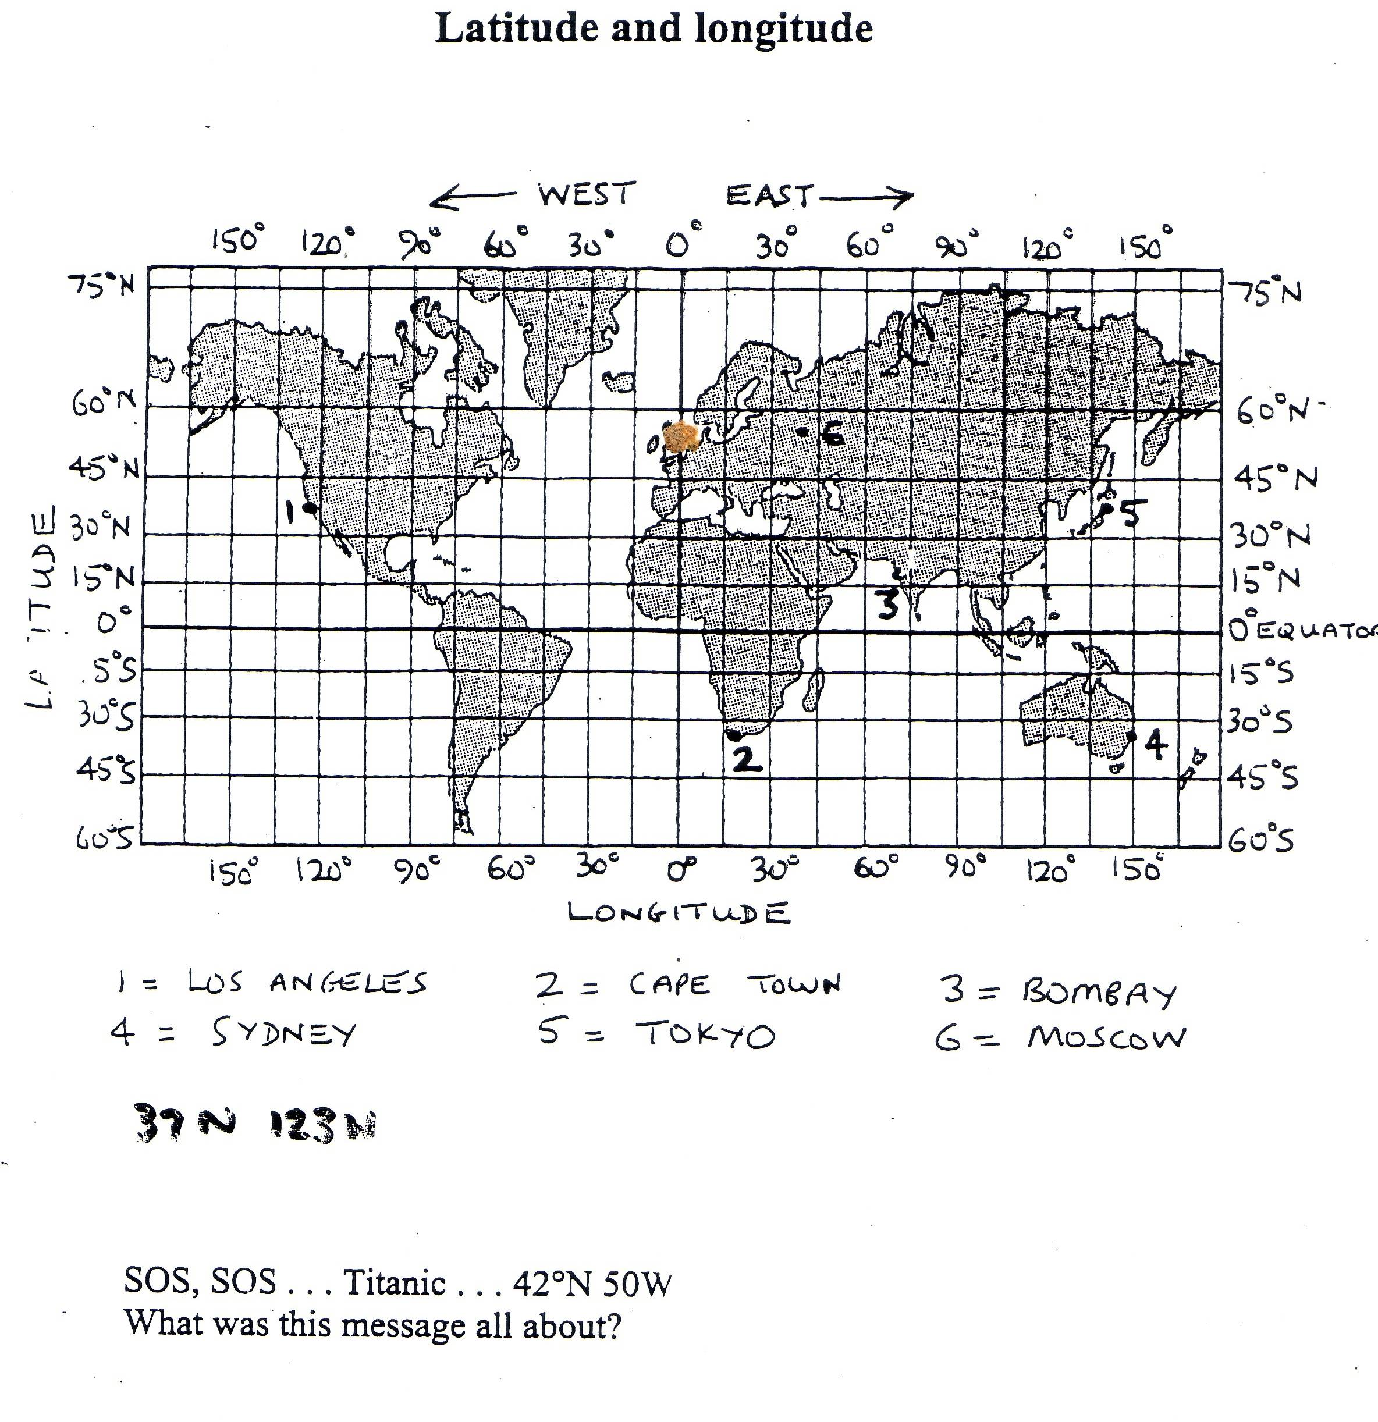
Mumbai
Match the cities to the numbers and write down their coordinates.

Slide 5
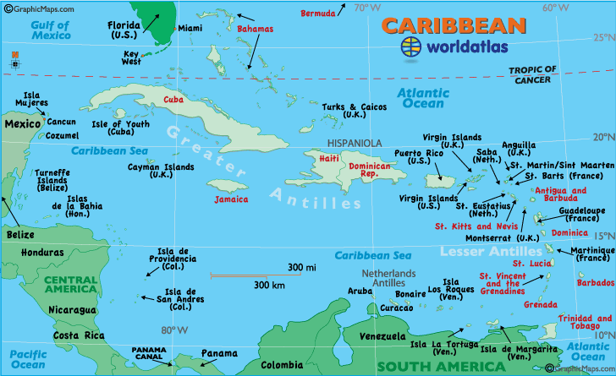
Give the coordinates (latitude and longitude) of the following Caribbean countries (aim for the centre of the country): Cuba, Trinidad and Tobago, Haiti
19°N 73° W
22°N 78° W
11°N 62° W

Slide 6
PLOT THE PLACES WHERE EARTHQUAKES OCCUR ON YOUR MAP!
Date | Place | Latitude | Longitude
2010 | Haiti | 22°N | 80°W
2005 | Sumatra | 0°N | 100°E
2003 | Iran | 30°N | 60°E
1999 | Turkey | 40°N | 30°E
1995 | Japan | 35°N | 135°E
1994 | USA | 35°N | 120°W
1985 | Mexico | 20°N | 100°W
1976 | China | 40°N | 120°E
1970 | Peru | 9°S | 78°W
1960 | Chile | 38°S | 73°W

Slide 7
USE YOUR MAP TO DESCRIBE WHERE ARE EARTHQUAKES FOUND?
Write a paragraph to describe where earthquakes are found.

Slide 8
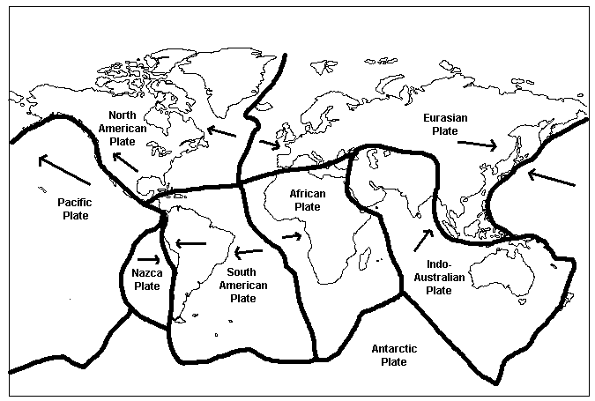
This shows the plate boundaries, earthquakes and volcanoes occur along these lines. Which of the cities we have looked at are close to these boundaries?

