Slide 1
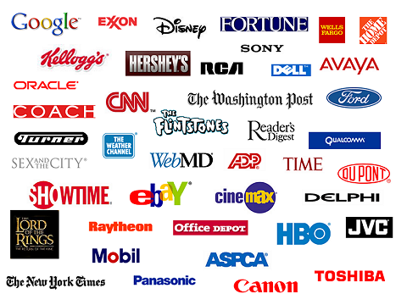
Logo Quiz!

Slide 2
Logo 1

Slide 3
Logo 2

Slide 4
Logo 3

Slide 5
Logo 4

Slide 6
Logo 5

Slide 7
Logo 6

Slide 8
Logo 7

Slide 9
Logo 8

Slide 10
Logo 9

Slide 11
Logo 10

Slide 12
Logo 11

Slide 13
Logo 12

Slide 14
Logo 13

Slide 15
1. Nike
2. Nestle
3. Apple
4. McDonalds
5. Reebok
6. Adidas
7. Shell
8. Wella
9. BT
10. Toyota
11. Pepsi
12. KFC
13. WWF
Answers

Slide 16
Are you born to wear brands? How many do you see around you now? Bag? Phone?
Why do we wear them?

Slide 17
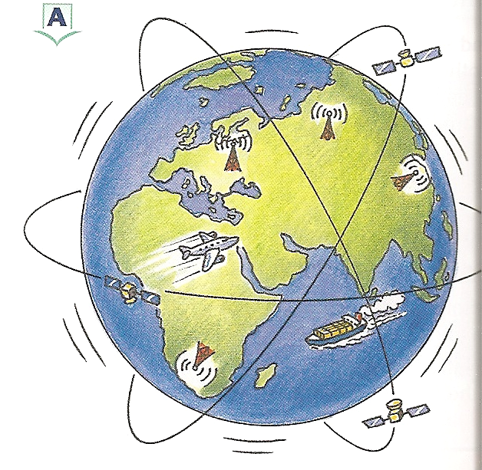
What is globalisation?
AF3 – to explain the cause and consequences of globalisation.

Slide 18
COPY: Globalisation means the way companies and ideas and lifestyles are spreading more and more easily around the world.

Slide 19
Task
You have 5 minutes to write a paragraph to describe your day and link it to as many different countries as you can.
Who will fit the most countries in?

Slide 20
Globingo
Find someone in the class that can name or has… Write down their name and their answer (you can not ask the same person more than once)
1) A sporting event watched in more than one country | 2) A band or artist from your home country | 3) Parents from different countries
4) Something you are wearing that was not made in China | 5) A famous person from a country in Africa | 6) A food you eat from another country
7) A film with a countries’ name in the title | 8) A language you speak other than English | 9) A brand of electronics other than Apple

Slide 21
All the following factors are influenced by globalisation.
TV & Film
Languages
Sport
Music
Nationality
Brands/TNCs
Fashion
Electronics/products
Trade
Food
Communication & Technology
1. Watch these TV advertisements from Egypt and Philippines.
a. Discuss how McDonalds are trying to encourage people to buy their food?
b. What demographic are they targeting?
c. How does this influence the food culture and lifestyles of people in these countries?
2. For one of these factors, explain how it influences globalisation (how it spreads ideas and culture around the world).

Slide 22
Homework
Go through your wardrobes and cupboards
Find 20 items that are produced in different countries
Complete the following table
Item Description | Country of Origin
Describe what you would eat if you only relied on the food of your home country.

Slide 23
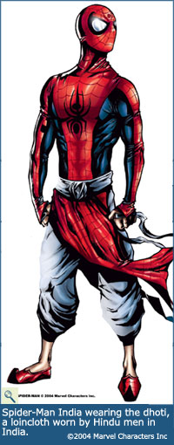
Why would ‘Marvel Comics’ change their Spiderman for people in India?
Notes:
Appeal to a wider audience. 2nd largest population, predicted to be the largest by 2030. More profit

Slide 24
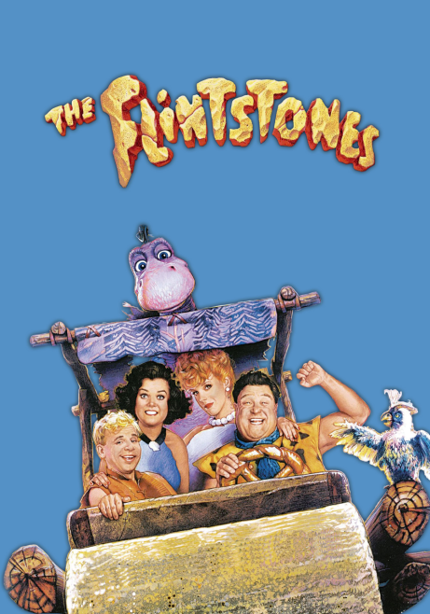
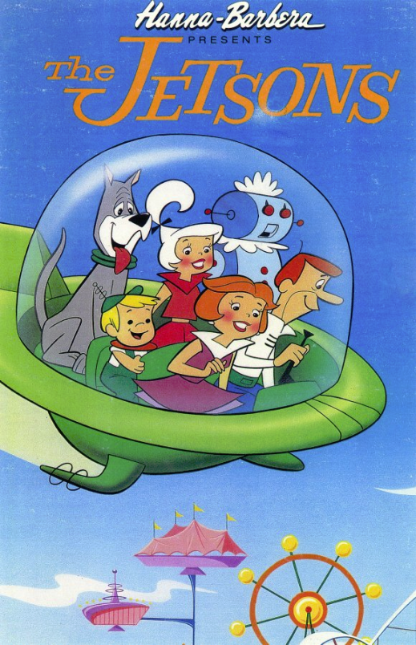
Without globalisation your lives would be very different.
Imagine a world where you had to stay in your country, not share ideas, inventions, foods, music or sport?
Would your country be like this…
Or like this…?
Discuss

