Slide 1
Where are the Himalayas?
AF2 – mapping the Himalayas.
AF3 – describing location and climate graphs
·

Slide 2
STARTER
The Himalayas are a mountain range, which means that
there are lots of mountains together. It has the 2 highest
mountains in the world.
How high are Mt Everest
and K2?
K2 – 8,611m
Everest – 8,848m

Slide 3
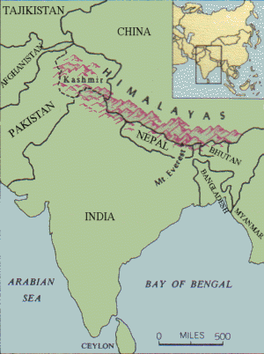
Describe the location of the Himalayas.
Better answers will include names of countries, the continent, direction and distance.
Sri Lanka

Slide 4
Peer Assessment by _____
WWW:
EBI:

Slide 5
WRITE ON THE FOLLOWING;
China – 0525
Bhutan – 0523
Nepal – 0323
Bangladesh – 0522
India – 0222
Pakistan – 00234
Myanmar – 0621
Bay of Bengal – 0520
USING A SYMBOL AND A KEY MARK
ON THE FOLLOWING MOUNTAINS;
Mt Everest – 044236
K2 – 024258
Kanchenjunga – 048236
EXTENSION
Nepal is approximately 500 miles in length. Add a scale bar to show the length of 1cm
27
26
25
24
23
22
21
20
00
01
02
03
04
05
06
07
08
Test your map skills –add the information on to your map.

Slide 6
WRITE ON THE FOLLOWING;
China – 0525
Bhutan – 0523
Nepal – 0323
Bangladesh – 0522
India – 0222
Pakistan – 0024
Myanmar – 0621
Bay of Bengal – 0520
USING A SYMBOL AND A KEY MARK
ON THE FOLLOWING MOUNTAINS;
Mt Everest – 044236
K2 – 024258
Kanchenjunga – 048236
EXTENSION
Nepal is approximately 500 miles in length. Add a scale bar to show the length of 1cm
27
26
China
25
Pakistan
24
Nepal
Bhutan
23
India
Bangladesh
22
Myanmar
Mt Everest
21
K2
Bay of Bengal
Kanchenjunga
20
00
01
02
03
04
05
06
07
08
Test your map skills –add the information on to your map.

Slide 7
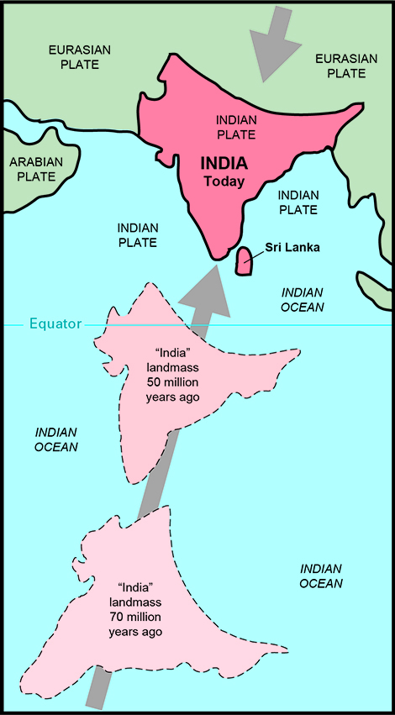
COPY: The Himalayas formed because the Indian plate is moving north, while the Eurasian plate is moving south causing the Himalayas to rise by 1cm a year.
How did they form?

Slide 8
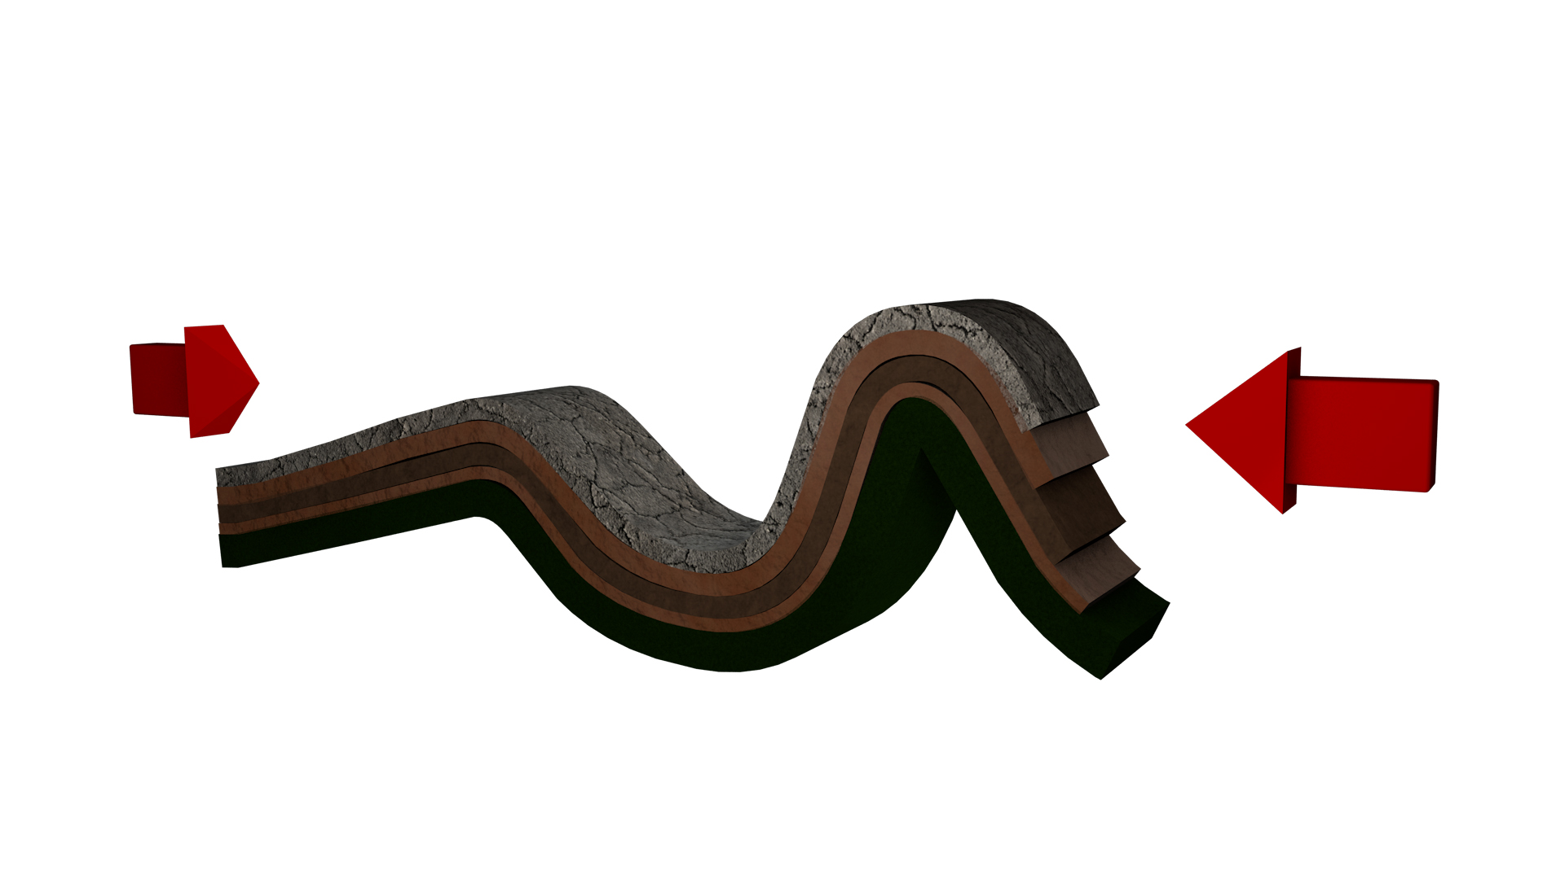
This causes fold mountains to form.

Slide 9
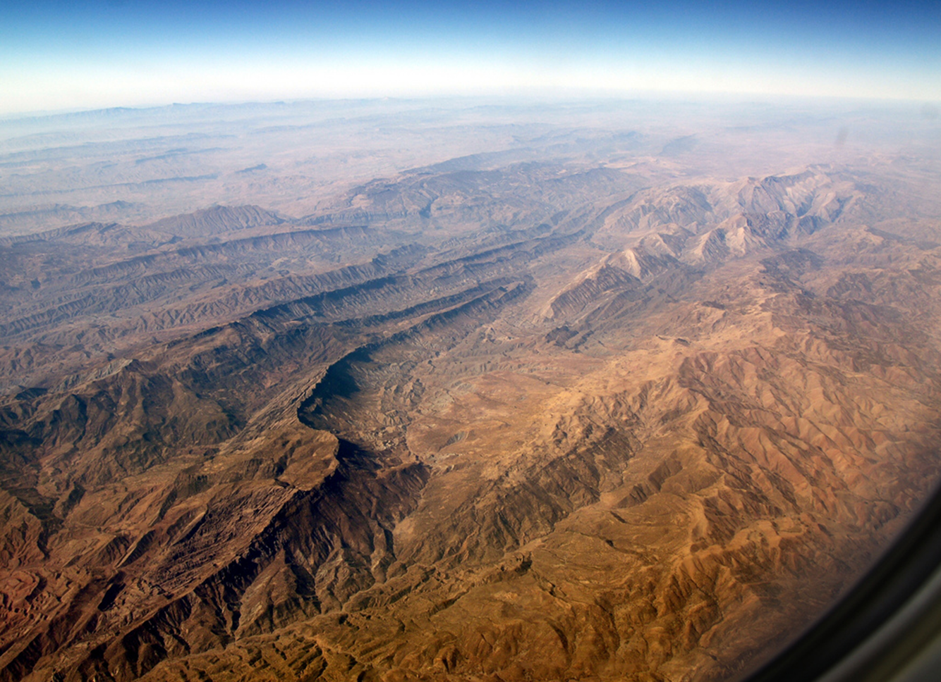
That can look like this…

Slide 10
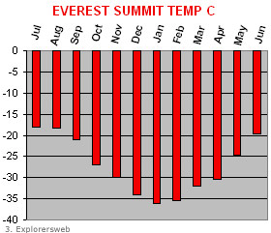
How cold is it at the summit (top)?
1) Describe the temperature at the top of Everest (include data and months)
2) Give some reasons why it is so cold? (remember your lessons on Antarctica).

Slide 11
Peer Assessment by _____
WWW:
EBI:

Slide 12
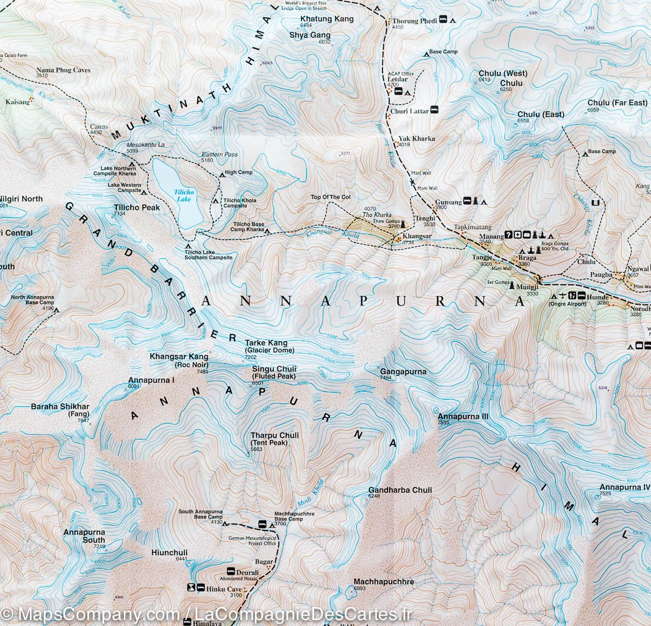
What do these brown lines show?
PLENARY
COPY: These are
called
contour lines. They show how the relief (how high and steep the land is).
If the lines are close
together it shows that it is very steep.

