Slide 1
Identify the following 8 slides

Slide 2
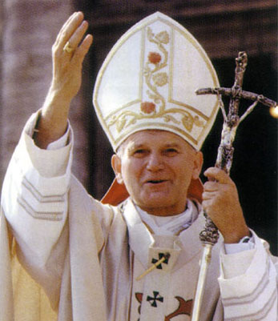

Slide 3
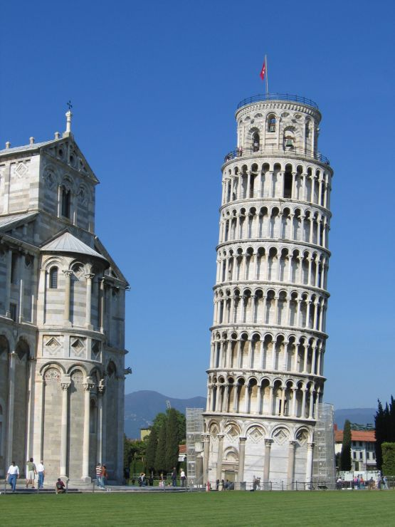

Slide 5
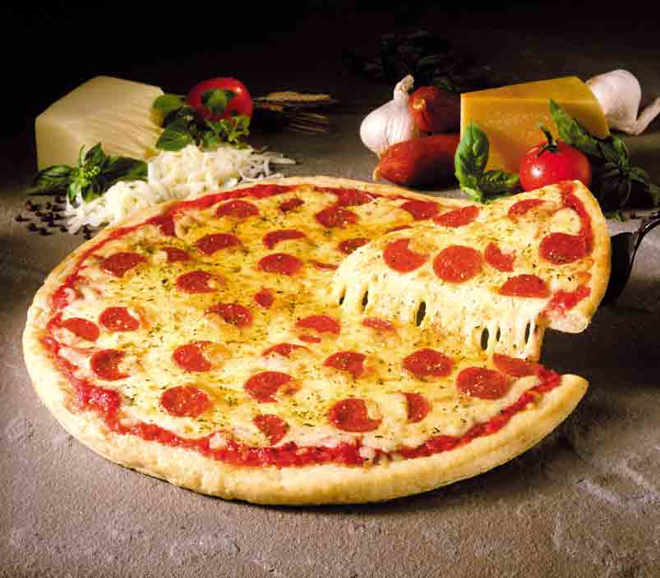

Slide 7
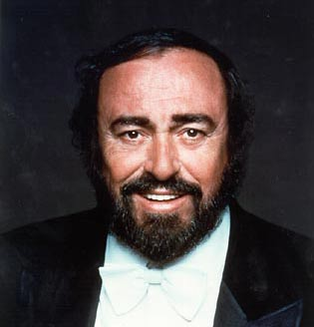

Slide 8
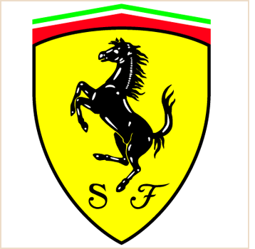

Slide 9
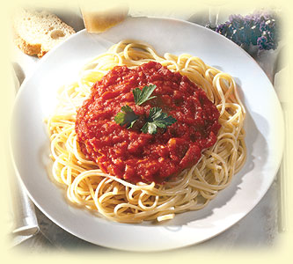

Slide 10
What do these slides have in common?
Write a sentence to answer this question

Slide 11
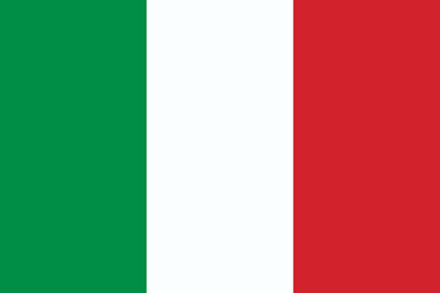
They are all Italian Icons

Slide 12
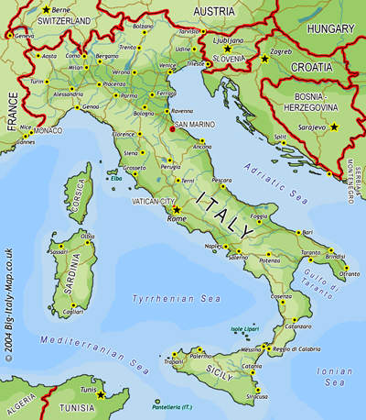
Where is Italy?
AF2: mapping physical and human geographical features of Italy
AF3: describing the location of Italy

Slide 13
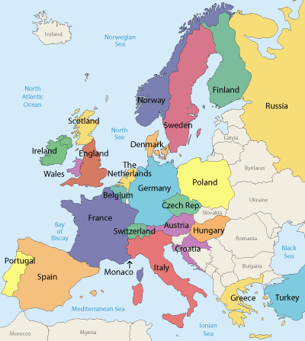
Where is Italy?
Italy is a country within the continent of.................
It is located in the .................
It borders with countries including .........................
It is shaped like a ........... that sticks out into the ............... Sea

Slide 14
Where is Italy?
Italy is a country within the continent of Europe
It is located in the South
It borders with countries including France, Switzerland, Austria and Slovenia (not Croatia)
It is shaped like a boot that sticks out into the Mediterranean Sea

Slide 15
Back to Back Exercise
Get into pairs and sit back to back. One person facing the board; one person facing the back.
The person facing the board must describe the image to the person facing the back, who tries to re-draw the image.
You have two minutes

Slide 16
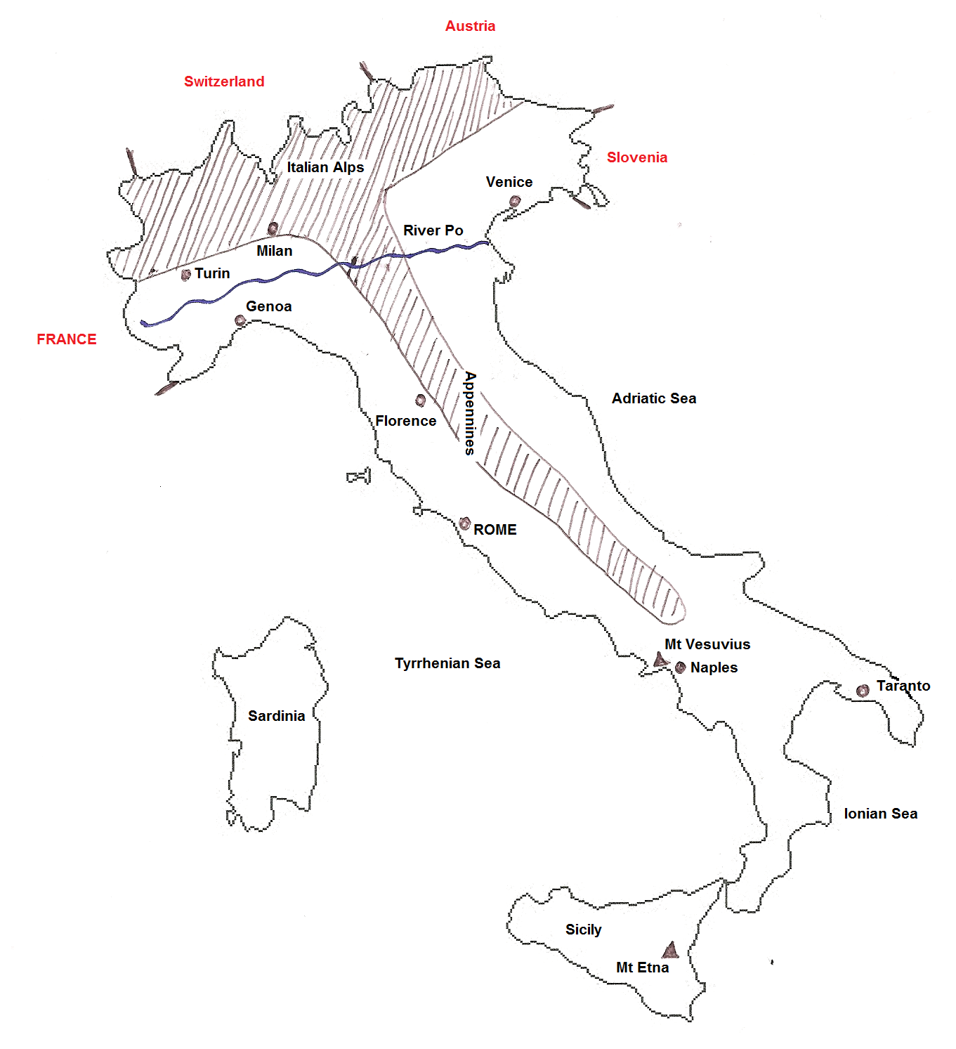

Slide 17
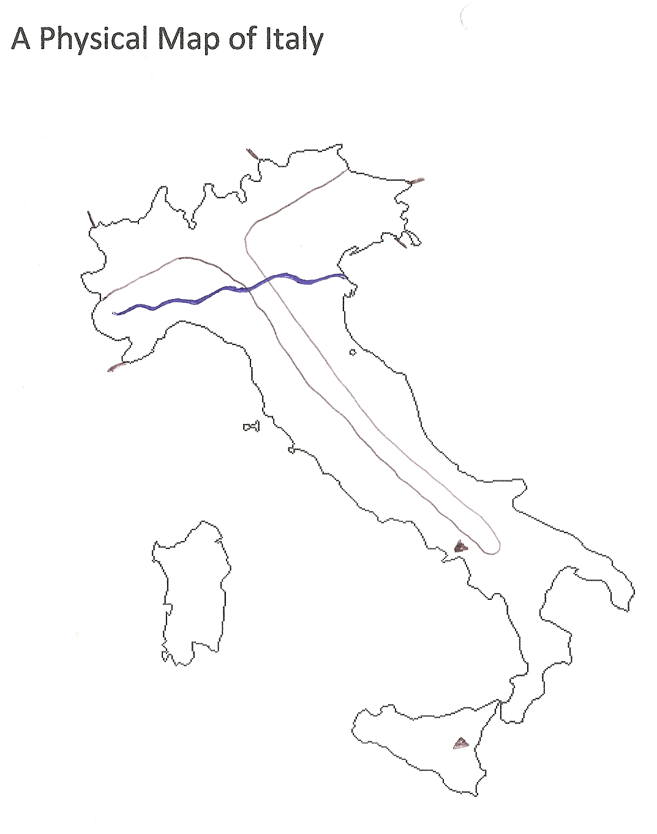
Use the atlas pg. 38 -43 & 50 to complete your worksheet
Label the following:
The 2 mountain ranges
(Alps and Appennines)
The 2 islands
(Sardinia and Sicily)
The 2 volcanoes
(Mt Etna and Vesuvius)
The 3 seas
(Ionian, Tyrrhenian and Adriatic)
The river
Remember to add a key using the symbols on the maps.

Slide 18
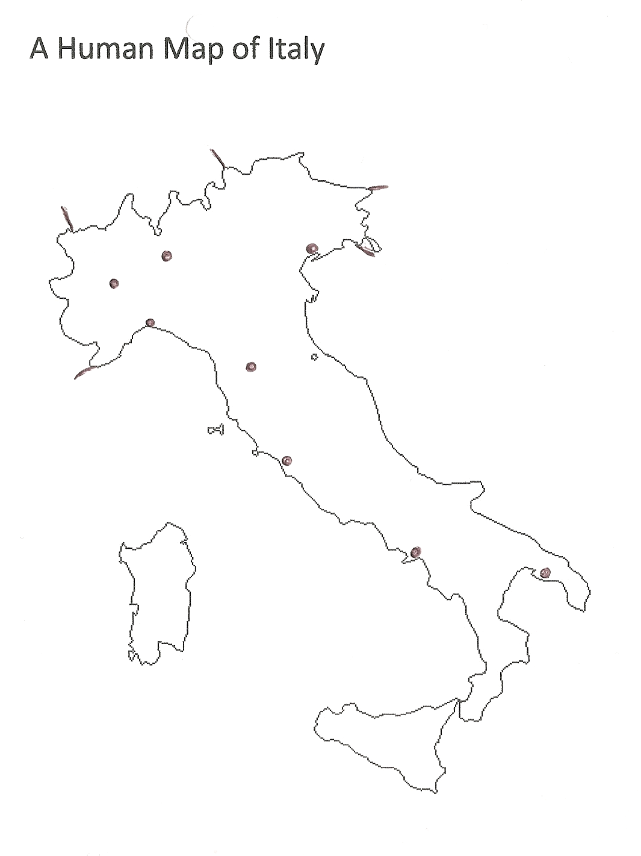
Use the atlas pg. 38 -43 & 50 to complete your worksheet
Label the following:
The 4 neighbouring countries
(Slovenia, Switzerland, France and Austria)
The 8 cities
(Taranto, Venice, Genoa, Rome,
Turin, Naples, Florence, Milan)

Slide 19
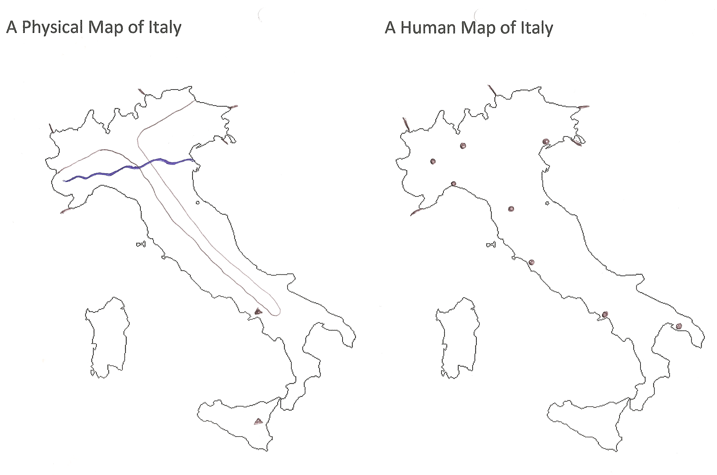

Slide 20
Plenary: Q & A
How many seas surround Italy?
What are their names?
How many islands does Italy have?
What are their names?
How many volcanoes does Italy have?
What are their names?
How many mountain ranges does Italy have?
What are their names?
What is the name of the river in North Italy?
What is the capital city of Italy?
How many bordering countries does Italy have?
What are their names?
3
Ionian, Tyrrhenian, Adriatic
2
Sardinia
Sicily
2
Vesuvius
Etna
2
Alps
Appennines
River Po
Rome
4
France, Switzerland, Austria and Slovenia

Slide 21
Questions you should be able to answer.
How many seas surround Italy?
What are their names?
How many islands does Italy have?
What are their names?
How many volcanoes does Italy have?
What are their names?
How many mountain ranges does Italy have?
What are their names?
What is the name of the river in North Italy?
What is the capital city of Italy?
How many bordering countries does Italy have?
What are their names?

