Slide 1
Natural World
Where is Zambia?
AF2 – to describe the distribution of population in Zambia.

Slide 2
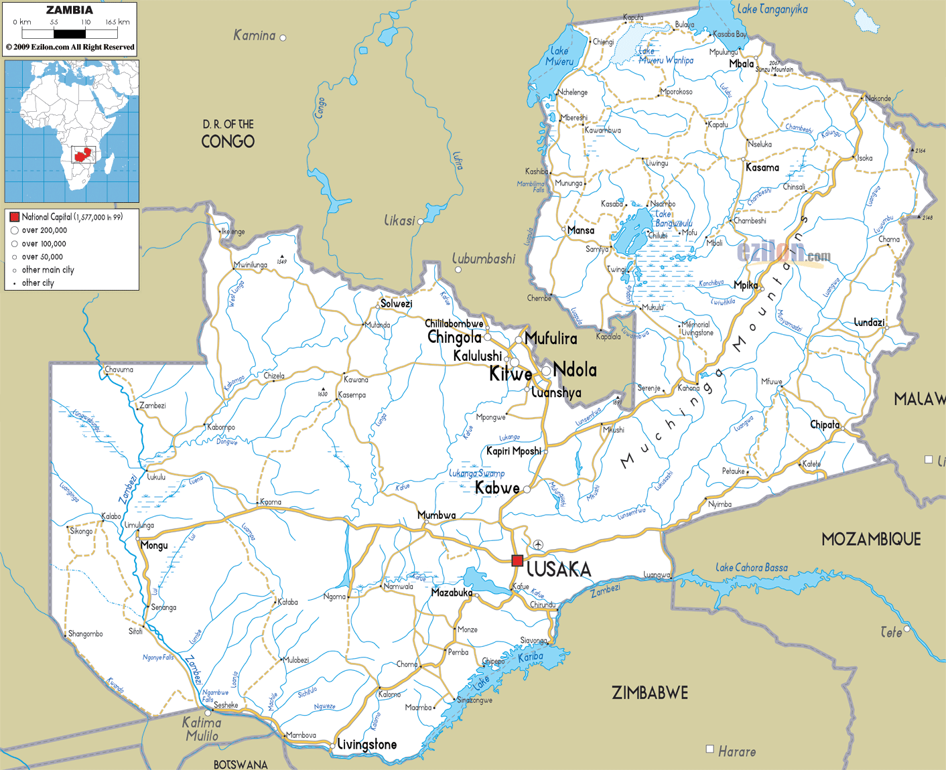
STARTER
Answer these in full sentences.
In which continent is Zambia in?
What is the capital city of Zambia?
What country is south of the capital city?
In what direction are the Muchinga Mountains from the capital city?

Slide 3
What does this show?
A choropleth map uses colour to show areas of high and low numbers.

Slide 4
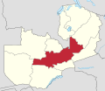
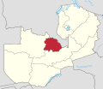
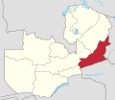
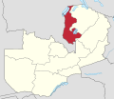
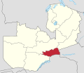
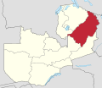
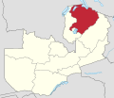
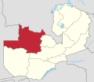
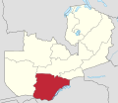
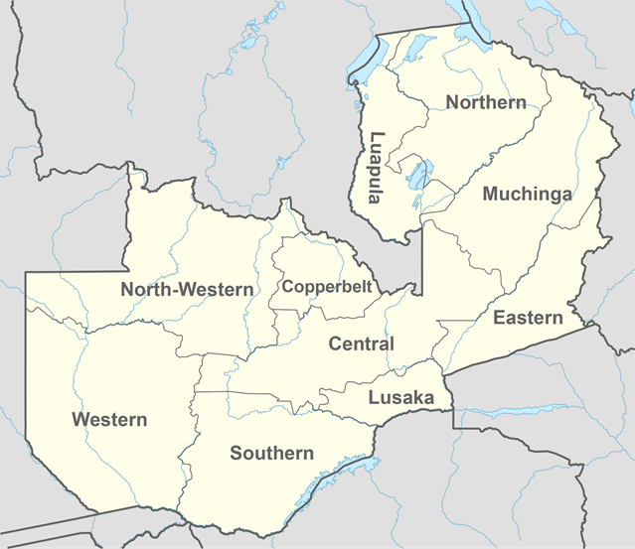
Province | Population
Central | 1,307,111
Copperbelt | 1,972,317
Eastern | 1,592,661
Luapula | 991,927
Lusaka | 2,191,225
Muchinga | 711,657
Northern | 1,105,824
North-Western | 727,044
Southern | 1,589,926
Western | 902,974

Slide 5
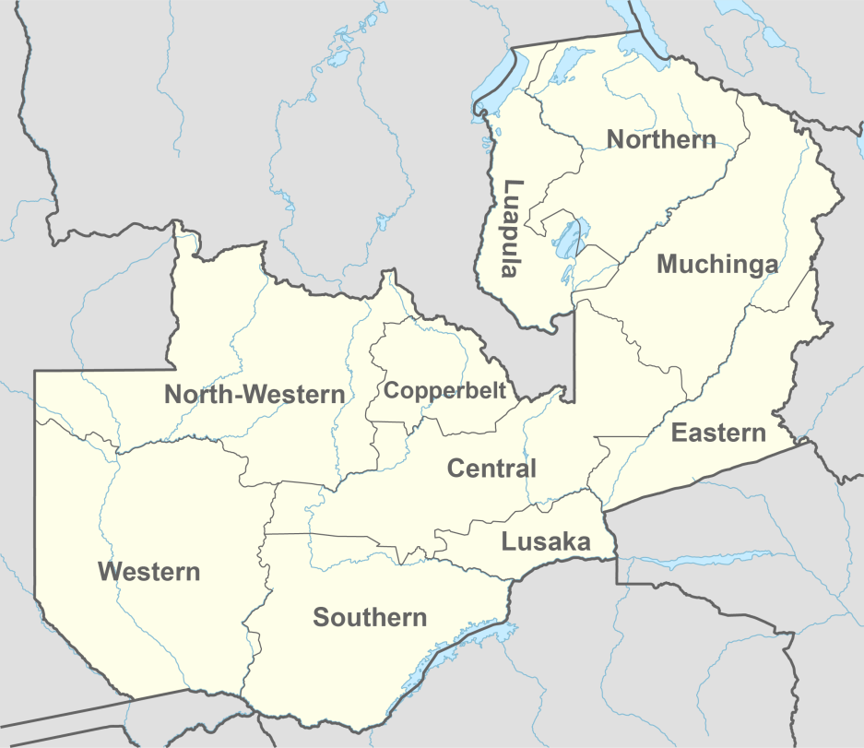
Complete the choropleth map. You can use any colour, but the darker colours should be with the highest number, then getting increasingly lighter, for example…
Province | Population
Central | 1,307,111
Copperbelt | 1,972,317
Eastern | 1,592,661
Luapula | 991,927
Lusaka | 2,191,225
Muchinga | 711,657
Northern | 1,105,824
North-Western | 727,044
Southern | 1,589,926
Western | 902,974
KEY | Population
 | 2,000,000 - 2,299,999
 | 1,600,000 – 1,999,999
 | 1,300, 000 – 1,599,999
 | 1,000,000 – 1,299,999
 | 700,000 - 999,999

Slide 6
AF3 - Describe
Describe the pattern shown on your map.
MARKED FOR LEARNING

Slide 7
Natural Wonders of the World
Task 1
Match up the pictures with the place.
Task 2
Put them in your order of the Seven Natural Wonders of the World. Best to Worst.
Lets see if you had them in the correct order!!

Slide 8
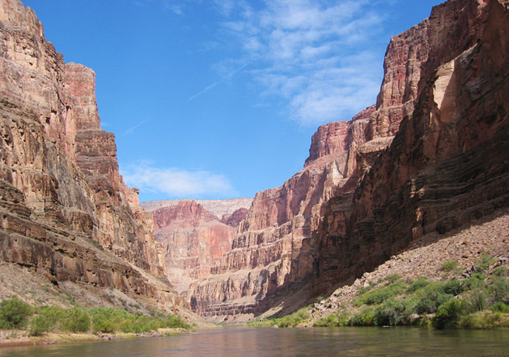
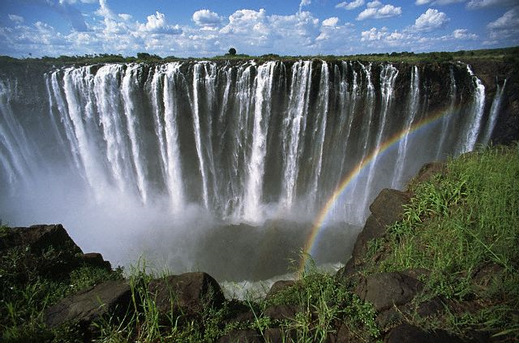
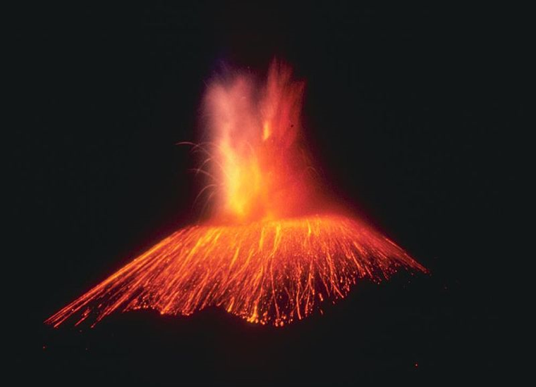
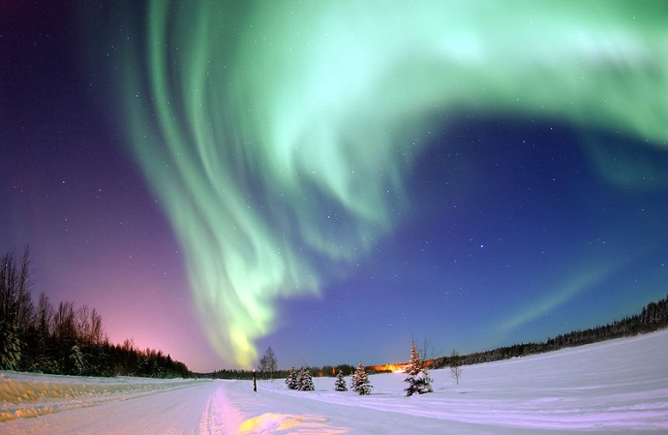
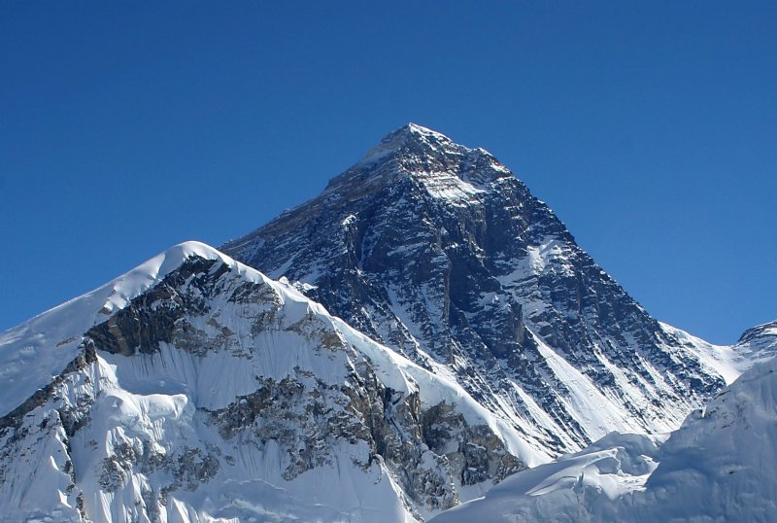
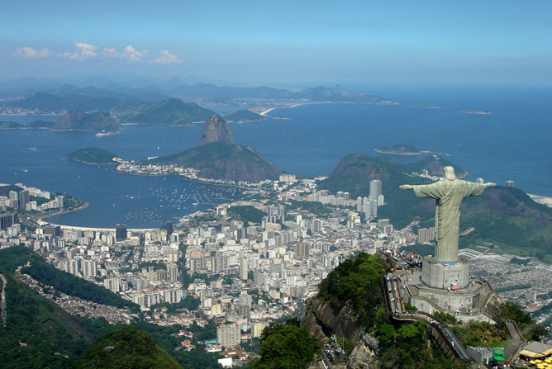
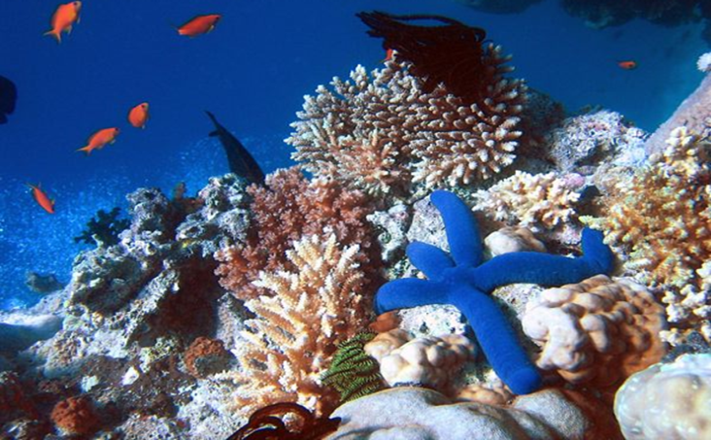
Grand Canyon
Mount Everest
Harbour of Rio de Janeiro
Victoria Falls
Parícutin
Great Barrier Reef
Aurora
Notes:
In B422

Slide 9
Grand Canyon

Slide 10
Great Barrier Reef

Slide 11
Harbour of Rio de Janeiro

Slide 12
Mount Everest

Slide 13
Aurora

Slide 14
Parícutin volcano

Slide 15
Victoria Falls

Slide 16
7 Natural Wonders of the World
Grand Canyon, USA
Great Barrier Reef
Harbour of Rio de Janeiro
Mount Everest
Aurora
Parícutin volcano
Victoria Falls

Slide 17
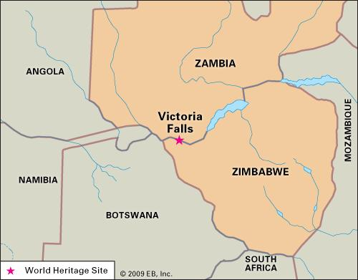
Locate the Victoria Falls on your map.
Using the description, mark where you think it is.
Victoria Falls is located in the south of Southern Province on the border with Zimbabwe, 80km east of the border with Western Province.

Slide 18
Homework
Flipped Learning
This is where you research waterfalls before we study it next lesson.
Watch the videos on Moodle and answer the questions on the worksheet.

Slide 19
Watch the 2 videos on Moodle to answer these questions:
http://learning.shunyi.nordanglia.com/
What is ‘crucial’ in understanding how a waterfall is formed?
What is the name of the landform that the river creates with very steep sides?
What is the name of the world’s tallest waterfall?
How high is it?
Flipped Homework
Draw 2 diagrams to show how a waterfall forms.

Slide 20
What am I?
I am found in Europe.
I have volcanoes.
I am not a city.
I am getting kicked by a boot.
I have Mt Etna on me.
I am an island.
I am Sicily.

Slide 21
PLENARY
Now create your own ‘What am I?’ about a place we have studied so far.
Remember, start with difficult clues and slowly make them easier.

