Slide 1
Overview
Week | Lesson | Assessment | Assessed Outcome
1 | Watch Shackleton’s Arctic Adventure
2 | Where is Antarctica? | AF2, AF3 | to calculate 4 & 6 figure grid references and to describe a route through Antarctica.
3 | Living in Antarctica today. | AF1, AF4 | to graph the climate of Antarctica and to explain how people live and work in Antarctica
4 | Who owns Antarctica? | AF5 | to evaluate who owns Antarctica and whether it should be used or protected.

Slide 2
Where in Antarctica?
Understand: How to explore our next topic – Antarctica!
Skill: To be able to navigate using grid references.
Competency: You will need to work this out!
Homework: Antarctic expedition training.
WTE | Be able to use four figure grid references accurately, together with recognizing map symbols
ME | Be able to use six figure grid references with some accuracy, together with recognizing map symbols. Plotting data on a map.
EE | Be able to use six figure grid references with accuracy, together with recognizing map symbols. Plotting data on a map correctly and showing the routes taken by the explorers.
AF2- mapping skills to read and plot 4 and 6 figure grid references

Slide 3
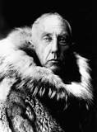
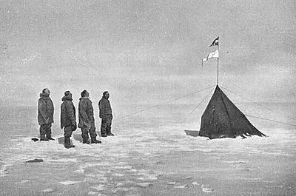
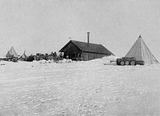
COPY
On December 14, 1911, Roald Amundsen and four fellow Norwegian explorers became the first men to reach the South Pole, beating the team of British Capt. Robert F. Scott by just over a month.

Slide 4
Grid Reference
A GRID REFERENCE is a number which gives a location on a map.
We can use them to say where something is …
...or if we got lost we could explain to someone else where we were.

Slide 5
The numbers at the bottom are called Eastings because they show you how far East you are.
47
46
45
44
30
31
32
33

Slide 6
Each Easting refers to the column which is to the right of its line.
47
46
45
44
30
31
32
33

Slide 7
The numbers at the side are called Northings because they show you how far North you are.
47
46
45
44
30
31
32
33

Slide 8
Each Northing refers to the row above its line.
47
46
45
44
30
31
32
33

Slide 9
We always read the Easting First and the Northing Second
You can remember this by thinking…
Along the corridor and up the stairs!

Slide 10
Let’s work out the Grid Reference of the blue square by reading along the corridor then up the stairs!
47
3246!
46
45
44
30
31
32
33

Slide 11
On a whiteboard hold up the Grid Reference for
Cowslip Farm
3145
47
Norbury Park |  | School
Lodge Farm | Cowslip Farm | Mickleham Hall
Beechy Wood |  | Fredley Manor
46
45
44
30
31
32
33

Slide 12
On a whiteboard hold up the Grid Reference for
School
47
Norbury Park |  | School
Lodge Farm | Cowslip Farm | Mickleham Hall
Beechy Wood |  | Fredley Manor
3246
46
45
44
30
31
32
33

Slide 13
On a whiteboard hold up the Grid Reference for
Fredley Manor
3244
47
Norbury Park |  | School
Lodge Farm | Cowslip Farm | Mickleham Hall
Beechy Wood |  | Fredley Manor
46
45
44
30
31
32
33

Slide 14
On a whiteboard hold up the Grid Reference for
Norbury Park
3046
47
Norbury Park |  | School
Lodge Farm | Cowslip Farm | Mickleham Hall
Beechy Wood |  | Fredley Manor
46
45
44
30
31
32
33

Slide 15
On a whiteboard hold up the Grid Reference for
Beechy Wood
3044
47
Norbury Park |  | School
Lodge Farm | Cowslip Farm | Mickleham Hall
Beechy Wood |  | Fredley Manor
46
45
44
30
31
32
33

Slide 16
On a whiteboard hold up the Grid Reference for
Lodge Farm
3045
47
Norbury Park |  | School
Lodge Farm | Cowslip Farm | Mickleham Hall
Beechy Wood |  | Fredley Manor
46
45
44
30
31
32
33

Slide 17
6 Figure Grid References
4 figure grid references give us a grid location but they are not very specific.
To be more exact we can use 6 figure grid references to explain where exactly something is within a square.

Slide 18
On the map there is actually a school and a church in square 3246
47
Norbury Park |  | School church
Lodge Farm | Cowslip Farm | Mickleham Hall
Beechy Wood |  | Fredley Manor
46
45
44
30
31
32
33

Slide 19
In order to give more precise locations for the church and the school
we divide each side of the square into 10 equal parts in our minds.
47
46
32
33

Slide 20
Each of these lines also has its own number…
47
9
8
7
6
5
4
3
2
1
46
1 2 3 4 5 6 7 8 9
32
33

Slide 21
Reading along the corridor and then up the stairs what do
You think the 6 figure grid reference for the school is?
47
9
8
7
6
5
4
3
2
1
323465
46
1 2 3 4 5 6 7 8 9
32
33

Slide 22
Reading along the corridor and then up the stairs what do
You think the 6 figure grid reference for the church is?
47
9
8
7
6
5
4
3
2
1
325461
46
1 2 3 4 5 6 7 8 9
32
33

Slide 23
To be a successful explorer like Amundsden, or a dedicated pioneer like Scott, you have to do your training first!
You need to work through the stages of training to be able to navigate on the final expedition – in ANTARCTICA!
You will work in pairs to complete two of the following:
Training Camp 1: 4 figure grid references (WTE)
Training Camp 2: 4 & 6 figure grid references (ME)
Training Camp 3: 6 figure grid references (EE)
Once you’ve mastered these, you will be able to undertake…
THE EXPEDITION TO ANTARCTICA.
Good luck! Don’t wait too long like Scott, you’ll freeze to death!

Slide 24
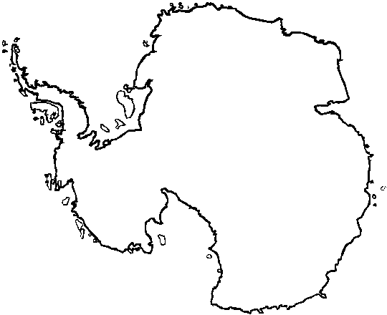
1. There are lots of reasons that Antarctica is visited. Colour in and label the following in grids:
Coal Seam 0624 Treasure? 0124
French Science Area 0522 Penguin colony 0625
2. Explorers want to know more about Antarctica - plot on the map the following science stations:
Halley (UK) 032255
Mawson (Aus) 070252
Progress (Rus) 073241
The Great Bateen
Antarctic Expedition!
3. Plot on the map the route that Amundsden followed.
1) 20th Oct. 1911- 034221
2) 4th Nov. 1911 – 036226
3) 17th Nov 1911 – 039231
4) 8th Dec 1911 – 038235
5) 14th Dec 1911 – 040238
4. Draw a line between the points to show the route.
27
26
25
24
5. Plot on the map the route that Scott followed.
1) 1st Nov. 1911- 043213
2) 21st Nov. 1911 – 041222
3) 9th Dec 1911 – 046229
4) 3rd Jan 1912 – 042235
5) 17th Jan 1912 – 040238
23
22
21
6. Draw a line between the points to show the route.
20
Congratulations! You are a qualified explorer!
00
01
02
03
04
05
06
07
08
Notes:
Hand out map

Slide 25
Where in Antarctica?
Understand: How to explore our next topic – Antarctica!
Skill: To be able to navigate using grid references.
Competency: You will need to work this out!
Homework: Antarctic expedition training.
WTE | Be able to use four figure grid references accurately, together with recognizing map symbols
ME | Be able to use six figure grid references with some accuracy, together with recognizing map symbols. Plotting data on a map.
EE | Be able to use six figure grid references with accuracy, together with recognizing map symbols. Plotting data on a map correctly and showing the routes taken by the explorers.
AF2- mapping skills to read and plot 4 and 6 figure grid references

Slide 26
How have you demonstrated collaboration (Team work) this lesson?
I have developed my skills of collaboration by…
Working as a team has helped me because?
Homework: Complete Antarctica Map for next lesson. (Due 1st November) If you need help visit albateengeography.weebly.com

