Slide 1
Where is Death Valley?
Changing World
OVER THE NEXT LESSONS WE WILL BE LEARNING ABOUT THE CLIMATE IN OUR CHANGING WORLD IN SOME OF THE WORLD’S MOST EXTREME PLACES,
.
Death Valley – Hot
Antarctica – Cold
AF3 - describe the distribution of landforms/objects/events
AF2 – Mapping Death Valley

Slide 2
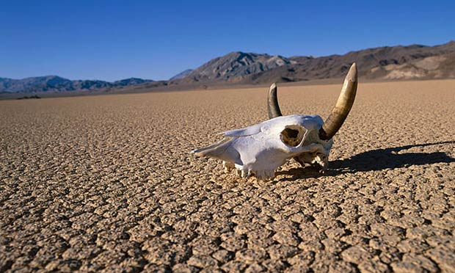
Prior Knowledge Review
Mind map everything YOU know already about Death Valley – don’t worry if it is blank.
DEATH VALLEY

Slide 3
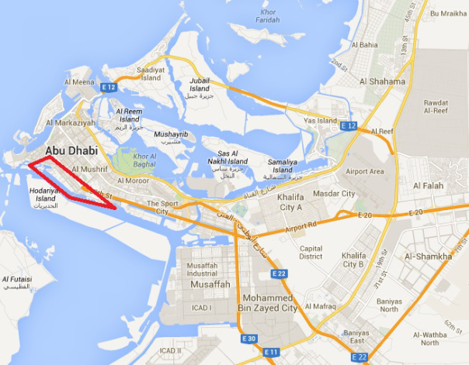
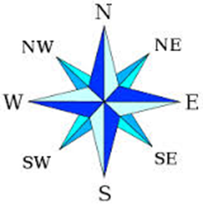
EXAMPLE: Describe the location of Al Bateen
Al Bateen is located in the north west of the capital city of Abu Dhabi, along the northern coastline of the UAE.
Using direction and place names
AF4 - describe the distribution of landforms/objects/events

Slide 4
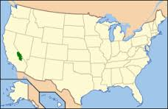
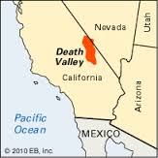
Your go - Describe the location of Death Valley
Better answers will include direction.
USA
AF3 - describe the distribution of landforms/objects/events

Slide 5
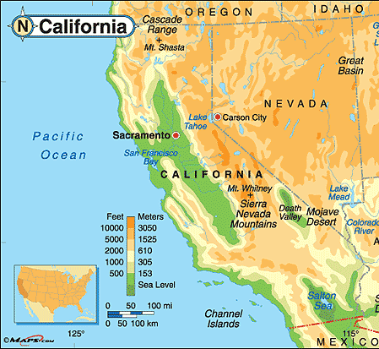
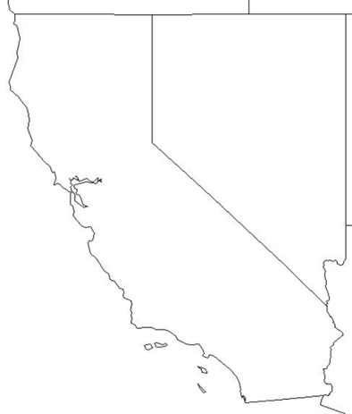
Mark the following on to your outline map.
HUMAN GEOGRAPHY (man made)
The cities of San Francisco, Los Angeles
The state capital of Sacramento.
States of California and Nevada and the country of Mexico
PHYSICAL GEOGRAPHY (natural)
Death Valley
Mt. Whitney
Pacific Ocean
Mojave Desert
KEY
San Francisco
Los Angeles
Better maps will have a key (like above), so the map stays clear; add a title and a north arrow.

Slide 6
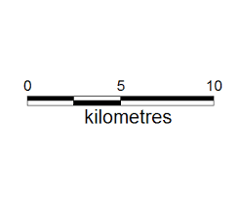
What is scale? Scale is the measurement used on a map.
These are all ways to show scale.
The best way to use this is by using a ruler.
This means that 9cm on the map is 10km
9cm=10km
4.5cm = 5km
2.25cm = 2.5km
0.9 cm (9mm) = 1km (1000m)
1:50 000
This means that 1 cm is the same as 50,000 cm (500m) in real life.

Slide 7
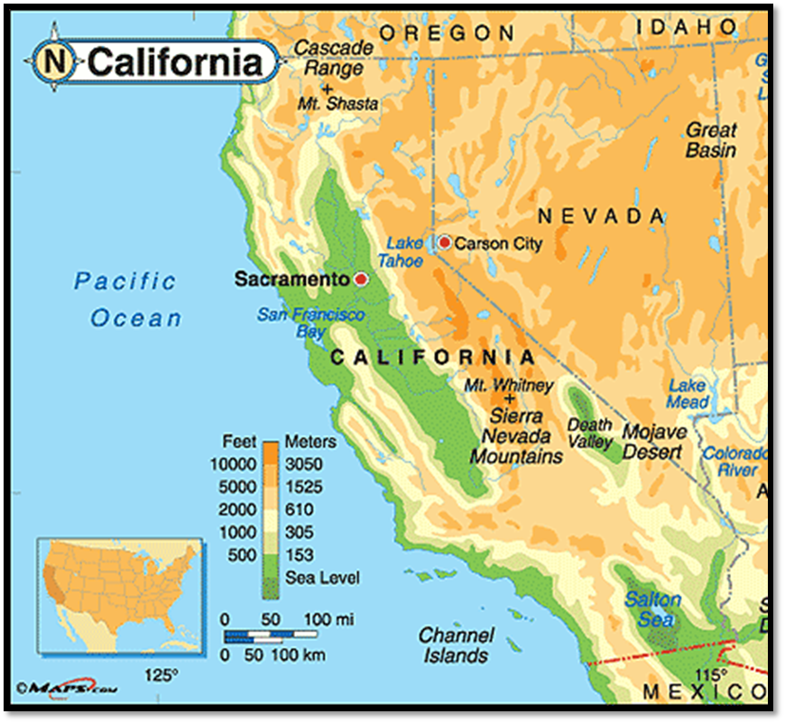
What is scale? Scale is the measurement used on a map.
· identify and measure scale
Where is the scale on this map?
Using kilometres (1000m)
How far is Death Valley from Los Angeles?
How far is Death Valley from Mt Whitney?
How far is Los Angeles from the Mexican border?
Answers
300km
150km
200km
Now add a scale bar onto your map.

Slide 8
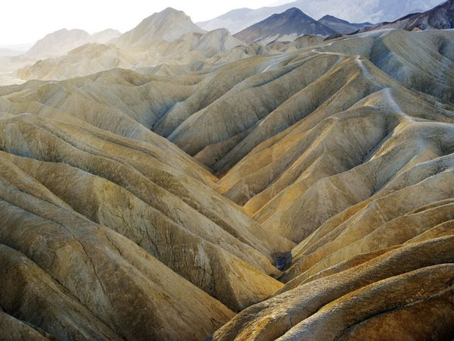
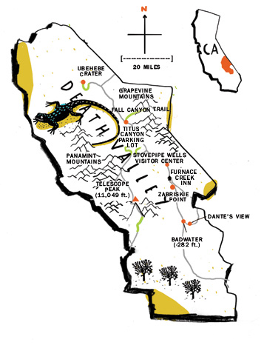
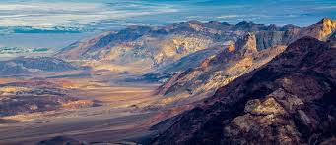
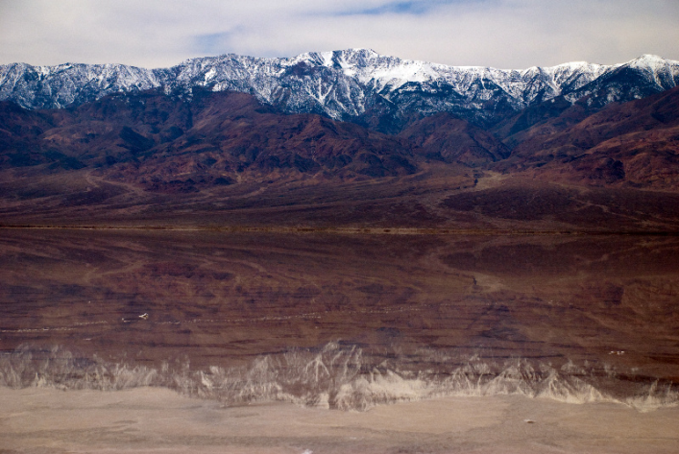
Zabriskie Point
Dante’s View
COPY
Established in 1994, Death Valley National Park is visited by almost 1 million visitors a year.
Telescope Peak

Slide 9
Estimate
1. In what direction and how far is Badwater from Ubehebe Crater?
2. How far are the Grapevine Mountains from Dante’s View?
Answers
South east - around 80 miles
Roughly 56 miles

Slide 10
Post Knowledge Review
Mind map everything YOU now know about Death Valley.
DEATH VALLEY

Slide 11
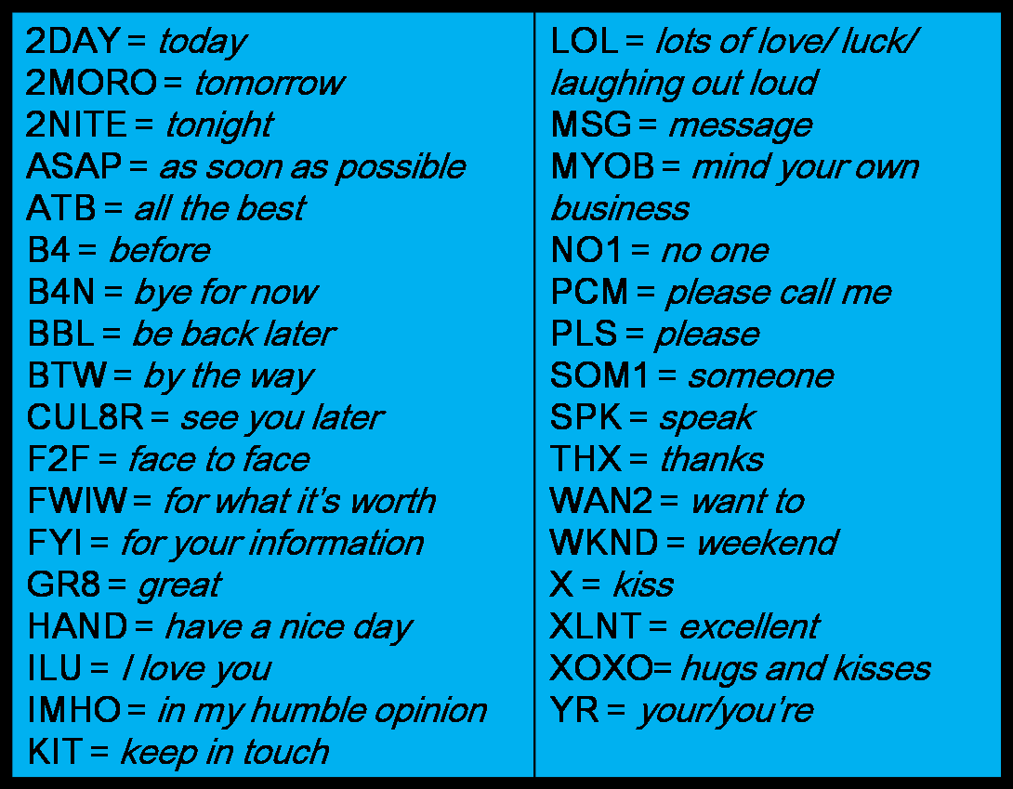
Txt Msg
Plenary
Write a txt msg explaining your learning

