Slide 1
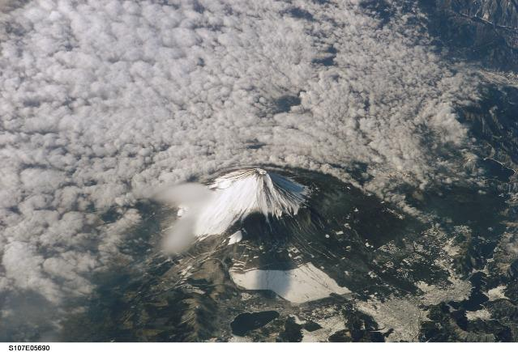
Where is Japan?
AF3- Describing location
AF3- Describing differences
AF2- Mapping physical and human features

Slide 2
Prior knowledge check
Japan

Slide 3
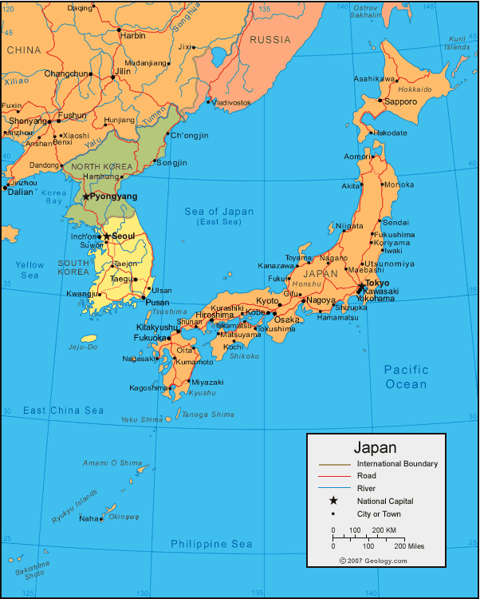
Describe the location of Japan and its capital city.
Where are the majority of cities located?

Slide 4
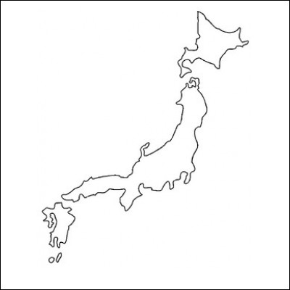
Label the key physical and human features of Japan.

Slide 5
Atlas
Describe the differences in Japan's climate and ecosystems.
Remember to include data.
.

Slide 6
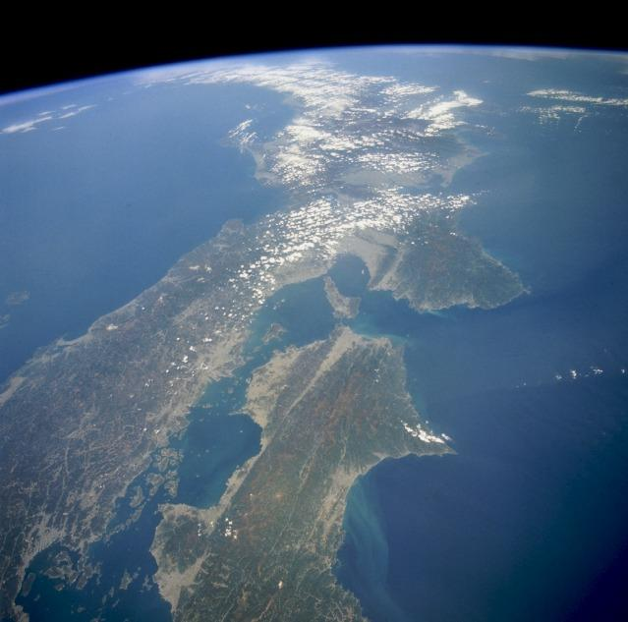
Describe Japan's relief?
What impacts might this have on Japan?
DISCUSS
This high-oblique, northeast-looking space shuttle photograph captures a portion of Southern Honshu Island and Shikoku Island of Japan. The darker areas show volcanic, mountainous terrain that comprises more than 80 percent of Japan; the lighter, more highly reflective areas of the coastal plains and valleys are urban and agricultural areas. Separated by the Seto Inland Sea are Shikoku Island to the south and the Osaka-Kobe industrial metroplex on Honshu Island to the north. Photo courtesy of NASA.

Slide 7
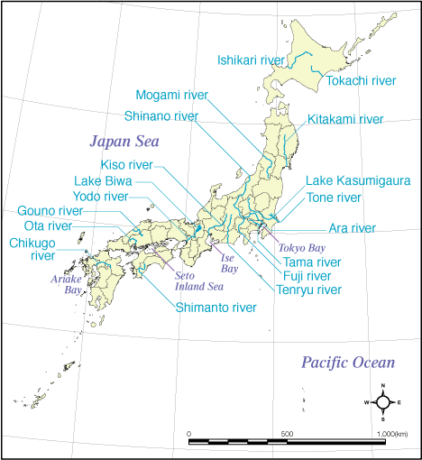
Which do you think is the longest river?
Why are rivers important?
DISCUSS
The longest river of Japan is the Shinano, 367 km, which flows from Nagano to Niigata. The Tone has the largest watershed and serves water to more than 30 million inhabitants of Tokyo metropolitan area

Slide 8
Knowledge check
Japan

