Slide 1
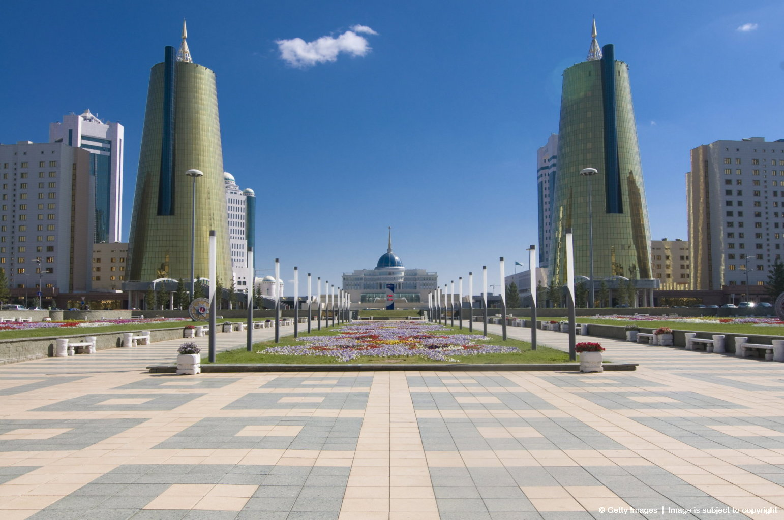
Where is Kazakhstan?
AF1- Identify differences on maps
AF3- Identify symbols using a key
AF4- describe the distribution of landforms

Slide 2
Prior knowledge check
Kazakhstan
3 minutes to write everything you know about Kazakhstan

Slide 3
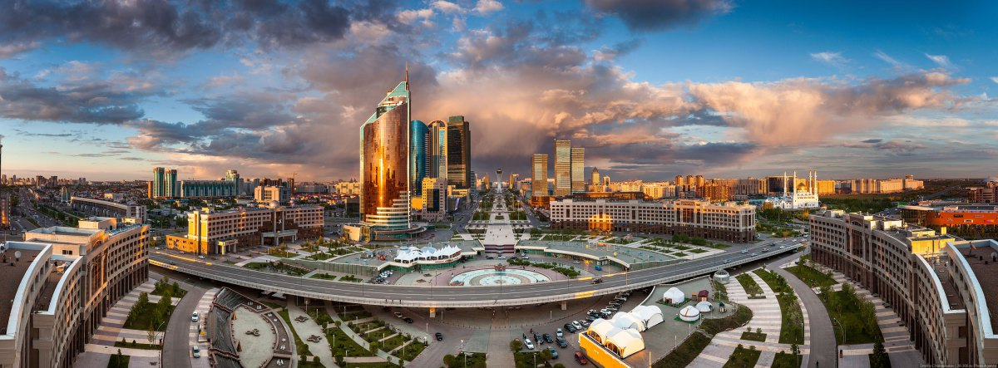
Write 3 questions you have about this picture?
Astana is a planned city, such as Canberra in Australia, Washington, D.C. in the United States and Brasilia in Brazil. The master plan of Astana was designed by Japanese architect Kisho KurokawaIt.

Slide 4
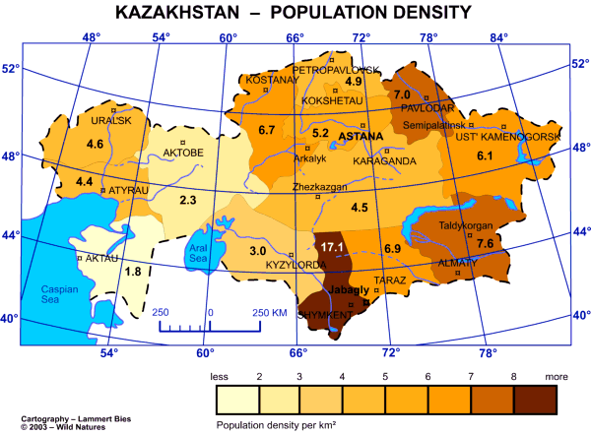

Slide 5
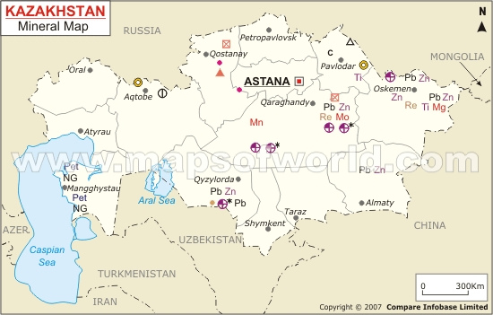

Slide 6
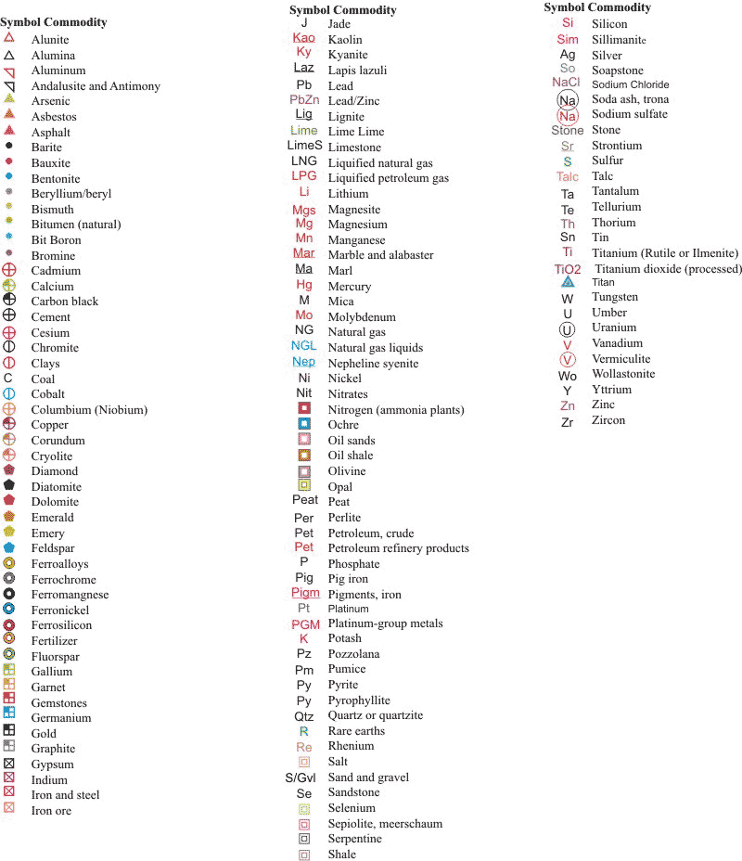

Slide 7
Therefore, it is home to many futuristic buildings, hotels and skyscrapers
COPY: Astana has a population density of 958 people per km2 and a population of about 835,153.

Slide 8
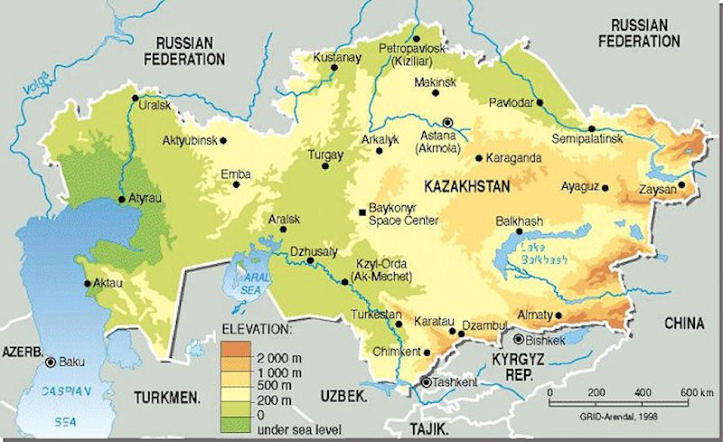
Shade the relief of Kazakhstan onto your map.
Choose 3 colours to show highest, middle and lowest land areas.
Mark on Astana and the biggest city of Almaty.
Add and label the Aral Sea, Caspian Sea and Lake Balkash, also the river Syr Dar'ya that feeds the Aral Sea.
Add the countries bordering Kazakhstan onto your map.

Slide 9
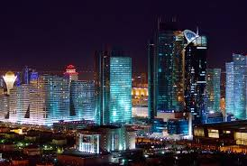
Using the Atlas...
Use the page 57 in the Atlas to describe the energy sources and minerals they have in Kazakhstan.
Describe the population distribution in Kazakhstan.
Use page 58 and what you have done already to try and give reasons why people live where they do.
Use the data sets to write down the total population, life expectancy and population density.
How does the population density of the country compare to the capital?

Slide 10
Prior knowledge check
Kazakhstan
Swap pens with the person next to you and write anything new you remember about Kazakhstan.

Slide 11
Anagrams
AHINC
LARA
ILO
AANAST
SCAPNIA
SMENTARUKTIN
WULA ROK KAT
Kisho KurokawaIt – the Japanese architect

