Slide 1
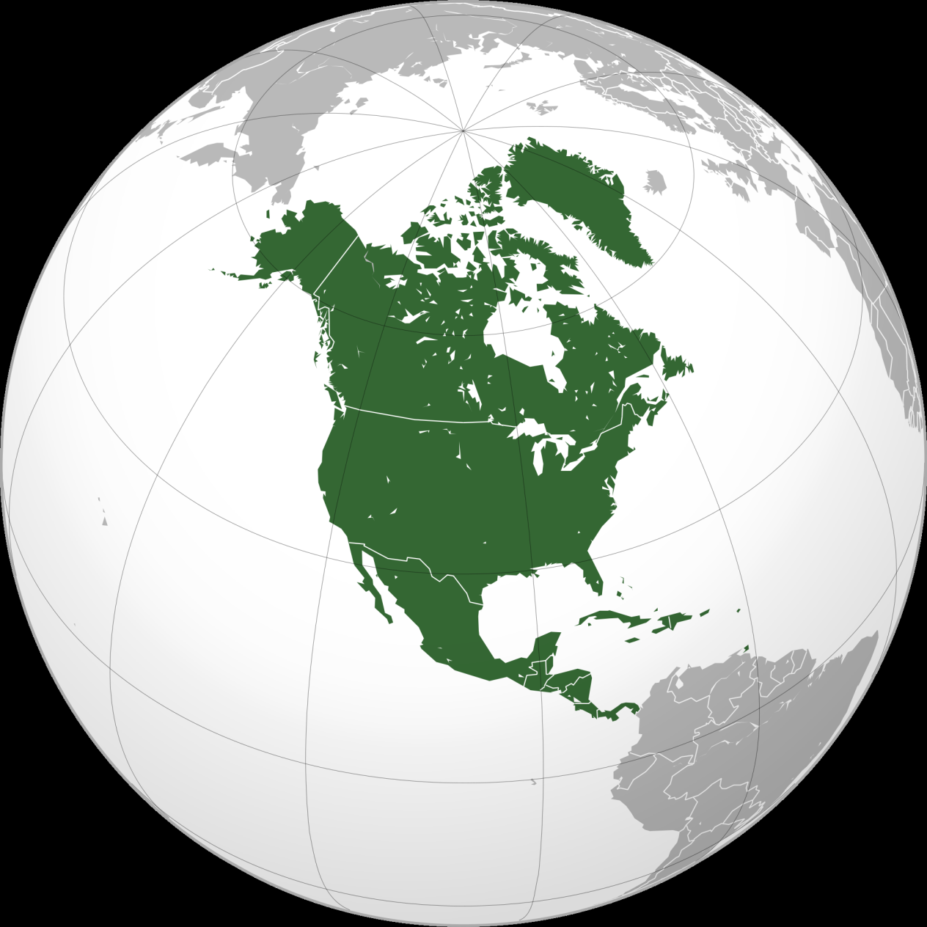
Where is North America?
AF2 - mapping North America
AF3 – Describing features of a US state

Slide 2
Prior knowledge check
North America

Slide 3
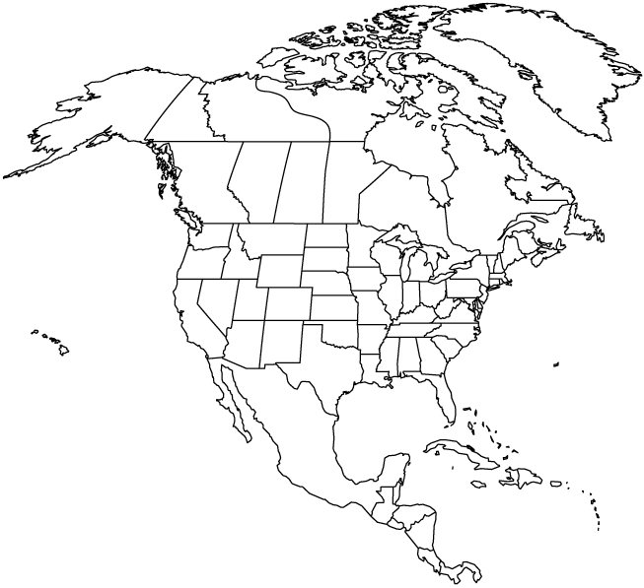
North America is every country north of the narrowest point that meets South America, including the countries in the Caribbean.
On your map, label:
Greenland,
Canada,
USA,
Mexico,
Guatemala,
Belize,
Honduras,
El Salvador,
Nicaragua,
Costa Rica,
Panama,
Cuba,
Jamaica,
The Bahamas,
Haiti,
Dominican Republic,
the Pacific Ocean,
Atlantic Ocean,
Caribbean Sea
Use a key
to produce a
neat and
well
presented
map.
AF2 - plot data onto maps

Slide 4
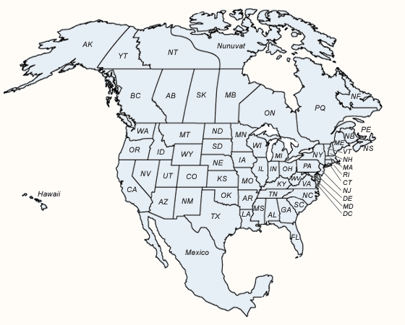
COPY
The USA is made up of 50 states and Canada has 10 provinces.
Label the US
states of Hawaii and Alaska on
your map.

Slide 5
Why is it called America?
The name America is believed to have come from an Italian explorer and cartographer called Amerigo Vespucci.
First used in 1507.
COPY

Slide 6
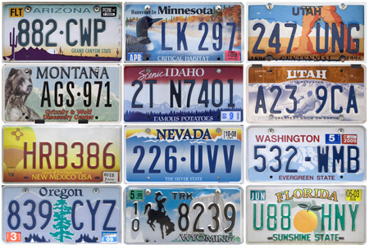
These are licence plates from different states

Slide 7
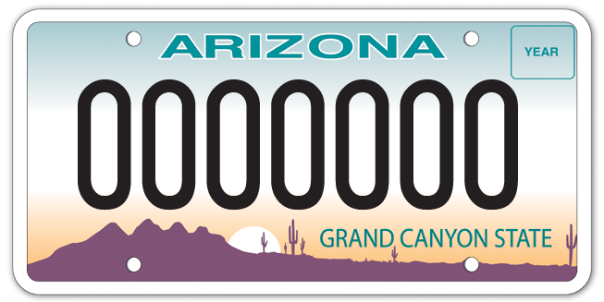
Each state has its own. The design gives you a clue about the state.
What does this design show us about Arizona?

Slide 8
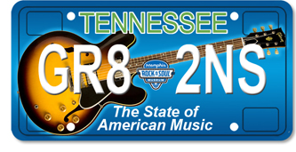
Use the state description you have been given to draw a license plate to represent the state in your book. Use a pencil and ruler!
You have 20 minutes to draw
Locate your state on your map.
Describe its location
Compare it to the person next to you.

Slide 9
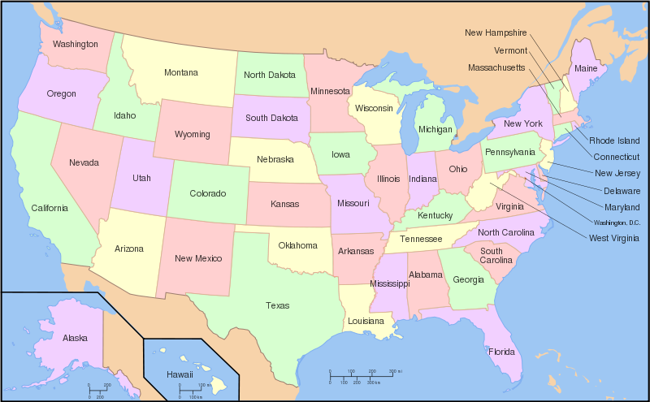
Name a state beginning with....

Slide 10
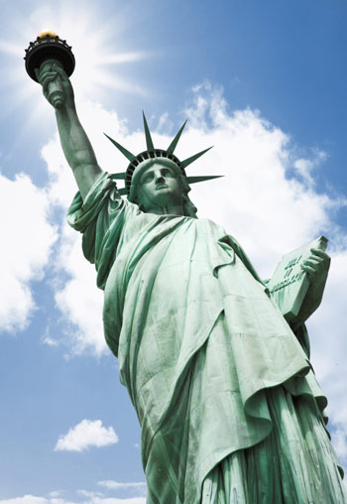
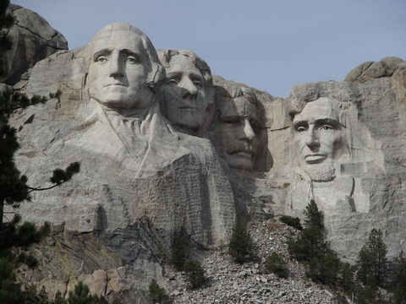
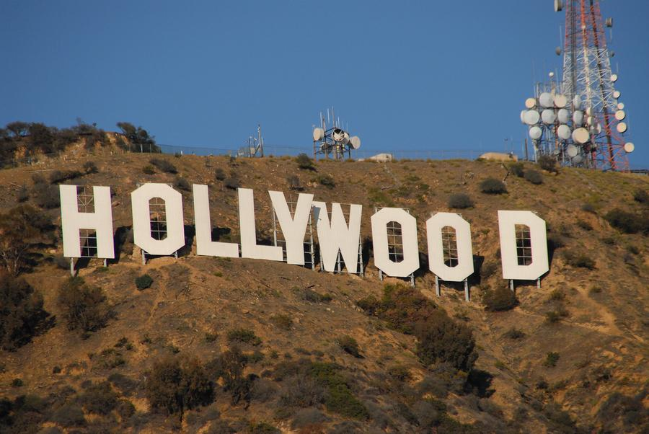
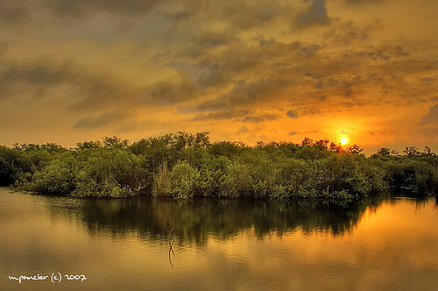
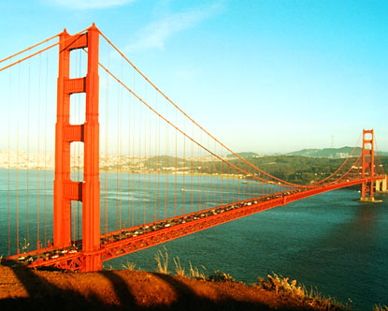
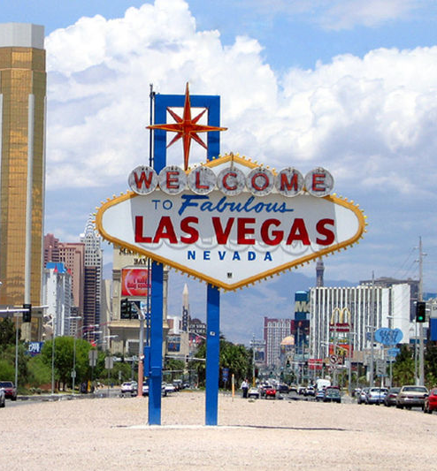
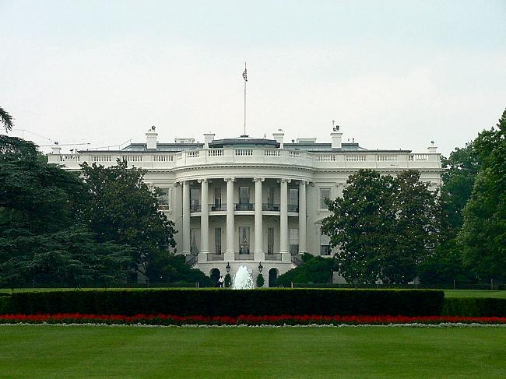
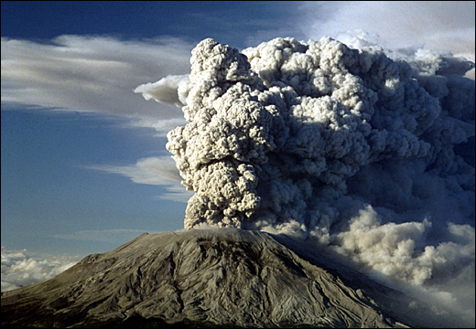
Which City? Which State?

Slide 11
Match up the landmark - city – state. How many can you do?
California | Mount Rushmore | Seattle | Bellagio Casino | Washington D.C.
Mount St. Helens | The White House | Keystone | Golden Gate Bridge | Nevada
Statue of Liberty | District of Columbia | San Francisco | Everglades | Orlando
Florida | New York City | Hollywood | South Dakota | New York
Los Angeles | Las Vegas | California | Washington State
Example: The White House – Washington D.C. – District of Columbia.
D. C. Stands for District of Columbia,
Washington is a different state in the west of the US.

Slide 12
Match up the landmark - city – state. How many can you do?
ANSWERS – colour coded
California | Mount Rushmore | Seattle | Bellagio Casino | Washington D.C.
Mount St. Helens | The White House | Keystone | Golden Gate Bridge | Nevada
Statue of Liberty | District of Columbia | San Francisco | Everglades | Orlando
Florida | New York City | Hollywood | South Dakota | New York
Los Angeles | Las Vegas | California | Washington State

Slide 13
Post knowledge check
North America
Swap pens with the person next to you or use a different colour. Add what your remember about North America.,

Slide 14
Match up the landmark - city – state.
California | Mount Rushmore | Seattle | Bellagio Casino | Washington D.C.
Mount St. Helens | The White House | Keystone | Golden Gate Bridge | Nevada
Statue of Liberty | District of Columbia | San Francisco | Everglades | Orlando
Florida | New York City | Hollywood | South Dakota | New York
Los Angeles | Las Vegas | California | Washington State
Match up the landmark - city – state.
California | Mount Rushmore | Seattle | Bellagio Casino | Washington D.C.
Mount St. Helens | The White House | Keystone | Golden Gate Bridge | Nevada
Statue of Liberty | District of Columbia | San Francisco | Everglades | Orlando
Florida | New York City | Hollywood | South Dakota | New York
Los Angeles | Las Vegas | California | Washington State

Slide 15
On your map, label:
Greenland,
Canada,
USA,
Mexico,
Guatemala,
Belize,
Honduras,
El Salvador,
Nicaragua,
Costa Rica,
Panama,
Cuba,
Jamaica,
The Bahamas,
Haiti,
Dominican Republic,
the Pacific Ocean,
Atlantic Ocean,
Caribbean Sea

