Slide 1
Is the Brandt line still accurate?
Enquiry
AF1-5

Slide 2
Route of Enquiry
Hypothesis
Method
Data Collection
Data Presentation & Analysis
Conclusion
Evaluation

Slide 3
Hypothesis – Copy either; The Brandt line is still accurate or The Brandt line is inaccurate

Slide 4
Choose 4 countries from Asia that you want to compare. 2 above the Brandt line and 2 below

Slide 5
Choose 3 development indicators you want to compare.
1 social e.g birth rate
1 economic e.g Cars per person
1 environmental e.g. Carbon dioxide emissions

Slide 6
Method
For each indicator explain how it will measure development and link it to how it will help answer the title question.
Explain - so should have 'because' and 'therefore', or similar.

Slide 7
Data Collection
Find the data and put it in a table.
From the atlas or online if you have a device.
Country Comparisons of Development
 | Azerbaijan | Saudi Arabia | Mongolia | Another country
Birth rate
Cars per person
Carbon dioxide emissions

Slide 8
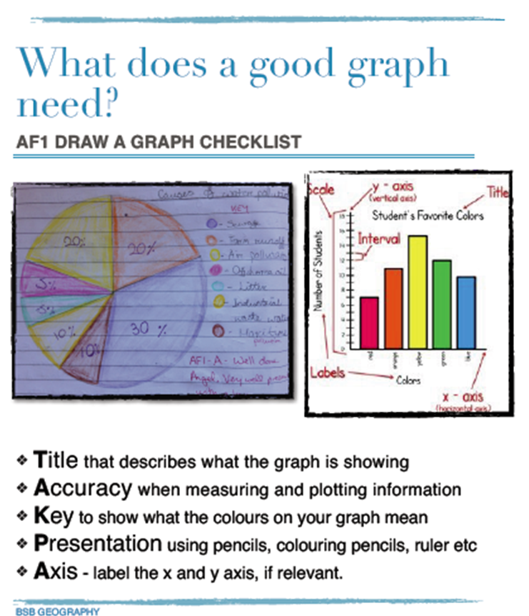
Data Presentation
Create 3 graphs to show the information.
'A' grade enquirers will have 3 different graphs and located on a map (spatially).

Slide 9
Analysis
Describe your graphs.
Explain the data.
For example, why is the birth rate in Mongolia higher than Saudi Arabia and Azerbaijan?

Slide 10
Conclusion
Is your hypothesis correct?
The hypothesis, is correct/ incorrect because…
Answer the title question, supported with data and place names.

Slide 11
Evaluation
Are your results accurate and reliable?
What about your source?
What could you do to improve your results?

