Slide 1
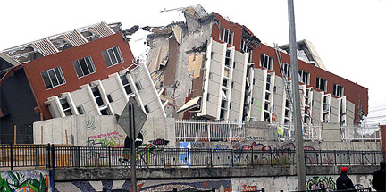
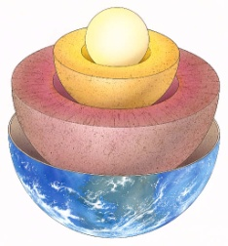
What is an Earthquakes?
AF6 · explain the formation of landforms/processes
AF6 · explain the impacts from processes/events

Slide 2
Starter
View this website of the most recent earthquakes.
http://earthquaketrack.com/
Where is the nearest to here and/or your home country?
Which is the strongest?

Slide 3
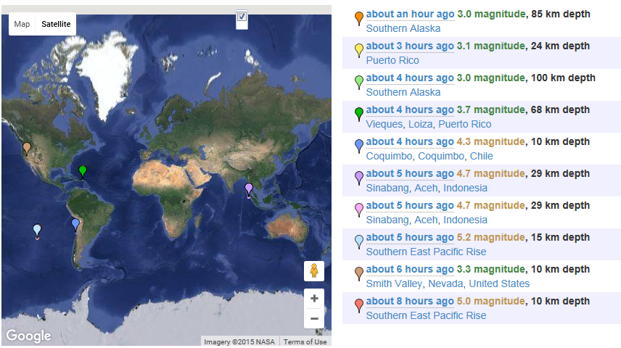
So what do these mean?
What kind of damage would magnitude 3 do?

Slide 4
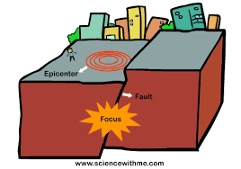
The depth is how far underground the start of the earthquake, this is called the focus.
The epicentre is centre of the earthquake on land.
Would a small depth make the earthquake stronger or weaker?

Slide 5
On which of these boundaries would we have earthquakes?
ALL of them
These would have the worst. Name the plate boundary?

Slide 6
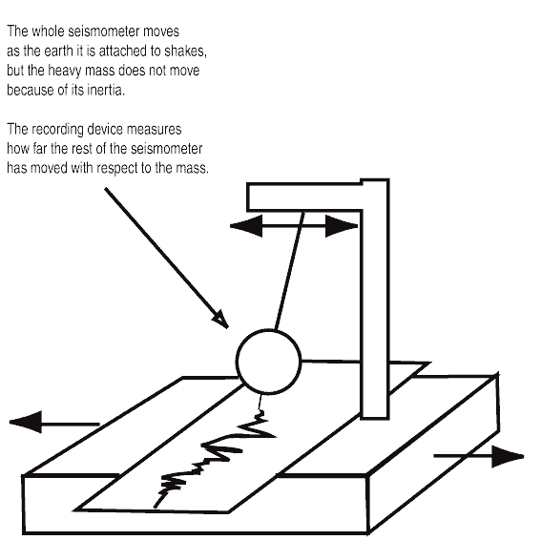
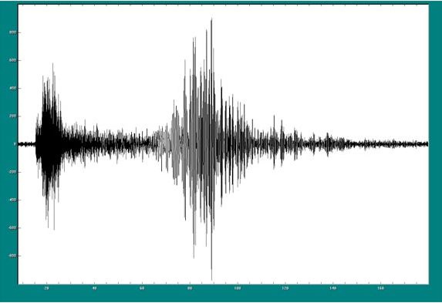
Measuring Earthquakes
COPY: Earthquakes are measured using an instrument called a seismometer and it is shown on a seismograph.
Try the seismometer app!

Slide 7
Was this a bad earthquake?
The strength of an earthquake is measured by how much damage it causes.
COPY: It is measured using the Richter Scale.
On a scale of 1-3 there is only minor damage
On a scale of 4-6 buildings are damaged,
On a scale of 7-9 there is major structural damage.
The Asian Tsunami 2004 was 9.1
Was this a bad earthquake?

Slide 8
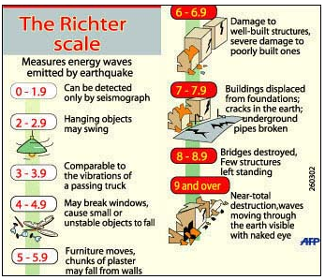

Slide 9
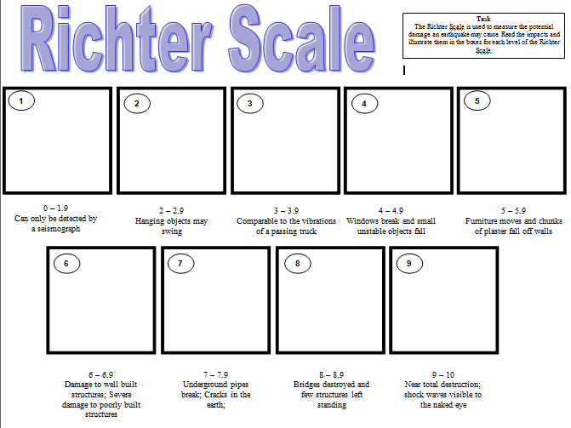
Draw sketches in the boxes to match the descriptions.
2 is 10 times stronger than 1
3 is 10 times stronger than 2
And so on…

Slide 10
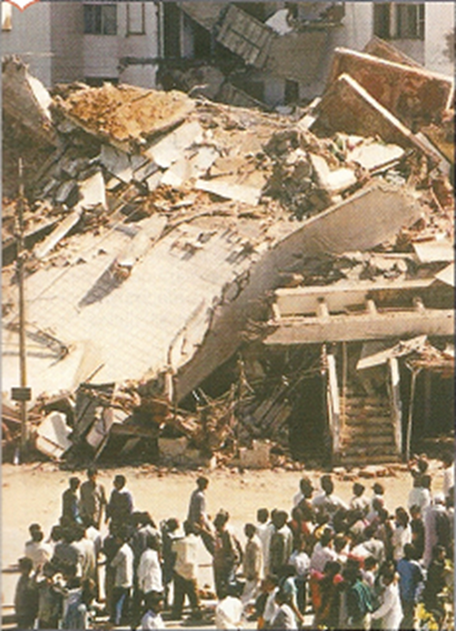
Gujarat, India
2001, 7.9 on the Richter
Scale.

Slide 11
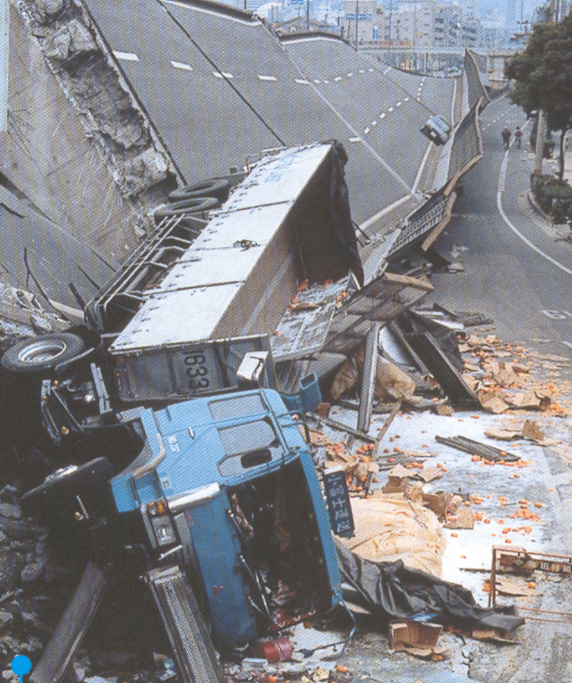
Guess the magnitude?
Kobe January 17th
1995, 7.2 on the Richter
Scale.

Slide 12
https://www.youtube.com/watch?v=hYGig_-xdPM
Kathmandu, Nepal April 25th
2015, 7.8 on the Richter
Scale.

Slide 13
https://www.youtube.com/watch?v=pmxX-QU-JDY
Haiti, 12 January 2010, 7.0 on the Richter Scale.
Why might the damage be different even though the strength of the earthquake is the same?
Notes:
Depth of the focus, distance from the epicentre, the quality of the buildings

Slide 14
Plenary
What scale is used to measure the strength of earthquakes?
What is meant by focus and epicentre?
Why do you think it is difficult to prepare for an earthquake?
Earthquakes and Volcanoes

