Slide 1
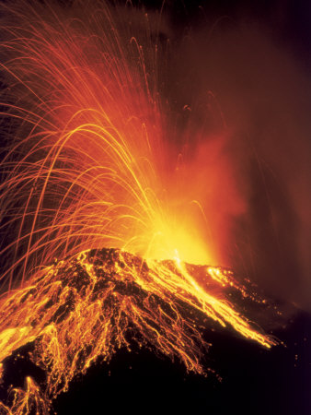
What is a volcano?
AF1 - add labels onto sketches
AF 2 - Show height using contours

Slide 2
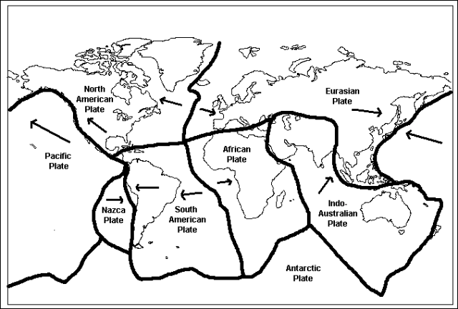
Starter: Is your home country near one of the black lines?
Review: What type of boundary is between the South American and the African? Nazca and the South American?.

Slide 3
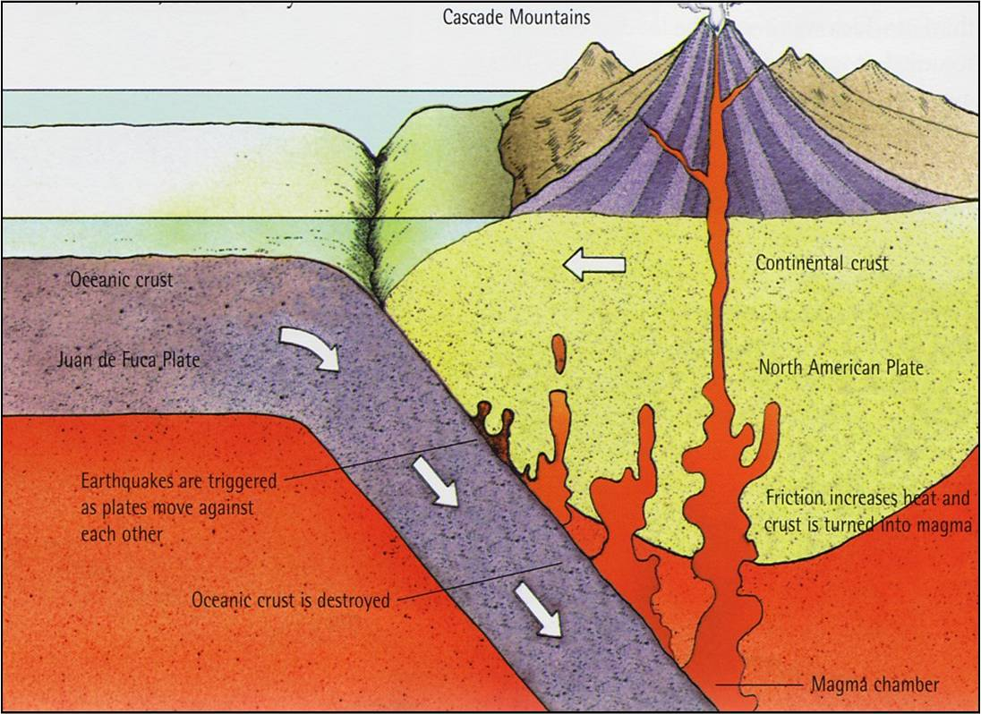
What plate boundary is this?
Oceanic crust is heavier than continental crust, so is pushed down. The rock of the crust then begins to melt as it is forced down. As it becomes molten (magma) it rises towards the surface to form a volcano.

Slide 4
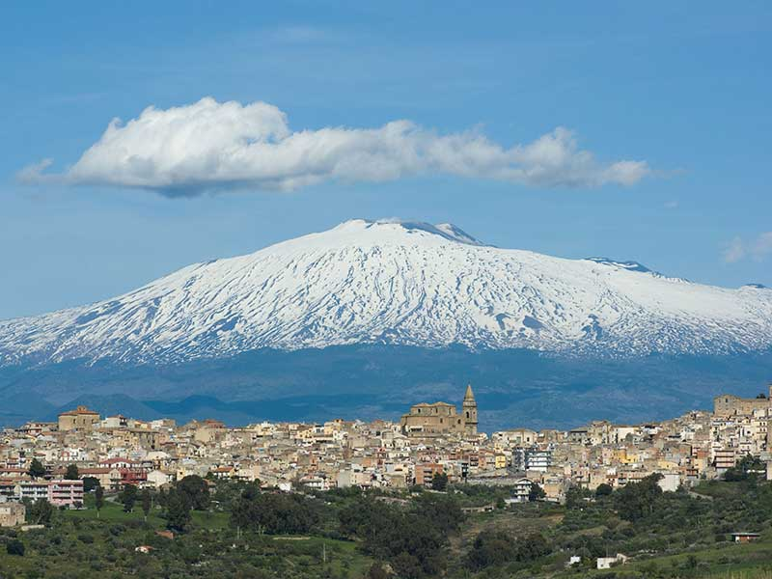
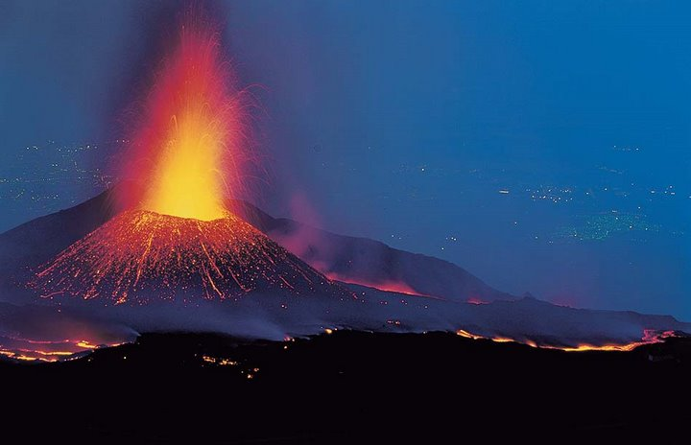
Mt Etna, Italy
https://www.youtube.com/watch?v=J2cy7scfloU

Slide 5
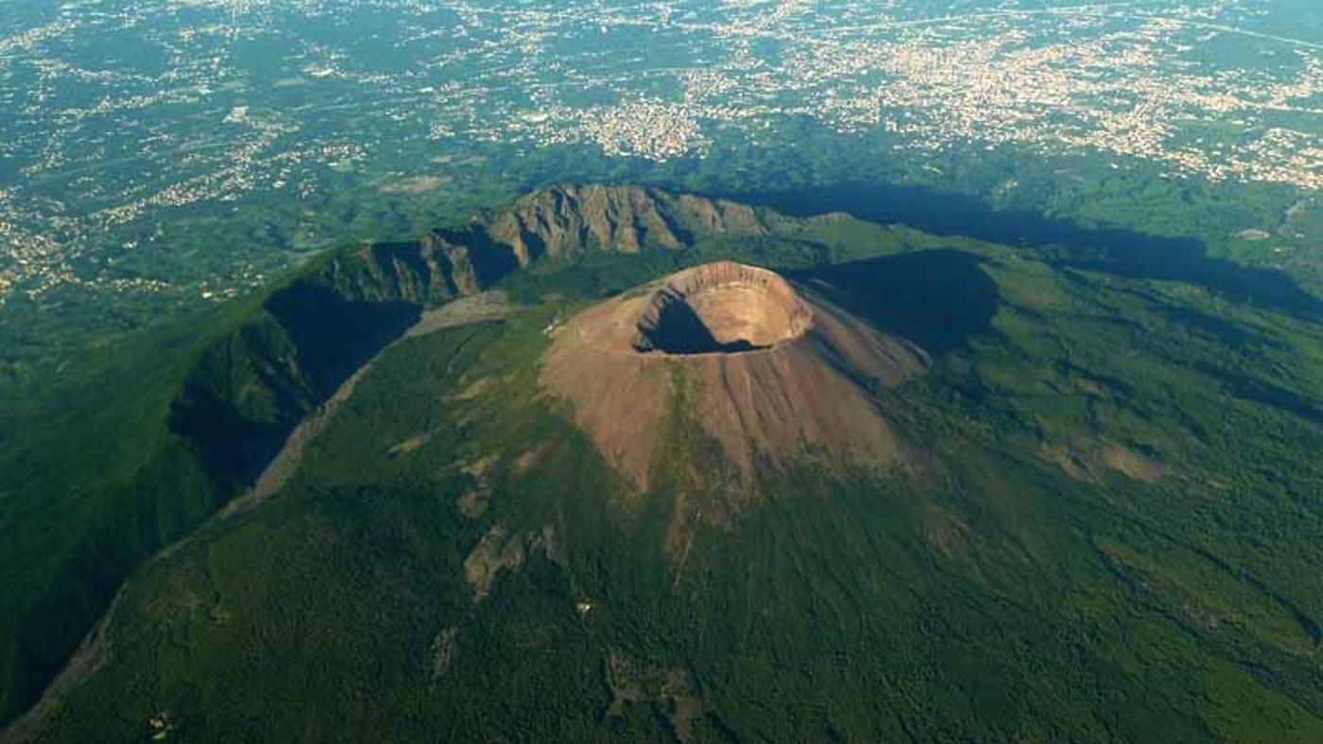
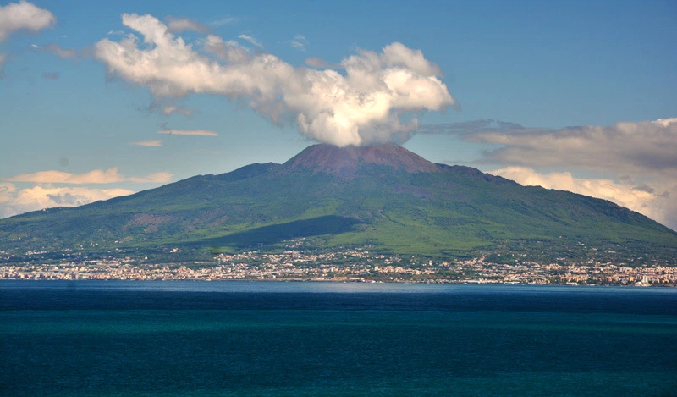
Mt Vesuvius (last erupted in 1944 but famous for erupting in 79AD and burying Pompeii)
https://www.youtube.com/watch?v=1bsmv6PyKs0
Watch a few minutes of this

Slide 6
Are we getting more volcanoes?
Year (decade) | Number of volcanoes
1950 | 50
1960 | 58
1970 | 56
1980 | 65
1990 | 55
2000 | 67
2010 | 70
AF1: Draw a graph to show this data.
What does a good graph need?

Slide 7
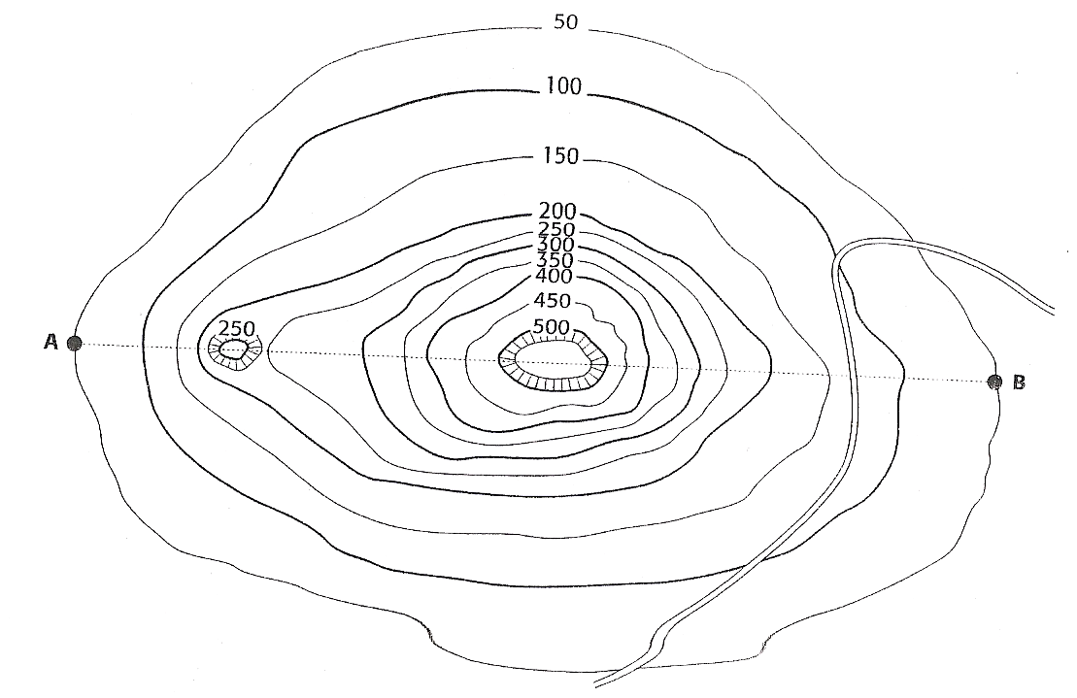
Volcano Cross Section (side view)
Volcanoes on this boundary are fairly small compared to the other types of volcano, but it is tall with steep sides. You will create a cross section of this volcano to illustrate this.
What is the name of the lines that show height?

Slide 8
Use your diagram, a strip of paper and the instructions on the next slide to help you.

Slide 9
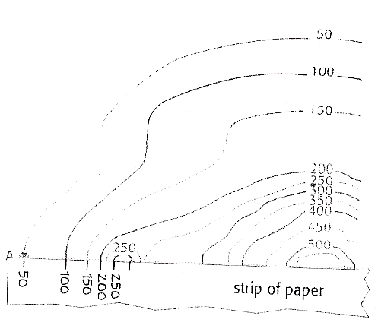
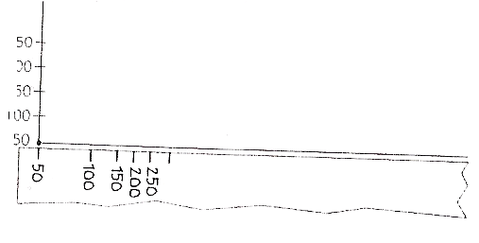
The line AB passes straight through the centre of the volcano.
Here you are going to draw a cross section of the volcano.
Take a strip of paper 20cm long and 2 cm wide
Place it along the line AB
Mark the strip each time it touches a contour line and write the height under your mark
Place the strip onto the axis
Transfer the points onto the appropriate height and join the dots

Slide 10
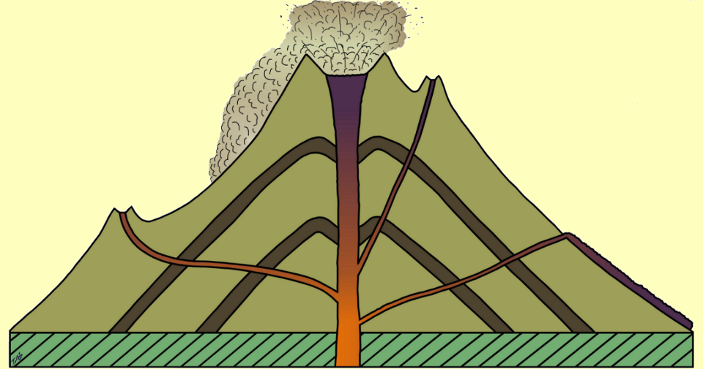
Add this information onto your sketch
Composite Volcano
Example: Mt Etna, Italy
The volcano is built up of alternate layers of LAVA and ASH.
Crater
Pyroclastic Flow
Ash layer
Secondary Vent
Lava Layer
Secondary
Cone
Lateral eruption
Lava
Flow
Vent
Crust

Slide 11
PLENARY: Volcanoes can be active, dormant or extinct:
Active. If a volcano has erupted recently and it is likely to erupt again, it is described as active.
Dormant. Volcanoes that have erupted in the last 2,000 years, but not recently are said to be dormant or sleeping.
Extinct. Many volcanoes are dead and there volcanic activity is finished. These are called extinct.

Slide 12
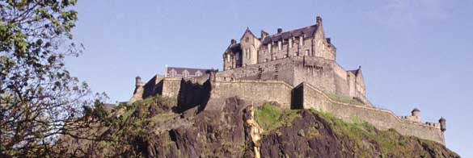
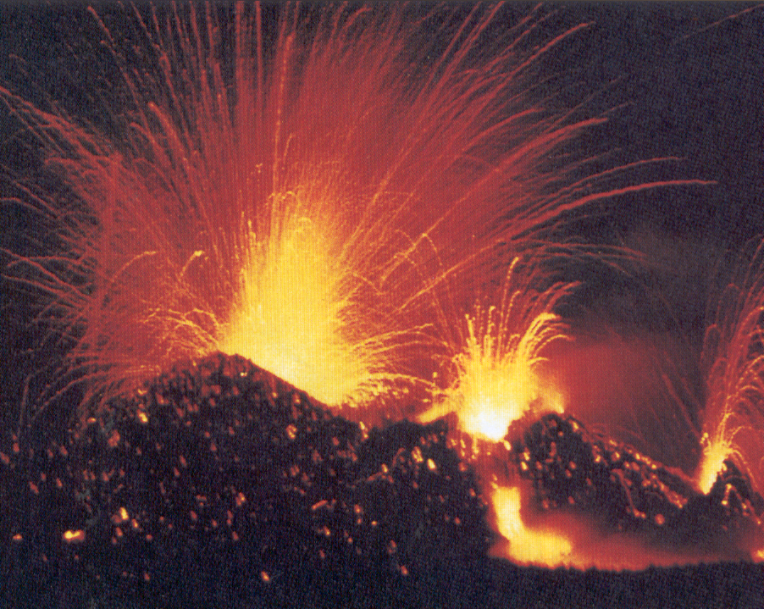
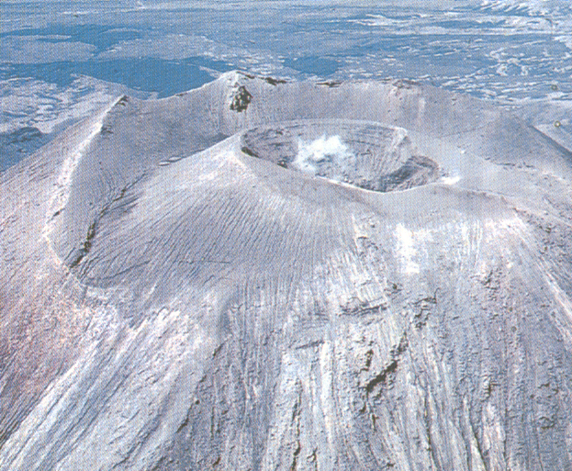
Which of these volcanoes are active, dormant and extinct

