Slide 1
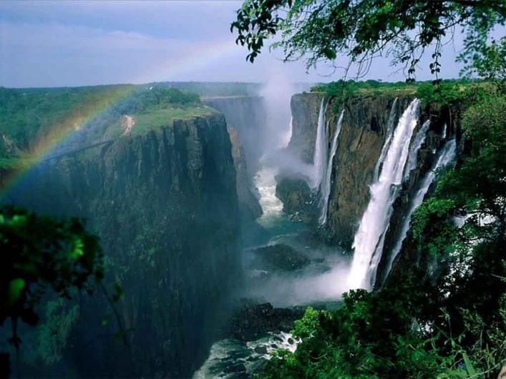
How did Victoria Falls form?
AF1 – to annotate a diagram of a waterfall

Slide 2
Flipped Starter Questions
What is the name of the world’s tallest waterfall?
How tall is it?
What is ‘crucial’ to the formation of waterfalls?
What is formed when a waterfall retreats?
Flipped homework questions – on the mini whiteboards, divide it into quarters and write the answers to the following questions

Slide 3
Answers
Angel Falls 979m
Hard and soft
rocks gorge

Slide 4
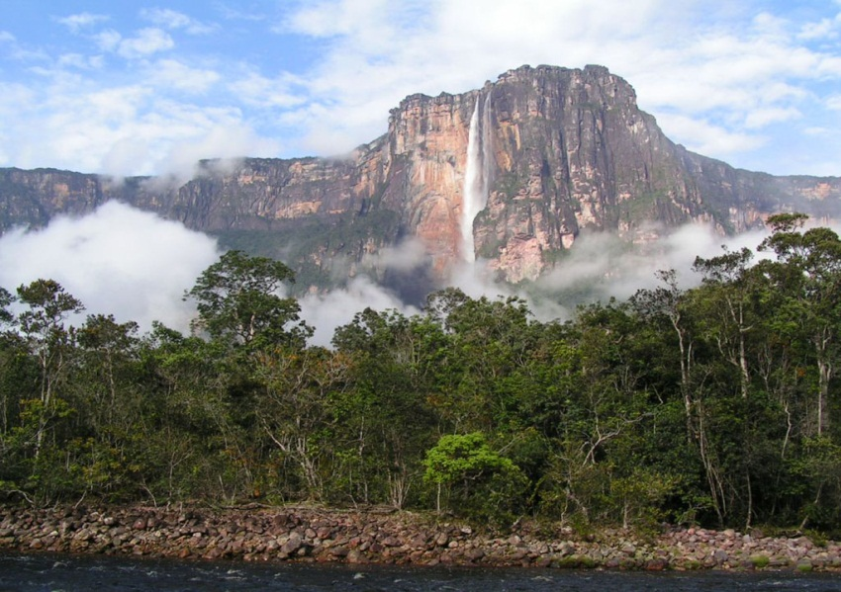
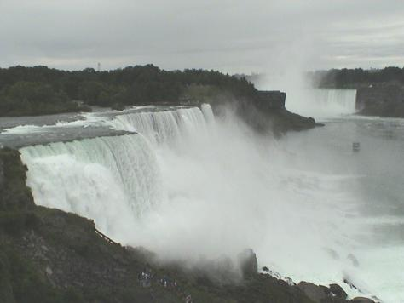
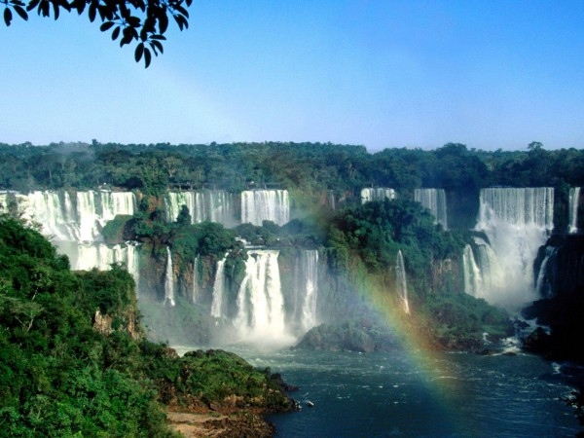
A
Angel Falls, Venezuela
Iguazu Falls, Brazil
C
Niagara Falls, USA
Victoria Falls, Zimbabwe
B
D
A
C
D
B

Slide 5
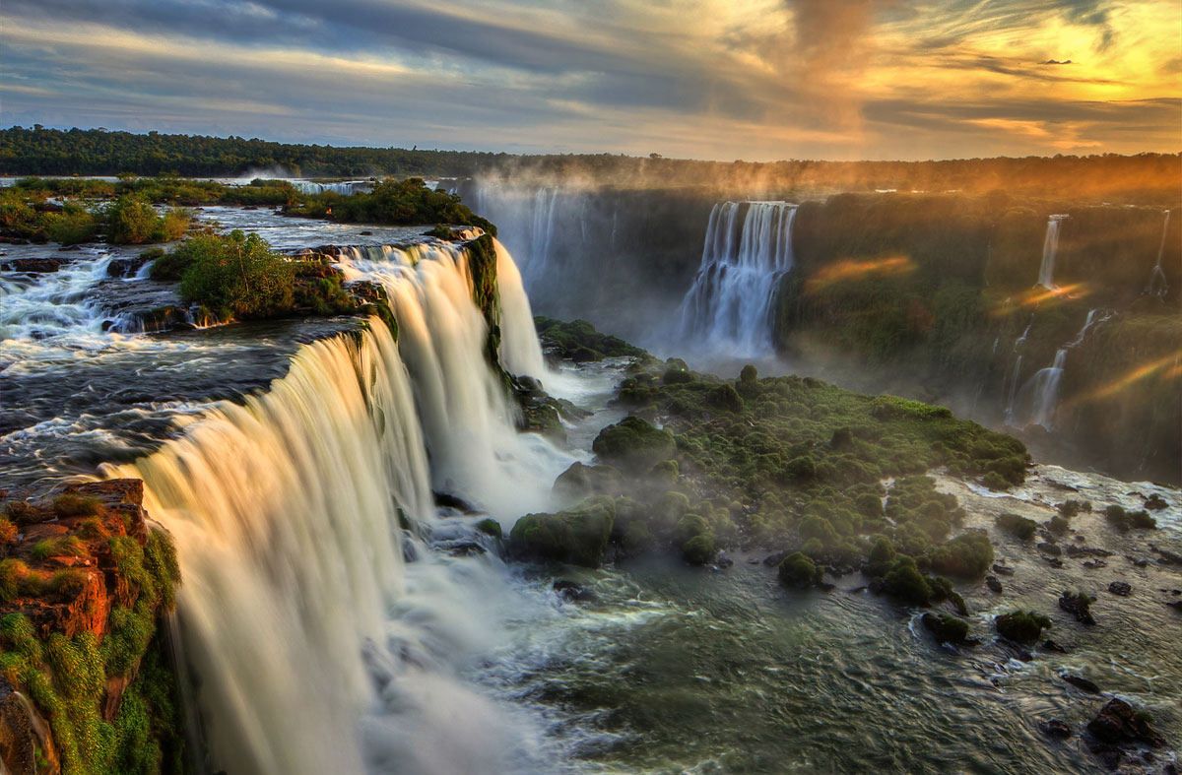
COPY: A landform is a feature that has been formed by natural processes e.g. waterfalls.
Can you name any others?
This is a landform –
VICTORIA FALLS

Slide 6
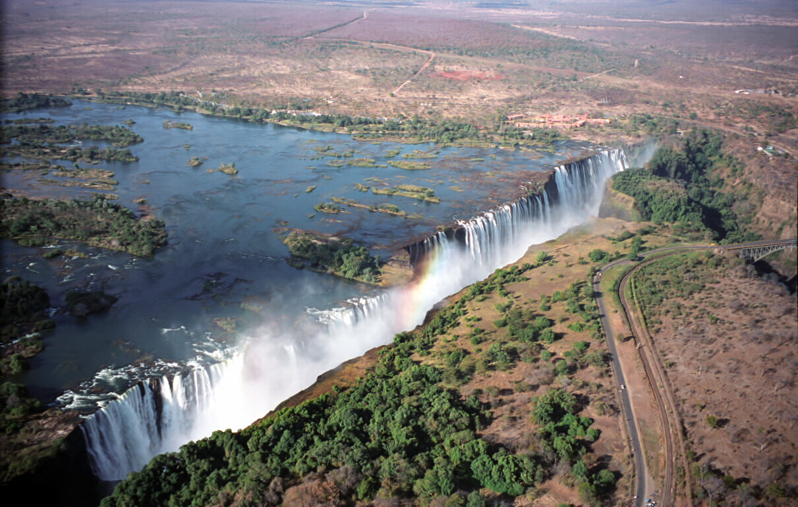
VICTORIA FALLS

Slide 7
Make a model of Victoria Falls!
Your book
A template
A stick of glue
Scissors
Pencil crayons
A pen
You will need

Slide 8
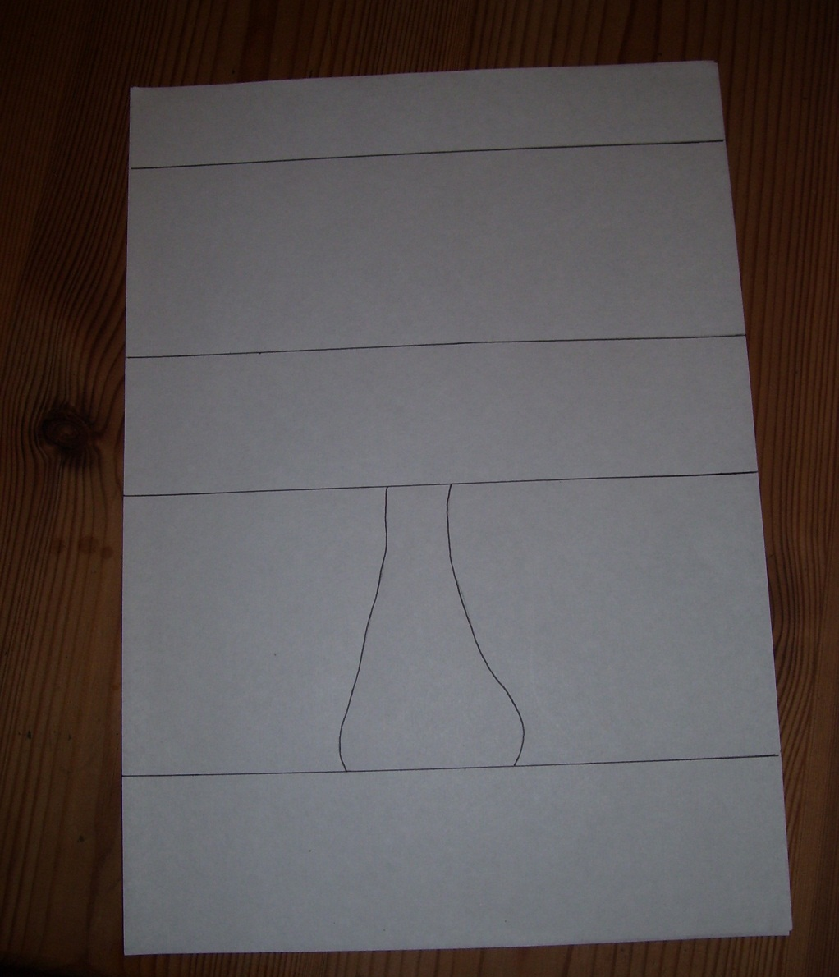
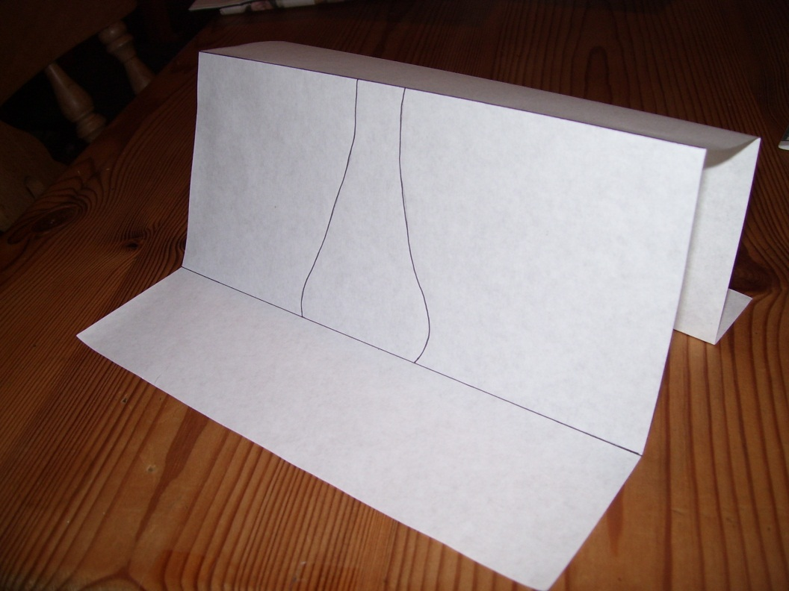
Fold along all the horizontal lines.
step 1

Slide 9
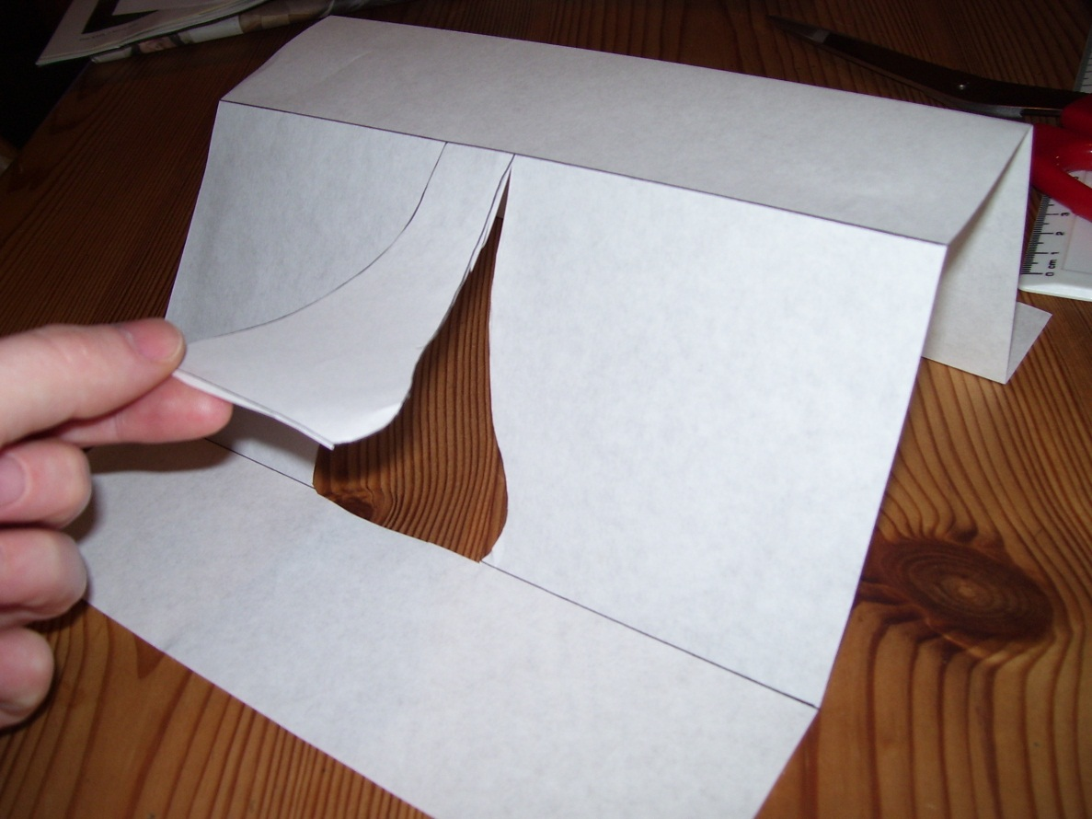
Using a scissors carefully cut out the section.
step 2

Slide 10
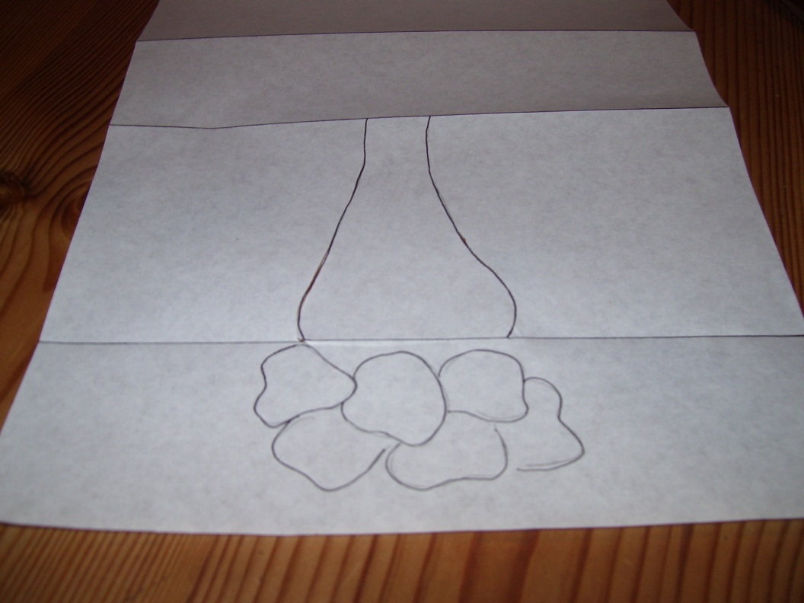
Using a pencil draw in rocks below the flap you have just cut out.
step 3

Slide 11
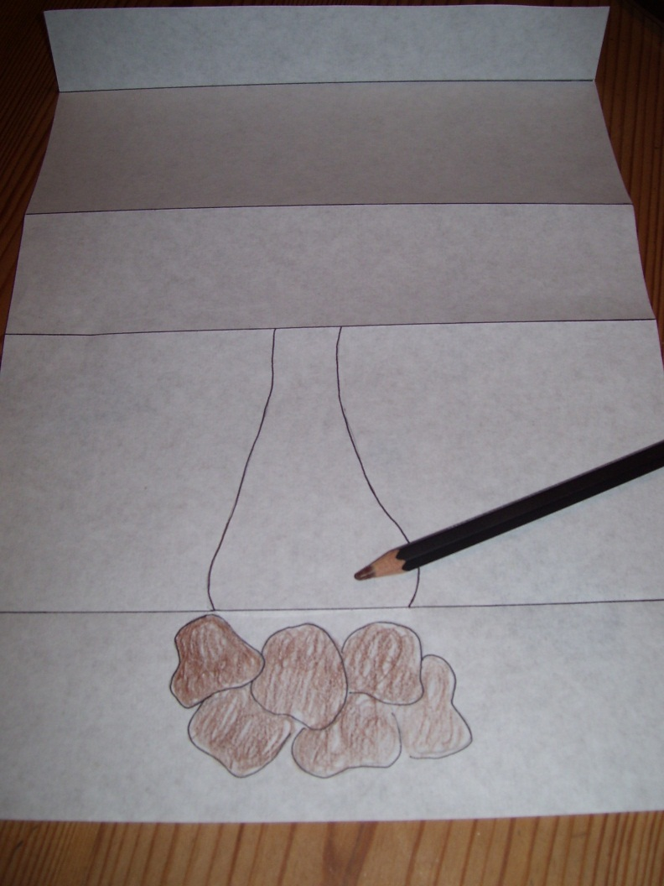
step 4
Using a pencil, colour in the rocks.

Slide 12
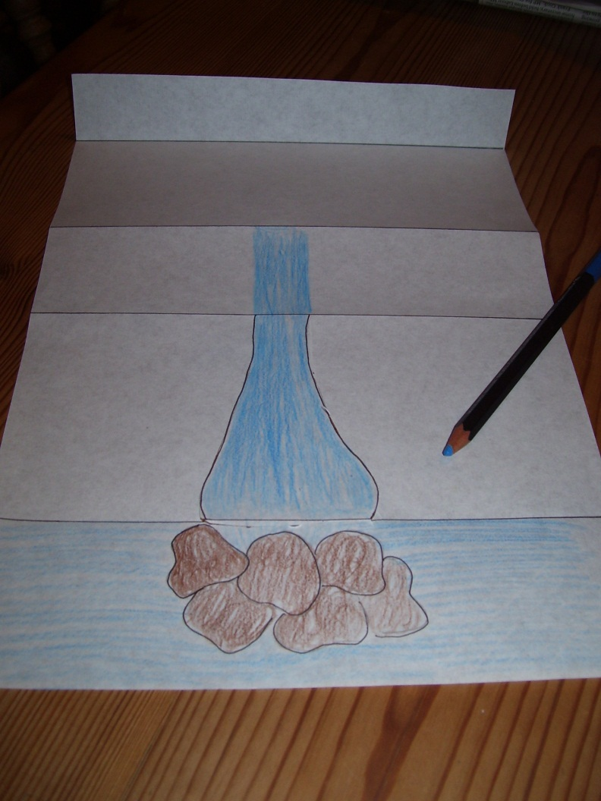
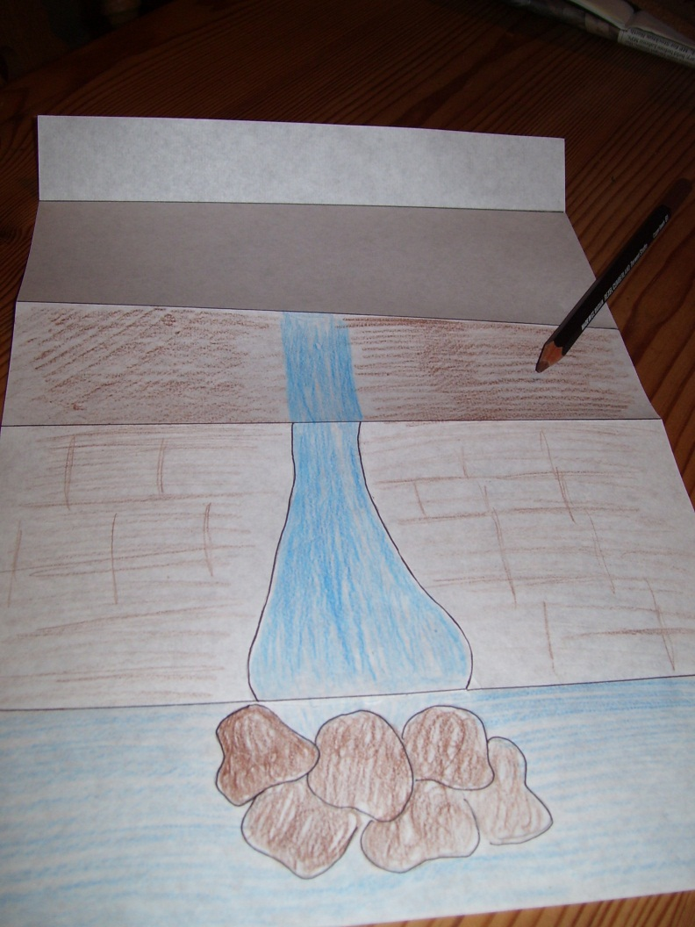
Colour in the remaining water and the surrounding rock.
Label the river the ZAMBEZI
step 5
Hard rock
Soft rock

Slide 13
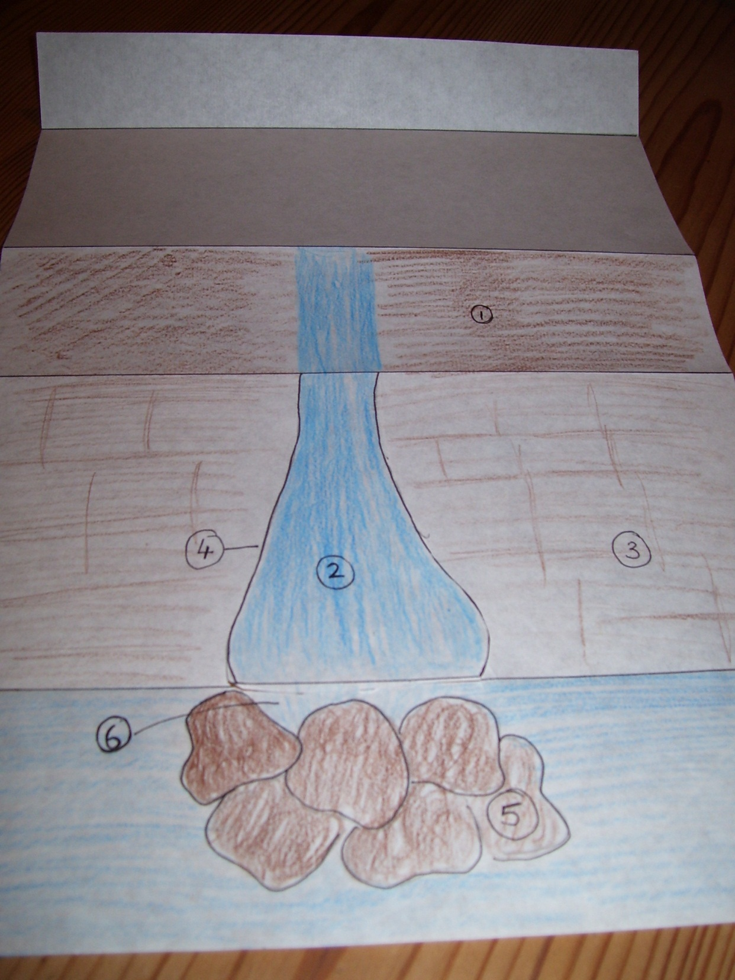
step 6
You will now need a pen. Number the following features on your template.

Slide 14
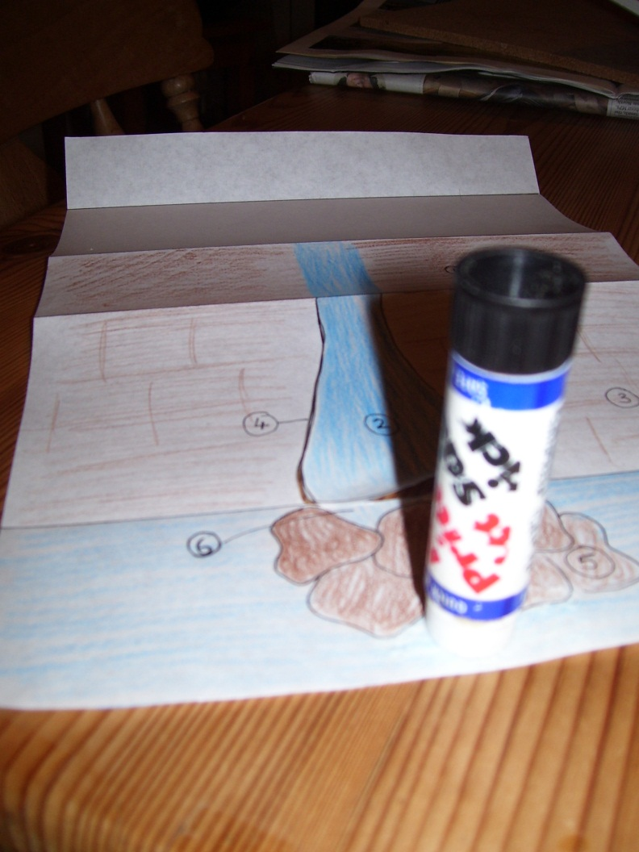
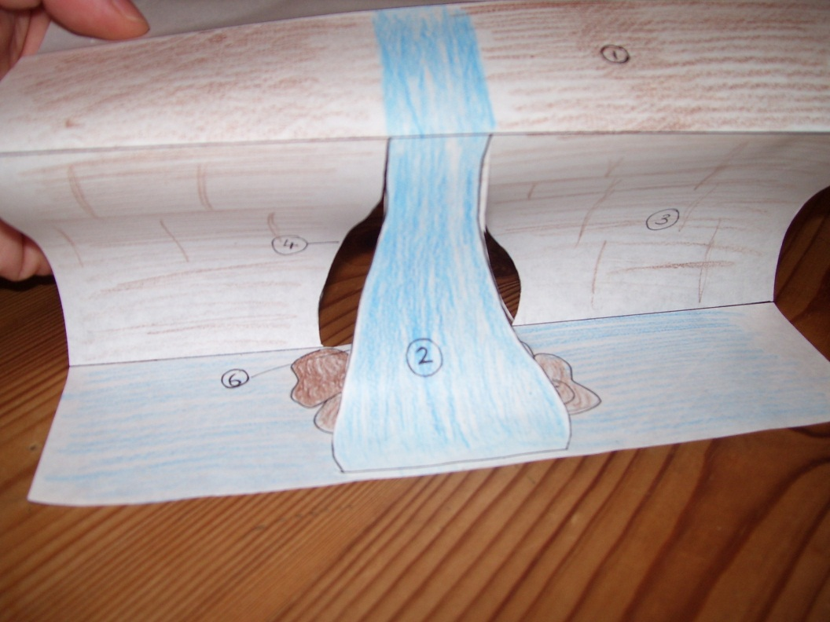
Stick the waterfall to the end of the paper.
step 7

Slide 15
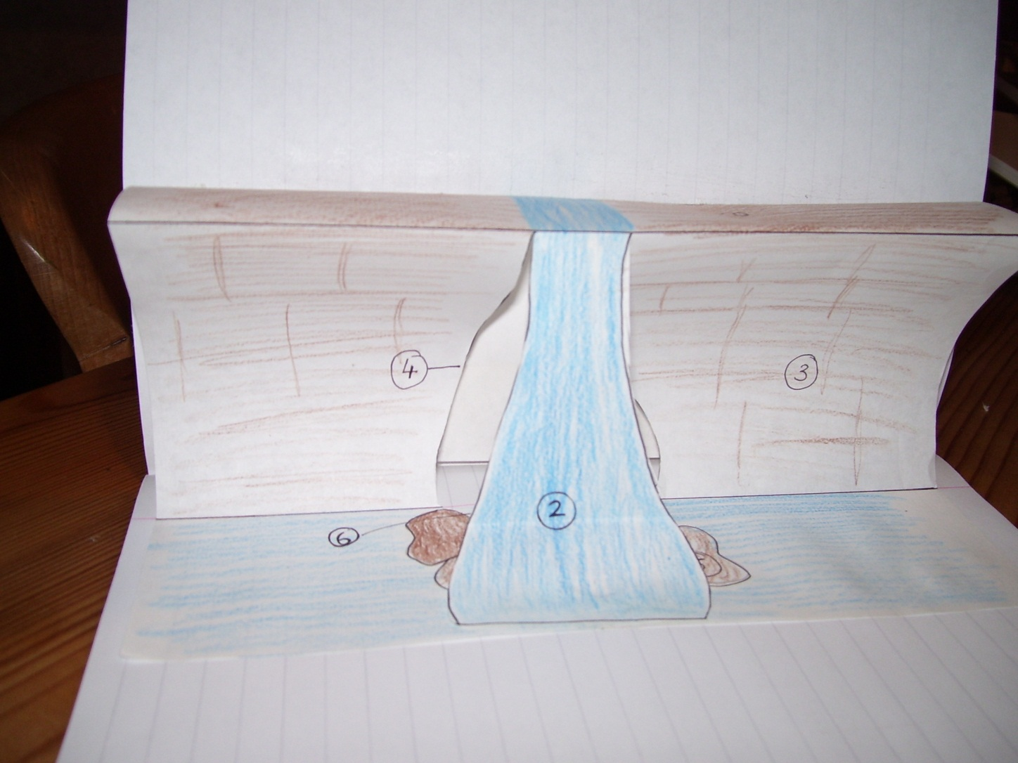
Open your book to a double page. Place the model over the centre of the page. Glue the base to the right page and the back to the left page.
step 8

Slide 16
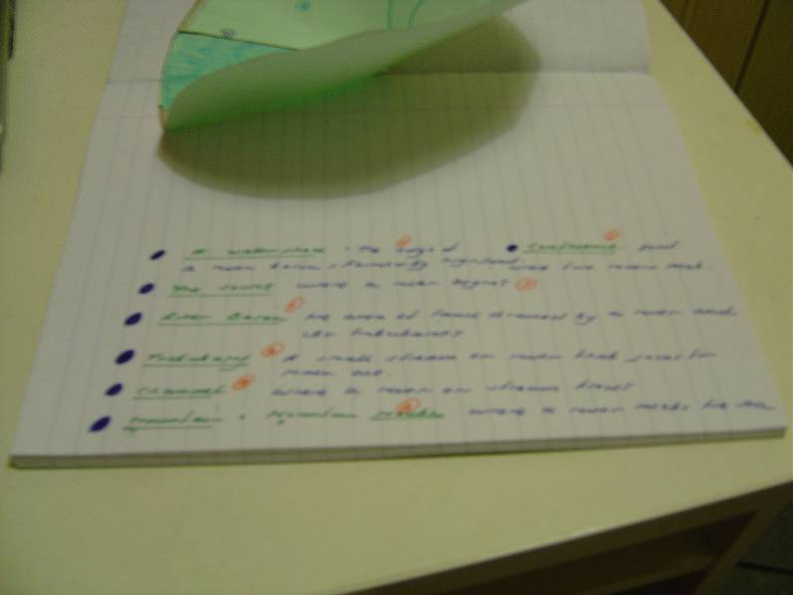
step 9
Hard Rock: This rock is resistant (basalt) so over time a ledge develops.
1
Give your diagram the title ‘Victoria Falls’. Write neatly the numbers and corresponding definitions into your book.
Waterfall: where the water tumbles over the ledge.
2
3
Soft Rock: This rock (sandstone) is easier to erode and undercuts the hard rock.
4
Gorge: The waterfall cuts its way up the valley.
5
Fallen Rocks : When the ledge collapse it falls into the plunge pool.
6
Plunge Pool: Here the debris speeds up erosion.

Slide 17
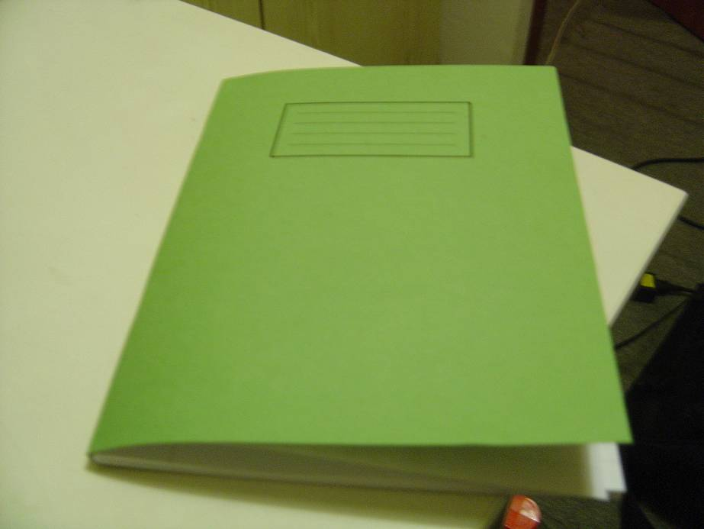
Close your book!
step 10

Slide 18
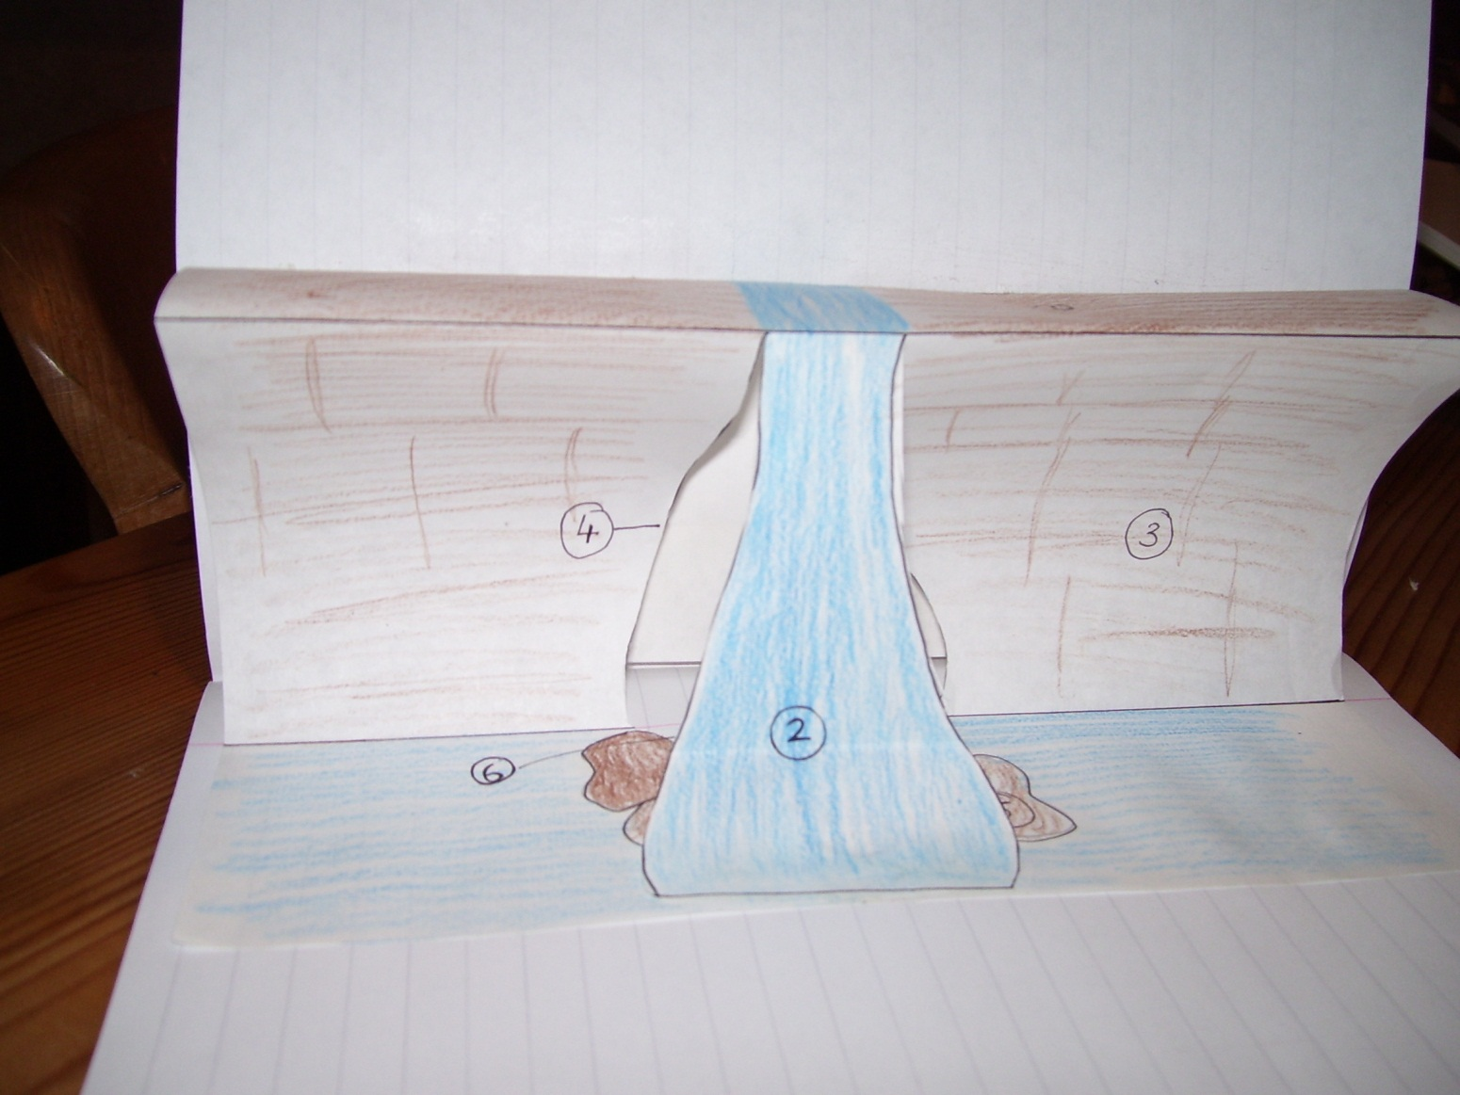
step 10
Open your book!

Slide 19
Watch the video clip..
See if you can recognise any of the features you have just labeled.

Slide 20
Plenary
Write a recipe to explain how to make a waterfall.
Think about the ingredients you will need and then the steps that you need to follow, e.g.
Ingredients : Soft rock
Method : Take one layer of soft rock and place a layer of

Slide 21
Here’s one I made earlier…
Ingredients : Soft rock, hard rock, river
Method : Take one layer of soft rock and place a layer of hard rock over it. Allow river to run over top until it creates a crack. Allow river to erode soft rock until plunge pool and large overhang created - allow overhang to collapse. Repeat process for 1000's of years until large gorge formed

