Slide 1
Why is Death Valley so hot?
AF1 - add detailed annotations onto sketches
AF3 - describe the features of landforms/processes (deserts).
AF4 - explain the formation of landforms/processes heat in Death Valley

Slide 2
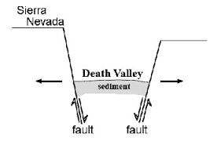
Reason 1: Low Land Reason 2: Wind direction
Wind
It is an area of low land, 86 metres below sea level, surrounded by mountains.
It is low because of two fault lines either side of the valley, causing it to drop.
Also the wind travels across the top , from west to east) and does not cool the air in the valley.

Slide 3
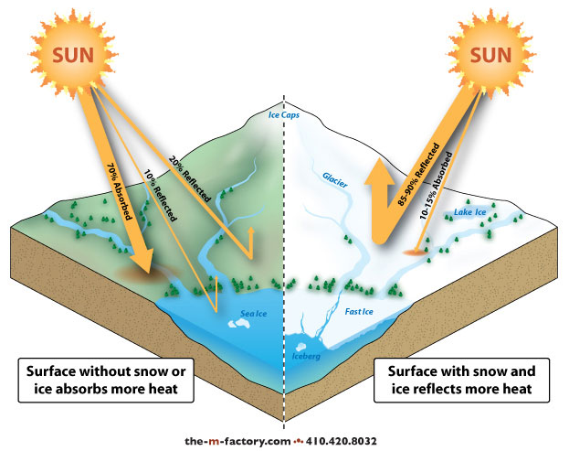
Reason 3: Albedo Effect
There are not many plants, so the bare soil absorbs the heat and does not reflect it away. Light surfaces like ice reflect lots of sun, therefore stay cool.

Slide 4
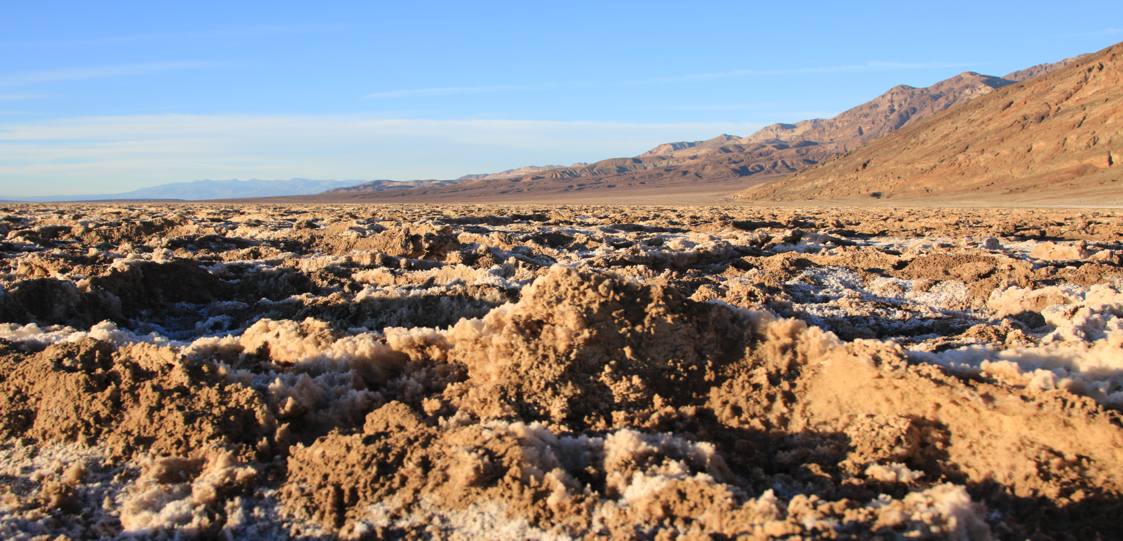
Reason 4: Humidity
Humidity is the amount of water in the air.
Without water and plants (which hold water) the air is very dry, this means that dry air is much easier to heat up than humid air.

Slide 5
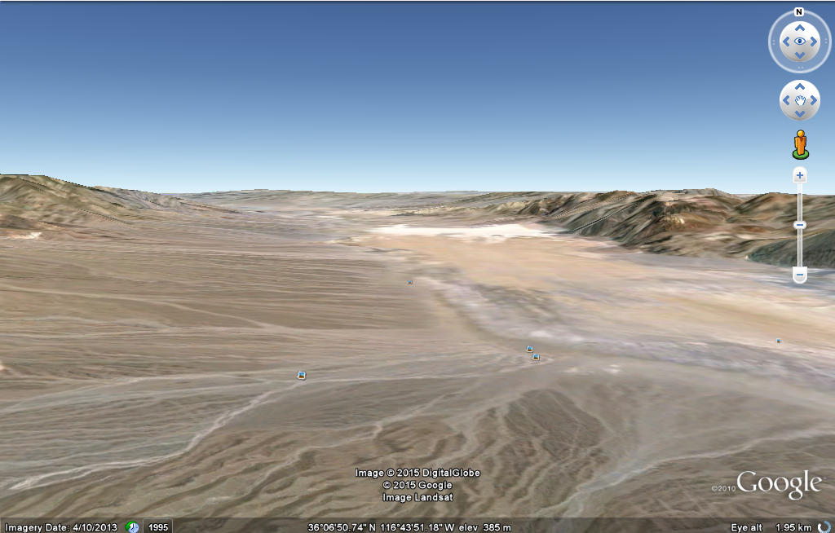
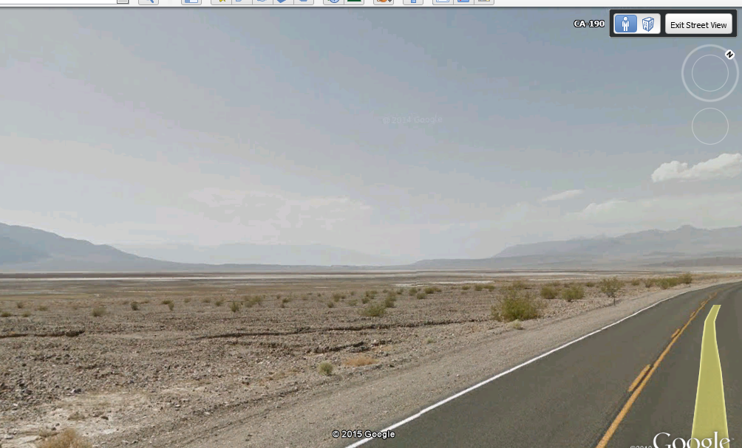
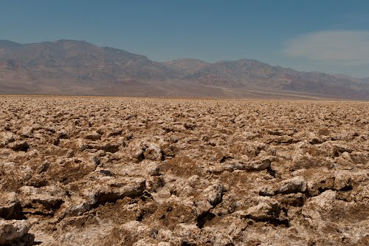
Google Earth View

Slide 6
Why is Death Valley so hot?
https://www.youtube.com/watch?v=YLOx81cHSY8

Slide 7
What does explain mean?
Connectives
Because
Therefore
Consequently
As a result
Thanks to this
Because of this
This causes
So
The reason that
This results in
When
BECAUSE
Explain means you should give reasons to say why.
Try and use a connective to develop your answer.

Slide 8
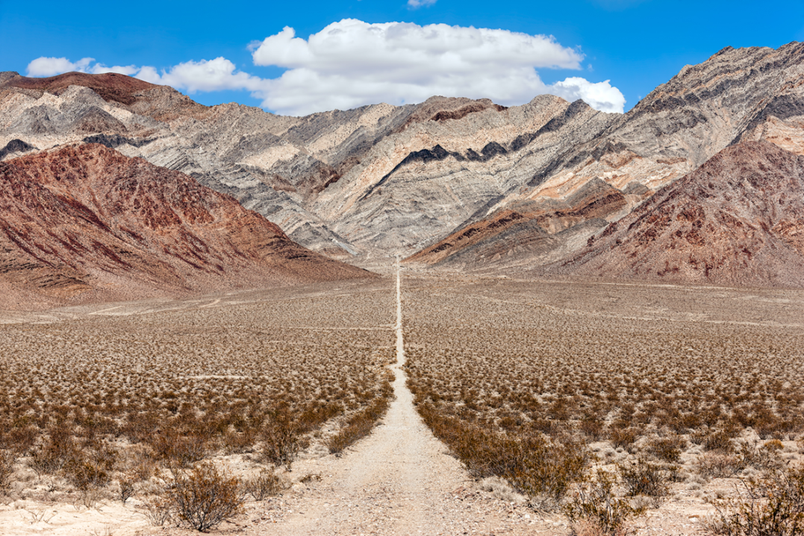
Task
AF2 - add detailed annotations onto sketches
AF6 - explain the formation of landforms/processes heat in Death Valley
Draw a sketch of Death Valley
Add annotations to explain why Death Valley is hot (remember the 4 reasons – low land, wind direction, albedo, humidity)
REMEMBER THE CONNECTIVES

