Slide 1
What is Japan doing to secure its future energy?
AF1- Draw graphs accurately with the data provided
AF3 – Describe patterns in graphs
AF5- evaluate the advantages and disadvantages of a solution
AF4- explain the justification for the choice of management strategy

Slide 2
Create a pie chart
Energy source | Usage (%)
Coal | 25
Natural gas | 17
Nuclear | 13
Oil | 40
Hydro | 4
Other renewables | 1
Draw a circle with a compass.
Draw a line from the centre to the top.
Multiply the % by 3.6 to get the angle in degrees.

Slide 3
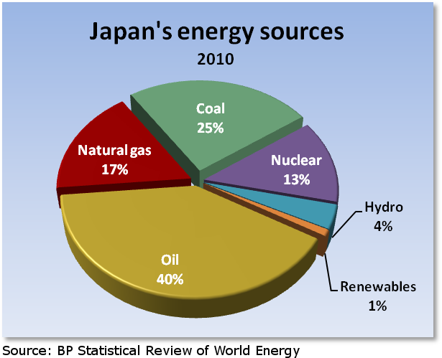
Describe Japan's energy sources.
A better answer would manipulate data e.g. 10 times more oil is used than hydro, a quarter is from coal.

Slide 4
Why does Japan need to import so much?
Why would Japan aim to increase its use of nuclear power?
Japan is the world's largest liquefied natural gas importer, second-largest coal importer, and third-largest net importer of crude oil and oil products.
The country relies almost solely on imports to meet its oil consumption needs because Japan's oil resources are very limited.

Slide 5
Japan considers energy future after Fukushima
March 13, 2014 at 6:18 PM EST
A disaster at the Fukushima Daiichi nuclear power plant on March 11, 2011, has greatly affected how Japanese citizens feel about that energy source. Polls suggest that 80 percent of voters now oppose nuclear power in Japan. But walking away from nuclear power is a tricky proposition for a country that has not invested much in renewable alternatives. Science correspondent Miles O'Brien reports.

Slide 6
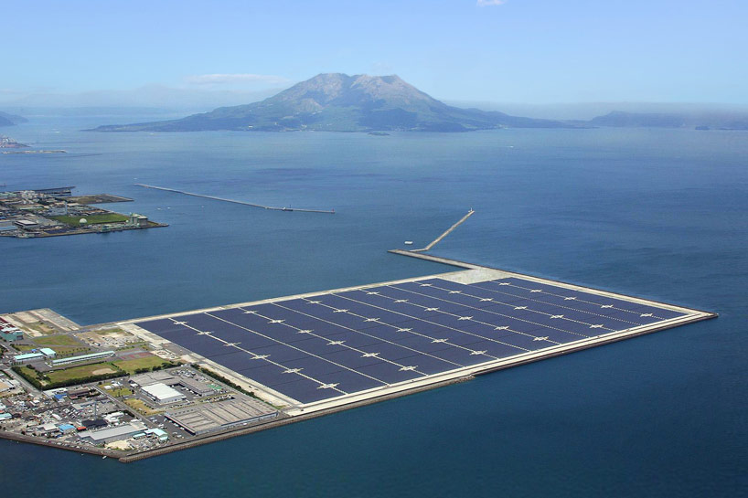
Better answer would consider Japan’s situation.
What are the advantages and disadvantages of this solution?
Offshore solar

Slide 7
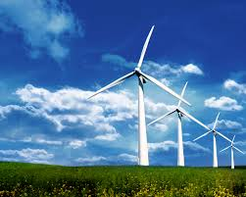
Wind
What are the advantages and disadvantages of this solution?

Slide 8
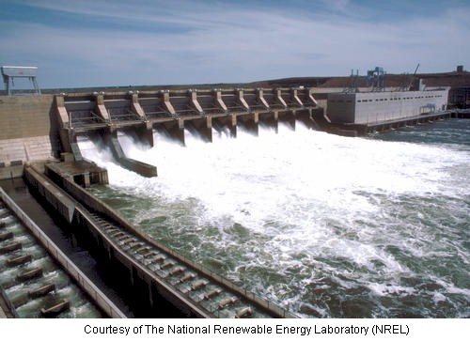
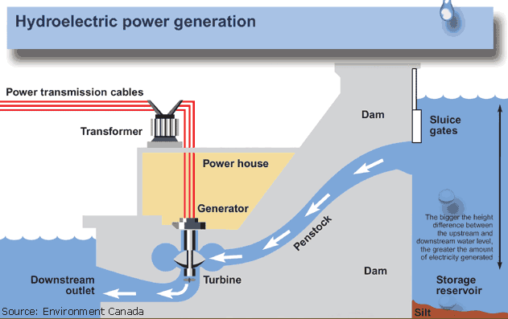
Hydro Electric Power (HEP)
What are the advantages and disadvantages of this solution?

Slide 9
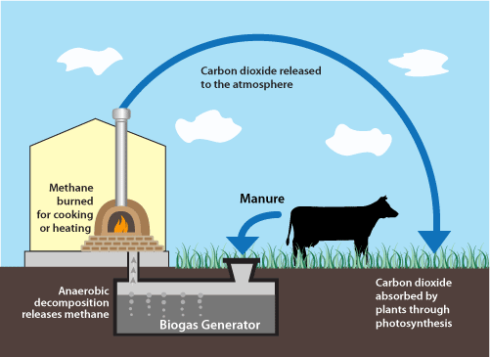
Biogas
What are the advantages and disadvantages of this solution?

Slide 10
What are the advantages and disadvantages of this solution?
Meanwhile, the Shimizu Corporation has presented plans for the ultimate offshore power plant: solar panels encircling the Moon’s equator that would transmit energy to Earth via microwaves and lasers. The company claims this project could provide up to 13,000 terawatts of electricity per year—more than three times what the U.S. produces. And as an added bonus, nobody would ever have to worry about cloudy days.
Read more: http://www.smithsonianmag.com/innovations/Is-Japans-Offshore-Solar-Power-Plant-the-Future-of-Renewable-Energy-180949453/#uFueLi28O85BMuDg.99

Slide 11
Plenary - what solution would you recommend and why?
Water
Wind
Solar
Space solar
Biogas

