Slide 1
Have my jeans travelled more than me?
AF3 - identify symbols using a key
AF3 - plot data onto maps
AF4- describe how landforms/events/impacts/processes occur
Cotton production

Slide 2
STARTER: List what you need to make a pair of jeans
To make a pair of jeans you will need:

Slide 3
The jeans (cotton) making process.
https://www.youtube.com/watch?v=weOva0gsnxY complete this flow diagram using this link.
COTTON
Takes 6 months to grow
Adds:
F………..
I………….
H……….. to help them grow
At the factory…………
……. litres of water, ….. kg of carbon dioxide are used and released for every pair of jeans.
They are made into jeans and
w……..,
s…….. or
r……. to give them a distressed look.
In 2009, …………...million pairs of jeans were to Australia.

Slide 4
What is the message behind this video?
How often do you throw out clothing?
Did you realise how far your clothes travel before they get to you?

Slide 5
The jeans were designed in the USA by an American jeans company
The denim is made from cotton grown in Kazakhstan
The denim cotton was woven and dyed in Italy
The zip was made in France by a Japanese company
The teeth of the zip use brass wire made in Japan
The dye used to dye the cotton denim was made in Germany
The copper for the brass came from Namibia
The buttons are made of brass (a mixture of copper and zinc) which was made in Germany
The zinc for the brass came from Australia
The jeans were sent by truck to Abu Dhabi
The jeans were sent by truck to the UK
The denim was sent by sea to Tunisia, where it was made into jeans
The jeans were stonewashed using lumps of pumice stone from an extinct volcano o in Turkey
The jeans were sent by sea to France
The jeans were shipped from the UK to Dubai in the UAE
The jeans ended up in a shop in Yas Mall
Some of the he thread was made in the UK
The fibre in the polyester thread came from oil imported from Kuwait
Some of the he thread was made in Turkey
The polyester fibre for the thread was made in Japan
Some of the he thread was made in the Hungary
The thread was dyed in Spain

Slide 6
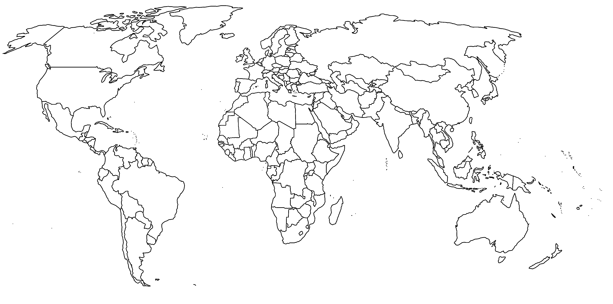
Paired task – Mapping.
Using the cards, map the movement of a pair of jeans around the world.
Use symbols to help show this movement effectively.
In your books, you should have a paragraph to describe the movement of the jeans and how far they have travelled and the modes of transport that are used.
What are the advantages and disadvantages of producing jeans like this?

Slide 7
So, have your jeans travelled more than you?
PLENARY
How many countries have you visited?
What about the jeans?
Revisit your list from the starter, what can you add now?

