Slide 1
Living in Antarctica today.
AF1 – to graph the climate or tourists in Antarctica
AF4 – to explain how people live and work in Antarctica

Slide 2
Starter: Has Antarctica always been cold?
http://discoveringantarctica.org.uk/activities/going_back_in_time/activity.php

Slide 3
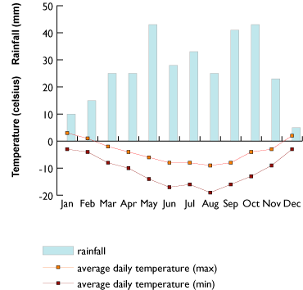
AF1 – Use this data to create a climate graph of Antarctica or tourism numbers (slide 6)

Slide 4
AF3 – Climate graph of Antarctica
EXTENSION TASK
Describe the graph (include the pattern and data)

Slide 5
How many people live in Antarctica?
About 1,200 people spend the winter on Antarctica – about a third are scientists and the rest are support staff.

Slide 6
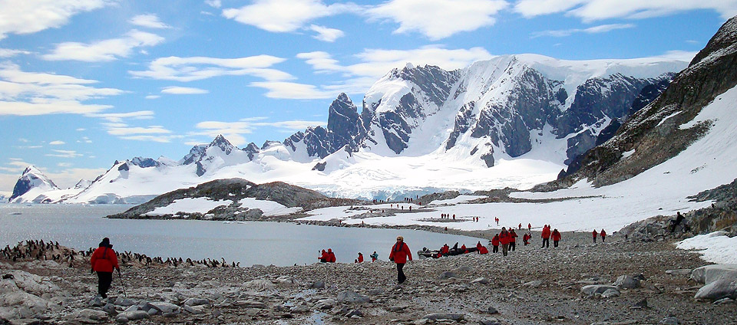
Tourism –many tourist may sail nearby, these actually land.
Date | Number of tourists landing on Antarctica
2006 | 29,576
2007 | 33,054
2008 | 27,206
2009 | 21,622
2010 | 19,445
2011 | 22,122
2012 | 25,284
2013 | 27,735
2014 | 27,243
2015 | 30,369
2016 | 36,907

Slide 7
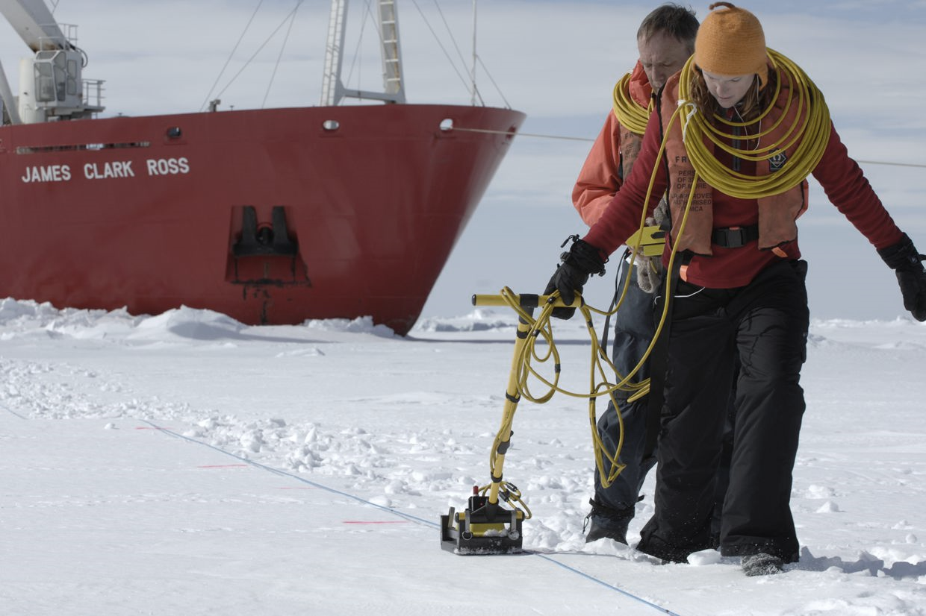
What do they do there?
6 aims have been identified:
Status – to determine the present environmental status of the polar regions.
Change – to quantify, and understand, past and present natural environmental and social change in the polar regions; and to improve projections of future change.
Global Linkages – to advance understanding on all scales of the links and interactions between polar regions and the rest of the globe, and of the processes controlling these.
New Frontiers – to investigate the frontiers of science in the polar regions.
Vantage Point – to use the unique vantage point of the polar regions to develop and enhance observatories from the interior of the Earth to the Sun and the cosmos beyond.
Human Dimension – to investigate the cultural, historical, and social processes that shape the sustainability of circumpolar human societies, and to identify their unique contributions to global cultural diversity and citizenship.

Slide 8
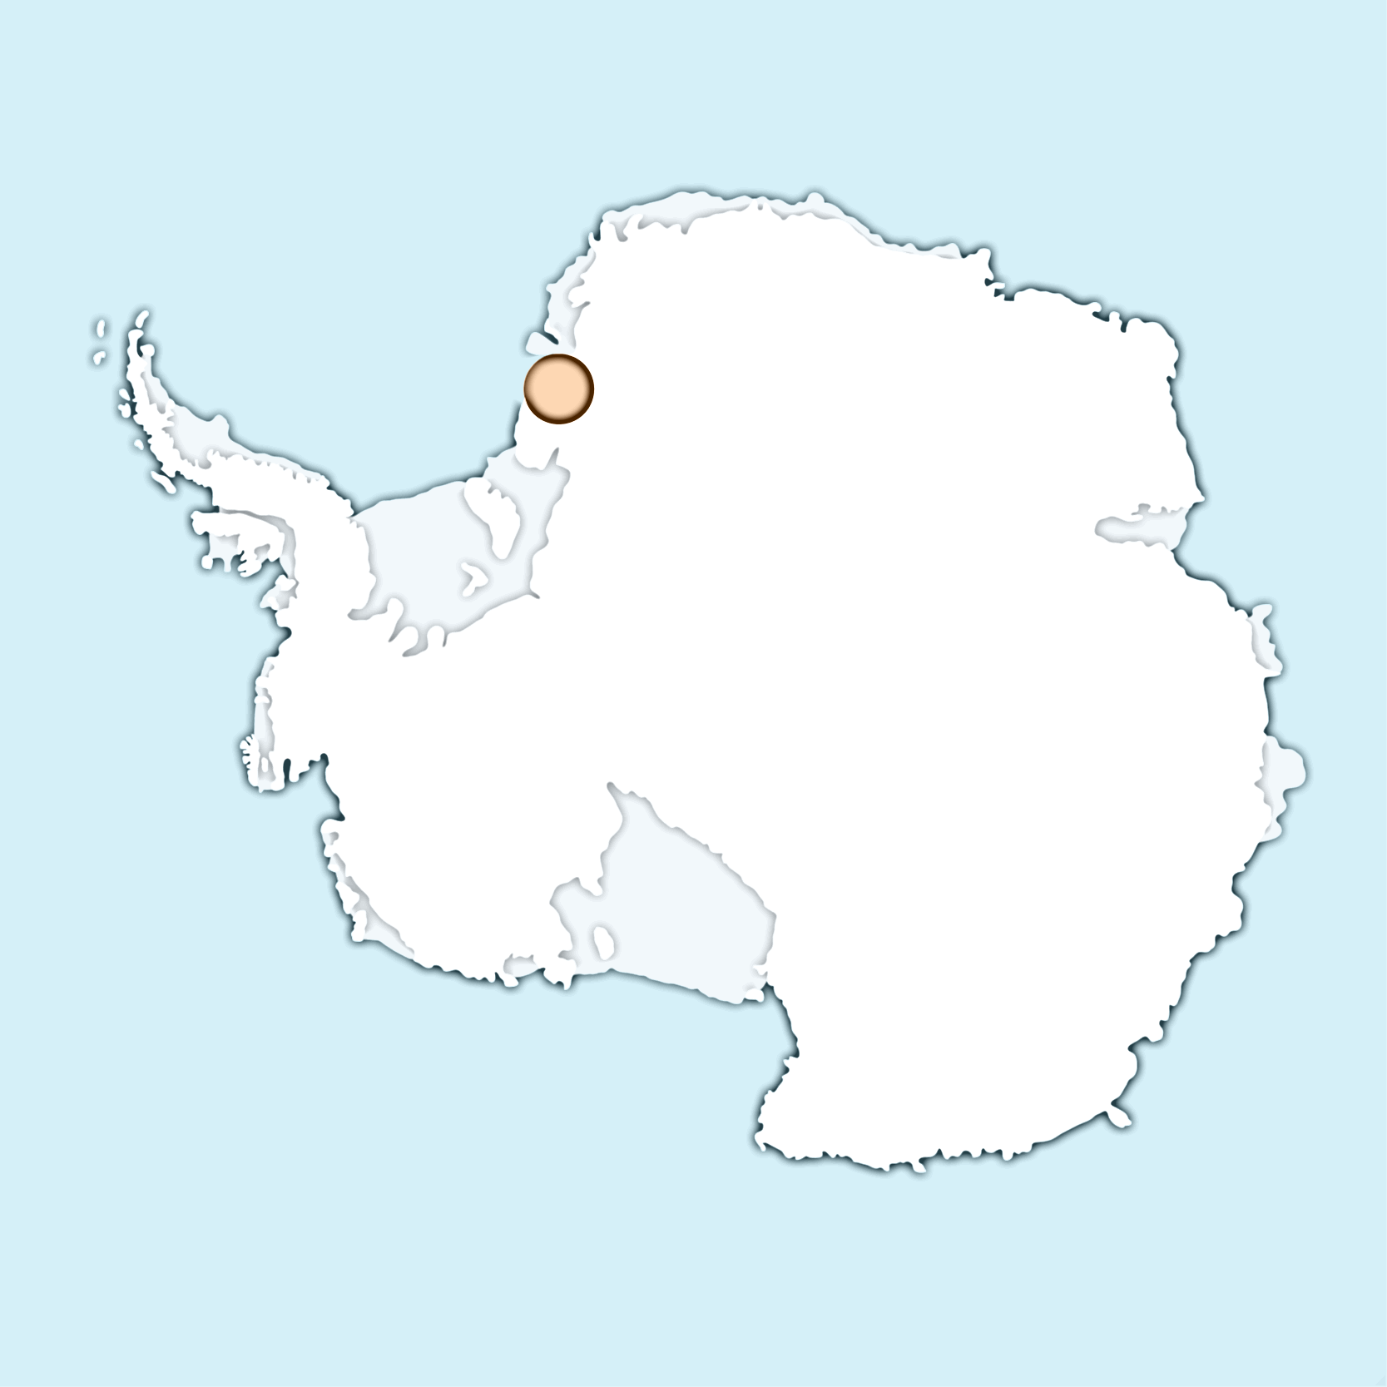
Where do they live?
Halley is the most southerly science research station operated by the British Antarctic Survey (BAS) and is located on the 150-metre thick floating Brunt Ice Shelf, which moves 400 metres per annum towards the sea. Snow levels rise by 1 metre every year, and the sun does not rise for 105 days during winter. Temperatures drop to -56˚C and winds blow in excess of 160 kph.

Slide 9
Your task is to design a building to house the workers.
Challenges to overcome
The building needs to be moved because the ice melts and refreezes at different times of the year.
It is cold, so it needs to be insulated (heated and kept warm).
Workers need a place to keep healthy.
Workers need entertainment.
An area to sleep, eat, wash and go to the toilet.
PRODUCE AN ANNOTATED SKETCH TO SHOW YOUR DESIGN.
You must explain (what have you done and why) what you have done to overcome the challenges.

Slide 10
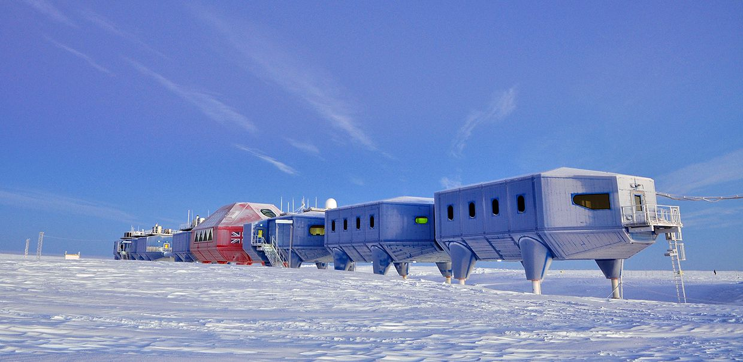
This is what was designed. How close were you to the actual design.

Slide 12
Can you guess a few of the other countries operating in Antarctica?
Brazil

Slide 13
South Korea

Slide 14
Spain

Slide 15
Plenary: Would you like to work in Antarctica?
Can you…
Live without fast food, a PS4 and the Premiership?
Cope with extreme cold and live with long, dark days and nights?
Do you…
Work well as part of a team?
Mix easily with people from different backgrounds and ages?
Have a good sense of humour?
Enjoy outdoor activities and don’t mind getting your hands dirty?
Would you…
Relish the chance of meeting penguins, seals, whales and albatrosses?
Then… let’s see what jobs are available in Britain’s Halley VI base.
https://secure.antarctica.ac.uk/employment/vacancies/

