Slide 1
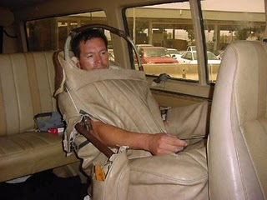
Who? What? Where? When? Why?

Slide 2
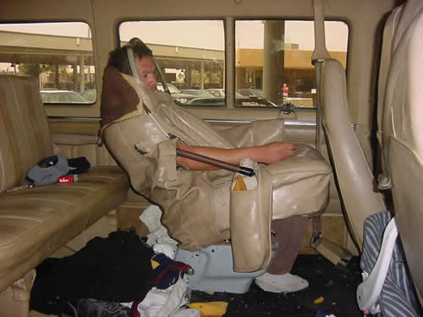
http://news.google.com/newspapers?nid=2245&dat=20010713&id=Gto0AAAAIBAJ&sjid=JCEGAAAAIBAJ&pg=4485,1261474

Slide 3
AF4 - explain the causes of migration

Slide 4
Key Terms
Migration is when people move from one place to another to live
Migrant is someone who migrates
International Migration is when people move to a different country to live
https://www.youtube.com/watch?v=sQHHNuc-1uA
Why do people migrate?

Slide 5
People migrate for 2 reasons:
To get away from the place where they were because they do not like it there – PUSH FACTORS
To live somewhere better – PULL FACTORS

Slide 6
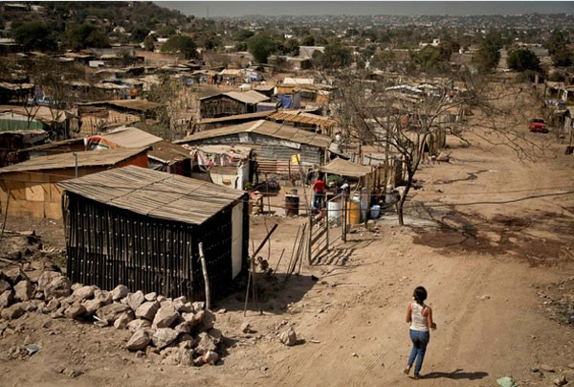
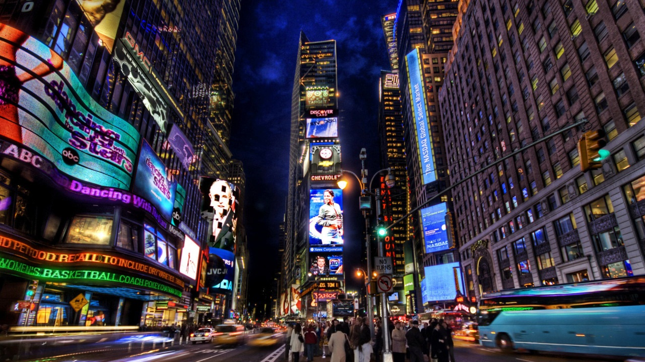
Discuss – why would people want to move from Mexico to America?
MEXICO
CONSIDER:
Economic (money, jobs)
Social (education, healthcare)
Environmental
USA

Slide 7
Describe the causes of migration from Mexico to the USA.
Make a list of:
What pushes people from Mexico?
What pulls people to the USA?
BAD in MEXICO
GOOD IN USA
Which of these did you get? What else did you have?

Slide 8
A B

Slide 9
 | Mexico | USA
GNP per Capita (salary) (money per person) | $18,000 | $54,000
Percentage in Farming | 14% | 1%
Food/Calories | 3132 cals | 3645 cals
Birth Rate | 19/1000 | 13/1000
Life Expectancy (length of life) | 75 years | 79 years
Literacy (% of people who read and write) | 92% | 99%
Clean Water | 94% | 99%
Urbanisation (% of people living in cities) | 78% | 82%
Population | 120 million | 318 million.

Slide 10
For example,
Choose at least three pieces of information to explain why Mexicans are wanting to migrate to the USA.
This means not copying but working out differences, ratios, fractions, it’s double etc.
Explaining
Manipulated data
Mexicans are likely to migrate to the USA because they have 5% more access to cleaner water (ME), which means that they are less likely to catch diseases, like cholera from dirty water (ME+)
SUCCESS CRITERIA
ME (AF4) – using connectives to explain e.g. as, because
ME+ (AF4) – using connectives to explain and then developing explanations further with this means that or so.
EE (AF4) – develop each explanation consistently.
Researched extra data
Developing
explanation
examples
AF4 - explain the causes of migration

Slide 11
PLENARY
How you would disguise yourself if you were trying to cross the Mexico - USA border?
Include an image/picture to explain your methods.
Try and be inventive like Enrique Anquilar Canchola

Slide 12
Write 4 explanative sentences to explain why Mexicans want to migrate to the USA
 | Mexico | USA
GNP per Capita (salary) (money per person) | $18,000 | $54,000
Percentage in Farming | 14% | 1%
Life Expectancy (length of life) | 75 years | 79 years
Literacy (% of people who read and write) | 92% | 99%
Clean Water | 94% | 99%
Urbanisation (% of people living in cities) | 78% | 82%
Population | 120 million | 318 million.

