Slide 1
What is air pollution?
대기 오염
AF1 - draw graphs accurately with data provided.
AF3- describe the distribution of events (air pollution).

Slide 2
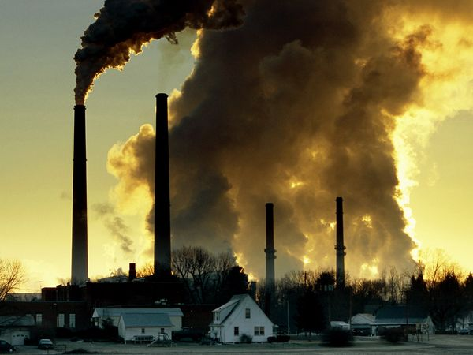
Smog hanging over cities is the most familiar and obvious form of air pollution. But there are different kinds of pollution—some visible, some invisible—that contribute to global warming. Generally any substance that people introduce into the atmosphere that has damaging effects on living things and the environment is considered air pollution

Slide 3
The World Health Organization (WHO) released its 2014 report into global air pollution.
The database looked at the air pollution levels of 1600 cities across 91 countries by using a reading called PM2.5. PM2.5 is considered the best indicator of assessing health impacts from air pollution and examines the concentration of fine particulate pollution of 2.5 micrometres or less in diameter (PM2.5).
These particles might be smoke, dirt, mould or pollen and their fine size poses the biggest risks to human health as they can be inhaled and accumulated in the respiratory system. WHO says there is no safe level of PM2.5.
https://www.youtube.com/watch?v=bq9ryD4Uucw
Discussion: how does this make you feel?

Slide 4
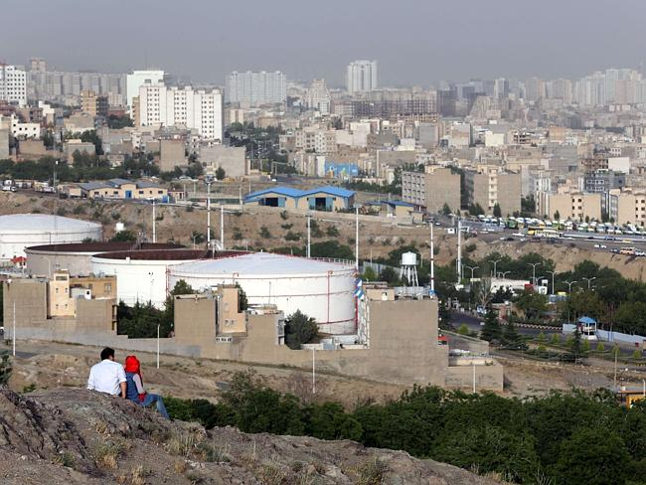
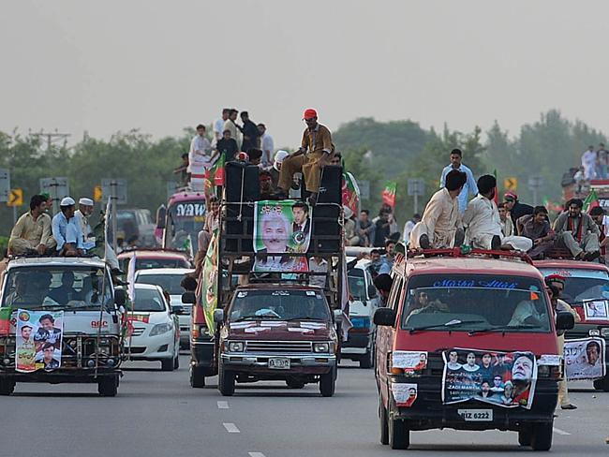
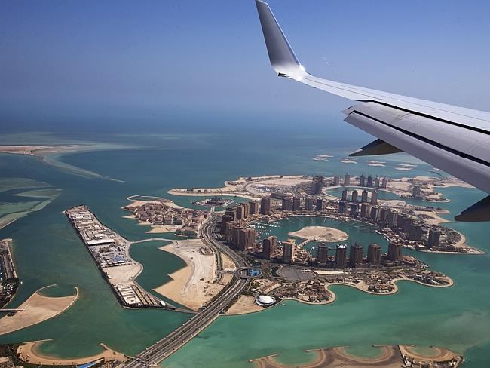
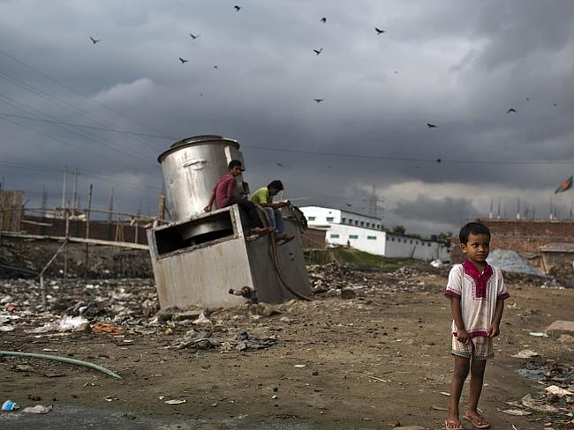
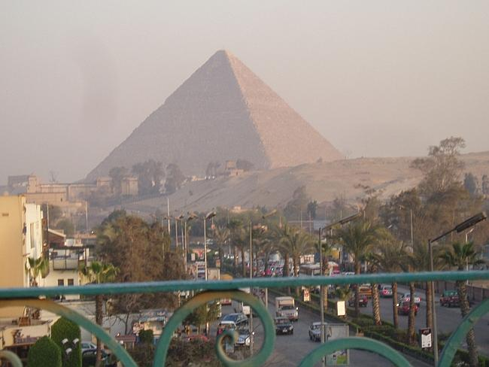
Prediction- write down, in order, the countries you think have the worst air pollution.
Pakistan
Iran
Egypt
Qatar
Bangladesh
Where you influenced by the pictures? It is important to question any data!

Slide 5
Create a graph to show this information
Here are the 10 most polluted countries in the world.
Country | Average PM2.5 pollution: ug/mᵌ
Pakistan | 101
Qatar | 92
Afghanistan | 84
Bangladesh | 79
Iran | 76
Egypt | 74
Mongolia | 64
United Arab Emirates | 61
India | 59
Bahrain | 57
Concentration of air pollution is measured in micrograms per cubic meter of air (ug/m3).
Despite extensive coverage of the pollution problems in Beijing, the city came in at number 77 on the list. Among the countries, China was ranked 14th.
Better graphs will have a title, labeled axis, accurate (pencil and ruler)

Slide 6
Comparing this data to AQI

Slide 7
1) Describe your graph
Better answers would manipulate data to make it easier to visualise – remember your lesson on Israel.
2) Use the map to describe the distribution of these countries.
Better answers will you direction and names of continents/regions.
Top 10 air polluted countries in 2014 (WHO)

Slide 8
Make a table: cause – impacts Use the information above to bullet point the causes and impacts of air pollution.
A World Bank report found that outdoor air pollution alone causes more than 80,000 hospital admissions per year; nearly 8,000 cases of chronic bronchitis, and almost five million cases of lower respiratory cases in children under the age of five.
In Kabul, Afghanistan, its size has led to illegal homes powered by diesel generators or for those who can’t afford electricity, they burn tires and plastic bags for fuel
Qatar also faces increased pollution from its high rate of construction and busy air traffic
A combination of poor political decisions, substandard gasoline/petrol and traffic congestion
Outdoor air pollution killed 3.7 million people in 2012. Tobacco and other kinds of smoking are examples of indoor air pollution.
Cold winters that can drop to -40°C means that many Mongolians burn coal for cooking and heating
The growing number of cars, factories and power plants, in Cairo, and the use of old heating methods such as burning coal and wood are considered to be the main man-made sources of air pollution.
Chemical reactions involving air pollutants can create acidic compounds, when this mixes with rain it falls as ‘acid rain’, it can kill trees and harm animals, fish, and other wildlife.

Slide 9
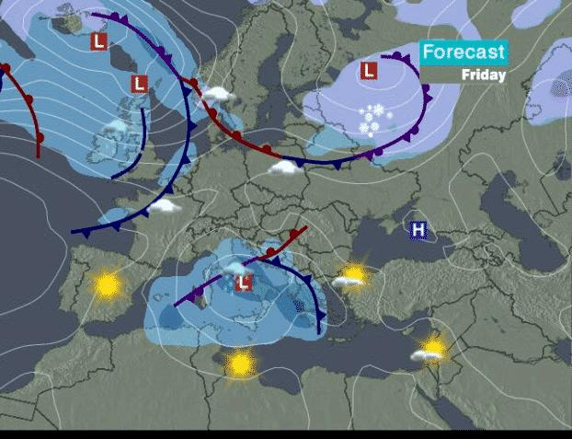
Plenary - Forecast
If what you have learnt today is true, what will the future be like?
If what you have learnt today were false, what would the future be like?

