Slide 1



Where shall I put my
factory
Skills: Decision Making
Using ICT
Using Numbers
Improving own learning and performance

Slide 2
Your job
™
i-fast
You have been hired by ‘i-fast’, a Trans National Company who make trainers and other designer sports clothing. You must analyse the data for 5 countries and then decide on which country is the best for their new factory.
™
i-fast

Slide 3
Possible country options
Below are the 5 possible countries to build the new factory. Click on each one in turn and fill in the decision matrix to help work out the best site.
Taiwan
United Kingdom
Bulgaria
Australia
Kenya

Slide 4
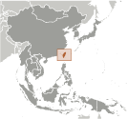
Taiwan
Taiwan has a dynamic capitalist economy with gradually decreasing government guidance of investment and foreign trade. Exports, led by electronics and machinery, generate about 70% of Taiwan's GDP growth, and have provided the primary impetus for economic development. This heavy dependence on exports exposes the economy to upturns and downturns in world demand. Taiwan involved in complex dispute with Brunei, China, Malaysia, the Philippines, and Vietnam over the Spratly Islands, and with China and the Philippines over Scarborough Reef.
Factor | Data
Labour force | 11.07 million
Exports | $274.6 billion
Internet users | 16.147 million
Airports | 41
Merchant ships | 101
Literacy | 96.1%
Minimum wage | 9.37 AED per hour
Natural Hazards | earthquakes; typhoons
Pictures of Taiwan

Slide 5
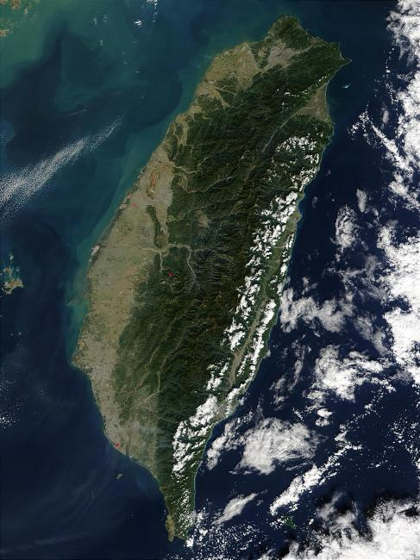
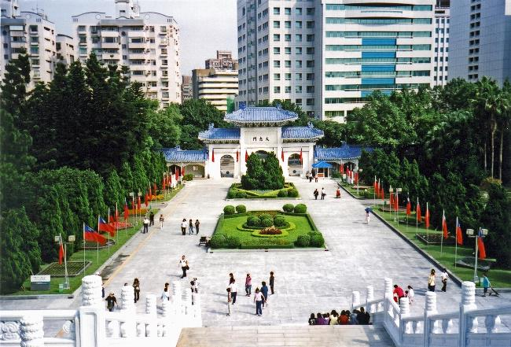
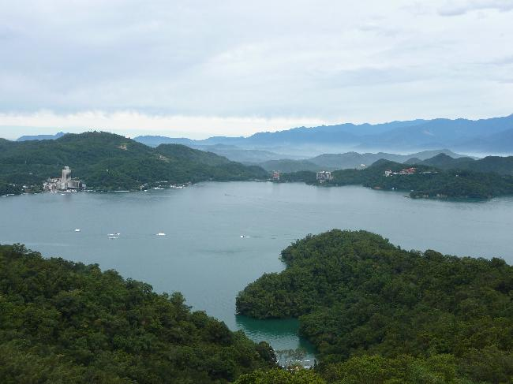
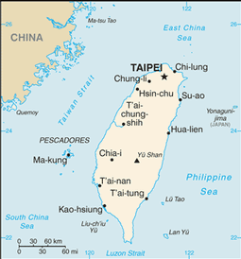
Pictures of Taiwan

Slide 6
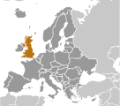
United Kingdom
At its peak in the 19th century, the British Empire stretched over one-fourth of the earth's surface. The first half of the 20th century saw the UK's strength seriously depleted in two world wars and the Irish republic withdraw from the union. The second half witnessed the dismantling of the Empire and the UK rebuilding itself into a modern and prosperous European nation.
Factor | Data
Labour force | 31.45 million
Exports | $405.6 billion
Internet users | 51.444 million
Airports | 505
Merchant ships | 527
Literacy | 99%
Minimum wage | 27AED per hour
Natural Hazards | winter windstorms; floods
Pictures of the UK

Slide 7
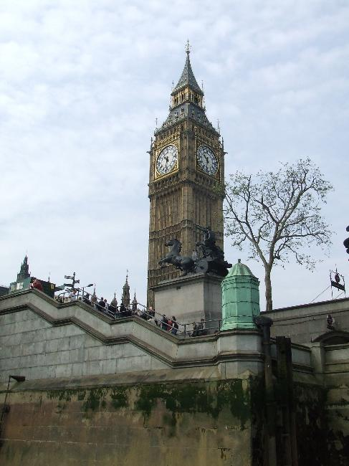
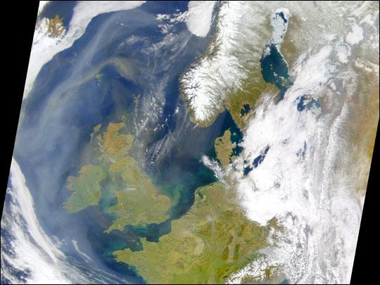
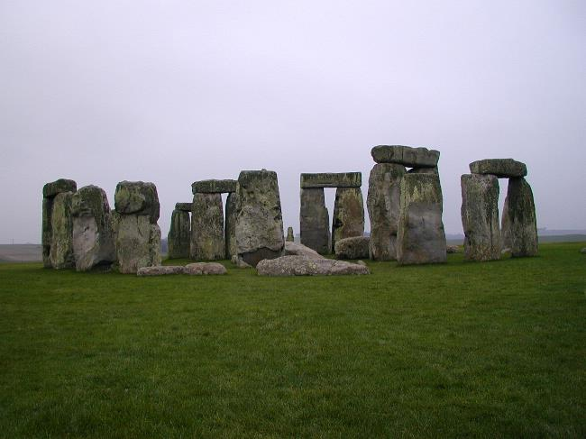
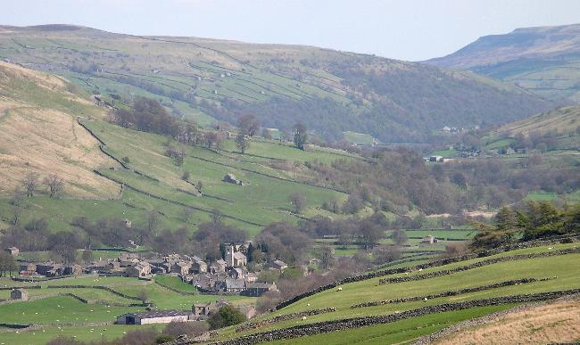
Pictures of the UK

Slide 8
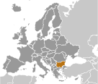
Bulgaria
Having fought on the losing side in both World Wars, Bulgaria fell within the Soviet sphere of influence and became a communist country in 1946 and this ended in 1990. Bulgaria moved towards a democracy and a market economy while combating inflation, unemployment, corruption, and crime.
Factor | Data
Labour force | 3.4 million
Exports | $19.33 billion
Internet users | 3.395 million
Airports | 210
Merchant ships | 37
Literacy | 98.2%
Minimum wage | 2AED per hour
Natural Hazards | earthquakes; landslides
Pictures of Bulgaria

Slide 9
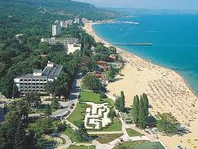
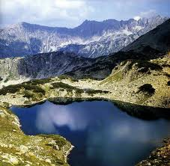
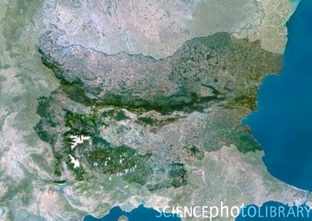
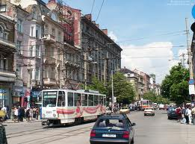
Pictures of Bulgaria

Slide 10

Australia
Australia has transformed itself into an internationally competitive, advanced market economy. It boasted one of the OECD's fastest growing economies during the 1990s, a performance due in large part to economic reforms adopted in the 1980s. Long-term concerns include ageing of the population, pressure on infrastructure, and environmental issues such as frequent droughts.
Factor | Data
Labour force | 11.62 million
Exports | $210.7 billion
Internet users | 15.81 million
Airports | 465
Merchant ships | 45
Literacy | 99%
Minimum wage | 45 AED per hour
Natural Hazards | cyclones; severe droughts; forest fires
Pictures of Australia

Slide 11
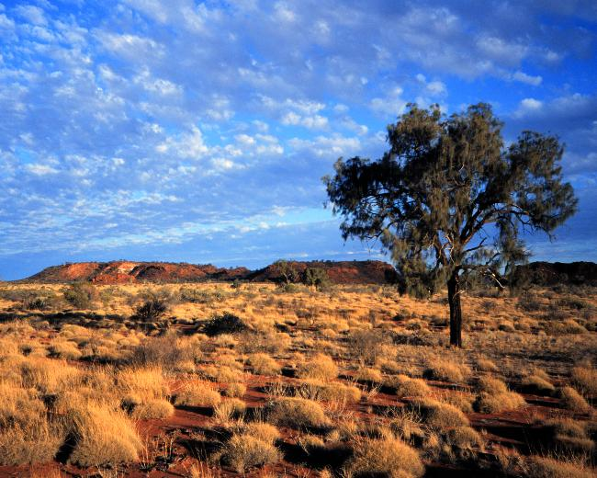
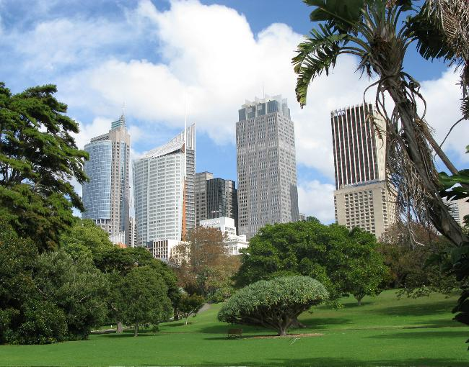
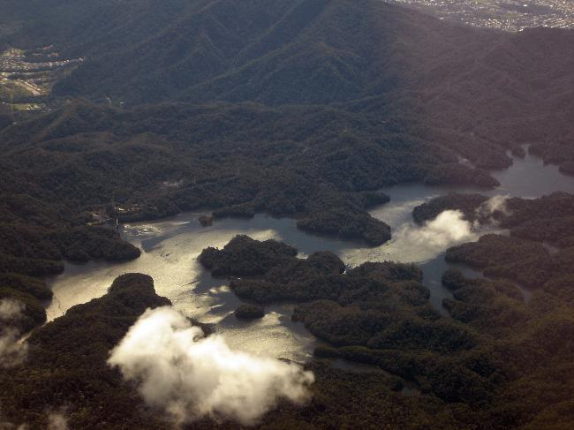
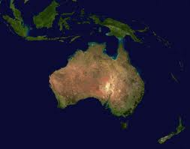
Pictures of Australia

Slide 12
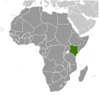
Kenya
Kenya has battled against different political parties competing for power. December 2007 brought charges of vote rigging from ODM candidate Raila Odinga and unleashed two months of violence in which as many as 1,500 people died. UN-sponsored talks in late February produced a power sharing bringing Odinga into the government in the restored position of prime minister.
Factor | Data
Labour force | 17.94 million
Exports | $5.141 billion
Internet users | 3.996 million
Airports | 191
Merchant ships | 1
Literacy | 85.1%
Minimum wage | 1 AED per hour
Natural Hazards | drought; flooding during rainy seasons Last volcano in 1921
Pictures of Kenya

Slide 13
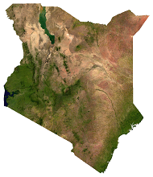
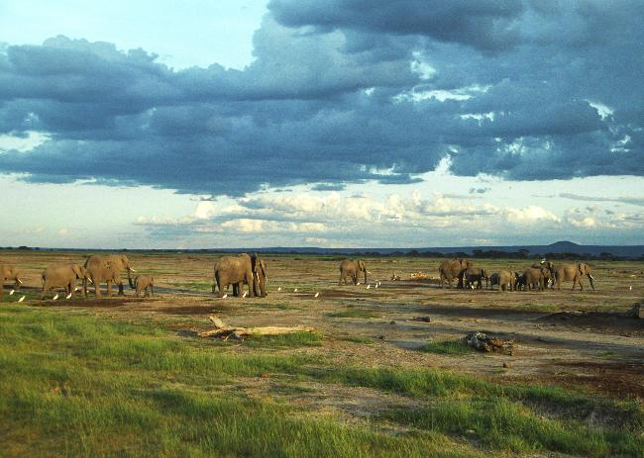
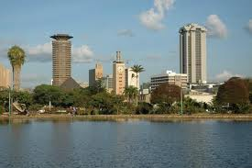
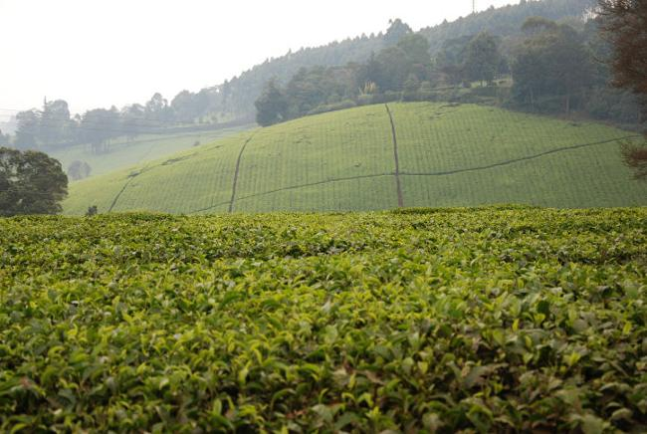
Pictures of Kenya

Slide 14
Decision Matrix
Factor | Taiwan | United Kingdom | Bulgaria | Australia | Kenya
Labour force
Exports
Internet users
Airports
Merchant ships
Literacy
Minimum wage
Natural Hazards
Rank each factor 1to 5 (1-worst, 5-best)

Slide 15
Glossary
Labour force – the amount of people the country has able to work.
Exports – the amount of products that the country sells to other countries.
Internet users – the amount of people who have the internet.
Airports – the number of airports in the country that are set up to export products.
Merchant ships - the number of ships in the country that are set up to export products
Literacy – the percentage of people in the country that can read and write.
Minimum wage – the lowest amount of pay you can give someone to work every hour.
Natural Hazards – the types of disasters the country may have.

