Slide 1
Why do people live near volcanoes?
AF 4 - explain the impacts of living near a volcano

Slide 2
Fertile soil
Lava and the weathered material (rock naturally broken down) form nutrient rich soil that can be cultivated to produce healthy crops and high yield harvests. The soil naturally contains: -
Potash, Nitrogen, Sulphur

Slide 3
Minerals
Lava from deep within the earth contains minerals which can be mined once the lava has cooled.
gold, silver, diamonds, copper, zinc and sulphur (above)

Slide 4
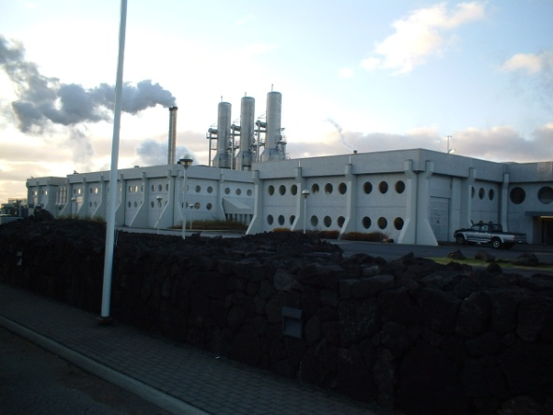
geothermal
This is energy created by using the steam from underground which is heated by the earths magma.

Slide 5
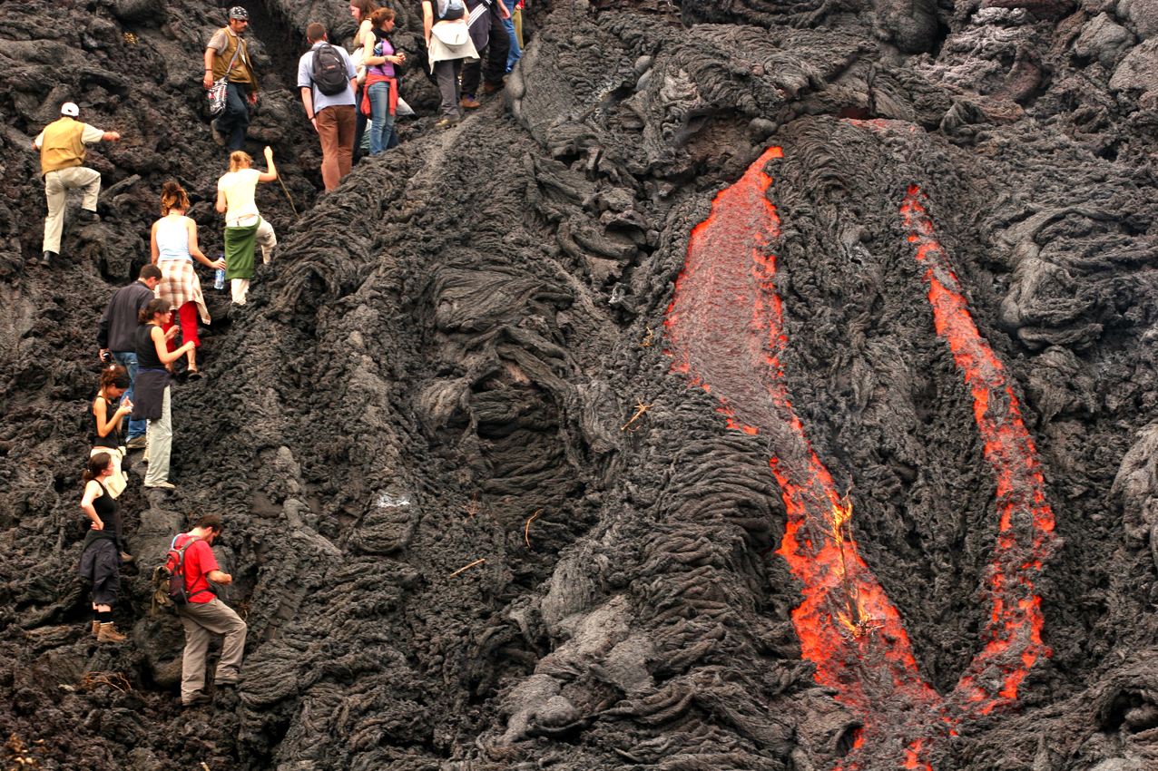
Tourism
this creates many jobs for local people in the tourism industry

Slide 6
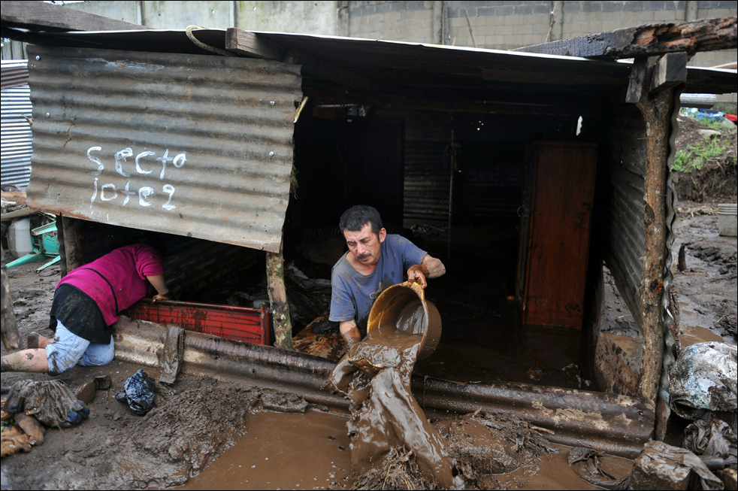
Lack of choice
People are born into this environment and are often to poor to move anywhere else!

Slide 7
TASK
Your job is to write a postcard explaining the benefits of living near a volcano in Italy.
Design a stamp (look at the next slide)
Add the address (home/school)
Complete the postcard and aim to include all the 4 reasons we have looked at,
Design the front of the postcard.
The best answers will include at least 4 reasons.
Use place specific information about Italy including place names and data (can be researched).

