Slide 1
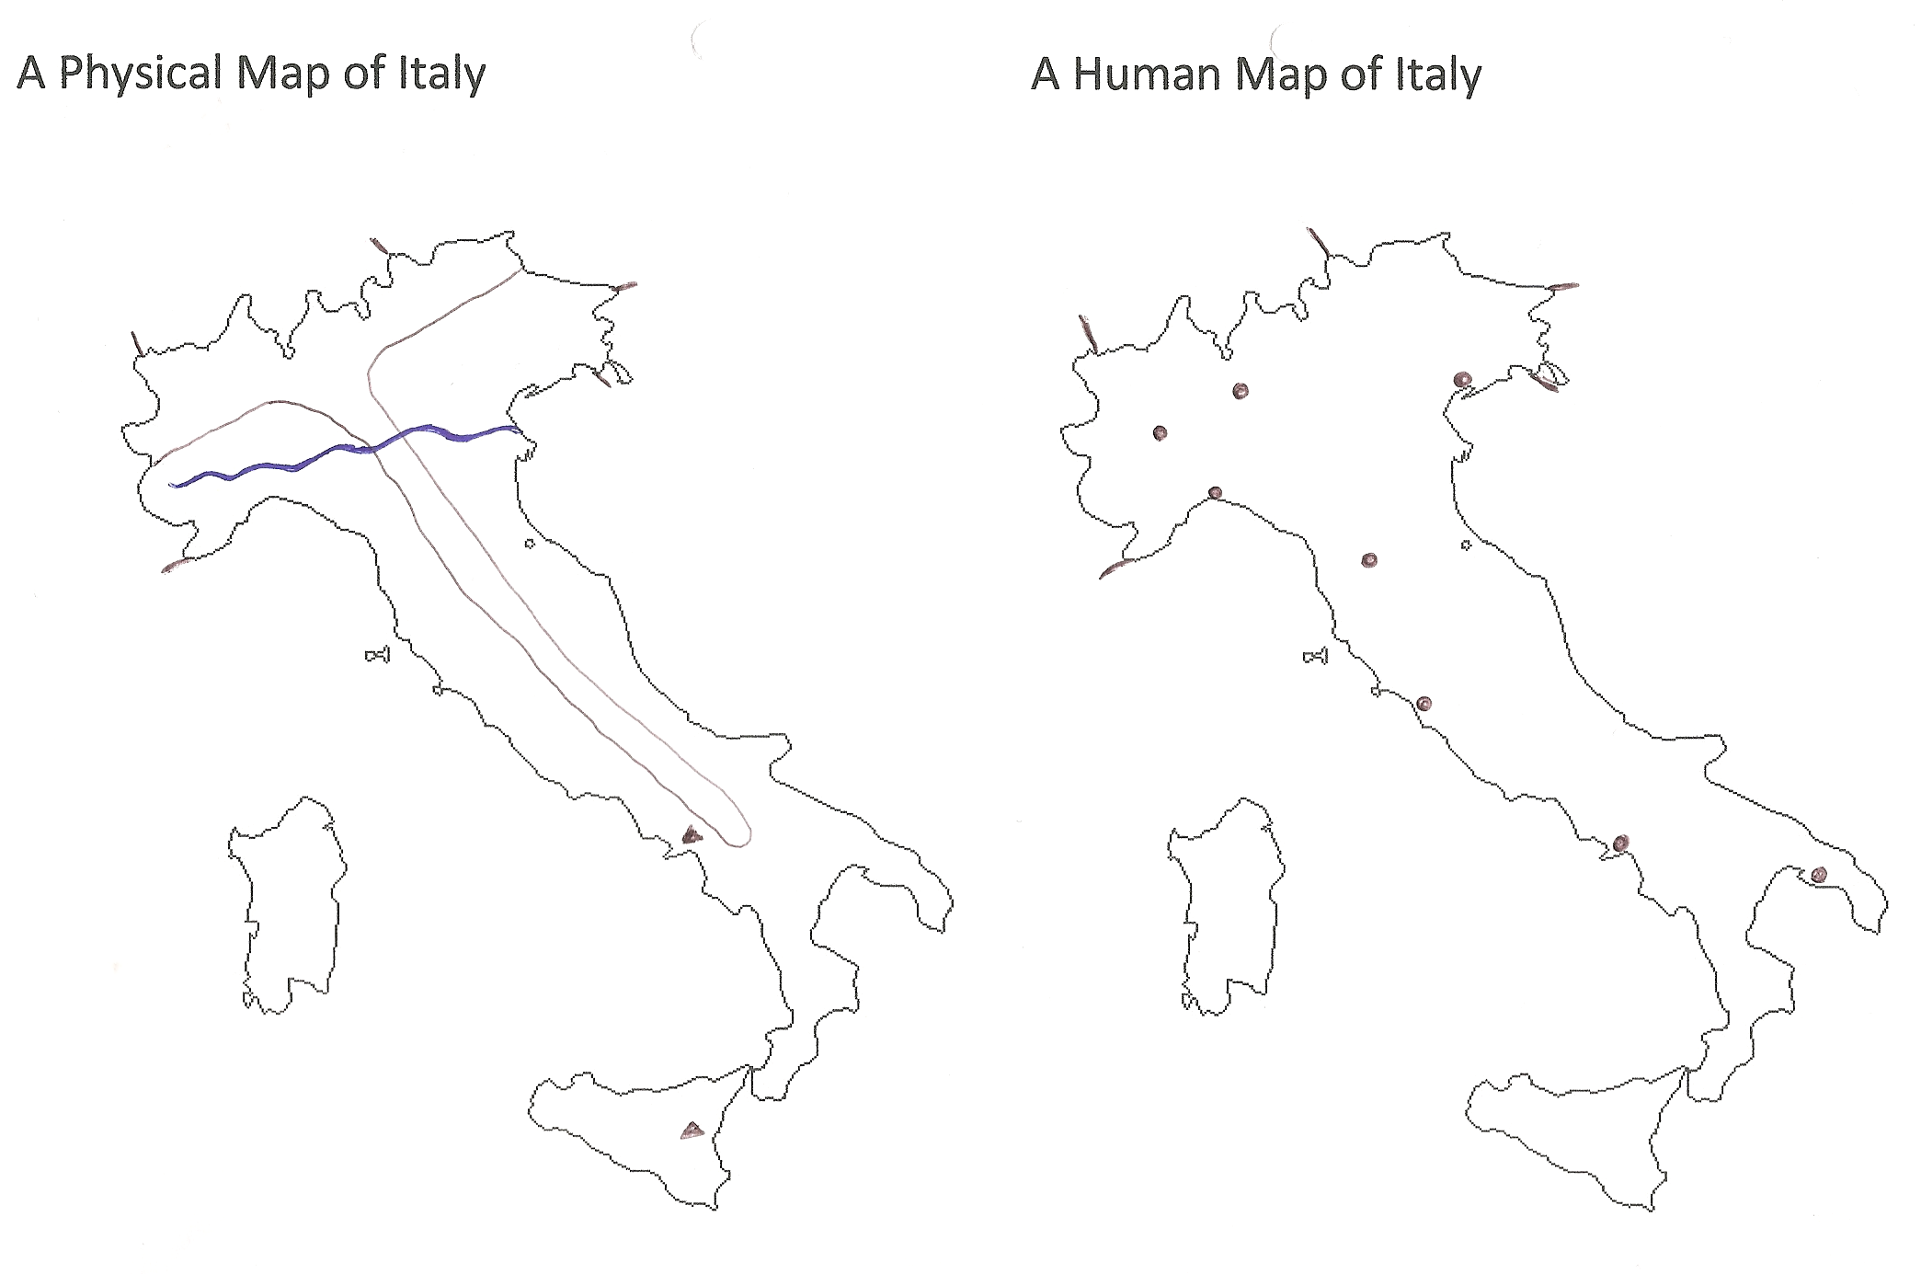
The 2 mountain ranges
(Alps and Apennines)
The 2 islands
(Sardinia and Sicily)
The 2 volcanoes
(Mt Etna and Vesuvius)
The 3 seas
(Ionian, Tyrrhenian and Adriatic)
The river Po
The 4 neighbouring countries
(Slovenia, Switzerland, France and Austria)
The 8 cities
(Taranto, Venice, Genoa, Rome,
Turin, Naples, Florence, Milan)

Slide 2
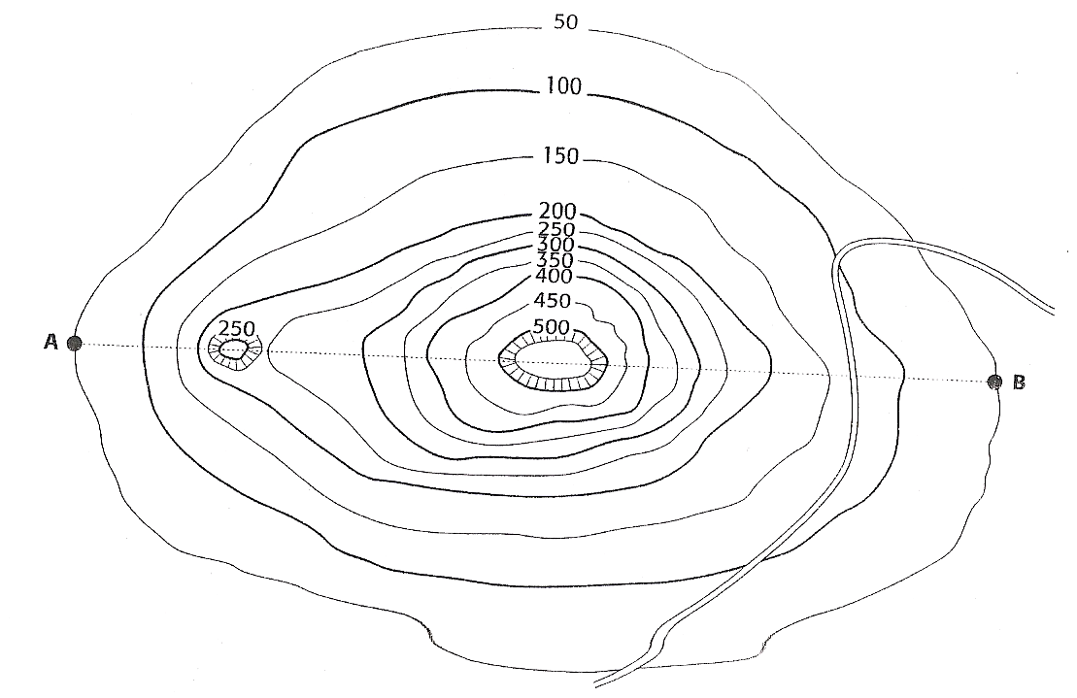
Volcano Cross Section (side view)
Volcanoes on this boundary are fairly small compared to the other types of volcano, but it is tall with steep sides. You will create a cross section of this volcano to illustrate this.
What is the name of the lines that show height?

Slide 3
Use your diagram, a strip of paper and the instructions on the next slide to help you.

Slide 4
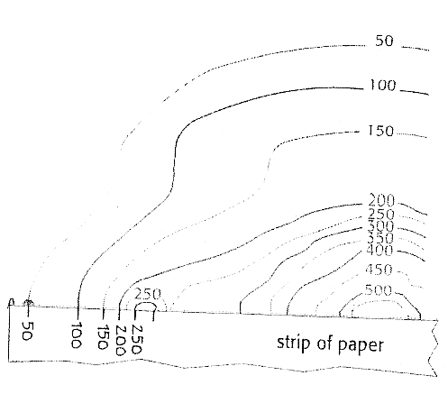
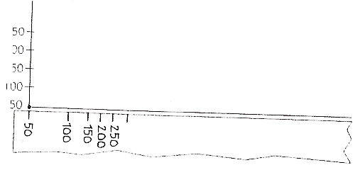
The line AB passes straight through the centre of the volcano.
Here you are going to draw a cross section of the volcano.
Take a strip of paper 20cm long and 2 cm wide
Place it along the line AB
Mark the strip each time it touches a contour line and write the height under your mark
Place the strip onto the axis
Transfer the points onto the appropriate height and join the dots

Slide 5
