Slide 1
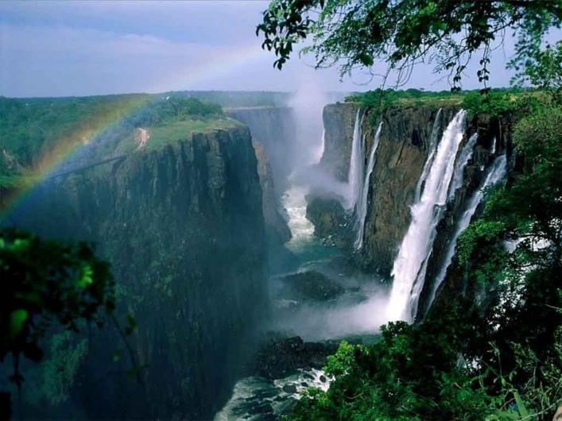
What attracts visitors to Victoria Falls?
AF1 – drawing graphs
AF3 – describing graphs
AF5 – evaluating an enquiry

Slide 2
The Zambian Tourist Board are enquiring into ways that they can improve the facilities for tourists.
First, they need to work out which activities attract tourists to the area.

Slide 3
They make a prediction. This is known as a hypothesis.
This is what they decide;
Most people visit Victoria Falls area to see the waterfall.

Slide 4
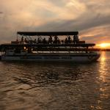
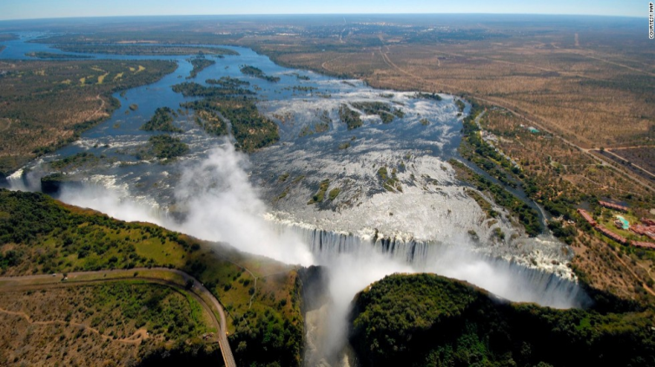
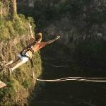
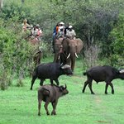
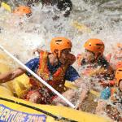
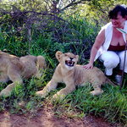
What can tourists do?
See the waterfall
Victoria Falls Bridge
Rafting
Bungee jumping
Wildlife Park
River Cruise
Elephant-back Safaris
What would you like to do there?
TASK: Write your hypothesis, similar to the one on the previous slide.

Slide 5
Data Collection
21 visitors were asked the following questions on Saturday April 2nd 2016.
Their 2nd hypothesis was.
Most visitors are between 48 and 58
TASK: Write your hypothesis – Most visitors will be……

Slide 6
Results
Visitor | Age | Activity
1 | Under 25 | Bungee
2 | 37-47 | Bungee
3 | Under 25 | Rafting
4 | Over 58 | Wildlife park
5 | Over 58 | Bungee
6 | 37-47 | River cruise
7 | 37-47 | Wildlife park
8 | Under 25 | Bungee
9 | Over 58 | Waterfall
10 | Over 58 | Waterfall
11 | Over 58 | Wildlife park
12 | Over 58 | Wildlife park
13 | 37-47 | Safaris
14 | Over 58 | Wildlife park
15 | Over 58 | Safaris
16 | Under 25 | Waterfall
17 | 37-47 | River cruise
18 | 37-47 | Safaris
19 | Over 58 | Wildlife park
20 | Over 58 | Bridge
21 | Over 58 | Wildlife park

Slide 7
Data presentation - select one piece of information, preferably different to the person next to you.
Present one piece of information in a graph (your choice)

Slide 8
Analysis
Describe the graph.
Give your reasons for the pattern/answers e.g. Why do you think most visitors were over 58?
Why were there no 26-36 year olds?

Slide 9
Conclusion
Was your hypothesis correct?
The hypothesis was correct/incorrect/partially correct because most people were______ (add data from the graph

Slide 10
Evaluation
Why might the results be unreliable?
How could we make them more accurate?
Notes:
More days, different times of the year, ask more people, different questions, more places, other areas of Zambia

Slide 11
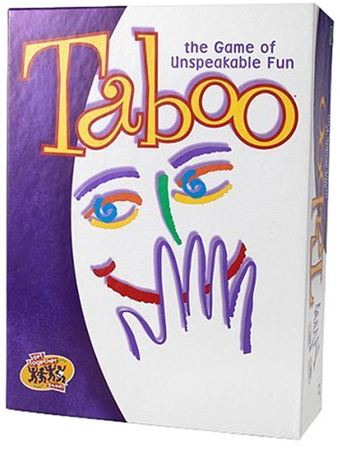
Taboo
I will give you a word – describe it to the class without using that word.
Notes:
Questionnaire, Evaluation, Conclusion, Graph, Hypothesis, Victoria Falls, Analysis

