Slide 1
Can we explain what happens at a plate boundary?
CREATIVE CHALLENGE
AF6 · explain the formation of landforms
AF6 · explain the impacts from processes
AF6 · explain the differences in the impacts

Slide 2
Creative CHALLENGE
You have 2 lessons to create a plate boundary
that explains how a volcano, earthquake or fold mountain is formed.
that explains the impact it could have on a country (positive and/or negative)
that explains how the impact could be different in different countries.
2-3 team members
A Year 5 student must be able to understand your explanations, so key terminology must be explained.

Slide 3
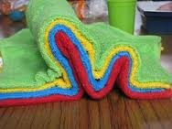
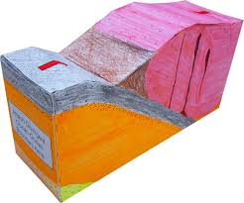
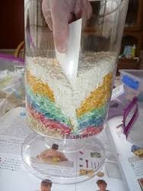
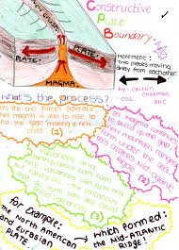
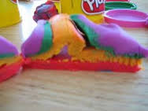
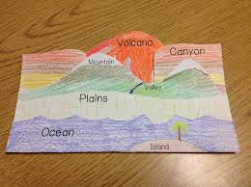
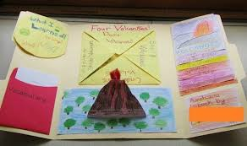
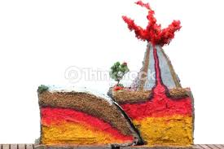

Slide 4
assessment
that explains how a volcano, earthquake or fold mountain is formed.
Annotations are used to explain how the landform is formed
The name of the plate boundary is given
There are place names to show the area that is affected
Key words are used
that explains the impact it could have on a country (positive and/or negative)
At least 4, positive or negative impacts are explained e.g. buildings collapse, fertile soil
that explains how the impact could be different in different countries
Why are the impacts worse in some countries than other countries, e.g. earthquakes in Haiti and Japan.
You have researched and compared the impacts including data, e.g. number of deaths, injured, buildings collapsed

Slide 5
GROUP SELF ASSESSMENT |  | NAMES :
Assessment Focus (AF) | Assessment Criteria – What have we done? |  | 0 not done | 1 Poor | 2 Ok | 3 Good | 4 Very Good | 5 Excellent
that explains how a volcano, earthquake or fold mountain is formed. | Annotations are used to explain how the landform is formed
 | The name of the plate boundary is given
 | There are place names to show the area that is affected
 | Key words are used
that explains the impact it could have on a country (positive and/or negative) | At least 4, positive or negative impacts are explained e.g. buildings collapse, fertile soil
that explains how the impact could be different in different countries | Why are the impacts worse in some countries than other countries, e.g. earthquakes in Haiti and Japan.
 | You have researched and compared the impacts including data, e.g. number of deaths, injured, buildings collapsed

