Slide 1
How do animals survive in Death Valley?
AF1 - add detailed annotations onto sketches.
AF4 - explain the impacts from processes/events
Notes:
I have the animal descriptions copied in colour! Come and grab them!

Slide 2
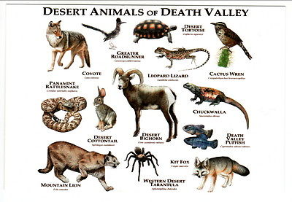
The impact of the heat has meant that animals have adapted to survive in Death Valley
AF6 - explain the impacts from processes/events

Slide 3
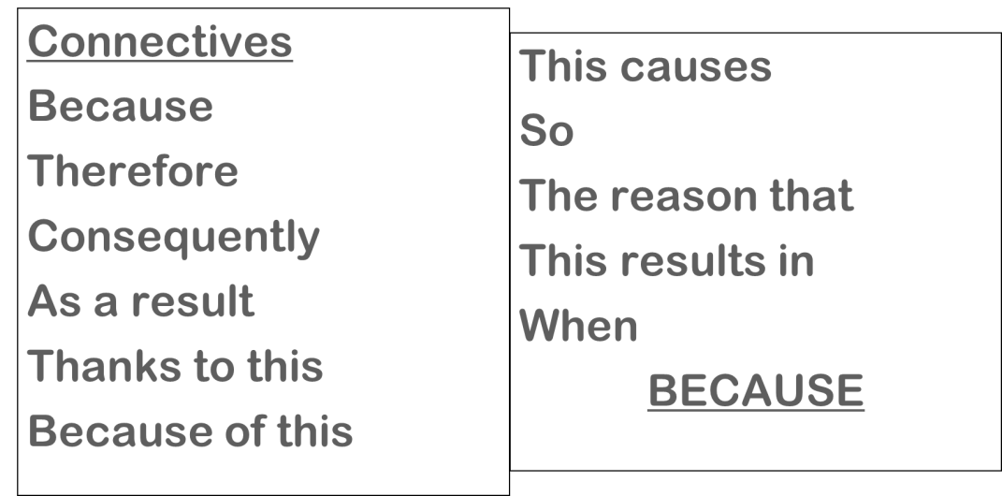
AF1- identify key terms AF2 - add detailed annotations onto sketches TASK
15 minutes to…
For the animal you have been given, sketch and annotate the adaptations (changes) that the animal has made to survive in the desert.
Better annotations will explain why the changes are important so look to use the connectives (from last lesson) to give a reason and include key terms.

Slide 4
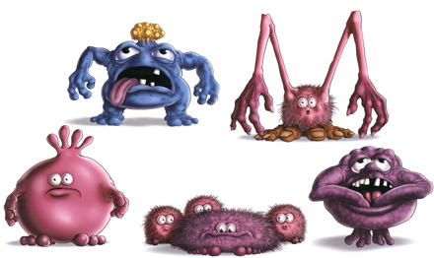
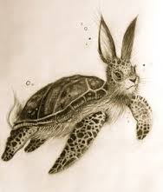
Design your own animal to survive in the desert
Completely new or a mixture of other animals.
Success Criteria
At least 4 adaptions that explain why it would survive well in Death Valley.
A short description of its living habits e.g. shy, nocturnal, lives in a herd.
Has a Death Valley background (see next slide).

Slide 5
