Slide 1



How will Japan provide energy for the future?
AF 1- add detailed annotations onto sketches.
AF 5 - evaluate the sustainability of management choices and provide further suggestions.

Slide 2
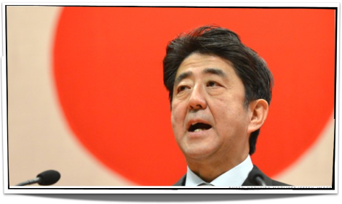
Words from the wise on our energy future
BY STEPHEN HESSE
SPECIAL TO THE JAPAN TIMES
JAN 24, 2015
Another year has dawned, Prime Minister Shinzo Abe has been at the helm for more than two years and nearly four years have passed since the Fukushima disaster brought Japan to its knees. And still we wait for a realistic blueprint from the government for clean and safe energy independence, a plan offering residents hope, confidence and pride.

Slide 3
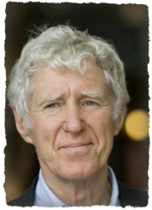

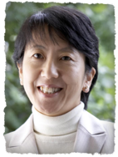
Earth Policy Institute President Lester Brown, Tokyo City University professor Junko Edahiro and naturalist and author C.W. Nicol.
“I strongly believe that we should not use nuclear energy,” Edahiro says. “Do you know how many earthquakes have occurred in Japan with more than 100 deaths since the great 1924 Kanto Earthquake left 142,800 dead and missing? Fifteen. On average, one every nine years.
“Having seen the wasteland that was once Fukushima and having been told that it would be wise not to use venison or wild boar from the Karuizawa area, and knowing that one power plant continues to leak radioactive water into the ocean, how the hell can anybody try to pretend that this stuff is for the benefit of the nation or the people?”
My inclination would be to put nuclear power in the past and concentrate on developing renewable resources,” Brown says by phone from his home in Washington, D.C.

Slide 4
Evaluate the possible strategies that Japan could adopt as their energy of the future?
“Solar power combined with agriculture is one of the promising energy and food generation systems. Another promising renewable energy source is offshore floating wind farms,” Edahiro says.
Brown thinks geothermal will have a role, but is still convinced that solar will be the big winner. “Geothermal will have a role,” he says, “but as a general matter I don’t think it will be anywhere near solar, which I think will be the big winner.”
Nicol touches on other energy options, including biomass byproducts from forestry and biogas from sewage and other organic waste, which can also be tapped for phosphates, the mainstay of agricultural fertilizers.

Slide 5

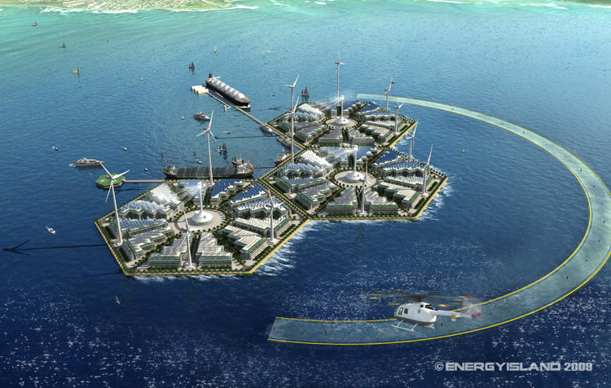
Evaluate the possible strategies that Japan could adopt as their energy of the future.

Slide 6

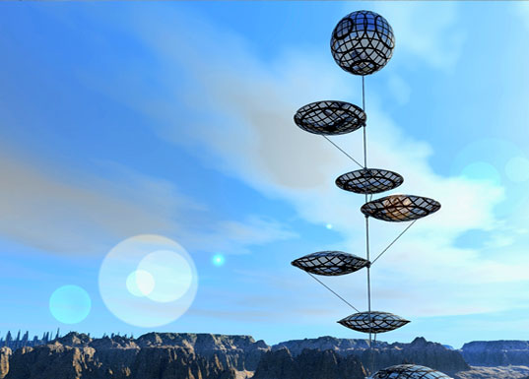
Evaluate the possible strategies that Japan could adopt as their energy of the future.

Slide 7

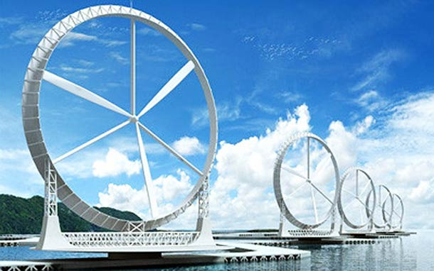
Evaluate the possible strategies that Japan could adopt as their energy of the future.

Slide 8
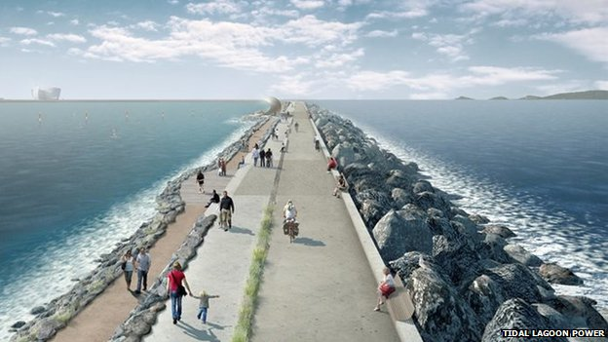
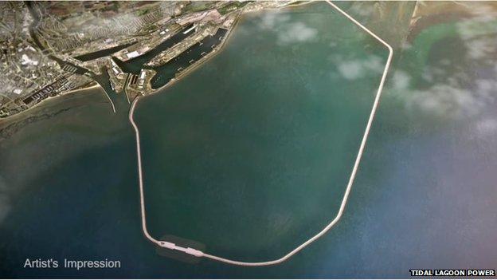
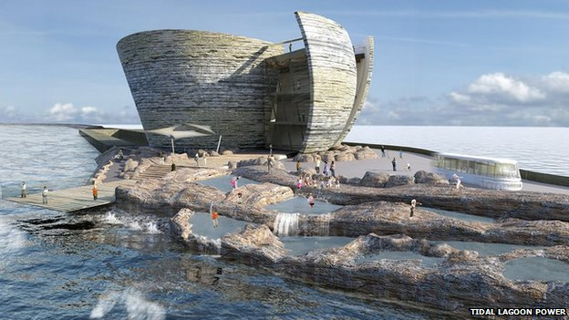
Lagoon Tidal Power
BBC News 2 March 2015
The proposed Tidal Lagoon Swansea Bay, Wales project would be the world's first man-made, energy-generating lagoon. A £1bn Swansea scheme, said to be able to produce energy for 155,000 homes, is already in the planning system.
When the tide is full outside the lagoon, the gates are opened and water rushes past the turbines to fill up the lagoon. When the tide turns to go out, the gates are shut to hold the water inside the lagoon, then let to spin the turbines again.

Slide 9

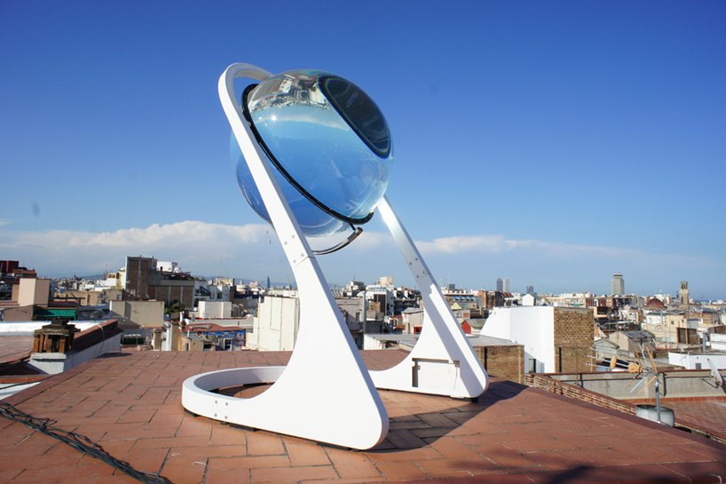
Evaluate the possible strategies that Japan could adopt as their energy of the future?
“German architect André Broessel, of Rawlemon, has looked into his crystal ball and seen the future of renewable energy. In this case it’s a spherical sun-tracking solar energy-generating globe — essentially a giant glass marble on a robotic steel frame. But this marble is no toy. It concentrates both sunlight and moonlight up to 10,000 times — making its solar harvesting capabilities 35 percent more efficient than conventional dual-axis photovoltaic designs.”

Slide 10

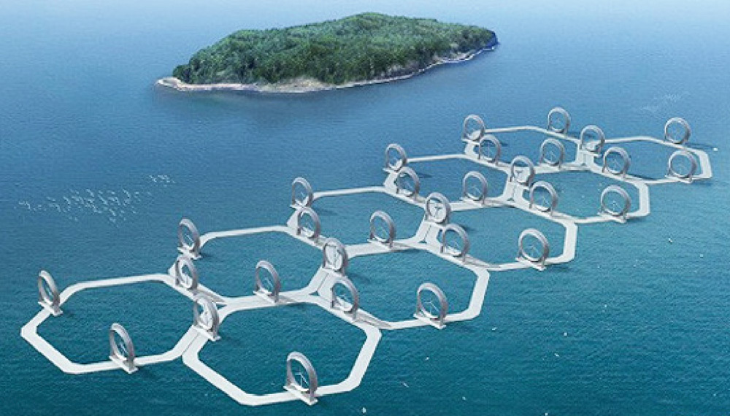

One of Japan's strategies
In order to replace nuclear power plants Japan will invest $700 billion in renewable energy infrastructure by 2030. As Japan’s mountainous terrain does not lend itself to onshore wind farms, offshore wind farms are now one cornerstone of the alternative energy strategy. A hexagon based platform has been designed to be sturdy enough to handle marine conditions but low cost enough to make the project’s wide application feasible.
It is estimated that one wind farm will produce as much energy as one small nuclear power plant. Pilot installations will come first at a capacity of 7.5MW. After that, installations will be scaled to provide 300MW-1000MW. Japan estimates it can build up to 1,600GW (gigawatts) of offshore wind power capacity in the future.

Slide 11
Evaluate the possible strategies that Japan could adopt as their energy of the future?
Your role is to design a method to generate energy for Japan.
Label your design to justify the features you have included.
AF 1- add detailed annotations onto sketches.
AF 5 - evaluate the sustainability of management choices and provide further suggestions.

