Slide 1
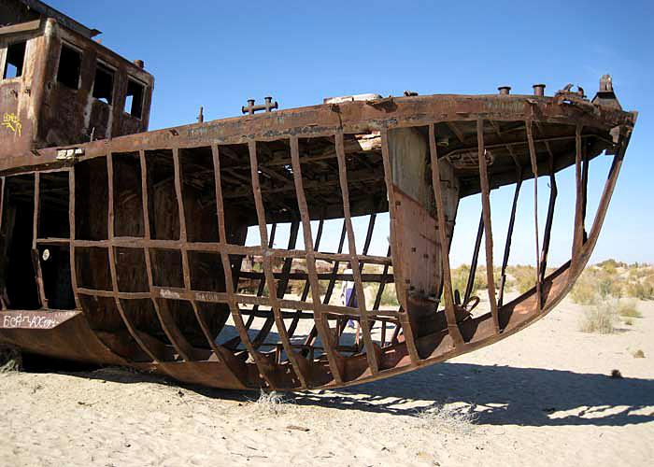
What happened to this boat?
AF4 – explain the causes and consequences of cotton production
AF5 - evaluate the impacts from cotton production

Slide 2
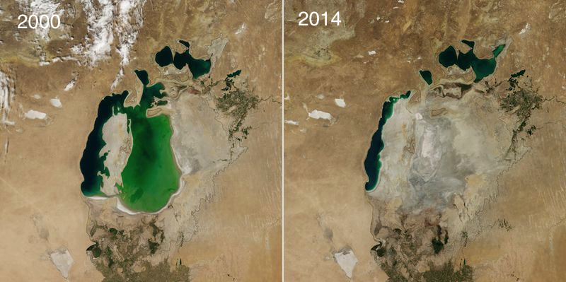
Describe the change between 2000 and 2014.
Better answers will
have data
The Aral Sea has….

Slide 3
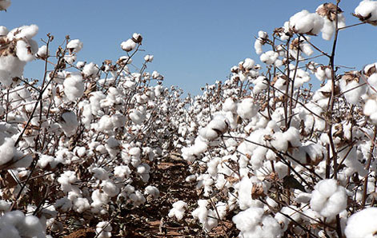
AF5 - evaluate the impacts from cotton production.
Are there any positive impacts?
2. What are the negative impacts?
3. Which do you think
was the worst and
why?
Use these to help
https://www.youtube.com/watch?v=oNDjL_q7kHU
(first 1 min then from 6min)
http://www.bbc.co.uk/newsround/31673854

Slide 4
Copy this cause/impacts table
Following the Cuban Missile Crisis in 1962, international relations improve
More exporting opportunities to improve Russia’s economy
Match up as many causes and impacts as you can.
Some may have more than one impact or cause.
therefore
Following the Cuban Missile Crisis in 1962, international relations improve | Exporting products (trade) brings in money | In 2000, the Aral Sea separated into two | Cotton is irrigated (watered) | They wanted to turn the desert into farms | More exporting opportunities to improve Russia’s economy | Wheat and other crops were planted around the Aral Sea
The Aral Sea used to be the 4th largest lake | Rates of throat cancer are among the highest in the world. | In the 1960s, the Soviet Union diverted water | The lake has shrunk to 15% of its original size. | Huge amounts of pesticides (chemicals to kill pests) are used to grow cotton. | The Soviet Union wanted money | Children were used as cheap workers during the cotton harvest.
Cotton plants need lots of water. | The salinity (salt) of the water and soil has increased. | Half of all human deaths in the area are form respiratory disease. | Fish are dying as the water is saltier. | People died of famine (no food) others moved away. | Crops (plants for food) can’t grow in the salty soil. | Children as young as 7 miss 3 months of school
Use because and therefore to help
you work out the cause and impact

Slide 5
What happened to the boat?
Khojabay is a fisherman who lives in a desert.
Almost everyone in his village used to fish for a living but in the 1970s the fish died, and the sea began to dry up. Steadily, over the past 40 years, around 60,000 sq km of water, in places 40m deep, has evaporated into thin air. The Aral Sea, in Central Asia, used to be the fourth largest lake in the world, after the Caspian Sea, and Lakes Superior and Victoria. Now barely 10% of it is left. This must be one of the most dramatic alterations of the Earth’s surface for centuries.
In Khojabay’s village, Zhalanash in Kazakhstan, on what used to be the Aral Sea’s northern shore, there is now no water in sight, just brown earth and wind-blown sand.
“Just over there was the sea. We would come over here and dive in the water. It was right here where we stand now. There was a sandy beach and all the kids sunbathed on it,” he remembers.
His eyes are now failing him, but on the horizon it’s possible to make out three black dots, one of the few reminders of the way things once were.
Each is the wreck of a giant fishing boat beached and abandoned, now clanking and rattling in the wind. Beyond the horizon there are hundreds more.
“This ship was big, she could accommodate at least 20 or even 40 people,” remembers Khojabay, now 86.
There were fishermen, chefs, sailors and engineers. These big ships could not reach shallow docks when the sea started shrinking. One by one they stranded in the soft mud, and the mud became the sand in the wind you see now.”
Use your classwork and the extract above to explain what happened.

Slide 6
Following the Cuban Missile Crisis in 1962, international relations improve
More exporting opportunities to improve Russia’s economy
Match up as many causes and impacts as you can.
Some may have more than one impact or cause.
therefore
Following the Cuban Missile Crisis in 1962, international relations improve | Exporting products (trade) brings in money | In 2000, the Aral Sea separated into two | Cotton is irrigated (watered) | They wanted to turn the desert into farms | More exporting opportunities to improve Russia’s economy | Wheat and other crops were planted around the Aral Sea
The Aral Sea used to be the 4th largest lake | Rates of throat cancer are among the highest in the world. | In the 1960s, the Soviet Union diverted water | The lake has shrunk to 15% of its original size. | Huge amounts of pesticides (chemicals to kill pests) are used to grow cotton. | The Soviet Union wanted money | Children were used as cheap workers during the cotton harvest.
Cotton plants need lots of water. | The salinity (salt) of the water and soil has increased. | Half of all human deaths in the area are form respiratory disease. | Fish are dying as the water is saltier. | People died of famine (no food) others moved away. | Crops (plants for food) can’t grow in the salty soil. | Children as young as 7 miss 3 months of school
Use because and therefore to help
you work out the cause and impact

Slide 7
AF5 – Evaluate: Of all the consequences which do you think was the worst and why?
Introduction: Describe what is happening. (include place names and data. The Aral Sea is on the border between Uzbekistan and Kazakhstan…
Paragraph 1: The first consequence of cotton production near the Aral Sea is… Use connectives, data and place names
Paragraph 2: The second consequence of cotton production near the Aral Sea is… Use connectives, data and place names
Paragraph 3: The third consequence of cotton production near the Aral Sea is… Use connectives, data and place names
Conclusion: The worst consequences of cotton production near the Aral Sea is…….because………therefore…….
Possible consequences to
discuss
Fish dying = famine
Pesticides = disease
No water left = migration
Children miss school = poor education

