Slide 1
Will the USA want me?
AF5: evaluate the impact of migration
 | No | Word | No | Word | No | Word | Theme
1 | 1 |  | 9 |  | 28
2 | 7 |  | 14 |  | 44
3 | 36 |  | 37 |  | 46
4 | 6 |  | 25 |  | 12

Slide 2
Complete the table using the numbers and words above
Highlight/Underline the odd one out.
Write the theme/reason for the choice.
EXT: make up your own.
https://www.youtube.com/watch?v=1eMq-MTw2wA&t=1s

Slide 3
DME: Pedro Morales
You need to decide:
How you are going to get into California
What job you are going to do
What you will be taking with you

Slide 4
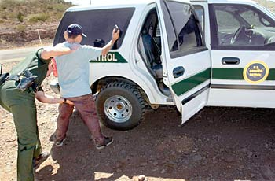
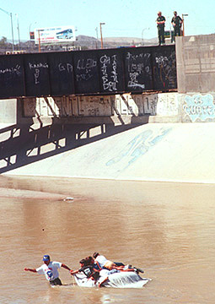
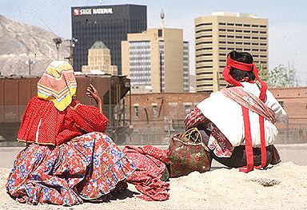
How are you going to get into
California?
Cross in the day, border, swim
https://www.youtube.com/watch?v=LvDPN_DU99M
1 in 10 chance!

Slide 5
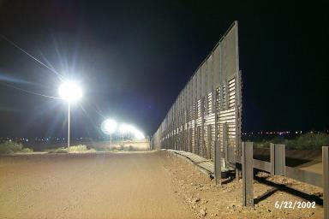
How are you going to get into
California?
Choose and justify which route you will take – wire cutters or swimming route?
1 in 3 chance - The border at night

Slide 6
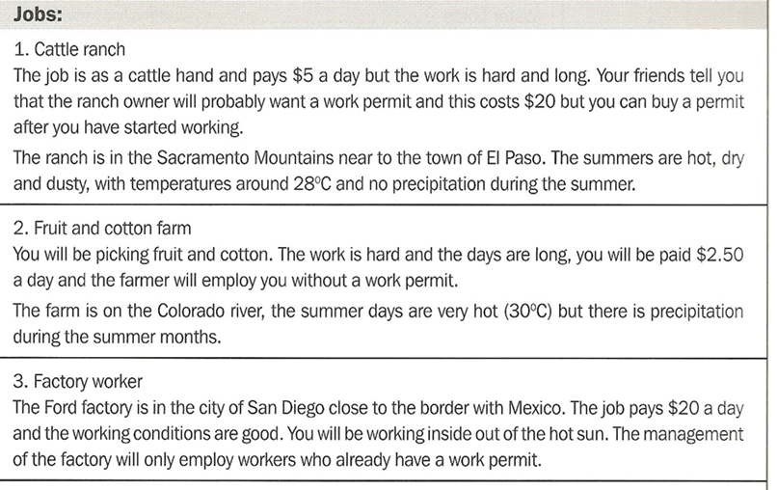
Which job are you going to do?
Choose and justify which of the 3 jobs you will do?

Slide 7
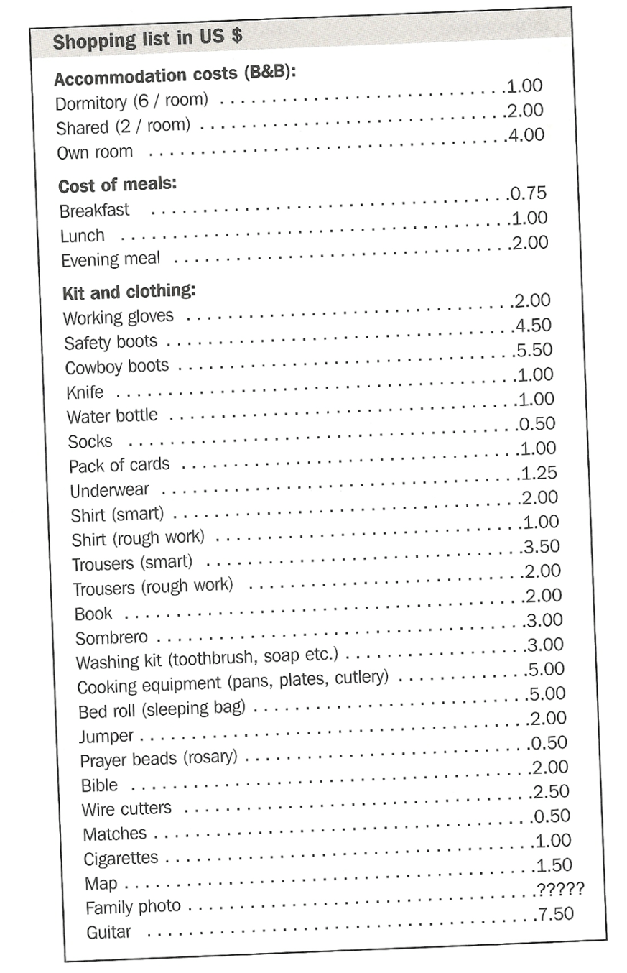
What are you going
to take with you?
Based on your job, choose what to buy with $40 – justify why you have bought these items - Produce a budget summary outlining what you spent your money on
Notes:
After DME activity – read out the source sheet to introduce the writing exercise

Slide 8
Task
Write a diary entry to describe your journey across the border and what it was like once you made it across.
What did you take with you?
What job did you get? How much were you paid?

Slide 9
Will the USA want me?
AF5: evaluate the impact of migration
1. In groups discuss either:
Reasons why the USA do want the Mexicans
Reasons why the USA do not want the Mexicans

Slide 10
AF5 - Evaluation…
Paragraph 1 - Explain reasons why America do want the Mexicans (2 developed reasons using connectives)
Paragraph 2 - Explain reasons why Americans do not want the Mexicans (2 developed reasons using connectives)
Conclusion: Do you think the Americans will want the
Mexicans? Summarise the reasons.
Success Criteria
EE - Balanced evaluation that is justified based on detailed
explanations which are supported with evidence/data.
A detailed conclusion with your own opinion
ME - Evaluation is two sided, however explanations are brief
with little evidence to justify the points. A brief conclusion.
WTE - one sided, no conclusion, points are briefly
explained with no further supporting data or
evidence. No conclusion.
Look back at your marked evaluations to see
what you need to focus on to get a higher grade!

Slide 11
Which is a WTE+? Which is ME+?
The Americans want me because I will work for little money. This is good for America because they will make more money by not paying me much money.
The Americans want me because I will work for little money. I want to work in a bar where I will be paid $2 per day. This is good for America because they will make a profit by not paying me much. This means that the country will become much more prosperous.
Success Criteria
EE - Balanced evaluation that is justified based on detailed explanations which are supported with data.
ME - Evaluation is two sided, however explanations are brief with little evidence to justify the points.
WTE - one sided, no conclusion, points are briefly explained with no further supporting data or evidence.

Slide 12
PLENARY

Slide 13
Will the USA want me?
EXAMPLE paragraph: The USA want me because I will work for little money, so they will make more money, by not paying me much money. For example, I will work picking fruit where I will be paid only $2.50 per day.
Another reason why the USA wants me is because/due to………………………, so/therefore…………… For example…
A reason the USA doesn't want me is because/due to………………………, so/therefore…………… For example…
Another reason the USA doesn’t want me is because/due to………………………, so/therefore……… For example…
CONCLUSION Answer the question: Will the USA want me? The USA will/will not want me because/due to………………………, so/therefore……… For example…
SUCCESS CRITERIA
Grade | Descriptor | Achieved?
WTE | Describing or listing your points
WTE+ | Using either ‘because’ and ‘therefore’ style connectives in your sentences
ME | Using both ‘because’ and ‘therefore’ style connectives in your sentences. Have a conclusion.
ME+ | Using both ‘because’ and ‘therefore’ style connectives in your sentences and including data and using examples, such as job and place names. Have a conclusion that is also explained.
EE | Using both ‘because’ and ‘therefore’ style connectives in your sentences and including data and using examples, such as job and place names. Have a conclusion that is explained and supported with data. Also, you have independently researched further reasons, data and examples to support your point.

