Slide 1
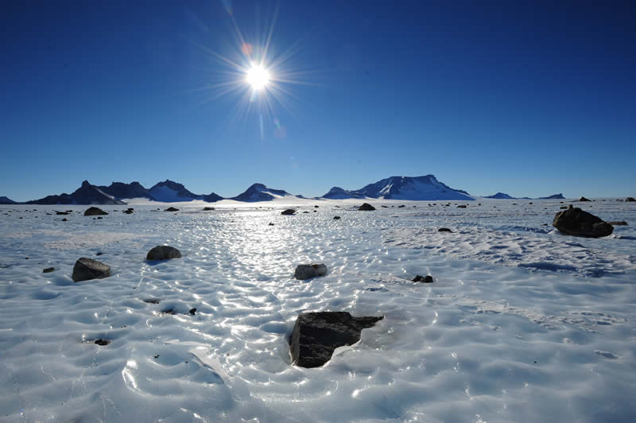
Who owns Antarctica?
AF5 – to evaluate who owns Antarctica and whether it should be used or protected.

Slide 2
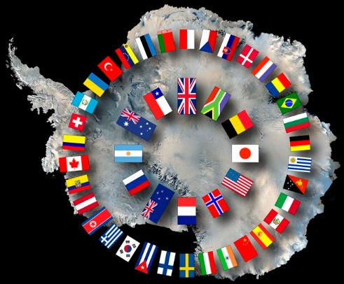
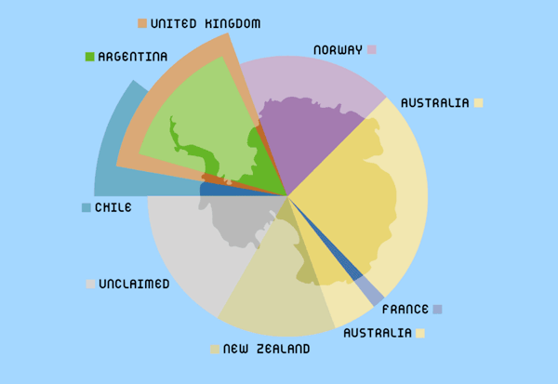
Starter: Who can you recognise?
The inner circle show the first countries with territorial claims.

Slide 3
What is the Antarctica Treaty?
Antarctica is a unique example of how governments cooperate.
The Antarctic Treaty of 1961 states that Antarctica “shall continue to be used forever for peaceful purposes and shall not become the scene or object of international discord”…

Slide 4
Create your own treaty.
In pairs or small groups, come up with a list of five rules that you agree are the bare minimum for any Treaty that decides what goes on in Antarctica.
Use this word bank for useful words to include in your five rules:
Ban | Quota | Limit | Introduce | Prohibit | Prevent | Protect | Reduce | Improve | Enhance | Monitor

Slide 5
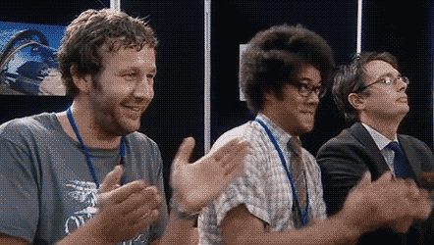
Should we use Antarctica for our benefit or leave it alone?
You have been commissioned by the Antarctic Treaty to evaluate the advantages and disadvantages of using Antarctica, and then to report back.

Slide 6
CAROUSEL: On the tables you will find information for and against using Antarctica.
Move around each station and make notes on each of the reasons.
It has resources!
A wonder!
Fishing
Tourism

Slide 7
It has resources!
All of the non-renewable resources (including natural gas, oil and drinking water) are finite and that means that we will run out of them someday, however Antarctica could provide that extra boost that humanity needs to survive for many more years, and this great reserve shall be used in the future.
Millions of people have died in the last years because of problems related to droughts and with environmental problems increasing, the situation will be worse soon. The majority of drinking water reserves are actually found on the ice and believe me, Antarctica has lots of it.

Slide 8
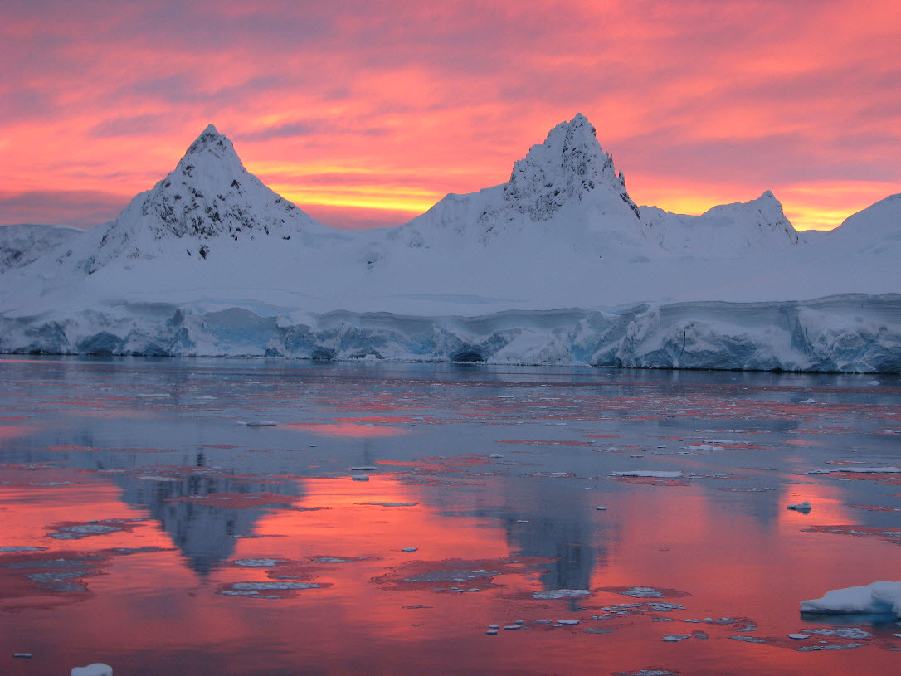
A Wonder!
Antarctica is an ecological wonder with immense diversity that encompasses various endangered species and ancient species. It is almost all untouched at the moment. Shall we make sure it stays that way?

Slide 9
Fishing
Fishing is the only large-scale commercial resource harvest currently undertaken in the Antarctic Treaty area now that sealing has effectively ceased and whaling has significantly decreased. The major negative effects of fisheries are:
potential for over-fishing of target species
effects on predator populations dependent on the target species as a food source
destruction of habitat
However, Over 110,000 tonnes of fisheries are caught in Antarctic waters every year. Among the varieties of fish and seafood that are commonly extracted from Antarctic Sea, the most important is Antarctic Krill, the catch for which is reported to have exceeded 200,000 tonnes per year. This does mean less fish are caught in other seas that are already over fished.

Slide 10
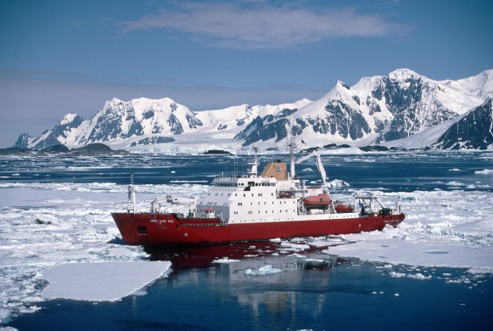
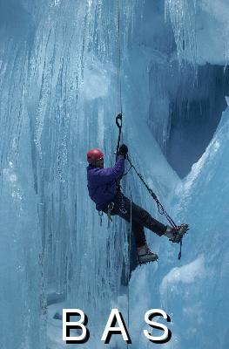
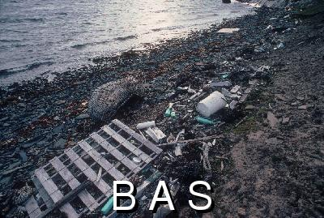
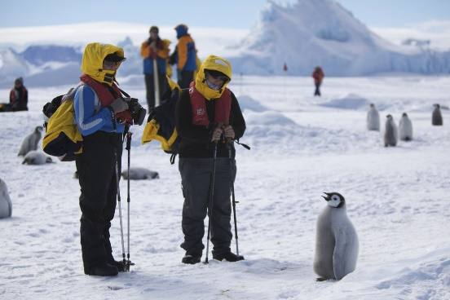
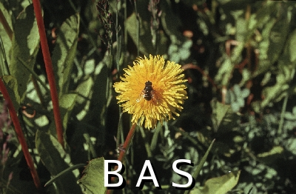
Tourism – British Antarctic Survey (BAS)
Tourists leave litter and it is washed up from passing boats.
Could it bring more jobs? Guides, shipbuilders, ship entertainers, cold clothing makers…
This hoverfly is an alien species to Antarctica, thought to have crossed from South America by tourists. Added species will change the food web and will eat the food of native species.
A rise in the number of new diseases killing penguins is believed to correlate to the increase in tourists visiting Antarctica.

Slide 11
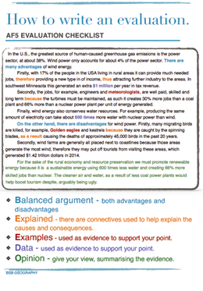
Write your report.
Introduction
This report will evaluate…
Reason for
Reason for
Reason against
Reason against
Your overall opinion
CAUSES: because, due to
CONSEQUENCES: so, therefore, this means that, as a result

