Slide 1
GRID REFERENCES
#inwhatgridsquareisPucksFm?

Slide 2
LEARNING OBJECTIVES
TITLE: GRID REFERENCES
DATE:
AF2: TO UNDERSTAND HOW TO WORK OUT 4 & 6 FIGURE GRID REFERENCES
ALL (WTE/WTE+) STUDENTS WILL BE ABLE TO WORK OUT 4 FIGURE GRID REFERENCES.
MOST (ME/ME+) STUDENTS WILL BE ABLE TO WORK OUT 4 FIGURE GRID REFERENCES & HAVE SOME UNDERSTANDING OF 6 FIGURE GRID REFERENCES.
SOME (EE/EE+) STUDENTS WILL BE ABLE TO CONFIDENTLY UNDERSTAND 4 & 6 FIGURE GRID REFERENCES & APPLY TO MAPS.
LEARNING OUTCOMES
SCF: Communication & Collaboration

Slide 3
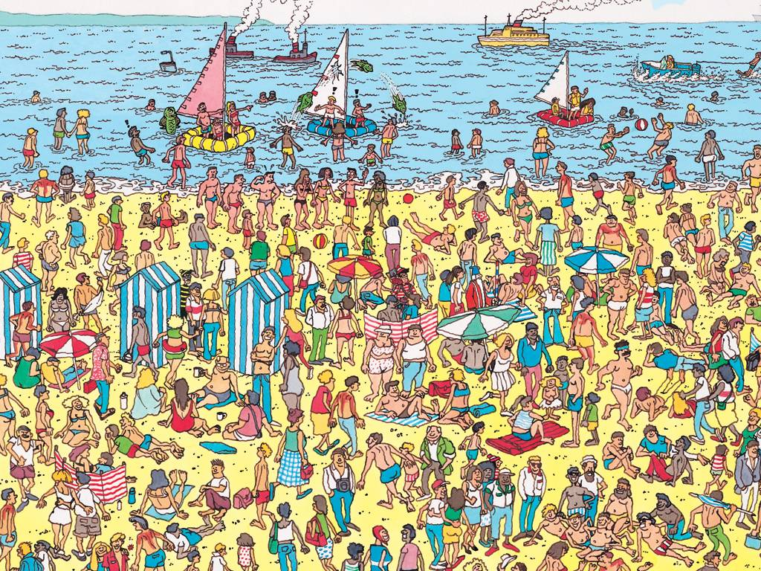
WHERE’S WALLY?
48
47
46
45
21
22
23
Notes:
START OF LESSON 2

Slide 4
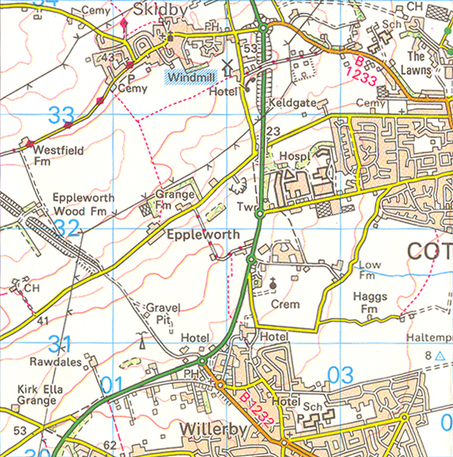
Grid references
COPY: Areas on maps can be identified with a grid reference.
COPY: The first two digit number is the easting. This is the number at the bottom of a map.
34
COPY: The second two digit number is
the northing. This is the number at the side of a map.
33
32
31
30
00
01
02
03
04
COPY: A grid reference is a set of two numbers, the easting and the northing.
Notes:
Map credit: Reproduced by permission of Ordnance Survey on behalf of HMSO.
© Crown Copyright 2008. All rights reserved. Ordnance Survey Licence number 1000 46271.

Slide 5
Finding a grid reference
How would you find the grid reference of square 0231?
34
Find the easting by placing your finger on the 02 line at the bottom.
Find the northing by placing a second finger on the 31 line at the side.
Draw your fingers along the lines until they meet.
33
32
31
The square is North-east of the point where they meet.
30
00
01
02
03
04
Notes:
Map credit: Reproduced by permission of Ordnance Survey on behalf of HMSO.
© Crown Copyright 2008. All rights reserved. Ordnance Survey Licence number 1000 46271.

Slide 6
Four figure grid references
Notes:
Worksheets: The worksheet Four Figure Grid References accompanies this slide.
Map credit: Reproduced by permission of Ordnance Survey on behalf of HMSO.
© Crown Copyright 2008. All rights reserved. Ordnance Survey Licence number 1000 46271.

Slide 7
4 FIG GRID PRACTICE
Question 1
Click on the square
2302
04
03
02
22
23
24

Slide 8
Well Done!

Slide 9
4 FIG GRID PRACTICE
Question 2
Click on the square
2202
04
03
02
22
23
24

Slide 10
Well Done!

Slide 11
4 FIG GRID PRACTICE
Question 3
Click on the square
2301
04
03
02
22
23
24

Slide 12
Well Done!

Slide 13
Wrong answer, try again!
Click here

Slide 14
THINKING QUESTION
HANDS UP……
WHAT’S THE BIG PROBLEM WITH 4-FIGURE GRID REFERENCES?

Slide 15
Six figure grid references
34
Sometimes we need to be specific about the location of a place.
33
Six figure grid references help us be more exact.
32
31
024 315 is the six figure grid reference of the church in grid square 02 31.
30
00
01
02
03
04
What do the extra numbers mean in 024 315?
Notes:
Map credit: Reproduced by permission of Ordnance Survey on behalf of HMSO.
© Crown Copyright 2008. All rights reserved. Ordnance Survey Licence number 1000 46271.

Slide 16
Finding a six figure grid reference
How would you find the grid reference 024 315?
Use the first two digits of each three digit number to find the four figure reference, 024 315.
Imagine the square, 02 31, is divided into tenths vertically and horizontally.
Use the last digit of each three digit number, 024 315 to estimate lines at 4 tenths across the square and 5 tenths up the square.
024 315 is the point where the imaginary lines cross.
32
5
31
4
02
03
Notes:
Map credit: Reproduced by permission of Ordnance Survey on behalf of HMSO.
© Crown Copyright 2008. All rights reserved. Ordnance Survey Licence number 1000 46271.

Slide 17
Finding six figure grid references
Notes:
Worksheets: The worksheet Six Figure Grid References accompanies this slide.
Map credit: Reproduced by permission of Ordnance Survey on behalf of HMSO.
© Crown Copyright 2008. All rights reserved. Ordnance Survey Licence number 1000 46271.

Slide 18
6 FIG GRID PRACTICE
Question 4
Click on the symbol found at:
152742
75
74
73
14
15
16

Slide 19
Well Done!

Slide 20
6 FIG GRID PRACTICE
Question 5
Click on the symbol found at:
154744
75
74
73
14
15
16

Slide 21
Well Done!

Slide 22
6 FIG GRID PRACTICE
Question 6
Click on the symbol found at:
158742
75
74
73
14
15
16

Slide 23
Well Done!

Slide 24
6 FIG GRID PRACTICE
Question 7
Click on the symbol found at:
153736
75
74
73
14
15
16

Slide 25
Well Done!

Slide 26
6 FIG GRID PRACTICE
Question 8
Click on the symbol found at:
157738
75
74
73
14
15
16

Slide 27
Well Done!

Slide 28
6 FIG GRID PRACTICE
Question 9
Click on the symbol found at:
150740
75
74
73
14
15
16

Slide 29
Well Done!

Slide 30
Wrong answer, try again!
Click here

Slide 31
6-FIG BATTLESHIPS
Notes:
Teacher’s note: Divisions are based on the 2005 Oxford Student Atlas © OUP. Some texts/atlases refer to the continent ‘Oceania’ as ‘Australasia’.

