Slide 1
Developing explanations…
AF4 – explain the formation of landforms
Choose three conditions from your worksheet, explain in detail how each condition allows the coral to grow. Use the connectives on the wall to explain and develop your explanations:
GOOD (AF4 - ME)
Coral needs to grow in shallow water so that sunlight can reach them
EVEN BETTER (AF4 – ME+)
Coral needs to grow in shallow water so that sunlight can reach them. This means that the coral is able to absorb the sunlight for photosynthesis.
EE Would also include data, examples and place specific information e.g., names of seas or towns
Explaining connectives: Because, so, so that, in order to…
Developing the explanation connectives: This means that, as a result of this, therefore…

Slide 2
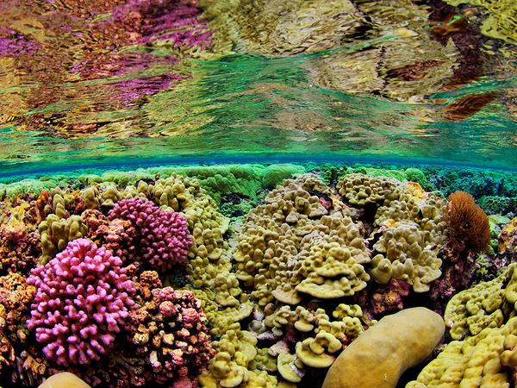
SHALLOW WATER
Corals need to grow in shallow water where sunlight can reach them. Corals depend on the zooxanthellae (algae) that grow inside of them for oxygen and other things, and since these algae needs sunlight to survive, corals also need sunlight to survive. Corals rarely develop in water deeper than 165 feet (50 meters).

Slide 3
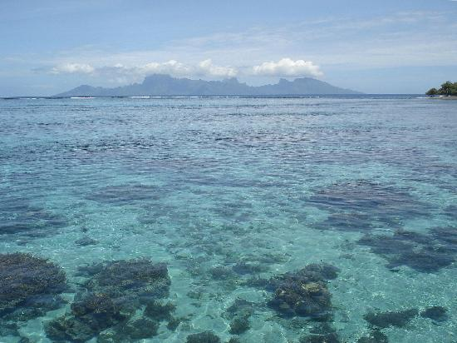
CLEAR WATER
Clear water: Corals need clear water that lets sunlight through; they don’t thrive well when the water is opaque. Sediment and plankton can cloud water, which decreases the amount of sunlight that reaches the zooxanthellae (algae).

Slide 4
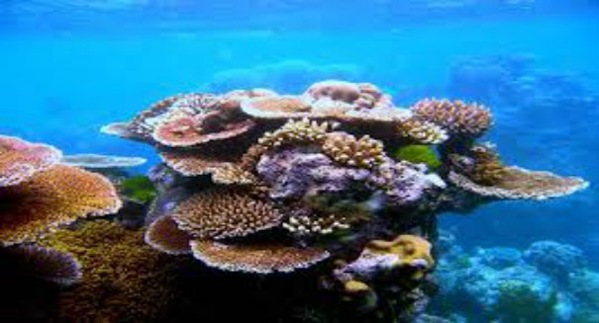
TEMPERATURE
Reef-building corals require warm water conditions to survive. Different corals living in different regions can withstand various temperature fluctuations. However, corals generally live in water temperatures of 68–90° F or 20–32° C.

Slide 5
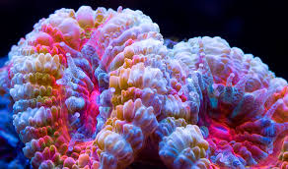
SALT WATER
Corals need saltwater to survive and require a certain balance in the ratio of salt to water. This is why corals don’t live in areas where rivers drain fresh water into the ocean (“estuaries”).

Slide 6
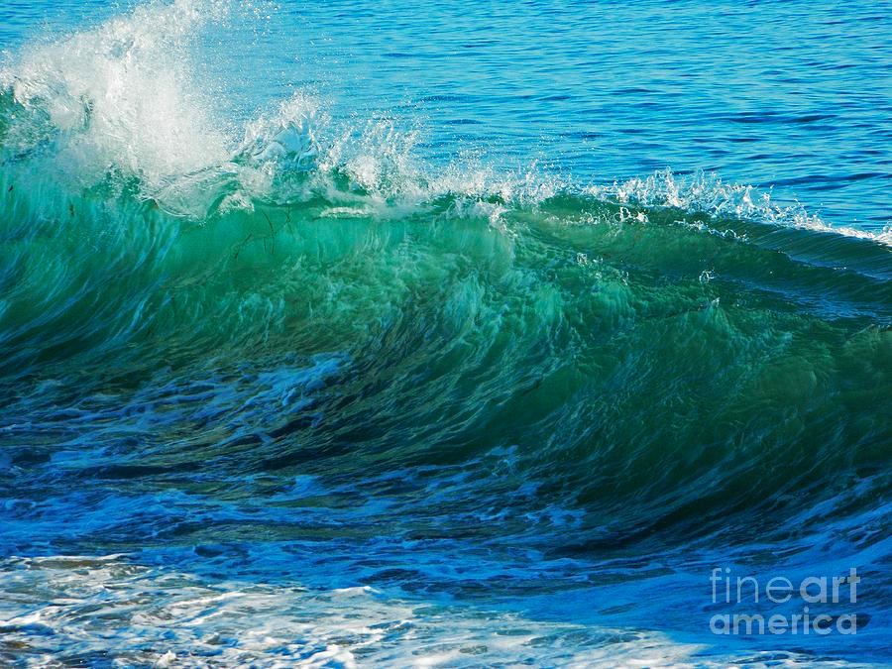
Wave action
Coral require strong wave action to ensure a supply of food and oxygen. It also prevents sediment from settling on the coral.

Slide 7
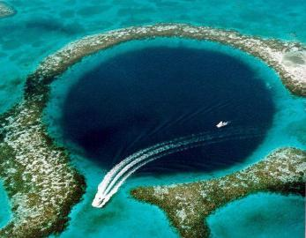
HARD SURFACE
Coral growth is upwards and outwards. As the coral grows it builds on top of old/dead coral, which provides a hard base for growth. Coral can also grow on submerged volcanoes, which acts as the solid base for growth.

