Slide 1
What problems might we have with maps, because they are flat?
1 minute to think of an answer
Well done if you said… ‘How do they show height?’

Slide 2
Contours
Aim - To recognise and be able to use contour lines on an OS map

Slide 3
Land isn’t flat.
We can’t make maps 3D to show different heights of the land.
We have to find a way to show height on a flat map…
Different heights of land are shown on maps using something called…
c_nto_rs
contours

Slide 4
Contours
Contour lines are a map’s way of showing you how high the land is
They join together places of the same height and form patterns that help us to imagine what the land actually looks like

Slide 5
A Contour is…
a line on a map that connects points of a land surface of the same height
Another word for height is:
Relief (the shape of the land)

Slide 6
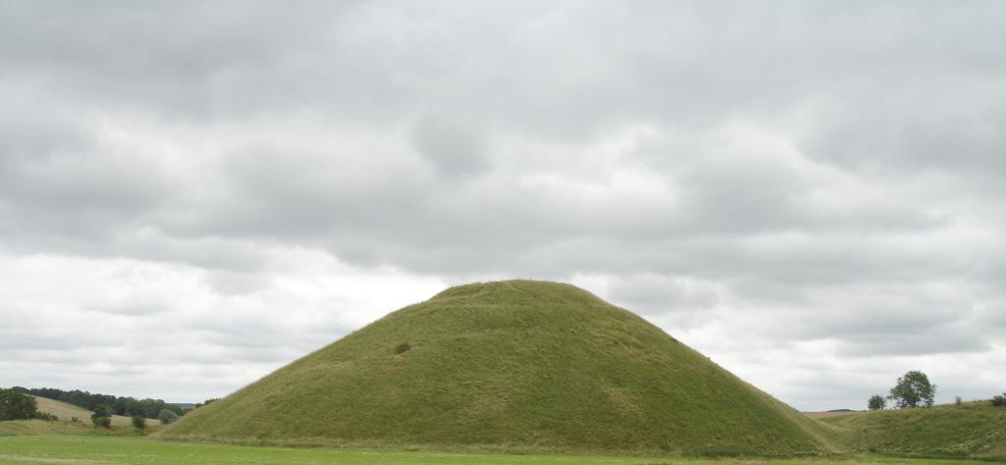
Guess the height!
30
20
10
0
Height (m)

Slide 7
So, the contours for the hill would look like this…
30
20
10

Slide 8
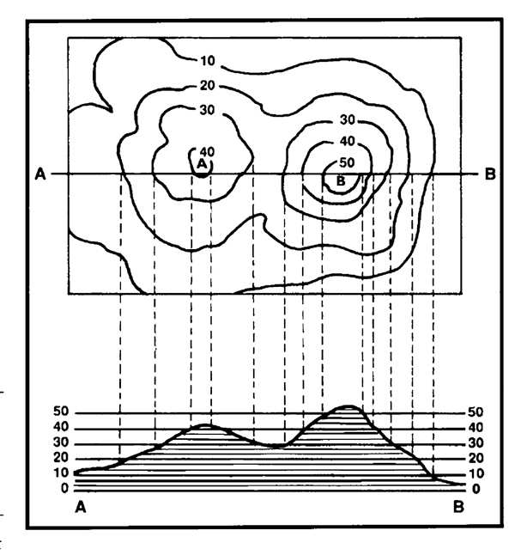

Slide 9
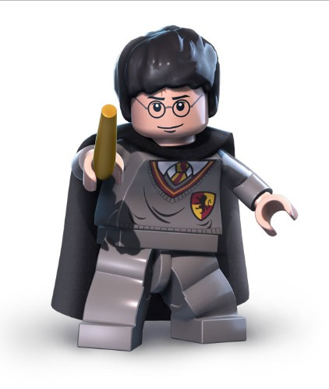
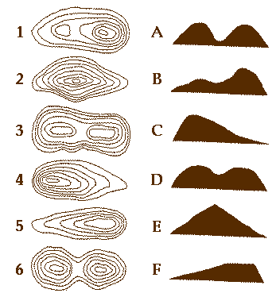
Tasks:
1. Write down in your books…
a)What are contours?
b)Why do we need them
2.. Match the contours with the corresponding landscape.
Extension: Try to draw your own landscape profile and the contours that represent it.

Slide 10
Contours on an OS map are orangey brown…

Slide 11
How many metres apart are the contours?

Slide 12
What about on this map?

Slide 13
Naismith’s rule
Remember that the closer together the contour lines are, the steeper the land.

Slide 15
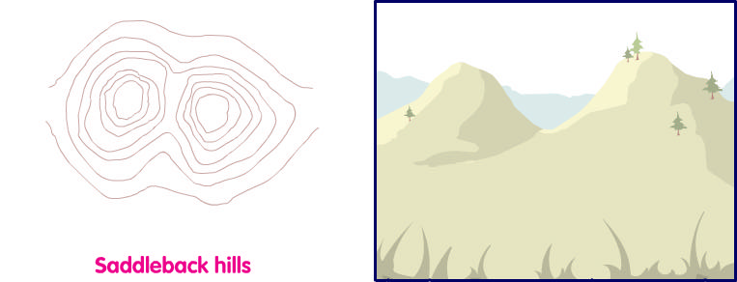
Contours can show us different shapes of the land…

Slide 16
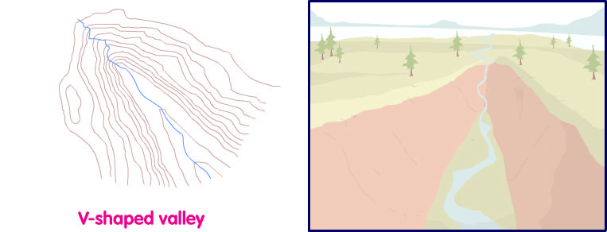
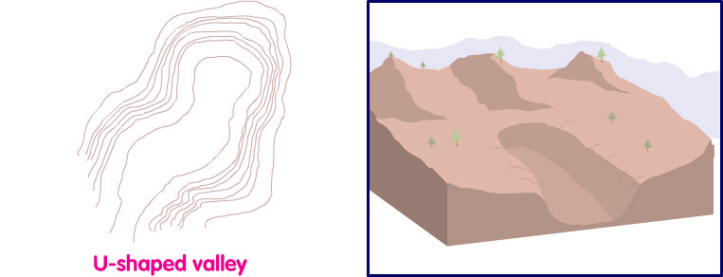

Slide 17
Fill in the gaps!
Maps
Contour Lines are found on _____________
They are used to show _____________
Another word for height is _____________
Height
Relief
Height
Hills
Maps
Relief

Slide 18
Fill in the gaps!
Steep
Close together contours show land that is __________
Far apart contours show land with slopes
Contours show land heights in
Gentle
Metres
Gentle
Hills
Steep
Metres

Slide 19
Heads & Tails! Complete the sentences on contours…
A. to imagine what the land actually looks like.
1. Contour lines are…
C. places of the same height and form patterns that help us
2. They join together…
B. a map’s way of showing you how high the land is.

Slide 20
