Slide 1
Development Gaps Within Urban Areas
LO:
To explore how levels of deprivation vary in a major city such as London
How wealth is spread among a population

Slide 2
What is the Multiple Deprivation Index (MDI)?
It is a composite measure of urban deprivation that looks at 7 different indicators which include:
Income
Unemployment
Health and disability
Education & qualifications
Access to housing and services
Environmental quality
Crime rates

Slide 3
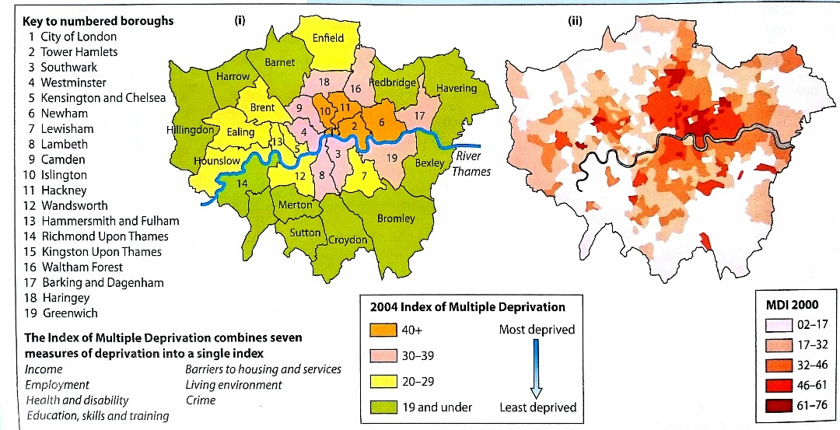
Levels of deprivation in London

Slide 4
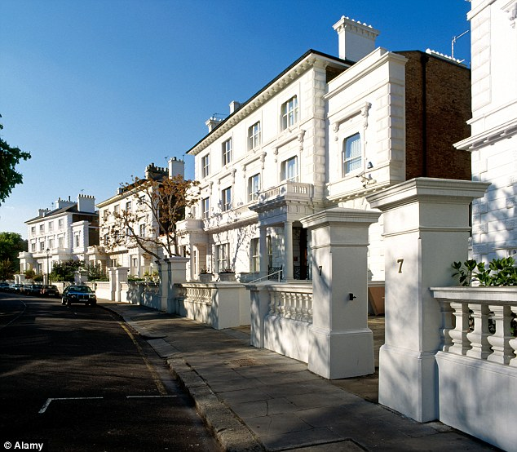
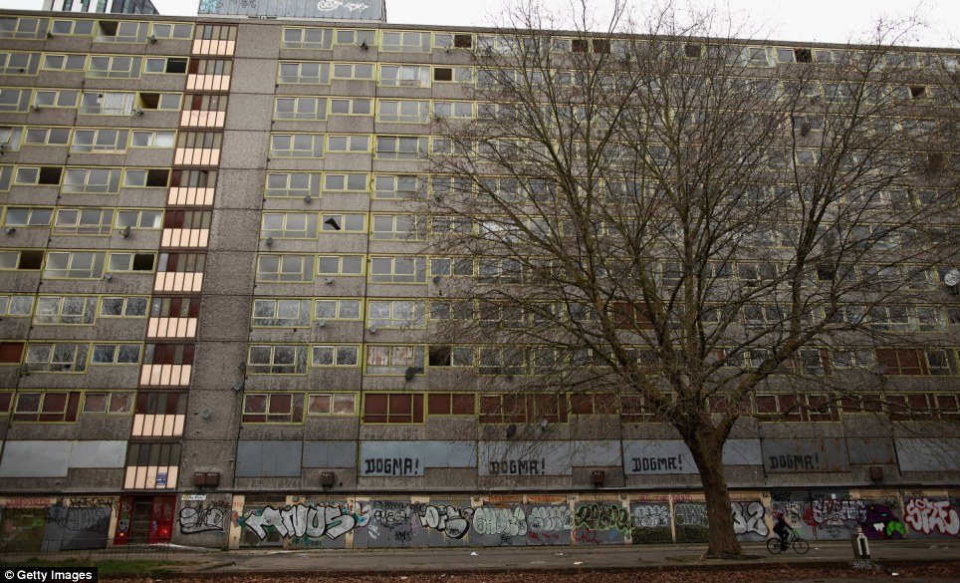
Affluence
Deprivation

Slide 5
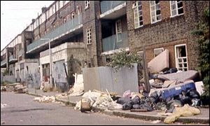
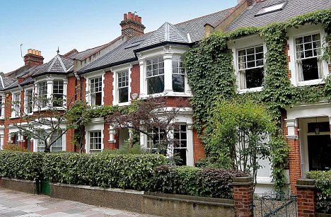
Deprivation
Affluence

Slide 6
Describing levels of deprivation in London study the choropleth map, what patterns does it show?
Areas of central London have higher levels of deprivation
It decreases towards the edge of the city
Slightly higher levels of deprivation north of the River Thames
Also slightly higher levels in the East compared to West
Boroughs including Tower Hamlets, Hackney, Islington are amongst the most deprived
Whereas boroughs towards the edge such as Bexley, Havering and Bromley have low levels of deprivation
However, there are exceptions such as…

Slide 7
Calculating the spread of wealth within a country
The distribution of wealth within a country is measured using the
The Gini Coefficient:
The Gini index is a widely used way of calculating inequality within countries. It measures the degree to which the distribution of wealth within an economy is different from a perfectly equal distribution. The more the inequality, the higher the index.
Study the map on page 255. what does it tell you about the distribution of wealth within countries?
Which countries have the fairest (most equal) distribution?
Which have the most unequal?
How is the map different from the GNI indicator map, are the richest countries always the fairest?
What do you think are the main causes for the unequal spread of wealth within a country?

