Slide 1
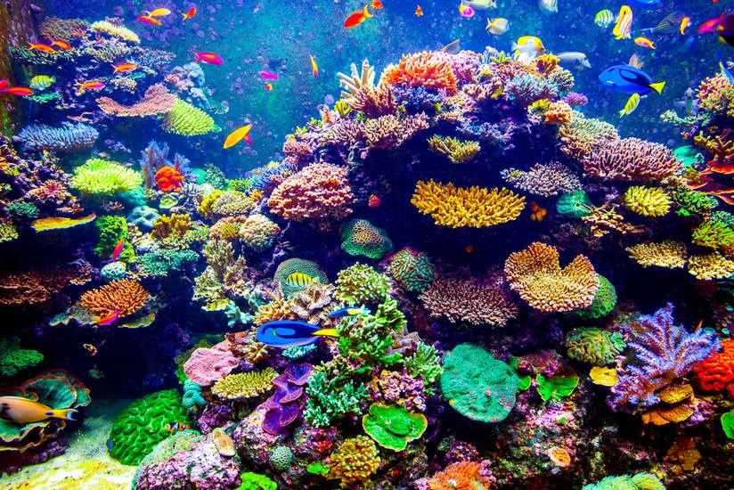
How are coral reefs valuable and why are they being threatened?
AF4 To explain the value of coral reefs and why they are being threatened

Slide 2
Why is coral so important?
Write a list of reasons why you think coral is important.

Slide 3
They support 25% of marine species (about 1 million species of plants and animals)
Act as natural recycling agent for carbon dioxide from sea and atmosphere
Why coral reefs are important?
They provide important fishing grounds
The global value of coral reefs in terms of coastal protection, fishing and tourism has been estimated at $375 billion.
They form as a natural barrier against tropical storms and even tsunamis (they can absorb energy).
Many species are being found to contain compounds useful in medicine.
They contribute material to the formation of beaches (eroded coral reef)
Task:
In your book, write down, what you think, are the top 4 reasons why coral reefs are important.
Explain you top answer.
They benefit the tourism industry because many people like to dive and snorkel over coral reefs
They are source of raw material (coral for jewellery and ornaments)
They protect coastlines from erosion

Slide 4
What is causing the coral to be damaged?
Write a list of reasons why you think coral is being damaged.

Slide 5
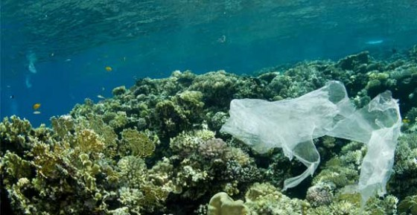

Slide 6
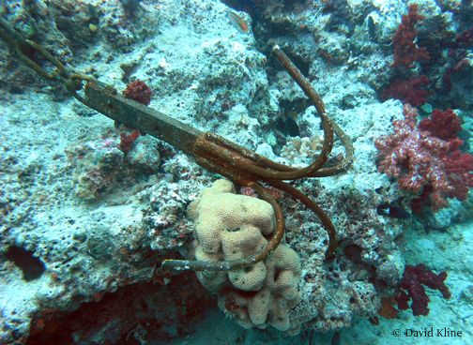

Slide 7
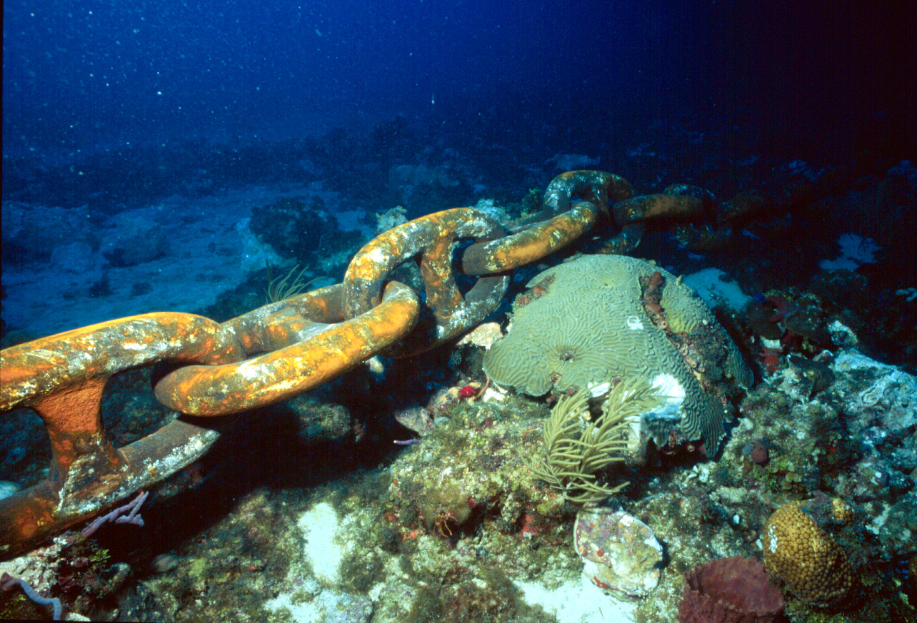

Slide 8
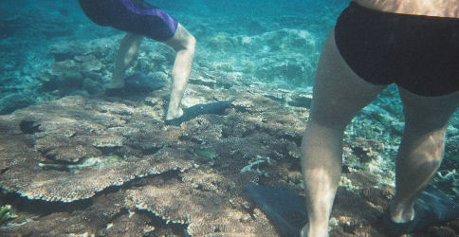

Slide 9
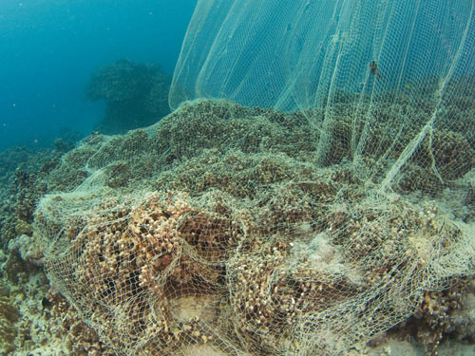

Slide 10
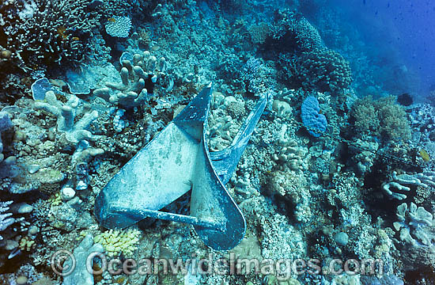

Slide 11
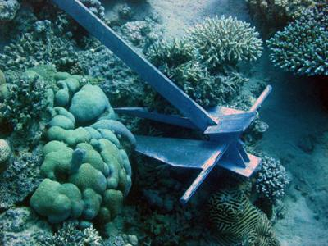

Slide 12
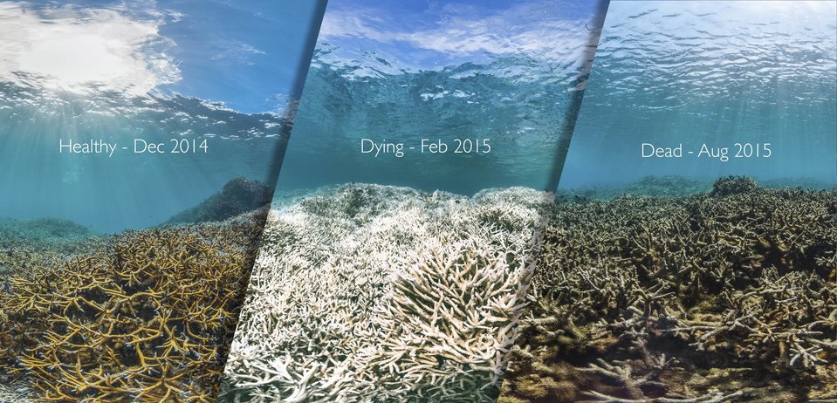

Slide 13
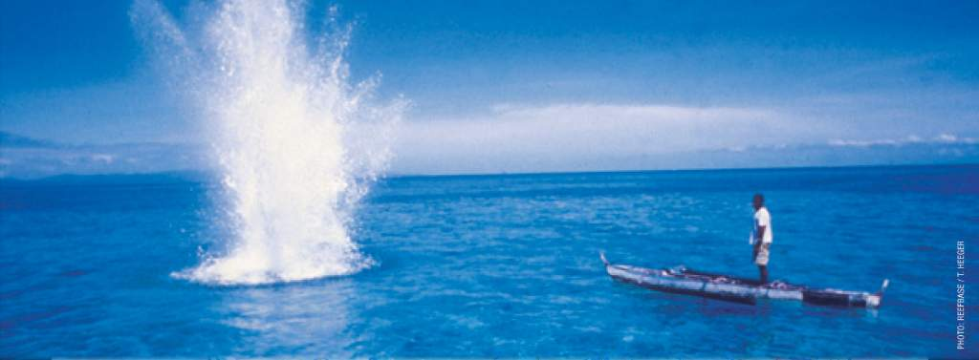
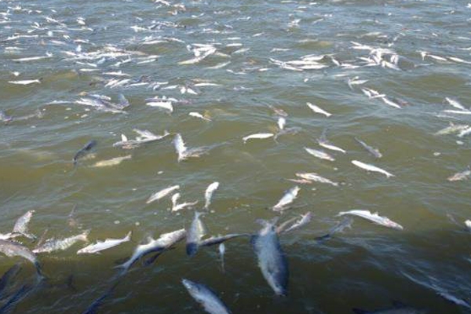
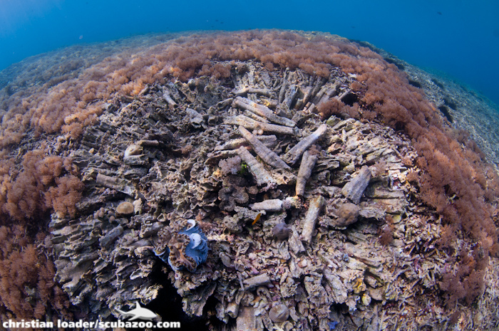

Slide 14
Rising sea levels mean that the depth of water above coral reefs is increasing. This means that in the future many coral reefs will not receive enough sunlight to survive.
Pollution. The growth of cities and hotels, as well as increased coastal traffic can also cause pollution to reefs.
Increases in the global temperature means that many corals are being bleached. Coral reefs are extremely sensitive to changes in temperature and can bleach (die and turn white) even with only small increases.
Hurricanes. Although coral reefs act as a natural defence against tropical storms, they can be severely damaged during tropical storms.
Deforestation. As areas of land are deforested, especially in the tropics (Indonesia, Thailand, Philippines) there is greater surface run-off and more sediment enters the rivers and is ultimately discharged into the sea. The increased sediment reduces visibility and means less sunlight reaches the coral.
Fishing techniques like dynamite, cyanide and trawling can damage corals. Corals are sensitive and take hundreds and thousands of years to grow.
Tourism. Tourism can damage reefs in many ways. Anchors from tourist boats can damage reefs. Motor boat engines can kill animals. Divers can touch and damage coral and tourist developments can release pollution.
Overfishing.
Trade. There are many products, like coral, turtle shells, star fish and sea shells that get removed from corals and sold. This removal of coral and animals damage the reefs
Task: Draw a sketch in your book to show 4 causes to why coral is getting damaged.

Slide 15
Watch the Muru Ami. The video on child labour on board fishing boats around the Philippines.
What value to they see in the reef?
How are they damaging the reef?

Slide 16
AF5
You have used connectives to develop your answer.
You have provided evidence.
You have used keywords
You have mentioned a number of reasons why coral reefs are valuable and how they are being threatened.
Your answer is well structured.
Use a range of connectives (e.g. which means, because, resulting in) to develop your points.
You must provide evidence in the form of numbers or specific examples to make points valid.
Mention more than one reason why coral reefs are valuable and how they are being threatened.
Plan your answer first. Think about the structure for each paragraph.
WWW:
EBI:

Slide 17
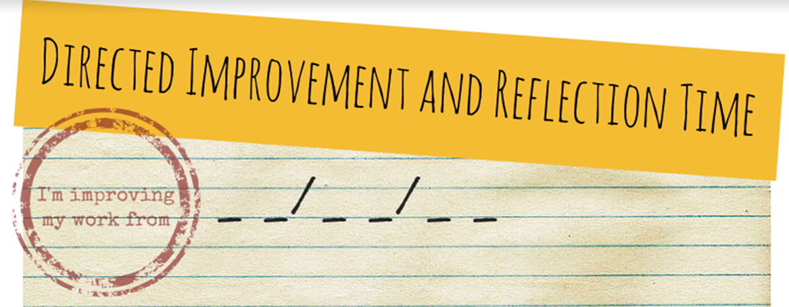
Be the
Best
Using a different coloured pen
Action your EBI by completing suggested improvements then complete one of the following tasks.
1. Highlight and rewrite 1-3 sentences that could be improved.
2. Highlight 3-5 words and replace them to be more ‘sophisticated’ and Geographical.
3. Rewrite out any spelling mistakes 3 times.

