Slide 1
Information Sheets

Slide 2
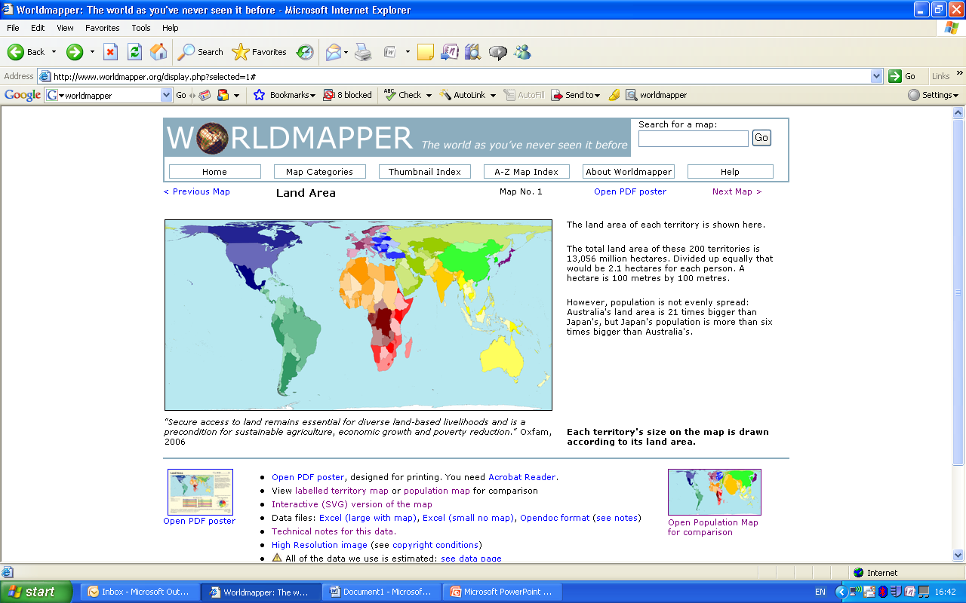
Size
Countries with a large land area are important because they:
  Tend to have greater natural resources
  Extend influence over a larger number of neighbours
Russia has a very large land area with enormous volumes of natural resources. Further, it has 14 neighbours over whom it is able to extend varying degrees of influence

Slide 3
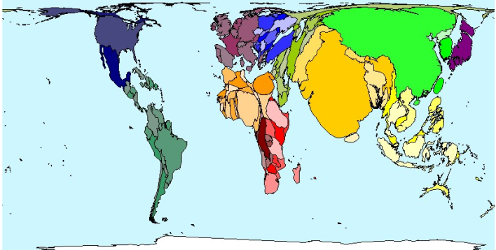
Population
Countries with a large population are seen as important because:
  Economic growth cannot be sustained without sufficient number of workers
  e.g. UK
  Cheap workers can help to promote economic growth
  e.g. China and India
  Larger populations encourage economic growth through markets
  e.g. EU
  However, some countries have managed to promote significant economic growth without a large population
  e.g. Singapore

Slide 4
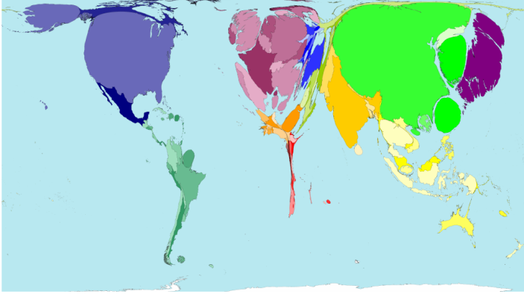
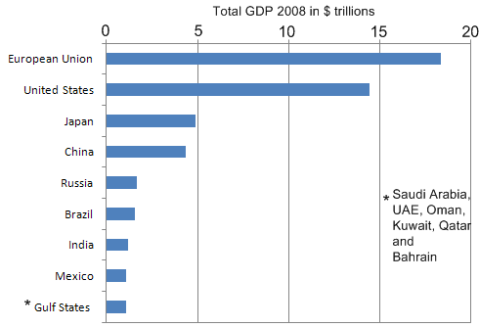
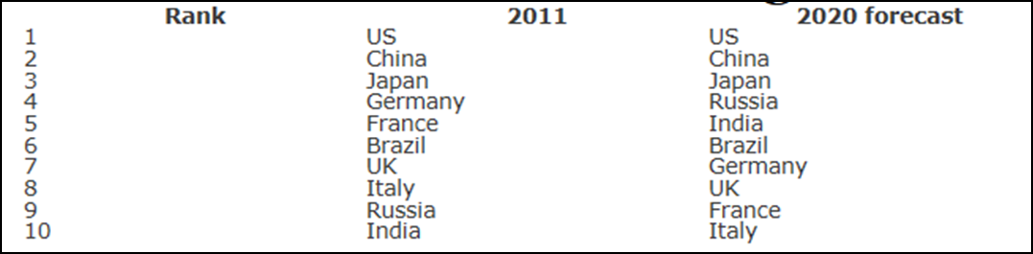
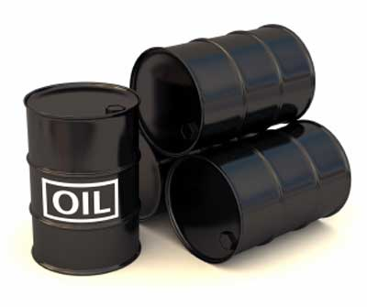
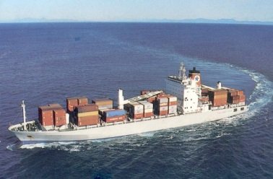
Economic Power
Countries with the largest economies have a significant influence over global economies
In 2011, the world’s 12 largest economies were:
Between these countries they:
  Earn around 2/3 of world GDP
  Control investment
  Use the world’s most powerful currencies ($, € and £)
  Determine economic policies which affect the globe
In addition, the G20 group (countries with the 19 largest economies plus the EU) influence the global economy and control aid to LEDCs.
Wealth allows superpowers to export their power around the world, buy resources and influence trade patterns.

Slide 5
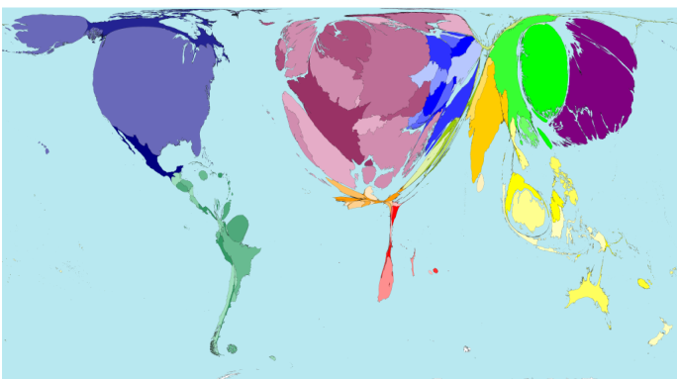
Resources
Countries with resources necessary for economic development should hold significant power
e.g. Russia – gas; Middle East – oil
However, countries with significant resources are not necessarily powerful because:
  Exporting raw materials adds little value
  e.g. Australia – iron ore
  TNCs control large volumes of resources
  e.g. BP - Nigeria

Slide 6
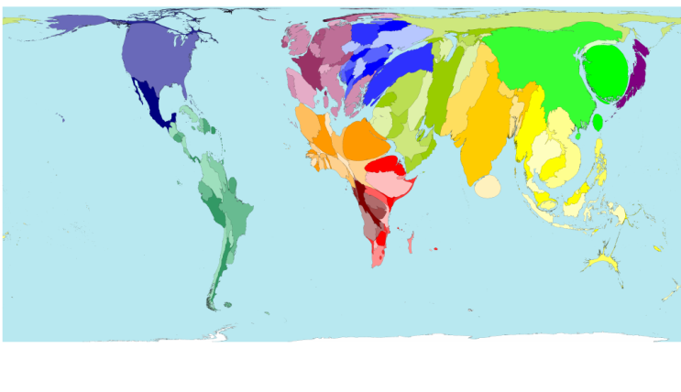
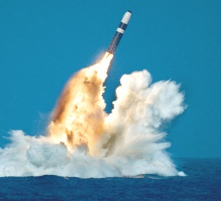
Military
Military spending is one form of power, as it allows superpowers such as the USA to have global military reach.
Countries with a large military may be viewed to be more powerful
e.g. India
However, the type of weapons owned is also representative of power
i.e. Countries in possession of nuclear weapons: USA, Russia, UK, France, China, India, Pakistan, North Korea, (Israel)
The USA has the world’s most powerful military machine and this is geographically widespread. 45% of all world spending on military is by the U.S.A. - Nuclear Weapons, Army Personnel, Satellite Technology, Spies…
2008/09 data | Total Population (millions) | Total military spending ($ billions)
China | 1,334 | 84
India | 1,174 | 30
EU | 500 | 280
USA | 308 | 607
Indonesia | 231 | 4
Brazil | 192 | 15
Pakistan | 168 | 4
Bangladesh | 162 | 1
Nigeria | 154 | 1
Russia | 141 | 59
Japan | 127 | 46
Mexico | 107 | 4
Gulf States | 40 | 40

Slide 7
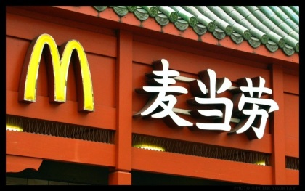
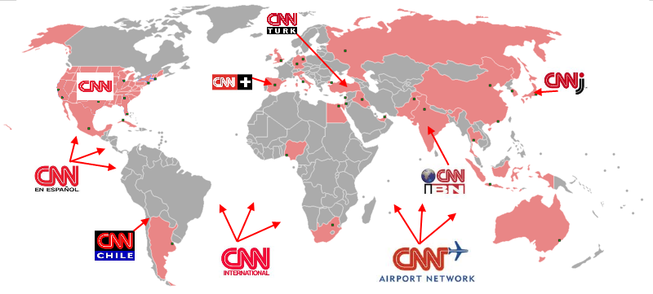
Culture& Media
Religion varies in influence across the world. The influence of European colonisation can be seen in North and South America, southern Africa and Australasia. Islam is the main religion in northern Africa, the Middle East and parts of Asia.
Capitalism has a huge, and ever growing, influence on the world (particularly since the collapse of the USSR in 1991). Whilst not everyone agrees with capitalism, it’s influence reaches most of the world, aided by globalisation.
Global capitalism is promoted by media, especially global new networks, e.g. CNN, Fox...
While the media alone does not make the USA a superpower, it does help it to maintain the USA’s position by using its influence politically.
Cultural imperialism is the practice of promoting the culture or language of one nation in another. ‘Americanisation’ is the cultural globalisation by the USA. Companies adapt slightly to local (host) country markets. However, it is not all one way from West to East or North to South. Increasingly Indian culture is being adopted around the world as well as American and Western lifestyles e.g. Bollywood, curry…

