Slide 1
Key Skill Checklists for Geography

Slide 2
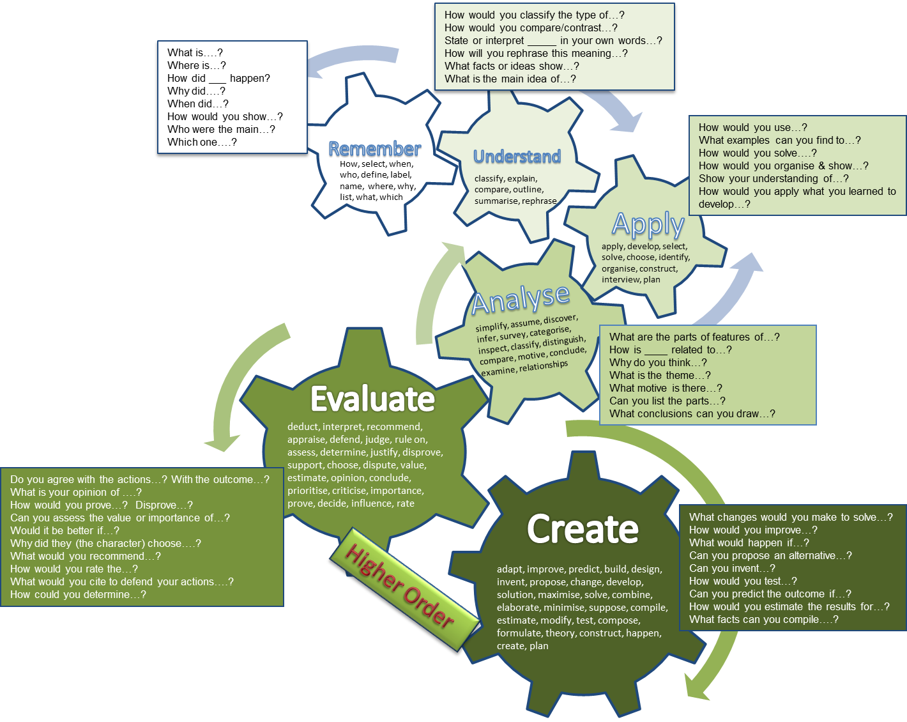
Connectives
Because
Therefore
Consequently
As a result
Thanks to this
Because of this
This causes
So
The reason that
This results in
When
For example
For instance
(Point)…because…(cause)… therefore…(consequence)… for example,….
Develop your point!

