Slide 1
The 17 Sustainable Development Goals
AF3 –Describe the aim of the SDG.
WTE/WTE+ Identify the 17 SDG.
ME/ME+: Describe the aim of each SDG
EE/EE+: Explain how an individual can change their actions in order to meet each SDG.

Slide 2
Starter TASK: Finish the sentence “In the world of the future, I hope that…” or “I believe that every person has the right to…”
Poverty
Inequality between countries
Hunger
Poor health and disease
Dirty water
Lack of sanitation
Poor education – some children can’t go to school
Low-paying and not enough jobs
Low economic growth
Gender inequality – men and women are treated differently and not given the same opportunities
War, fighting and instability
People don’t feel safe
Violence between people
Corruption and injustice
No respect for human rights
Countries never work together or agree on anything
Not enough energy for everyone to live comfortably
Weak infrastructures, poor technology and communications
Un-safe towns and cities
Unsustainable cities that consume more than the world can produce
There’s too much wastage of resources and not enough recycling
Climate change
Polluted seas and oceans
Damaged habitats
We have limited access to technology and expensive mobile phones and computers
People don’t feel they are protected properly
Population growth
Obesity
Racism
Breakdown of communities

Slide 3
Being ‘Sustainable’ means …..
“Sustainable development is development that meets the needs of the present without compromising the ability of future generations to meet their own needs.”
The Brundtland Report, 1987
Think , Pair, Share – what examples can you think of to
describe sustainability?

Slide 4
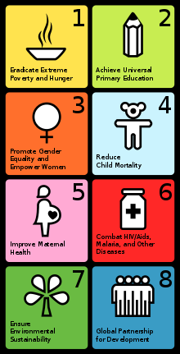
The Millennium Development Goals
In 2000, the United Nations who represent 193 countries set up 8 goals to improve the lives of the 7.5 billion people on the planet. This ended in 2015.
No Point Going Halfway
https://www.youtube.com/watch?v=q5nFFTnUM4w

Slide 5
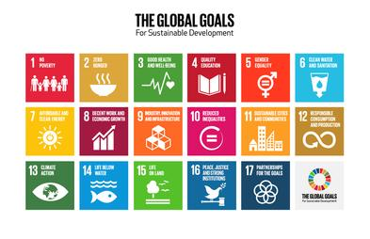
In 2016, 17 Sustainable Development Goals were introduced to continue to improve our planet by 2030.
The World’s Largest Lesson https://www.youtube.com/watch?v=ry_9SU0eq9M
was introduced by Malala.
Malala Yousafzai is a Pakistani activist for female education and the youngest-ever Nobel Peace Prize winner. She was shot on her way to school on the 9th October 2012.

Slide 6
Everything and everyone in the world are interdependent (we rely on one another; our actions affect other people in good and bad ways)
Not all girls are allowed an education e.g. Malala
Write the ‘goals’ out in your exercise book and draw arrows to show how the goals are connected.
Along the arrow write how it affects the other.
See the example (right)
A good job can give you money to buy food and pay for healthcare

Slide 7
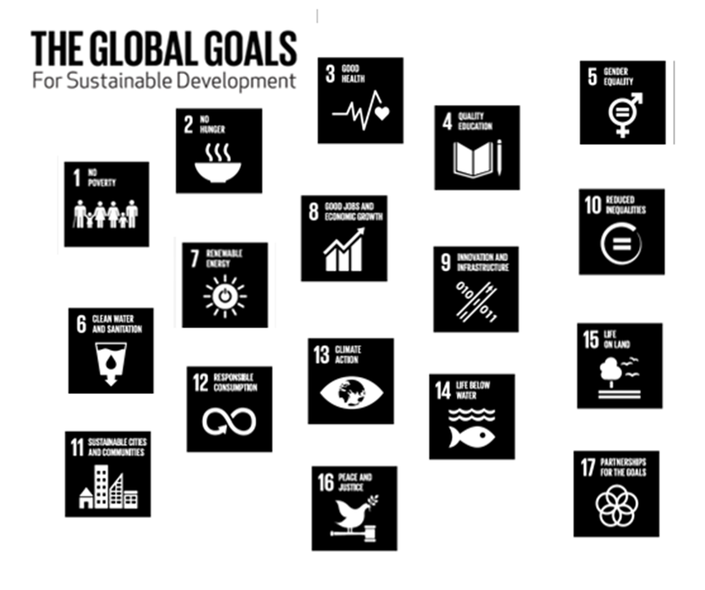

Slide 8
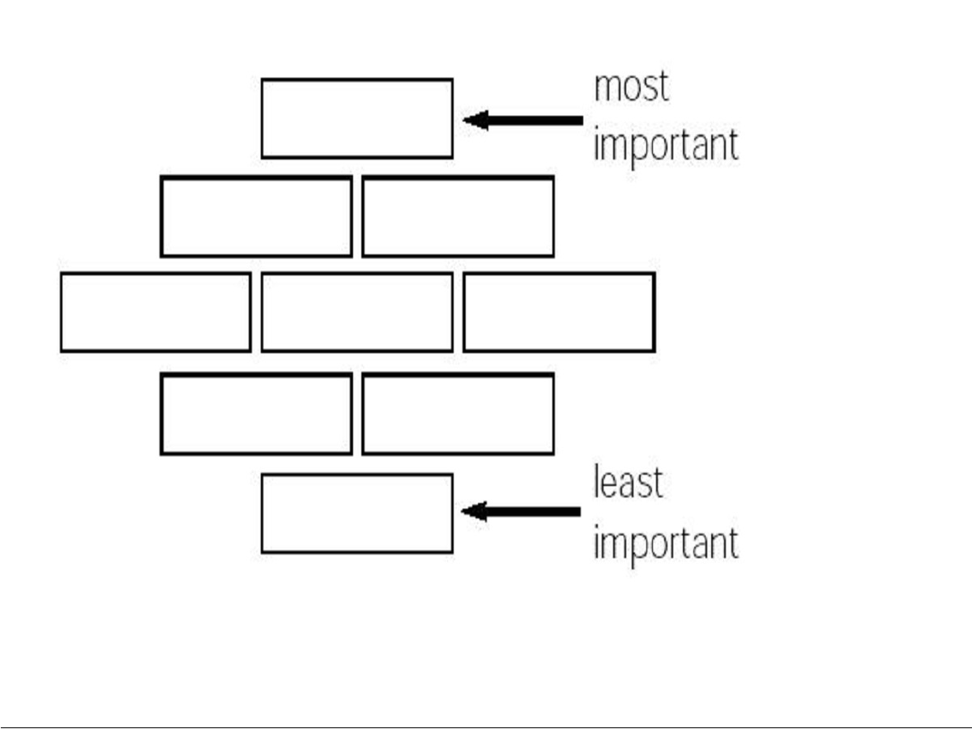
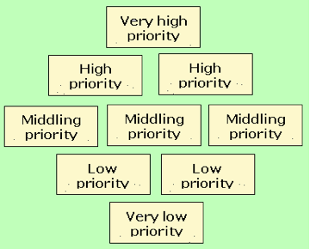
Diamond 9 ranking
Choosing the top 9 from the 17 rank them in order of importance.
Look at where most of your arrows come from – this will give you a clue to what you think is the most important to you.
Challenge: Explain how you could change your actions to meet the top 3 SDG’s.

Slide 9
Remember that word sustainable? How would you define it now?
Make a difference today, so we can enjoy the planet, but making sure the future generations can enjoy it too!
‘We the People’ for Sustainable Goals
https://www.youtube.com/watch?v=RpqVmvMCmp0

