Slide 1
“We live our lives as if we had the resources of 4.2 planets. Our carbon footprint is one of the ten worst in the world. This means we steal 3.2 years of natural resources from future generations”
Who said this?

Slide 2
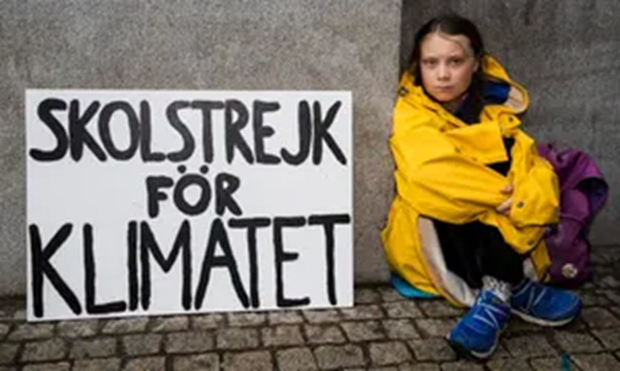
“The seas are rising, and so are we!”

Slide 3
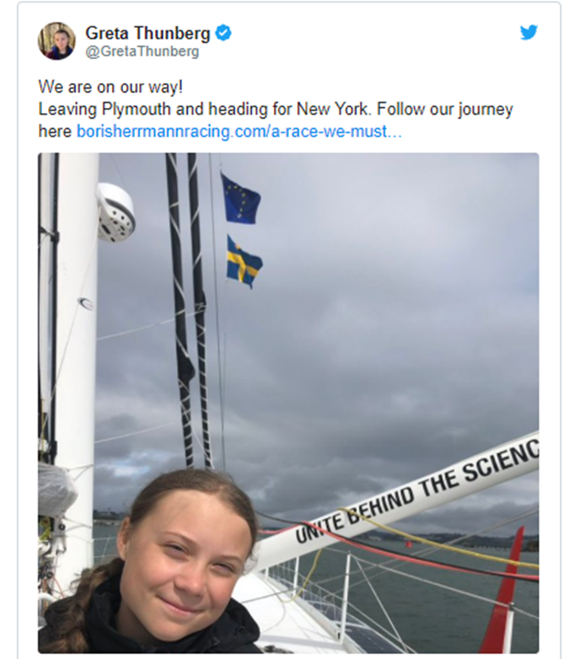
Greta has become one of the youngest Climate Activists.
She has led major protests in Sweden and encouraged protests globally.
She believes we are living in a ‘climate emergency’ and we must take action ..
She decided to sail to New York to attend the next Climate Summit, hosted by the United Nations this September!
QUIZ

Slide 4
Discussing Climate Change ….
AF2– MAP SKILLS
WTE/ WTE+
Show confidence in plotting human features on a map
ME/ME+
Be able to plot 6 figure grid references.
EE/EE+
Be able to work out accurate scale.

Slide 5
RACE FOR KNOWLEDGE
In groups, you must use the information on your table to find the correct answers.
Once you have answered the questions and are confident they are right. Stand up.
House points awarded to the fastest and most accurate team!!
WHAT IS THE UN?

Slide 6
RACE FOR KNOWLEDGE
What is the purpose of the United Nations ?
When was the United Nations set up?
How many countries are part of the UN?
Who makes the decisions?
What is the job of the Secretary General for the UN?
When was the UN Declaration for Human Rights created?
There are 30 Human right agreements. What is number 1?
What are the SDGs ?
What takes place at a Climate Summit?
What was agreed at the Paris Agreement?
Which country withdrew from the Paris Agreement in November 2017?
When is the next Climate Summit?

Slide 7
No toilet, no shower, no kitchen; Swedish climate activist Greta Thunberg is off on her trans-Atlantic yacht trip from Plymouth. She will spend two noisy weeks on the waves instead of flying for eight hours.
Why not fly?

Slide 8
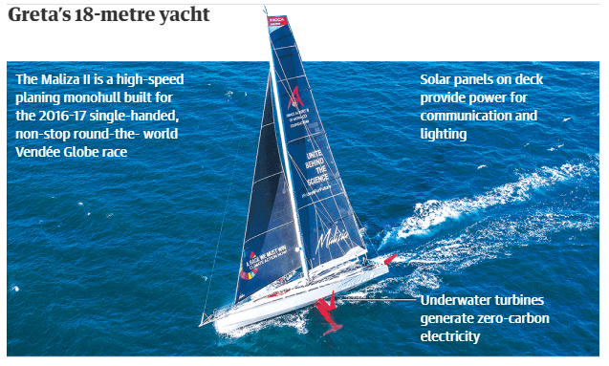

Slide 9
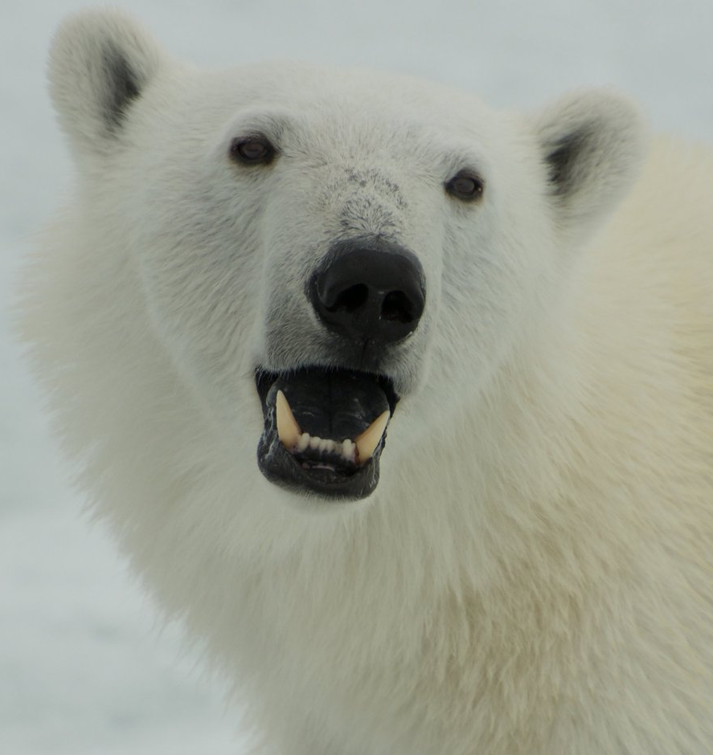
Make sure you use include an appropriate key!
TASK 1: The United Nations has conducted many conferences discussing global warming. Many cities around the world have hosted these talks. Some are listed below. Plot each city on your map:
World’s first climate change conference, 1979. Geneva , Switzerland.
Earth Summit, Agenda 21, 1992. Rio de Janeiro, Brazil.
Kyoto Protocol Agreement, 1997 . Kyoto, Japan.
2030 Agenda on Paris Agreement – COP15. Copenhagen , Denmark.
COP17, 2011. Durban, South Africa.
Green Climate fund established at COP19. Warsaw, Poland.
COP20, 2014. Lima, Peru.
The Paris Agreement , 2015- COP20. Paris, France.
Greta protests outside Swedish Parliament, 2019. Stockholm, Sweden.
Greta first spoke at COP24 , 2018. Katowice, Poland
Climate Action Summit which Greta will attend on 23^{/0/19} , 2019. New York.
TASK 2: Work out the 6 figure grid reference for each Climate Change conference.
Extension: Greta is off on her voyage. Work out the distance Greta sailed from Plymouth, UK to New York.
Notes:
Expedition and photographs - https://tracker.borisherrmannracing.com/

Slide 10
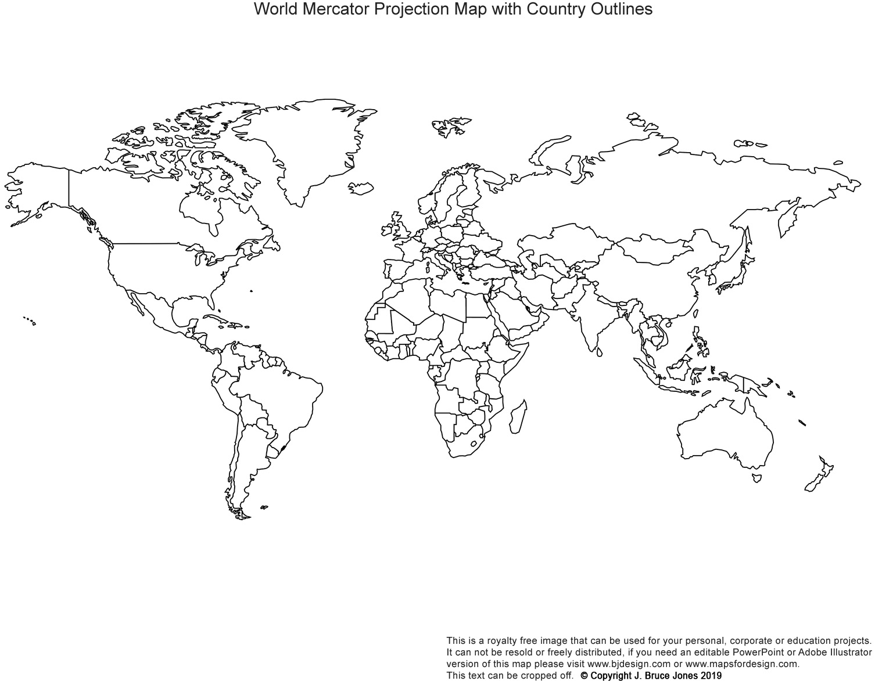
Greta expedition from Plymouth to NY.
50
49
48
47
46
45
44
43
42
17
18
19
20
21
22
23
24
25
26
27
28
29

Slide 11
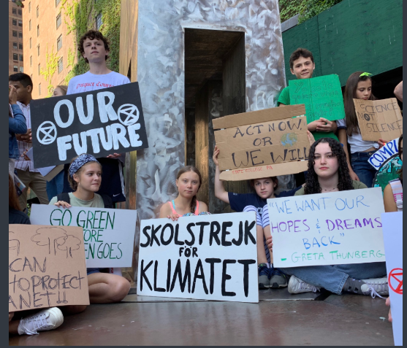
News just in …
While you were working we have had confirmation that Greta has made it to New York for the UN Summit on 23/9/19.
And she is currently joining teenagers in a climate protest in New York ……

Slide 12
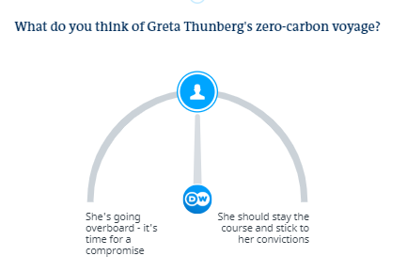

Slide 13
#BTWYOUHAVEHOMEWORK
You must complete all map tasks.
Challenge: Research the objectives of UN Climate Summit (23/9/19) and summerise key points into 5 sentences.

Slide 14
Extension

Slide 15
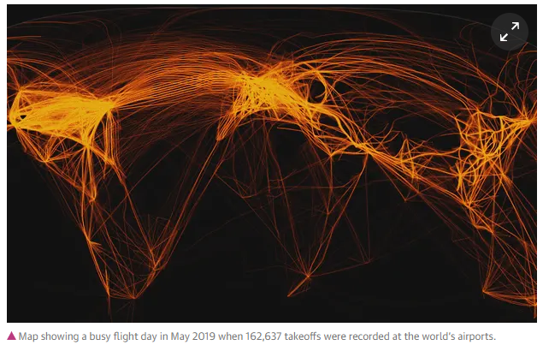
Upwards of 2,500 flights take place across the Atlantic, with each one-way trip estimated to emit about one ton of carbon dioxide in a whole year.
What impact will this have?

Slide 16
MATHS
CHALLENGE
Greta sailed to New York UN Climate Summit to reduce her carbon footprint. The Geography department could learn from Greta. For Geography teachers, we should be ashamed at our carbon footprints.
Can you work out the carbon emissions emitted into the atmosphere for each geography teacher?
Which teacher has emitted the highest carbon emissions?
What suggestions would you make to the Geographers? As part of our jobs we must travel and see the world to then pass on our experiences and knowledge to you!
At a cruising speed of 780 km per hour the emissions are around 90 kg CO2 per hour.
A plane can fly 7 miles per minute.
LOCATIONS
Mr Smith – Abu Dhabi to Hanoi. Hanoi to London. London to Abu Dhabi.
Mr Barnett – Abu Dhabi to Amman. Amman to Abu Dhabi. Abu Dhabi to San Jose. San Jose to Cardiff. Cardiff to Abu Dhabi.
Mr Sali – Abu Dhabi to Istanbul. Istanbul to London. London to Abu Dhabi.
Miss Winters – Abu Dhabi to Amsterdam. Amsterdam to Birmingham. Bristol to Copenhagen. Copenhagen to London. London to Abu Dhabi.

