Slide 1
Secure Knowledge (1-3) Describe investigation process. Further Develop (4-6) Explain investigation process and make links between human and physical geography. Achieve Excellence (7+) Evaluate the investigation process and explain how our results affect our understanding of a key concept.

Slide 2
In your exam you will come across questions about 2 types of Fieldwork: Physical Geography – Mangroves National Park Human Geography – Masdar City
Collecting fieldwork data – For both fieldtrips we will be collecting different types of data.
Challenge: List as many ways as you can think of that we could collect quantitative and qualitative data.
Key Tip – You can pick up marks for SPAG. Maybe spend come time at home practicing the spelling of Q& Q data type.

Slide 3
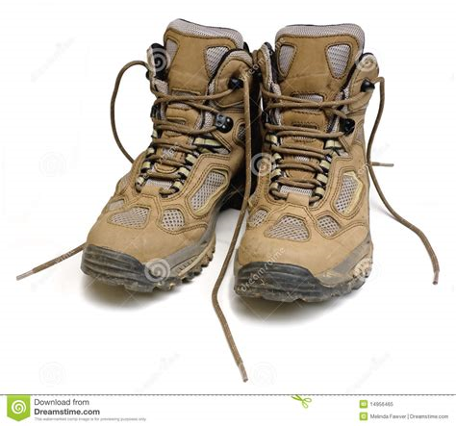
(6) Evaluating and reflecting
(1) Setting up a suitable enquiry question
(5) Reaching conclusions and considering significance.
Steps to conducting a Geographical Investigation (enquiry)
(2) Selecting, measuring and recording primary and secondary data appropriate to the enquiry.
(4) Describing, analyzing and explaining fieldwork data
(3) Selecting appropriate methods of collecting and presenting data

Slide 4
(1) Setting up a suitable enquiry question
(++) These are good questions because they link to a theme we have studied. It also links human and physical geography together.
Physical and human geography (Rivers) : How has river X been managed as a result of human intervention.
Human geography (Urban environments): The regeneration of Brindley Place has had a positive impact on the locality.

Slide 5
(2) Selecting, measuring and recording primary and secondary data.
We will collect primary data out in the field and will be given a booklet to record your data.
Before we go, we need to do the following:
Collect secondary data for Brindley Place and Cardinal Valley.
Assess the risk for each area and complete a Risk Assessment.
Choose appropriate methods to collect primary data.

Slide 6
What risks are there when completing this fieldwork?
Identify the hazards
2. Decide who might be harmed and how
3. Evaluate the risks and decide on precautions
4. Record your findings and implement them
5. Review your assessment and update if necessary.

Slide 7
(3) Selecting appropriate methods of collecting and presenting data
Now you have been on your fieldtrips and collected your Primary data, it is very important that you manage and organise this data.
1. Collect raw data from the recording sheets.
2. Collate all data and combine in a spreadsheet.
3. Select data relevant to your study.
4. Present your data using a range of maps, annotated photos, table and graphs/ charts. You must choose the most appropriate methods.

Slide 8
(3) Selecting appropriate methods of collecting and presenting data
Ways to present your data:
Maps | GIS and Photos | Tables | Graphs and Charts
Used to show locations and patterns. Mini-graphs and charts can be located on maps. This makes it easier to compare patterns at locations. Consider isolines or choropleth maps. | Used to show historic maps to show change in an urban area. Useful for aerial photos of the town/ city to show land use. Helps to show deprivation of a place. | Can be used to present raw data that you and your group collected. Useful to highlight trends and patterns. Can be highlighted and annotated. Can help to identify anomalies (any data which looks unusual). | There is a wide range of graphs and charts available. Can show data and patterns clearly – easier to read data.

Slide 9
(4) Describing, analyzing and explaining fieldwork data
To analysis you need to:
Identify patterns and trends in your results, and describe them.
Make links between different sets of data – for example, how sediment size and roundness seem to change.
Identify anomalies – unusual data which do not fit the general pattern pf results.
Explain reasons for patterns you are sure about.
Suggest possible reasons for patterns you are unsure about. For example – why results change in a way that you wouldn’t expect.
Language of analysis. These words and short phrases are useful to use.
Cause and effect | Emphasis | Explaining | Suggesting
As a result of ….. | Above all … | This shows … | Could be caused by …
This results in …. | Mainly….. | Because …. | This looks like …
Triggering this … | Mostly …. | Similarly … | Points towards …
Consequently…. | Most significantly … | Therefore … | Tentatively ….
The effect of this is … | Usually …. | As a result of …. | The evidence shows ….
Task: Using the word bank and phrases above, write up your analysis for each investigation.

Slide 10
(5) Reaching conclusions and considering significance.
A conclusion is almost the end point of your investigation. It is shorter than the analysis, because it is more focused and summarises the main points.
A good conclusion should include:
It refers back to the main aims of your investigation.
States the most important data that supports your conclusions.
Comments on any anomalies and any unexpected results.
Comment on wider geographical significance of the study. Think about why this data is so important, how it could be used and whether other urban/ river studies would show similar results.

Slide 11
(6) Evaluating and reflecting .
** Command word ** Pick out good and bad points and make judgements / judge from available evidence
Evaluating is the last part of the investigation and allows us to evaluate the process of collecting data and reflect on the overall quality of results and conclusions.
1. What part of my fieldwork design caused errors?
2. How might the problems affect the reliability and validity of the outcomes?
3. How do my results help me reflect more about geographical knowledge gained?

Slide 12
(6) Evaluating and reflecting
Several factors can influence the reliability, validity and therefore the overall quality of your enquiry.
Sources of error | Impacts on quality
Sample size | Smaller sample sizes usually means lower quality data.
Frequency of sample | Fewer sites reduces frequency, which then reduces quality.
Type of sampling | Sampling approaches may create ‘gaps’ and introduce bias in the results.
Equipment used | The wrong/ inaccurate equipment can affect overall quality by producing incorrect results.
Time of survey | Different days or times of day might influence perceptions and pedestrian flows.
Location of Survey | Big variations in environmental quality can occur between places very close to each other.
Quality of secondary data | Age and reliability of secondary data affect their overall quality.

Slide 13
(6) Evaluating and reflecting .
Strengths – what did you do well? | Weaknesses – did anything impact accuracy of results?
Threats – What stopped us from collecting accurate data (I.e: Time of day. School restrictions) | Opportunities – How could we improve the investigation if we were to do it again?
TASK: Using the table on the previous slide , complete a SWOT analysis of your investigation.

Slide 14
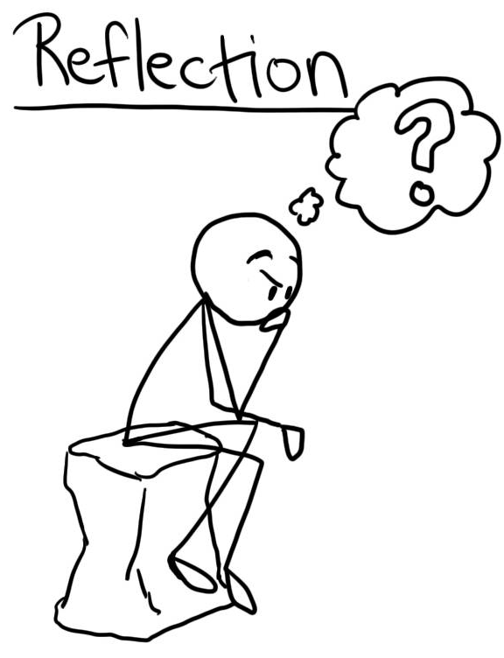
(6) Evaluating and reflecting .
How much do I trust my overall patterns and trends in my results?
What is the chance that these outcomes could have been generated randomly?
Which of my conclusions are most reliable compared to other conclusions?
Which part of my investigation produced are the most reliable compared to other conclusions?
Which part of the investigation have produced the most unreliable results?
Notes:
Reflection of fieldtrip.
Stretch and challenge – How do your results affect your understanding of the geographical concept.

