Slide 1
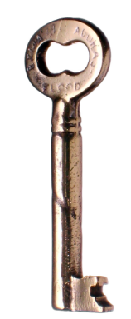
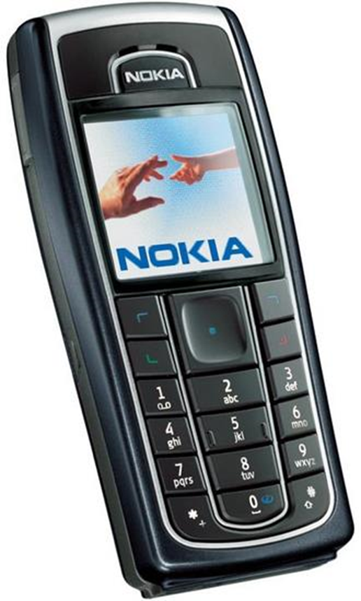
Title: Where do our mobiles come from? Monday, 11 November 2019
Transnational Corporation: A company that operates in more than one country.
WTE/WTE+ - Describe distribution of Nokia operations across the Globe.
ME/ME+ - Explain how Nokia is linked to countries at different levels of development.
EE/EE+ - Suggest benefits and problems of Nokia’s operations.
Starter: Construct a flow chart to show the life of a Nokia.
https://www.youtube.com/watch?v=JZeCxqa08ck
https://www.youtube.com/watch?v=UyVRpjq5-sc

Slide 2
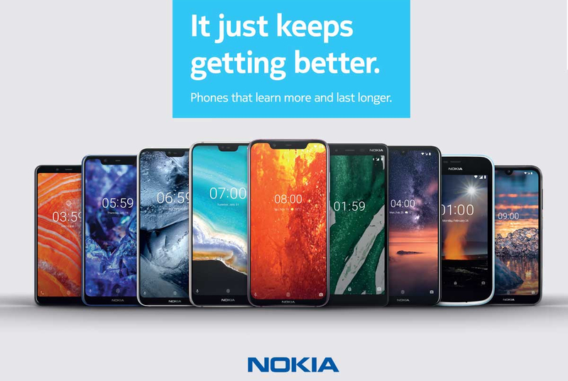
Nokia is a global brand
Nokia works with suppliers in 43 countries
Works with over 200 suppliers
Working in 4 different industries

Slide 3
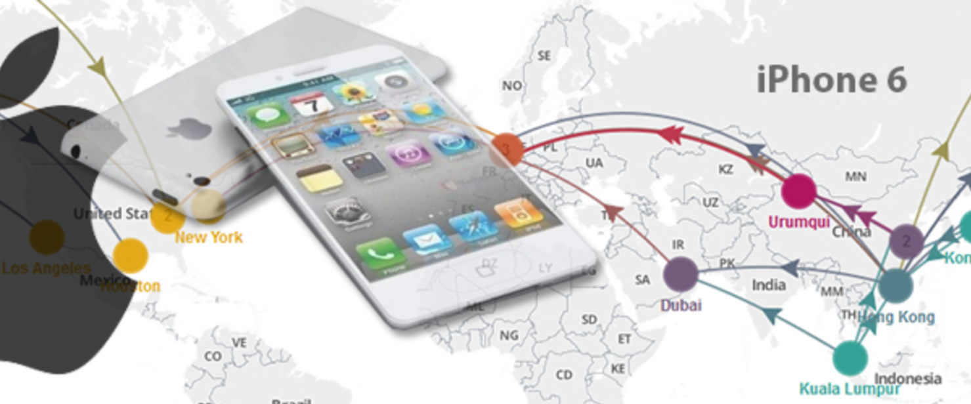
TASK: Copy down key definitions and list examples of jobs for each one.
Primary Industry - These industries extract raw materials directly from the earth or sea.
Secondary Industry – These industries process and manufacture products from raw materials.
Tertiary Industry – These industries provide a service.
Quaternary Industry – These industries incorporate a high degree of research and technology in their processes and employ highly qualified people.
Notes:
Keyword definitions to hand out.

Slide 4
Its all about profit!!
Revenue
Costs
Profit
This is all the money the company takes in from selling things.
This is what is spent on making and selling them (the costs if materials, wages, ads etc)
This is what the company wants in the end.

Slide 5
MAKE A PREDICTION …..
What type of countries would Nokia operate in?
Where would they produce the product?
Where would they sell their products?

Slide 6
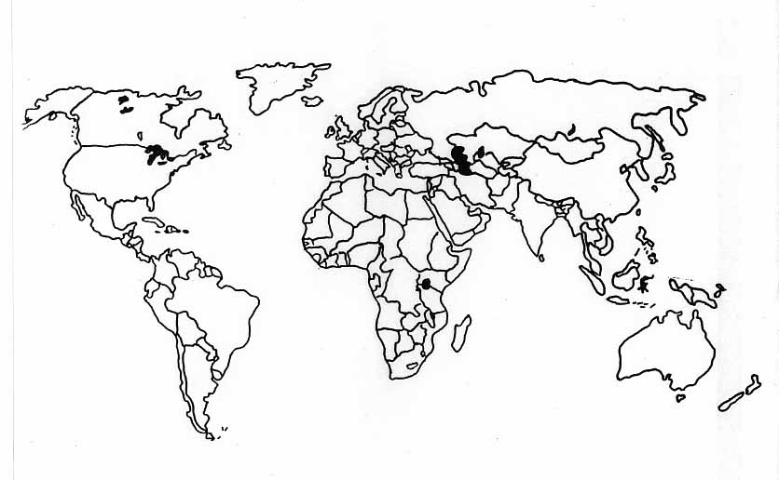
Task:
Label each country that your mobile has passed through and write the statement .
Shade each country to show whether it is a LIC, NEE or HIC.
Colour code each statement to show which industry it would be part of
Make sure you have included a Key and Title!
UAE, Bought in shops by consumers.
Challenge: Can you identify a pattern? Suggest reasons for this.
Key:
Primary
Secondary
Tertiary
Quaternary

Slide 7
Nokia’s headquarters are in Finland. Decisions about future developments for the company happen here. | The plastic case of your phone is made of crude oil. Saudi Arabia is the biggest exporters of crude oil. |  |  | Rare earth metals (Yttrium, Terbium, Gadolinium and Europium) that have magnetic properties and are used for magnets and help your phone vibrate. 80% of these minerals are mined in China.
Your phone could not be made without a material called coltan. 80% of the worlds reserves of this are found in the Congo (this is why you should recycle old phones). |  | Can you watch TV on your phone? The technology that allows you to do this was developed in South Korea in 2002. |  | In Australia, 80% of the world’s coltan is processed into the metals needed in your phone.
The SIM cards are made in many Asian countries such as China, Taiwan and Singapore. |  |  | Nokia conducts research and development into mobile technology in Cambridge, UK. | The battery case for your phone comes from a number of manufacturers in China.. | Nokia products are often featured in films and adverts made in the USA
Natural minerals such as Tantalum are used to create electrical processors and mined in Rwanda. |  |  | Packaging is made in Amkor, Philippines. | Nokia can be brought by consumers at LuLu supermarket in Abu Dhabi, UAE. | Touch screen panels are manufactured in Taiwan

Slide 8
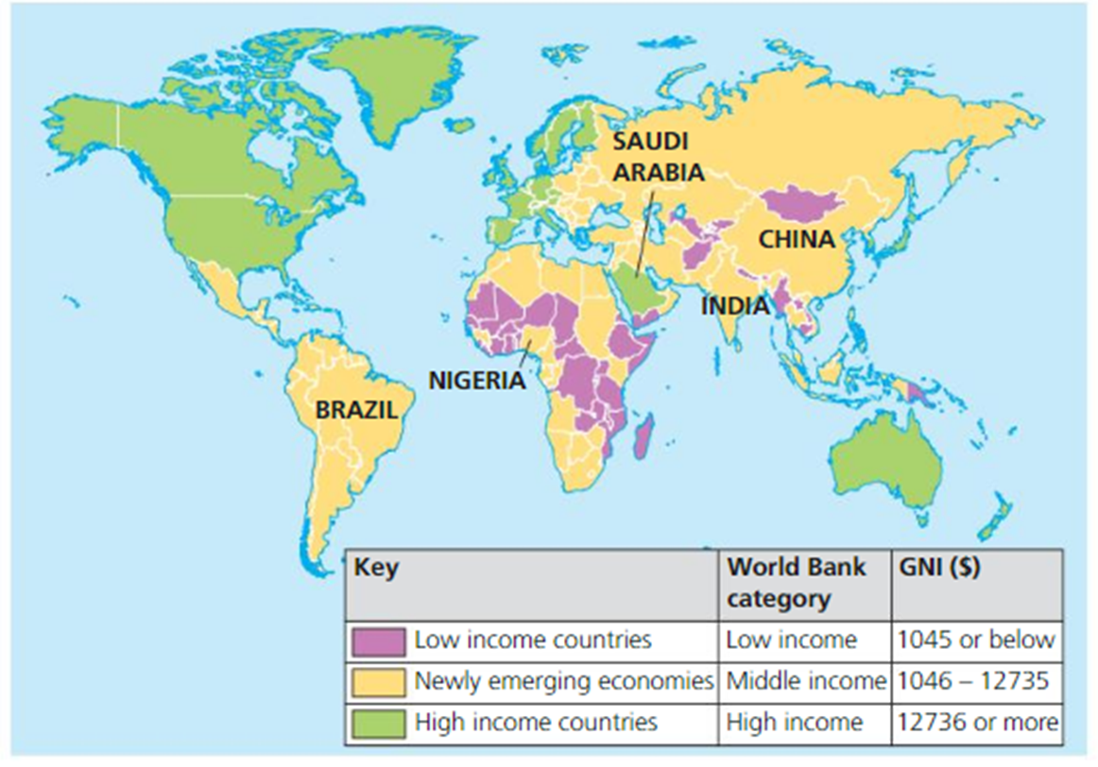
Challenge: Can you identify a pattern? Suggest reasons for this.

Slide 9
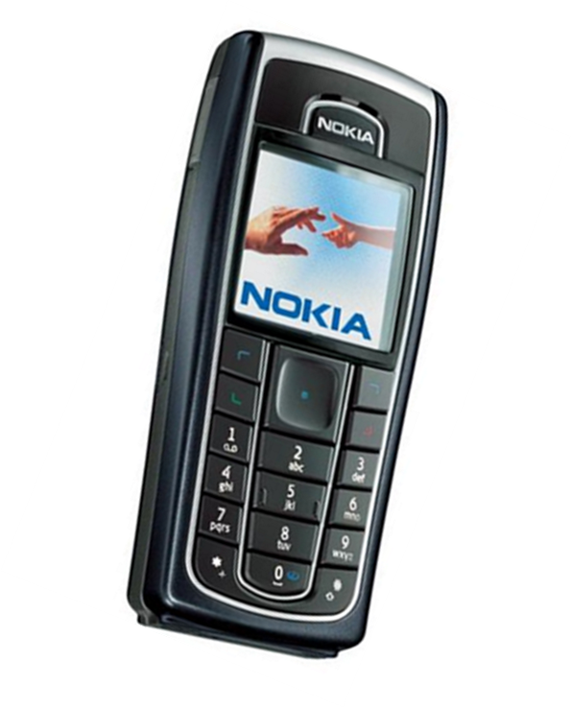
Nokia CEO:
You are the new CEO for Nokia. Your aim is to make money. Explain where you have located your following operations and why:
Factories making phones
Offices/shops selling phones
R&D laboratories

Slide 10
I have chosen to locate factories in ___________________________________
________________________________________________________________
I believe that these countries ________________________________________
________________________________________________________________________________________________________________________________________________________________________________________________________________________________________________________________________________________________________________________________________________________________________________________________________________________________________________________________________________________________________________________________________________________________________________________________
EXPLAIN (AF4) where your operations are located. Justify reasons why.
Factories
Office/shops selling phones
R&D laboratories
HELPFUL HINTS..
Primary Industry is normally long-hours and require ‘muscle’ (low skill)
Manufacturing requires low skill and more people.
Research and Development is high skill and high pay.
In LIC and NEE environmental and Workers rights are more lenient than in HIC countries.

Slide 11
HELPFUL HINTS..

Slide 12
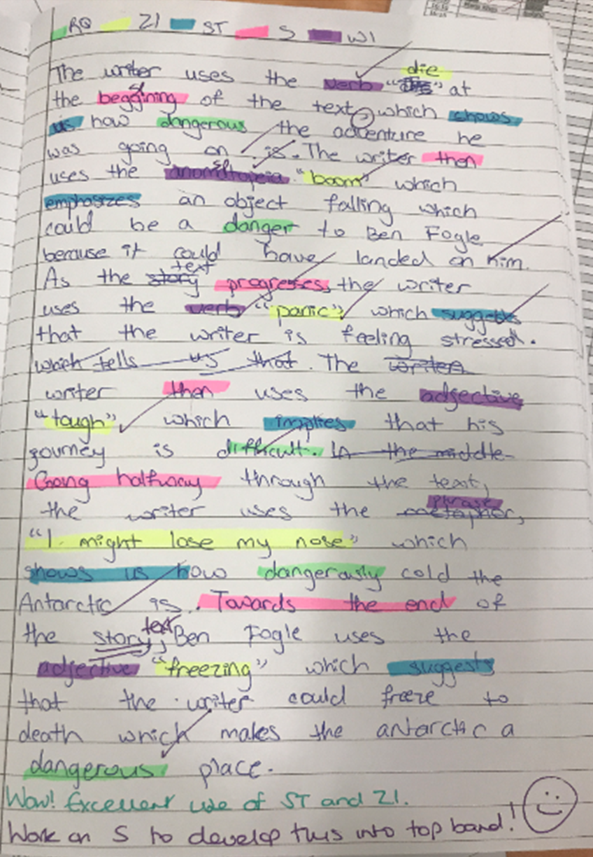
SELECT MODEL ANSWER
MARK ANSWER AS CLASS AND SHOW HOW TO EFFECTIVELY MARK

Slide 13
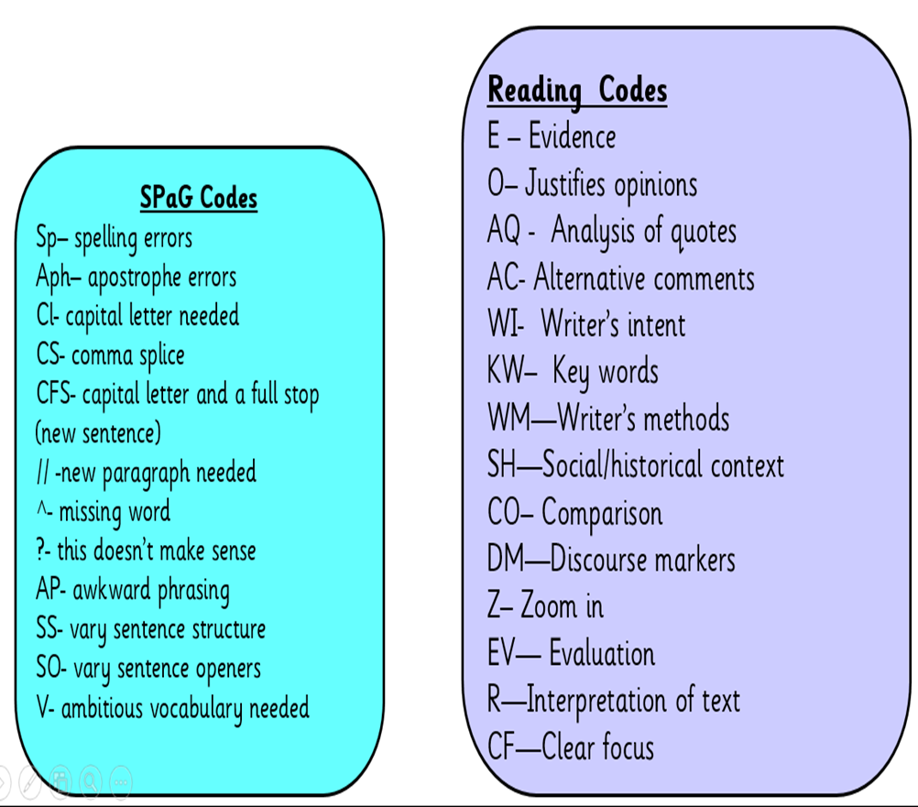
Self Assessment
Look familiar?
English marking code
You will create your own marking code for AF4 and write a key in your partners book.
You will assess your work, annotating your answer with your marking code and give yourself WWW/ EBI.

Slide 14
AF4 Marking Code:

