Slide 1
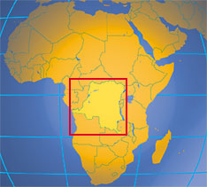
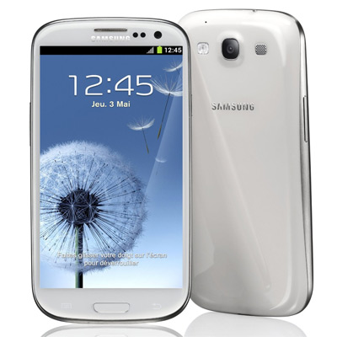
Death in the Congo
LO: to learn what is happening in the DRC (democratic republic of Congo)
Your new phone is responsible for the deaths of 4 million people. Why?
Talk to your partner and come up with some ideas

Slide 2
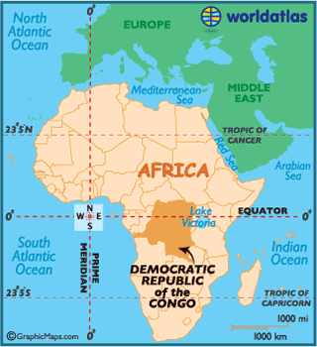
AF3: Where is the DRC located?
Describe the location of the Democratic Republic of the Congo.
The DRC is located…
Continent
Hemisphere
Lines of latitude
Direction and distance from other countries
Surrounding oceans
Coordinates

Slide 3
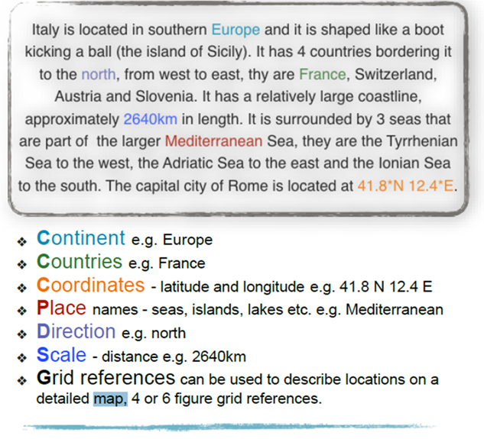
Where is D.R.C?
Describe the location of Democratic Republic of Congo
PA –
WWW
EBI

Slide 4
To make your mobile work it requires Cobalt…

Slide 5
6 Hats Thinking Skills

Slide 6
6 Hats Thinking Skills
The White Hat calls for information known or needed. "The facts, just the facts."
The Yellow Hat symbolizes brightness and optimism. Under this hat you explore the positives in the issue
The Black Hat is - the devil's advocate or why something may not work. Spot the difficulties and dangers; where things might go wrong.
The Red Hat signifies feelings, hunches and intuition. When using this hat you can express emotions and feelings and share fears, likes, dislikes, loves, and hates that don’t have to be supported by facts.
The Green Hat focuses on creativity; the possibilities, alternatives, and new ideas. Is there another way to look at this?
The Blue Hat asks: “How are we thinking about this most?”

Slide 7
ACTIVE LISTENING
https://www.youtube.com/watch?v=AA6BnitgdP8
https://www.youtube.com/watch?v=wQhlLuBwOtE
https://www.youtube.com/watch?v=JcJ8me22NVs
You have been given a DE BONO THINKING HAT.
You must watch the video clips with your THINKING HAT on. Write down your thoughts.
Be prepared to give feedback to each other.

Slide 8
Task:
AF3: Imagine you work in a Cobalt mine. Describe a day in the life of a young Cobalt miner.
Task:
AF4: “Explain why your phone is partly responsible for the deaths of 4 million people”
OR
Cobalt | Democratic Republic of Congo | mining | mobile phones | electronics | conflict | militias | fuelling the trade | conflict minerals

Slide 9
Peer Assessment
WWW
EBI

