Slide 1
Which continent is the Sahara located on? | Which countries make up the Sahara? | Name 2 cities you find in the Sahara. | What mountain range borders the North West side of the Sahara?
What type of biome/ecosystem if the Sahara? | What is the highest average annual temperature and in which month? | What is the lowest average annual temperature and in which month? | How much rain falls in the Sahara?
How is temperature shown in a climate graph? | How is the precipitation (rainfall) shown in a climate graph? | Describe the climate of the Sahara in 2 words | What are the differences between the Sahara desert climate and Beijing’s climate?
What are the advantages of a climate graph? | What are the disadvantages of a climate graph?

Slide 2
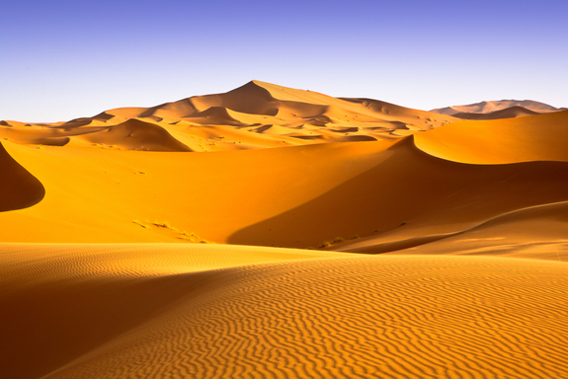
Sahara
To describe the Sahara desert climate
AF3 – describe the distribution of landforms/objects/events
AF3 – describe differences in trends on graphs

Slide 3
True or False?
Write down the true statements and correct the false:
The Sahara is the world’s largest hot desert
TRUE
Antarctica and the Arctic are not known as deserts because they are too cold
FALSE – They are known as COLD DESERTS
The whole of the Sahara is made up of Sand Dunes
FALSE – most is made up of rocky desert landscape
The sand dunes can reach as high as 50m tall
FALSE – some reach as high as 180 metres
There has to be less than 250mm of rainfall to be named a desert
TRUE

Slide 4
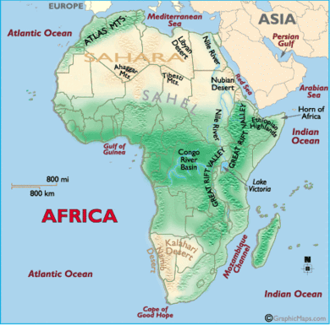
Where is the SAHARA located?
Use the map and an Atlas to…
Describe its location in no less than 30 words.
The Sahara is located…
Continent
Hemisphere
Lines of latitude
Compass points
Oceans
Countries

Slide 5
SAHARA
Using an Atlas, complete the following on the map of Africa:
Colour in the extent of the Sahara desert in YELLOW or ORANGE.
Name the countries located in the desert
Label the mountain range in the North-West
Label the Atlantic Ocean, Red Sea and the Mediterranean.
Choose two countries in the Sahara and label their cities.
REMEMBER BETTER MAPS HAVE
SYMBOLS, A KEY and a TITLE
EXTENSION – add the lines of latitude – Equator, Tropic of Cancer/Capricorn.

Slide 6
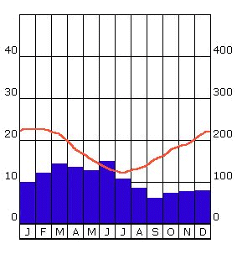
What does this graph show?
This is a CLIMATE GRAPH.
Climate graphs show how temperature and precipitation vary throughout the year for a particular place.

Slide 7
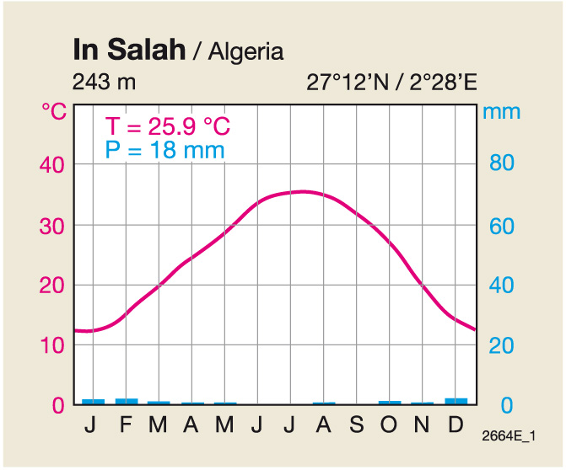
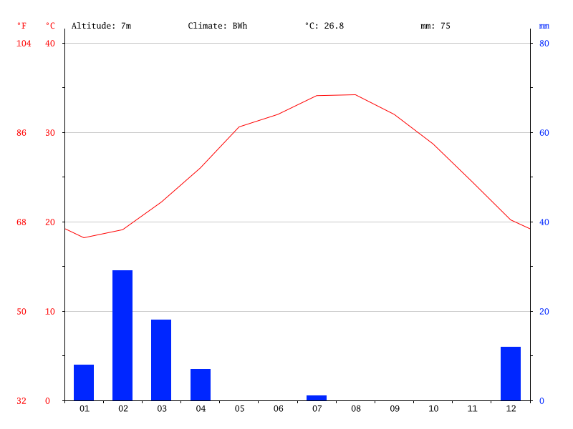
Sahara Desert
Abu Dhabi
What is the climate like in the Sahara Desert (Algeria)?
How does it compare to the climate of Beijing?

Slide 8
Interpret the climate graph…
1. What is the climate like in the Sahara Desert (Algeria)? (100 words)
Use the following to support your answer:
Use the graph to describe the overall climate.
Use data from the graph to support your description (better descriptions will use the data and months)
2. How does it compare to the climate of Abu Dhabi? (150 words)
Use the following to support your answer:
Use the graph to describe the climate in Abu Dhabi
Describe how it is different to the climate of the Sahara.
Use data from the graph to support your description and the differences in the climate
Extension –
Analyse the use of climate graphs – what are the advantages and disadvantages?
KEY TERMS: hot, cold, wet, dry, temperature, precipitation
AF3 – describe the trends and differences in trends in graphs

Slide 9
Interpret the climate graph…
1. What is the climate like in the Sahara Desert?
Copy and complete the following sentences:
Overall, the climate is…
The highest temperature is… The lowest temperature is….
The highest precipitation level is…. The lowest precipitation level is…
This type of climate is called…
2. How does it compare to the climate of Abu Dhabi?
The climate in Abu Dhabi is colder/warmer/wetter/drier… compared to the Sahara…
The highest temperature is… The lowest temperature is…. compared to the Sahara…
The highest precipitation level is…. The lowest precipitation level is… compared to the Sahara…
Extension –
Analyse the use of climate graphs – what are the advantages and disadvantages?
AF3 – describe the trends and differences in trends in graphs

Slide 10
HOMEWORK
You are lost in the Desert – what would you need to survive?
Design your own survival pack – pick 5 items and justify your choice. Make sure it has a link to the climate!
BYOD – next lesson

Slide 11
Which continent is the Sahara located on? | Which countries make up the Sahara? | Name 2 cities you find in the Sahara. | What mountain range borders the North West side of the Sahara?
What type of biome/ecosystem if the Sahara? | What is the highest average annual temperature and in which month? | What is the lowest average annual temperature and in which month? | How much rain falls in the Sahara?
How is temperature shown in a climate graph? | How is the precipitation (rainfall) shown in a climate graph? | Describe the climate of the Sahara in 2 words | What are the differences between the Sahara desert climate and Beijing’s climate?
What are the advantages of a climate graph? | What are the disadvantages of a climate graph?

Slide 12
Climate of The Sahara Desert
Draw a climate graph for the SAHARA using the following data:
 | Jan | Feb | Mar | Apr | May | June | July | Aug | Sept | Oct | Nov | Dec
mm | 8 | 11 | 31 | 51 | 26 | 4 | 36 | 55 | 8 | 2 | 9 | 8
oC | 12 | 14 | 16 | 17 | 18 | 20 | 20 | 20 | 18 | 15 | 12 | 12
How to draw a climate graph:
Label the left hand axis Rainfall (mm) and choose an appropriate scale and go up in even amounts, starting from zero.
Label the right hand axis Temperature (oC) and choose an appropriate scale to go up in even amounts. This can start below zero if you need to.
Label the bottom axis, Months and write the 1st letter of each month in each of the 12 columns
Plot the data for rainfall using the left hand axis and use BARS that take up the whole column.
Shade in the bars BLUE
Plot the temperature data using the right hand axis. Plot each temperature point in the MIDDLE of the month column.
Connect each temperature point with a smooth RED line and join these to the axis.
Give your graph and appropriate title which includes the type of graph and place it is for.
AF2 – draw graphs accurately with data provided

