Slide 1
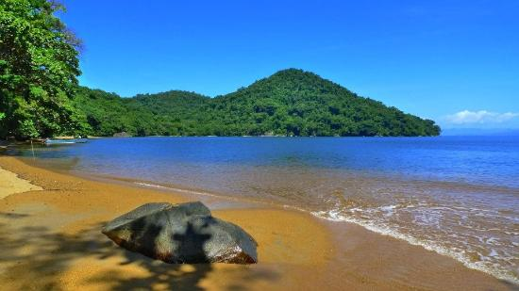
MADAGASCAR
To describe the location and physical features of Madagascar
AF3 – describe the distribution of landforms/objects/events
AF2 – identify and measure scale
AF2 – interpret relief on maps using spot heights and layer shading

Slide 2
Prior Knowledge Check
MADAGASCAR

Slide 3
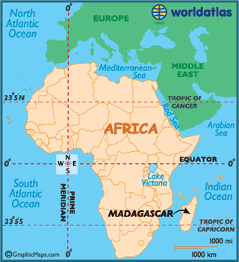
Where is
MADAGASCAR located?
AF3 – describe the
distribution of landforms/
objects/events
Describe its location in no less than 30 words.
Madagascar is located…
Continent
Hemisphere
Lines of latitude
Compass points
Oceans

Slide 4
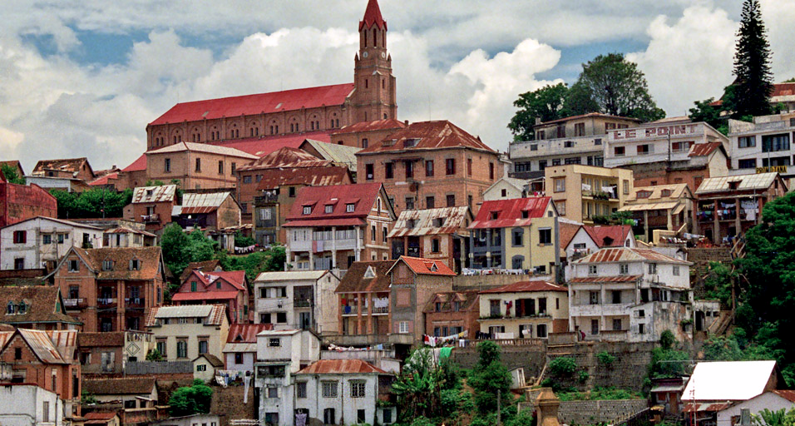
AF3 – describe the
distribution of landforms/
objects/events
MADAGASCAR
Using the Atlas and the range of maps provided, label the following on a blank map of Madagascar:
Antananarivo (capital city)
Mozambique Channel
Indian Ocean
Capital city
Mangoky river
Central Highlands
Comoros Islands
REMEMBER BETTER MAPS HAVE
SYMBOLS, A KEY and a TITLE

Slide 5
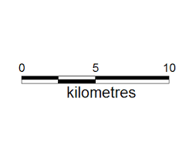
What is scale?
Scale is the measurement used on a map.
You can show scale in 3 ways:
In words – 1cm to 30cm
2. As a ratio 1:30 (this means 1cm is the same as 30cm on a map)
3. As a line divided into cm, then labelled
The best way to use this one is by using a ruler.
This means that 9cm on the map is 10km
9cm=10km
4.5cm = 5km
2.25cm = 2.5km
0.9 cm (9mm) = 1km (1000m)
Scale is always marked on a map, so that you can tell the size in real life

Slide 6
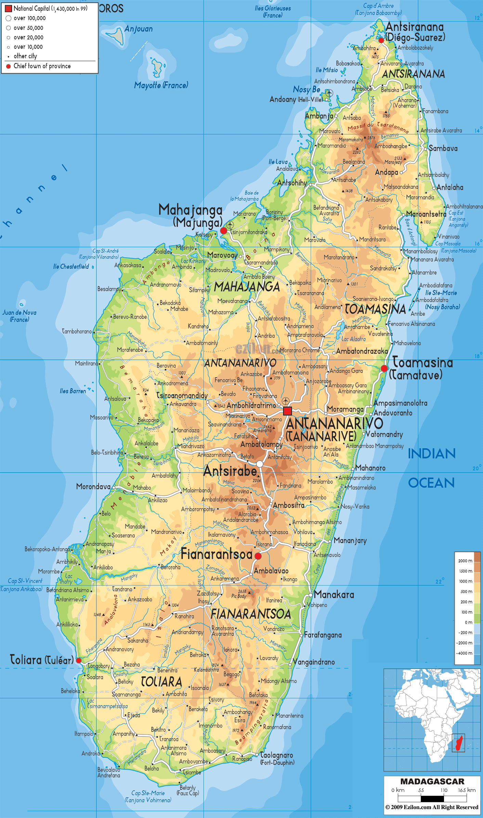
AF2 – identify and measure scale
What is scale?
Scale is the measurement used on a map.
Where is the scale bar on this map?
Using the scale, find the following (in Kilometres (km):
1. Distance between Toamasina and Antananarivo (1)
2. Distance between Mahajanga and Fianarantsod (1)
3. Distance and direction from Antsirabe to Morondava (2)
4. Distance and direction from Manakara to Toliara (2)
5. Distance and direction from Antsiranana to Antananarivo (2)
Extension: Create your own questions and test your partner!

Slide 7
AF2– interpret relief on maps using spot heights and layer shading
What is relief?
Relief is the height and shape of land.
This map shows relief in 2 different ways:
Spot Heights
Layer shading
Show the exact height of a spot in metres above sea level
The darker brown represents high ground, the green shows lowland

Slide 8
AF2 – interpret relief on maps using spot heights and layer shading
AF3 – describe the distribution of landforms/objects/events
What is relief?
Relief is the height and shape of land.
What is the highest point on the map?
Describe the relief of Madagascar
Include the following:
Where is the highland/lowland?
Use the words: coastal, inland, central
to identify locations
Use compass points and the key
Use data
The relief of Madagascar includes…
The highland is… The lowland is…
Notes:
1. 2876

Slide 9
Noun
= A word that refers to a person, animal, place, thing or object.
Teacher, Pupil, Classroom, Desk
Boys, Cats, Pencil, School.
Create 5 other nouns that you can see?

Slide 10
Adjectives
= Describing words. Give us extra information about the nouns.
CLEVER teacher.
LARGE classroom.
WHITE board.
Create 5 adjectives to describe your nouns

Slide 11
Verbs
= Doing words.
Running, swimming, playing, hiding, listening.
Think of 5 different verbs you may be doing today.

Slide 12
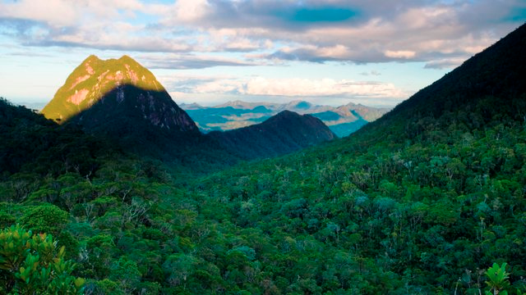
Describe the photograph.
How would you describe this? DISCUSS ONLY – IN PAIRS

Slide 13
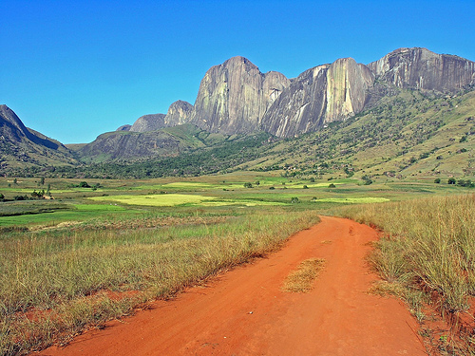
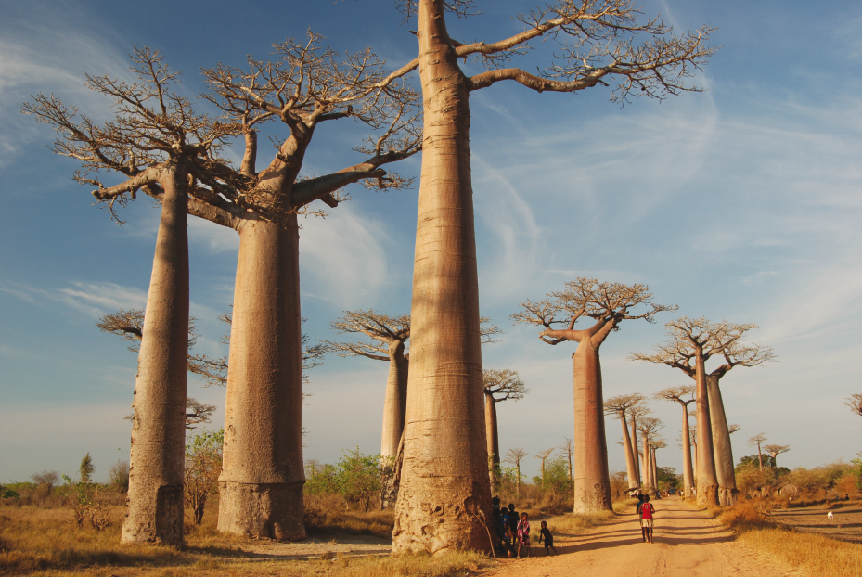
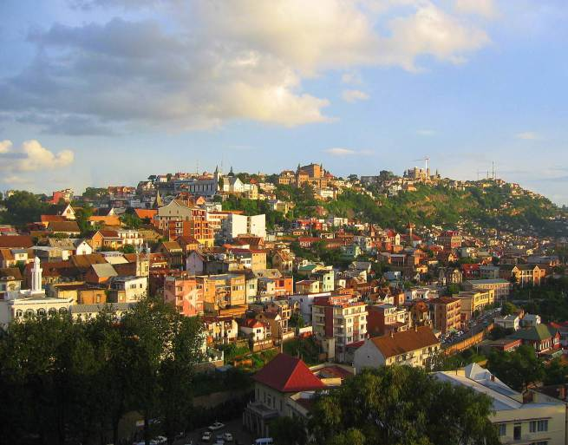
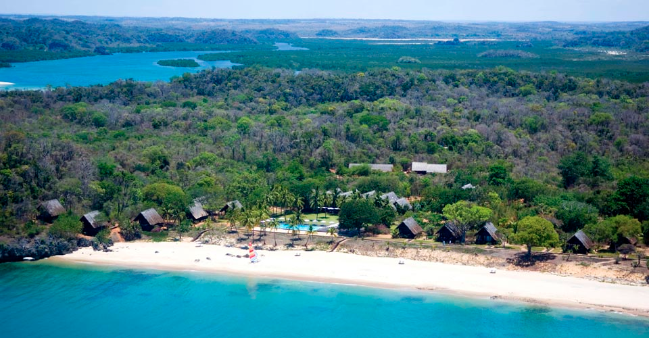
Describe one of these photographs Better answers will include nouns, adjectives and verbs

Slide 14
Knowledge Check
MADAGASCAR

Slide 15
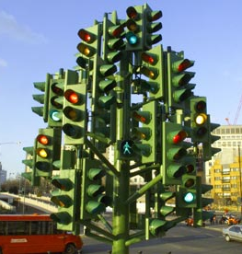
Self Assessment
 | RED | ORANGE | GREEN
AF3
AF4
AF4 – describe the distribution of landforms/objects/events
AF3 – identify and measure scale
AF3 – interpret relief on maps using spot heights and layer shading

