Slide 1
SECTION D: Development and Human Welfare
Lesson title: The Nature of Development
LO:
Define development and quality of life.
Outline the nature of development as a complex, multi–strand process with many facets.

Slide 2
What is development?

Slide 3
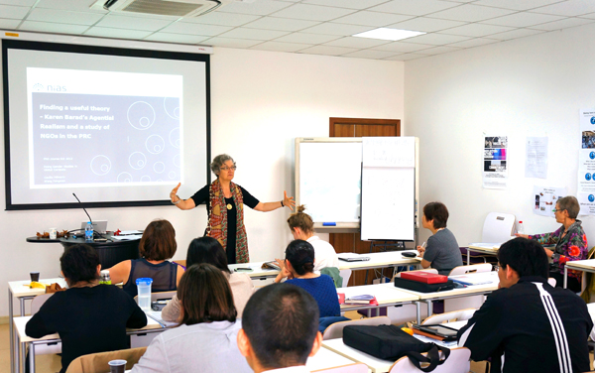

Slide 4
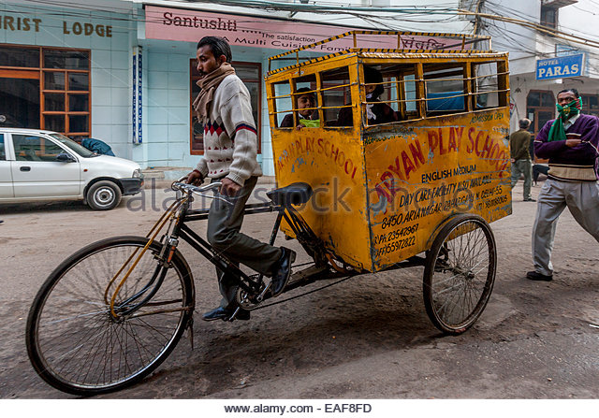

Slide 6
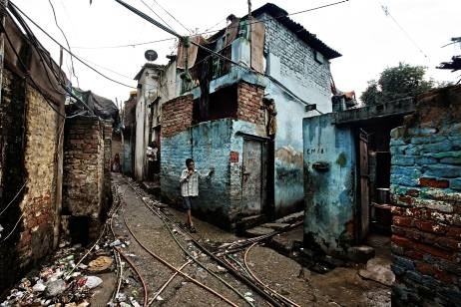

Slide 10
Development is…
Making progress in a number of ways, most of which can be related to economic growth

Slide 11
The Strands of Development
Salary
Types of job
Economic
What are the Strands of Development?
Social
Access to education

Slide 12
So what is quality of life?

Slide 13
What factors affect the economic development of a country?
Natural resources such as oil, generate wealth
A populations ability to exploit natural resources
Climate will affect agricultural output
Political stability (geopolitics), peaceful relations with neighbours, including historic setbacks
Successful government/economic planning
Opportunities for trade with other countries i.e. part of a trade bloc
Geographic location – landlocked, isolated countries less likely to develop
Business culture and national ambition

