Slide 1
HOMEWORK
You are lost in the Desert – what would you need to survive?
Design your own survival pack – pick 5 items and justify your choice. Make sure it has a link to the climate!

Slide 2
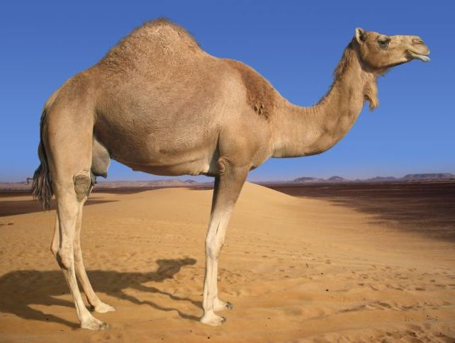
Saharan Desert Animals
To explain how Saharan desert animals are adapted to living there
Find the person in the room with the same animal as you. Organise yourselves so that you’re sat together.
AF2 – add detailed annotations onto sketches
AF6 – explain how animals are adapted to the climate

Slide 3
Expert groups: CAMELS
Research how your animal is adapted to the desert climate and produce an ANNOTATED SKETCH.
What does ANNOTATED mean? = detailed label with description/explanation
Give at least 3 detailed annotations.
Each member of the group needs a copy of the annotated animal for the next exercise.
Hump
Nostrils
The nostrils can be closed to keep out the blowing sand when it’s windy.
The humps are full of their body fat to help them to survive long periods without food and water
Legs
Long strong legs to help it carry heavy loads and keep its body further away from the hot sand.
Feet
They can spread their toes wide to prevent feet from sinking into the sand
LABEL
AF2 – add detailed annotations onto sketches
AF6 – explain how animals are adapted to the climate
ANNOTATION

Slide 4
Expert groups
Now that you are an expert on your animal, you are going to separate into mixed groups and find out how all the other animals are adapted to living in the desert.
Whilst listening to each other, you need to complete the adaptations table.

Slide 5
You will be given one of the animals studied today. This will be shown on the screen but you must not look!
You can ask questions, but the audience can only answer YES or NO.
Your questions need to be related to how it is adapted to the desert.
e.g. Do I have a hump?
You have a maximum of 5 questions. Only the last 2 questions can name the animal.

Slide 6
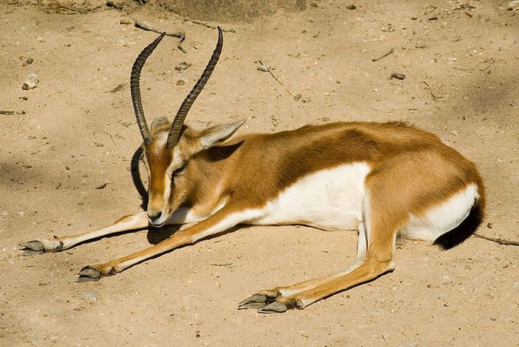
Dorcas Gazelle
Notes:
Dorcas Gazelle

Slide 7
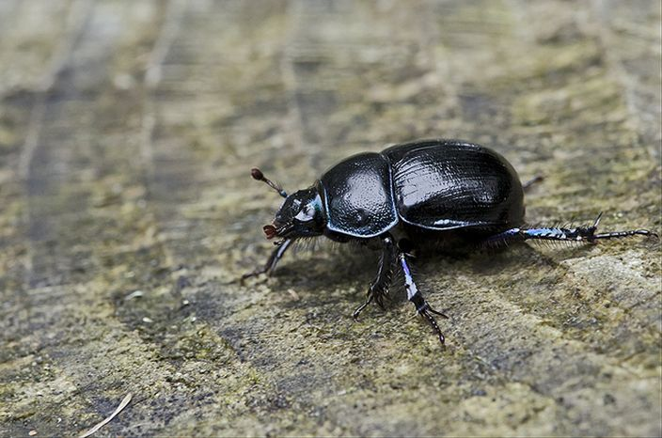
Scarab Beetle

Slide 8
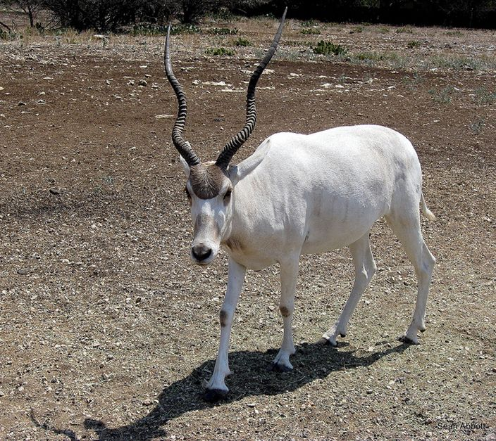
Addax Antelope

Slide 9
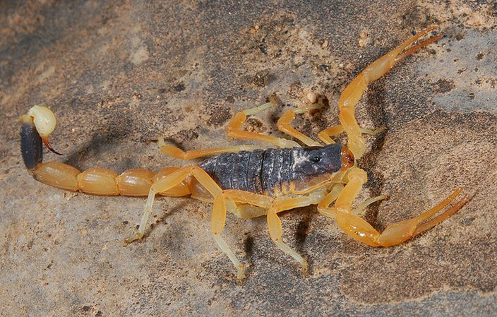
Death Stalker Scorpion

Slide 10
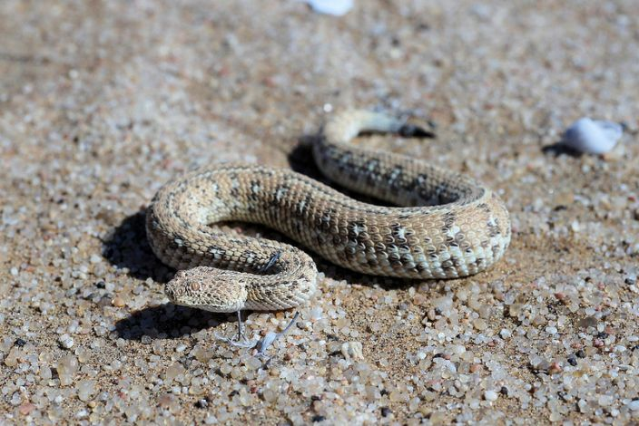
Sidewinder

Slide 11
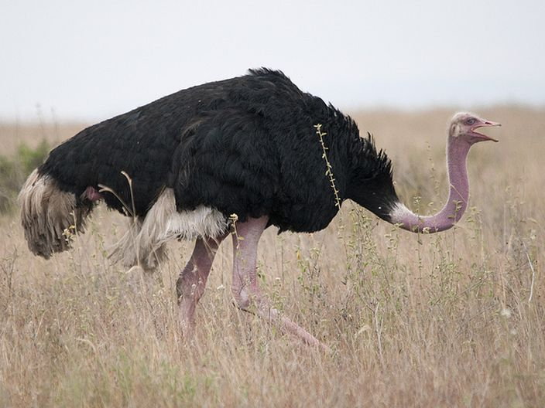
Ostrich

Slide 12
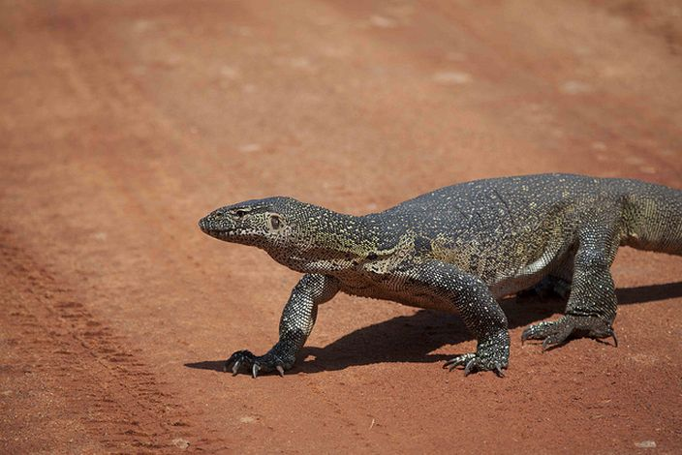
Monitor Lizard

Slide 13
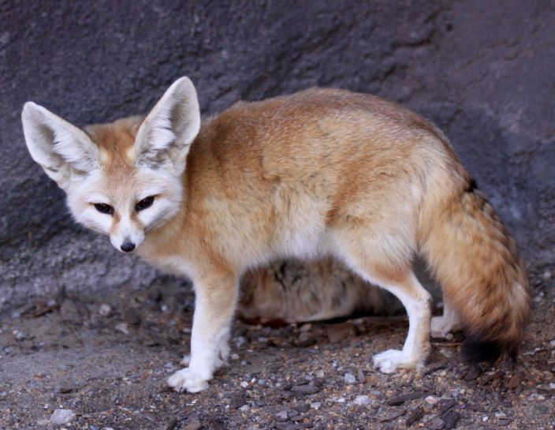
Fennec Fox

Slide 14
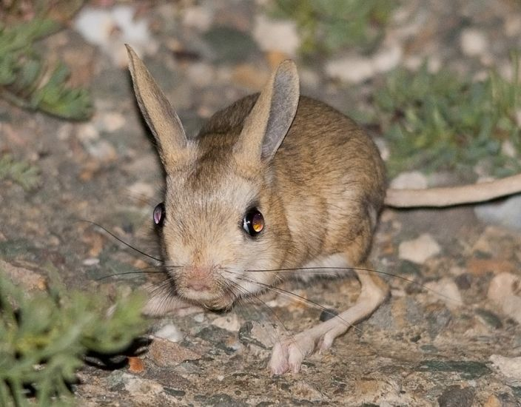
Jerboa

Slide 15
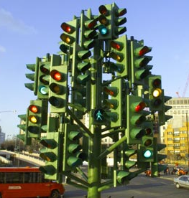
Self Assessment
 | RED | ORANGE | GREEN
AF2
AF6
AF2 – add detailed annotations onto sketches
AF6 – explain the animal adaptations

