Slide 1
MAPS FOR MEMORY
In groups of 4, number yourselves from 1-4
Outside the classroom there are 2 diagrams that are exactly the same.
When I call your number, you must go outside for 30 seconds and memorise it.
After 30 seconds, return to the classroom and draw/write as much as you can remember on to the blank paper.
You have 1 minute before the next number is called.
You will be peer assessing each others diagram on the following:
10 points for each correct spelling/number in the correct location
Clarity of the diagram – is it clear/make sense? – you will get marked on a scale of 1-10 (1 – what??? up to 10 – replica of the diagram!)

Slide 2
Peer
Assess
10 points for each correct spelling/number in the correct location
Clarity of the diagram – is it clear/make sense? Mark this on a scale of 1-10 (1 – what??? up to 10 – replica of the diagram!)
Total - 20

Slide 3
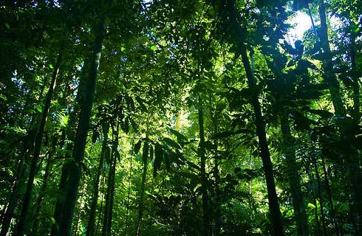
Madagascar’s Tropical Rainforest:
How do the plants survive here?
To describe and explain how plants are adapted to the Tropical Rainforest climate
AF2 – add detailed annotations onto sketches

Slide 4
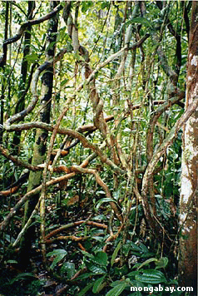
Lianas/Vines – adaptation?
Notes:
Grow around trees to reach the sun
Provide some level of stability for the tall trees but can cause groups of trees to fall

Slide 5
Plant Adaptations
On the worksheet,
In the first 2 columns - sort the correct feature with how the plant is adapted.
Link the photo with its feature/adaptation. The photos are displayed around the room.
In your exercise books, sketch each of the adaptations and use the information to annotate your diagrams in detail – EXPLAIN the adaptation using ‘because…’… ‘this means that…’
Look back at your animal annotation for the Sahara Desert to see how to improve on annotations (AF2).
AF2 – add detailed annotations onto sketches

Slide 6
FEATURE… | HOW IT IS ADAPTED…
Waxy leaves with Drip Tips | …helps to prevent other plants from growing on the surface. Plenty of rain and moisture so no need to prevent moisture loss.
Smooth, thin bark | …Leaves are arranged at different angles so that a plant avoids shading its own leaves.
Tall Trees and Straight Trunks which are often branchless | …live on the surface of other plants e.g. tree trunks/branches, to allow them to make the most of the sunlight in the canopy layer.
Buttress Roots | …soils are shallow with all the nutrients remaining at the surface
Dark green leaves with a large surface area | …in competition for light and water for photosynthesis
Roots growing on the surface | …to help drain away excess water from the leaf to prevent the leaf breaking and the growth of algae, which if able to grow would reduce a plants ability to photosynthesise.
Leaf angling | …to help stabilise the tree in the shallow soils
Epiphytes e.g. orchids | …these leaves are full of chlorophyll (gives the green colour) to absorb the little sunlight available on the forest floor.

Slide 7
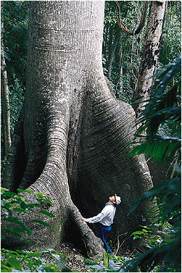
1

Slide 8
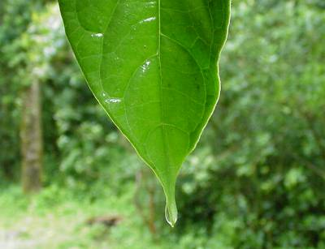
2

Slide 9
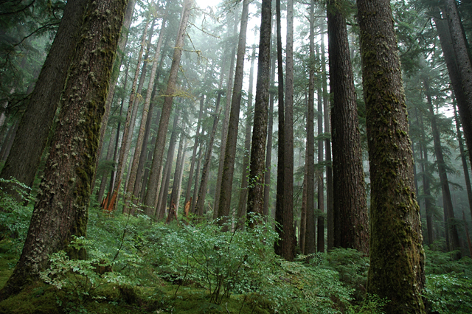
3

Slide 10
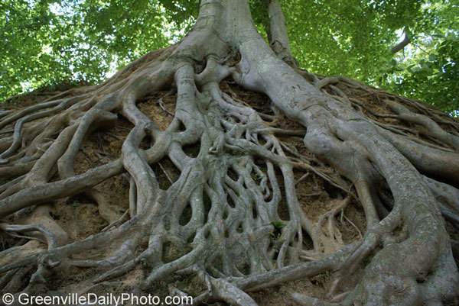
5

Slide 11
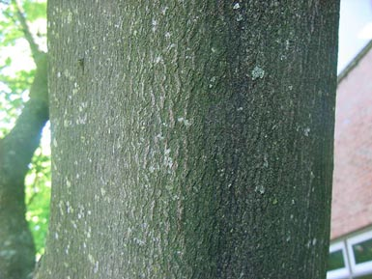
6

Slide 12
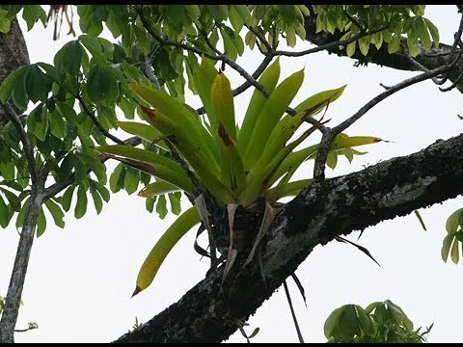
7

Slide 13
Homework - Plant Design
On an A4 piece of paper, design your own rainforest plant.
Success Criteria:
Clear and colourful design of your plant
At least 5 features showing how it has adapted to the rainforest
Each feature needs to be annotated to explain the adaptation
Give your plant a name
Underneath the design write a short report to describe and explain how it is adapted.

