Slide 1
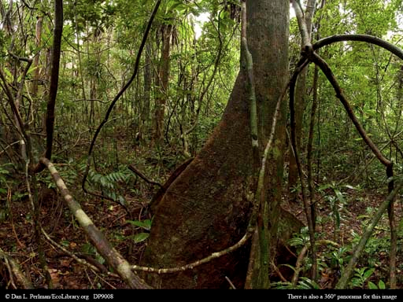
Madagascar’s Tropical Climate
AF2 – draw graphs accurately with data provided
AF4 – describe the trends and differences in the trends in graphs

Slide 2
Climate of the Tropical Rainforest
Draw a climate graph for the Tropical Rainforest in Madagascar using the following data:
 | Jan | Feb | Mar | Apr | May | June | July | Aug | Sept | Oct | Nov | Dec
Rain (mm) | 334 | 388 | 345 | 234 | 198 | 179 | 206 | 165 | 111 | 135 | 174 | 256
Temp (oC) | 29 | 29 | 28 | 27 | 26 | 25 | 24 | 24 | 25 | 26 | 27 | 28
How to draw a climate graph:
Label the left hand axis Rainfall (mm) and choose an appropriate scale and go up in even amounts, starting from zero.
Label the right hand axis Temperature (oC) and choose an appropriate scale to go up in even amounts. This can start below zero if you need to.
Label the bottom axis, Months and write the 1st letter of each month in each of the 12 columns
Plot the data for rainfall using the left hand axis and use BARS that take up the whole column.
Shade in the bars BLUE
Plot the temperature data using the right hand axis. Plot each temperature point in the MIDDLE of the month column.
Connect each temperature point with a smooth RED line and join these to the axis.
Give your graph an appropriate title which includes the type of graph and place it is for.
AF2 – draw graphs accurately with data provided

Slide 3
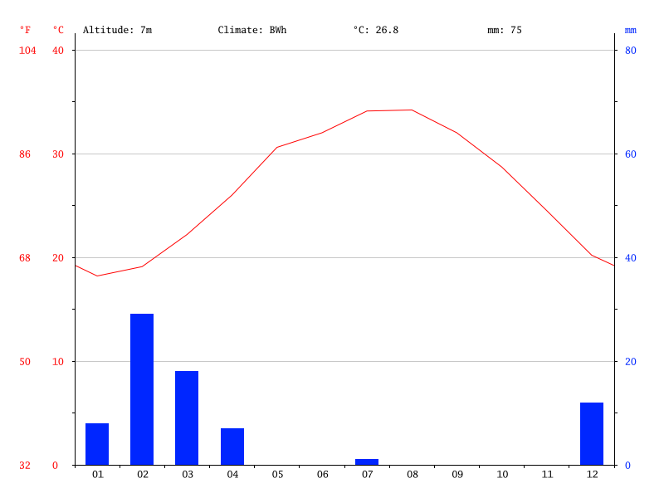
Describing the climate…
Climate = the average weather over a long period of time. Includes temperature and rainfall.
AF4 – describe trends and describe differences in trends in graphs
Madagascar – Tropical Rainforest Climate
Using your completed climate graph for Madagascar’s tropical rainforest:
Describe the climate of Madagascar’s tropical rainforest (100 words)
Use the graph to describe the overall climate.
Use data from the graph to support your description (better descriptions will use the data and months)
2. How does the climate compare to Abu Dhabi? (150 words)
Describe how it is different to the climate of Abu Dhabi.
Use data from the graph to support your description and the differences in the climate
E.g. The temperature in Abu Dhabi is more varied ranging from ………..degrees Celcius. However in the TRF of Madagascar it is…
The rainfall in Abu Dhabi is…
EXTENSION
3. Describe how the climate compare to somewhere else in the world?
Abu Dhabi
Notes:
Compare to Beijing

Slide 4
1. What is the climate like in Madagascar’s Tropical Rainforest?
Copy and complete the following sentences:
Overall, the climate is…
The highest temperature is… The lowest temperature is….
The highest precipitation level is…. The lowest precipitation level is…
This type of climate is called…
2. How does it compare to the climate of Abu Dhabi?
The climate in Beijing is colder/warmer/wetter/drier… compared to the tropical rainforest…
The highest temperature is… The lowest temperature is…. compared to…
The highest precipitation level is…. The lowest precipitation level is… compared to…
AF1 – identify trends in graphs
AF4 – describe the trends and differences in trends in graphs

Slide 5
