Slide 1
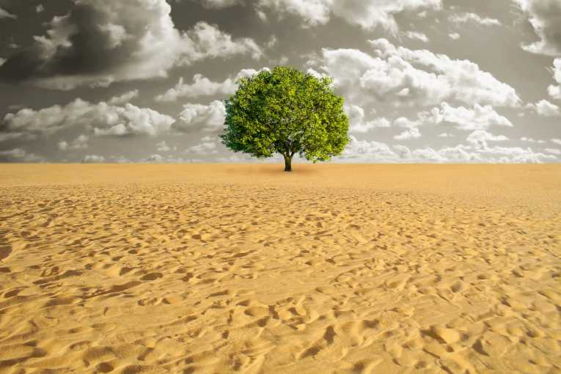
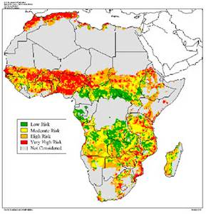
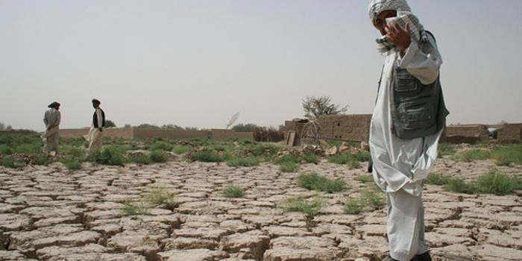
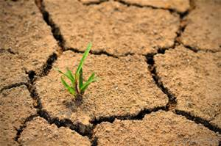
What?
Where?
Who?
Why?
When?

Slide 2
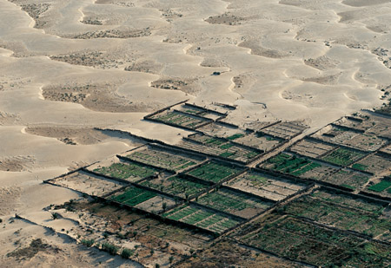
This is known as Desertification…

Slide 3
Desertification
Using the images you have seen so far, describe what is meant by DESERTIFICATION and write it on to the white board.
Desertification is the process whereby a desert spreads into the surrounding land
AF1 – identify key terms
AF2 – draw diagrams to explain in a sequence
AF4 – describe the cause, effect and response.
AF5 – analyse the advantages and disadvantages of a solution

Slide 4
Desertification
In the Sahel Desert, desertification is becoming a huge problem. Around the 1950’s, people settled into the Sahel region, in areas where there was water. This resulted in overgrazing. Eventually, the vegetation was destroyed because of grazing, which left bare soil. A lot of the topsoil was washed away, and all that was left were rocks. Plants were not able to grow because there roots could not penetrate this hard layer. Now this region has turned to desert and it continues to expand.
Using the information above, draw diagrams to illustrate the process of Desertification. Add labels/annotations to make your diagrams clear to follow.

Slide 5
What’s the cause and effect in the Sahara?
Watch the following video clip. Whilst you are watching, note down what you think are the causes and effects of desertification.
Read the information in the hand out. CATEGORISE the information using different colours into CAUSE, EFFECT and RESPONSE.
Notes:
http://www.bbc.co.uk/education/clips/zcg76sg
https://www.youtube.com/watch?v=w9RxnuBiFbg

Slide 6
Questions…
Work through these questions based on your learning today.
What is desertification? (AF1)
Describe the main causes of desertification (AF4)
Explain the impact of desertification (AF6)
Analyse the advantages and disadvantages of at least 1 solution (AF5)

Slide 7
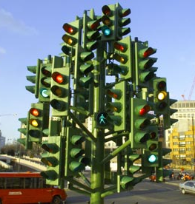
Self Assessment
 | RED | ORANGE | GREEN
AF1
AF4
AF5
AF6
AF1 – identify key terms
AF4 – describe the cause, effect and response.
AF5 – analyse the advantages and disadvantages of a solution
AF6 – explain the impact of the process, desertification

